Slide 1
二次排序 Secondary Sort

Slide 2
Introduction
A secondary sort problem relates to sorting values associated with a key in the reduce phase
The secondary sorting technique will enable us to sort the values passed to each reducer

Slide 3
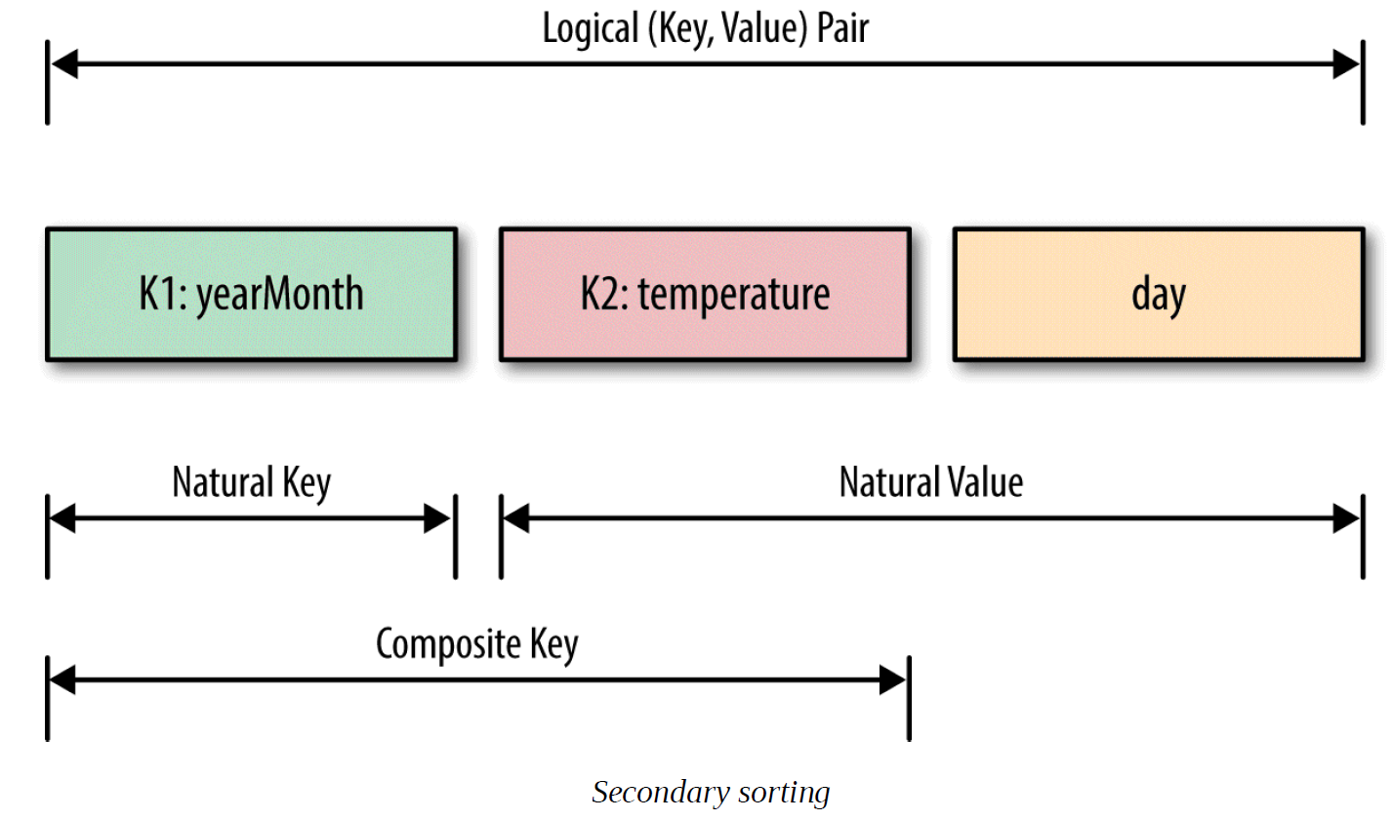

Slide 4
练习1：基于groupByKey方法
数据文件：TimeSeries1.txt
格式：
x 2 1
y 2 2
x 1 3
y 1 4
要求：先按照第一列分组，组内按照第二列升序排序输出。
输出：
...
('p', [(1, 13), (2, 11), (4, 12), (6, 14), (7, 15)]),
('x', [(1, 3), (2, 1), (3, 6)]) …

Slide 5
练习2：利用repartitionAndSortWithinPartitions
数据文件：TimeSeries2.txt
Create temporary composite key
显示分区内容
repartitionAndSortWithinPartitions(numPartitions=None, partitionFunc=<function portable_hash>, ascending=True, keyfunc=<function RDD.<lambda>>)
显示重新分区并排序的每个分区数据
显示最终的二次排序结果
Notes:
Repartition the RDD according to the given partitioner and, within each resulting partition, sort records by their keys.

