Slide 1
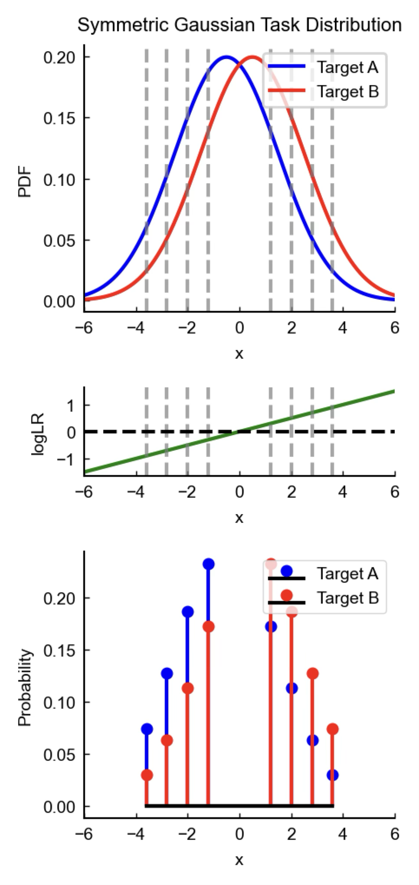
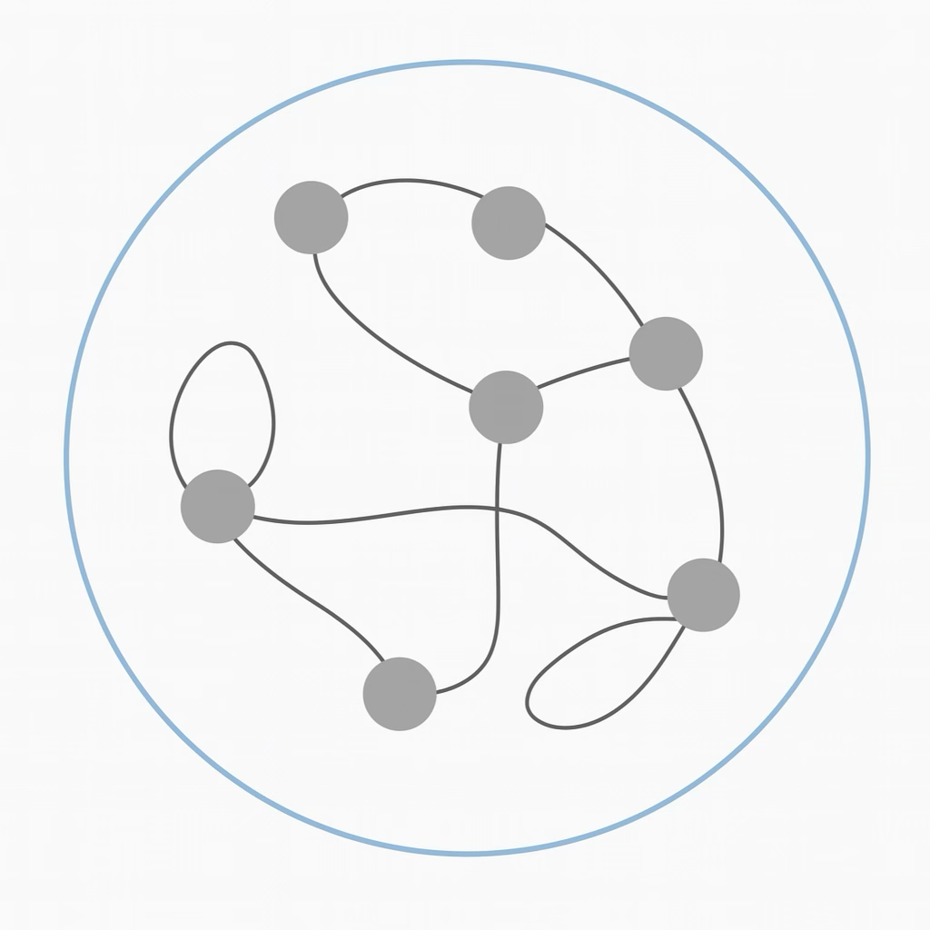
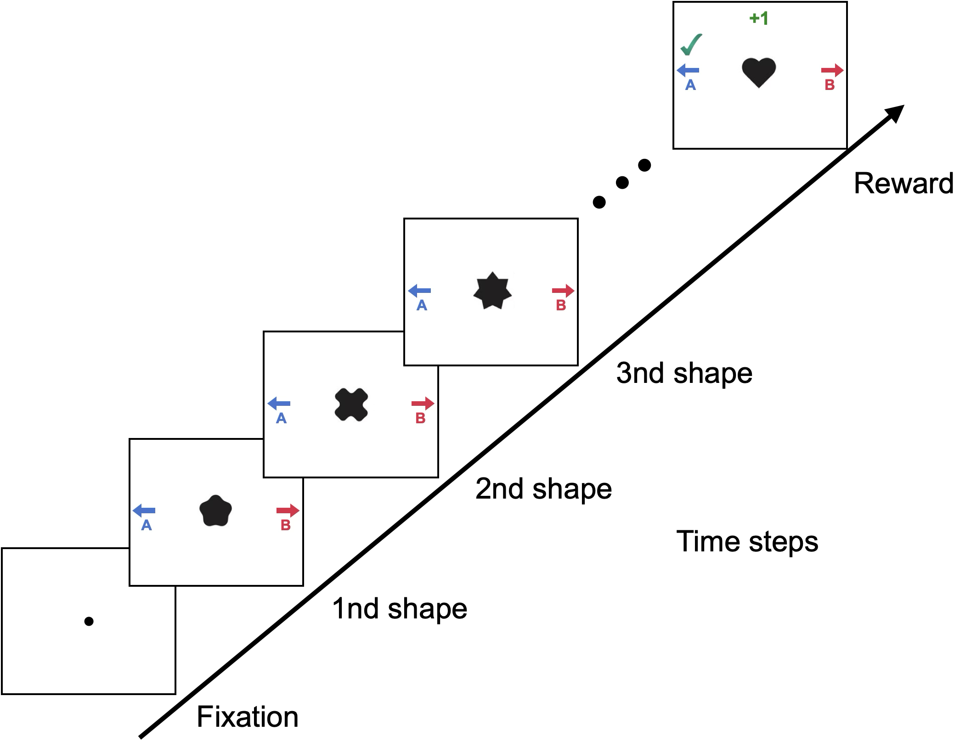
A
B
RNN agent
Policy
Input
Value
Environment
Act

Slide 2
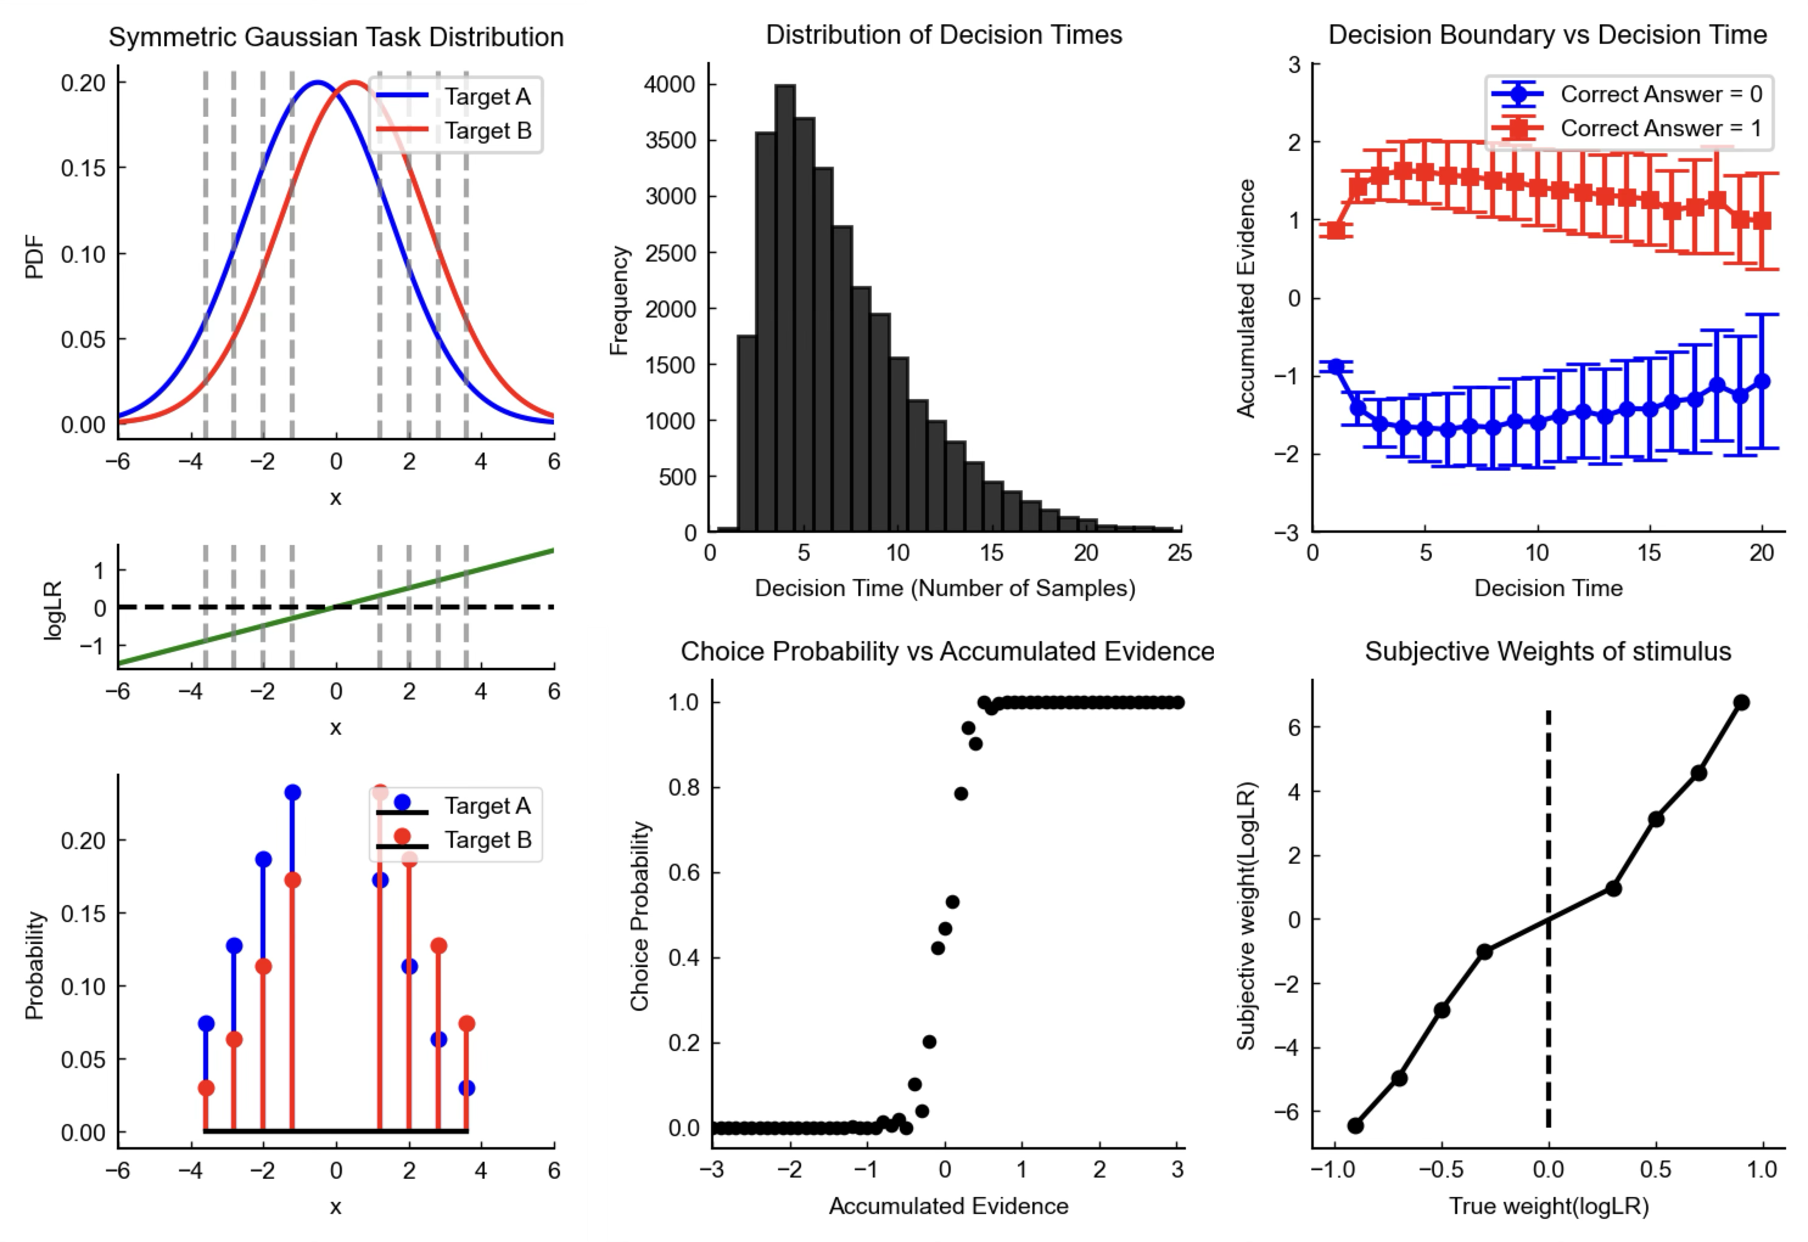
One-hot vectors

Slide 3
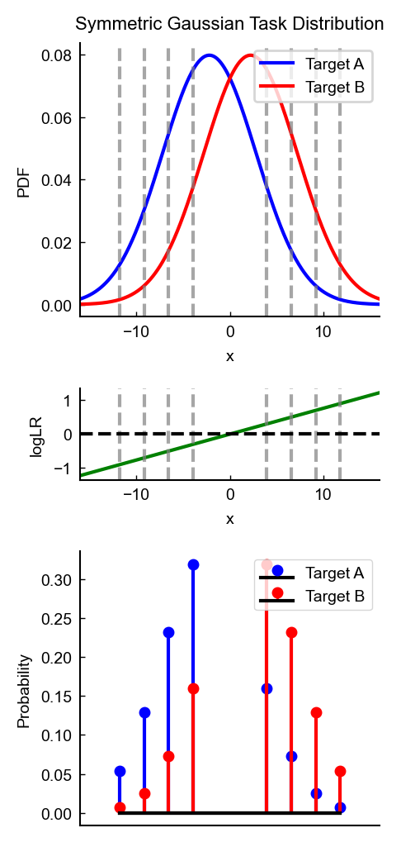
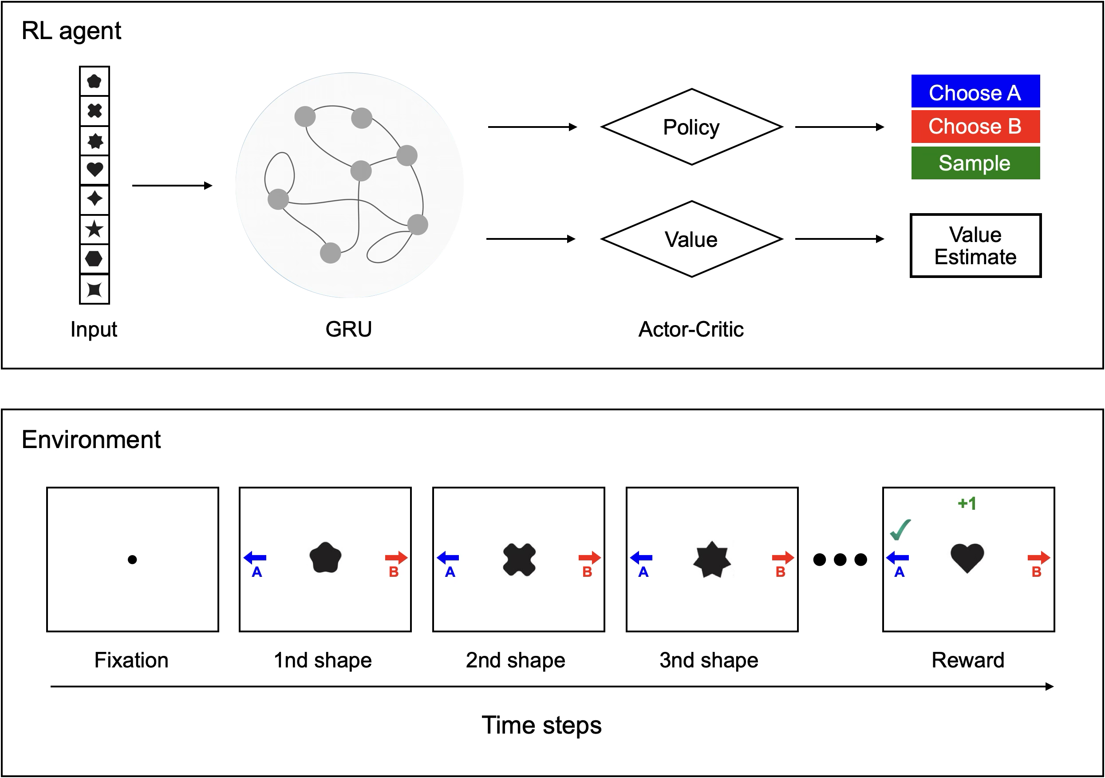

Slide 4




A
Fixation
1st shape
2nd shape
3rd shape
Saccade
Time steps

Slide 5


Slide 6



Slide 7
RNN agent
Input
Environment
Act

