Slide 1




A
Fixation
1st shape
2nd shape
3rd shape
Saccade
Time steps

Slide 2










Sample
Cost = $−c$
Reward/no reward
$$+r/0$$
✔︎
$$H_{0}$$
$$H_{1}$$
$$H_{0}$$
$$H_{1}$$
$$H_{0}$$
$$H_{1}$$
$$H_{0}$$
$$H_{1}$$
Fixation
1st cue
2nd cue
3rd cue
Choice
Time steps

Slide 3






Input
Hidden
$$h_{t}^{(1)}$$
$$h_{t}^{(2)}$$
Output
$$P\left(choose H_{0}\right)$$
$$P\left(choose H_{1}\right)$$
$$P(sample)$$

Slide 4
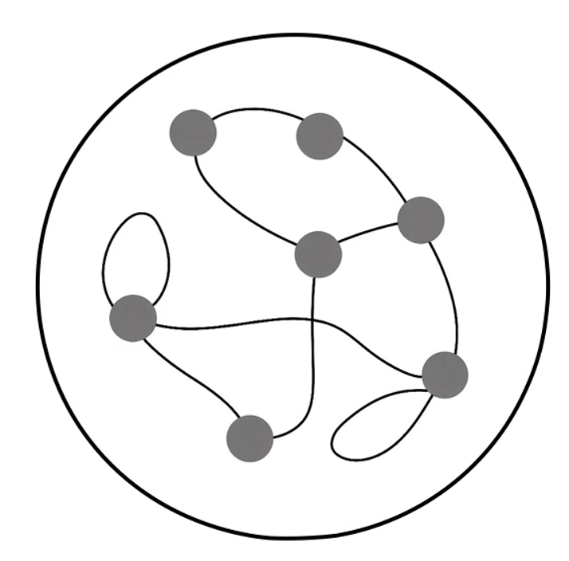





Choose A
Policy
Choose B
Sample
Value
Value Estimate
…
Input
GRU
Actor-Critic
Output

Slide 5


Environment
Agent
Representation
Input Stream
Inference,
Integration,
Memory
Action Execution
Behavioral Output
$$ε$$
$$η$$

Slide 6

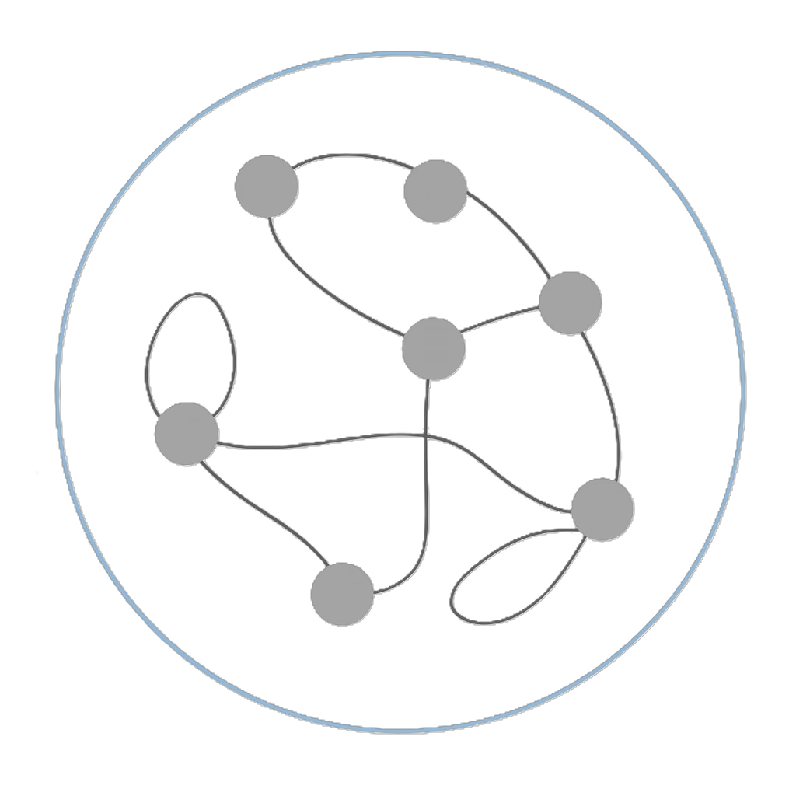

Slide 7
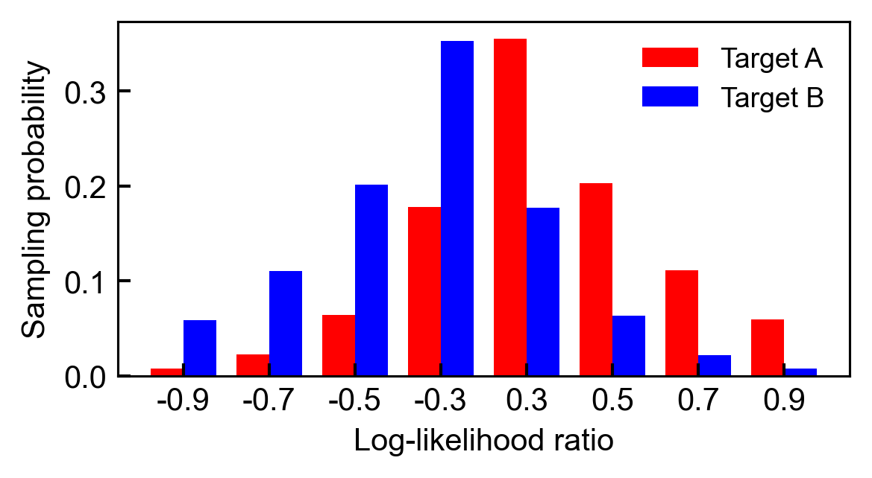









Saccade
Input
A
Time steps
3rd shape
Hidden
$$h_{t}^{(1)}$$
$$h_{t}^{(2)}$$
2nd shape
1st shape
Fixation
Output
$$P\left(choose A\right)$$
$$P\left(choose B\right)$$
$$P(sample)$$
$$t=N$$
…
$$t=3$$
$$t=2$$
Maximize the likelihood
$$t=1$$

Slide 8
A
Fixation
1st shape
2nd shape
3rd shape
Saccade
Time steps

Slide 9
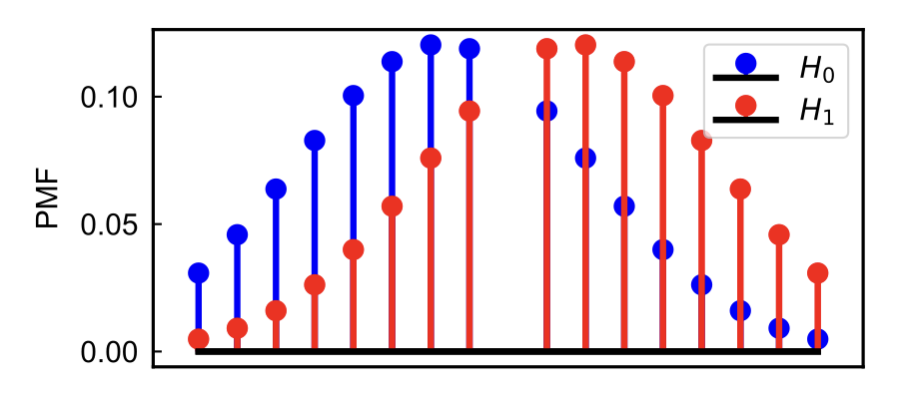








Input
Choice
+1
Time steps
✔︎
$$H_{0}$$
$$H_{1}$$
sample
3rd shape
Hidden
$$h_{t}^{(1)}$$
$$h_{t}^{(2)}$$
2nd shape
$$H_{0}$$
$$H_{1}$$
1st shape
sample
$$H_{0}$$
$$H_{1}$$
Fixation
sample
$$H_{0}$$
$$H_{1}$$
Output
$$P\left(choose A\right)$$
$$P\left(choose B\right)$$
$$P(sample)$$
sample

Slide 10
