Slide 1
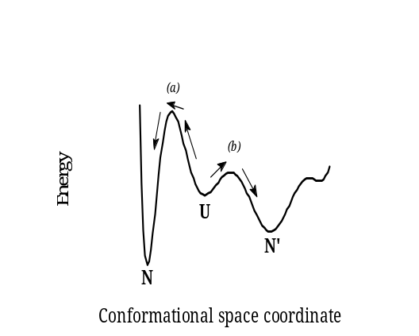
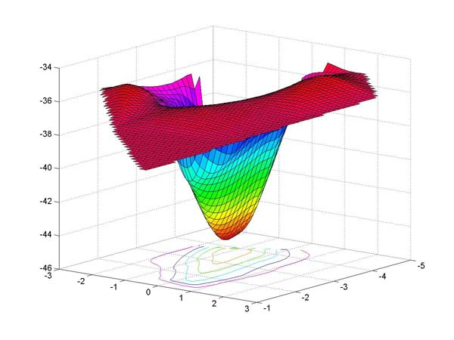


Protein dynamics
Folding/unfolding dynamics
  Passage over one or more energy barriers
  Transitions between infinitely many conformations
Fluctuations near the folded state
  Local conformational changes
  Fluctuations near a global minimum

Slide 2
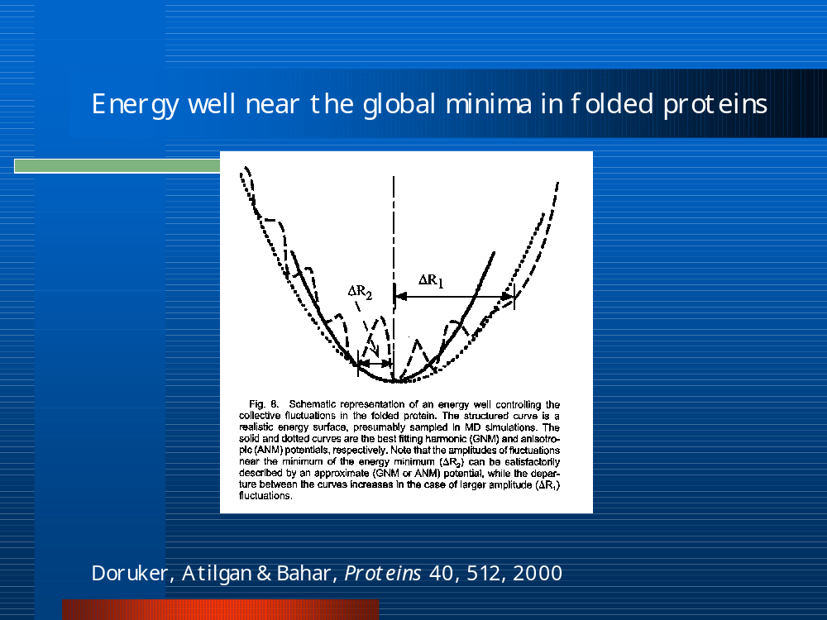
Fluctuations near folded structure

Slide 3
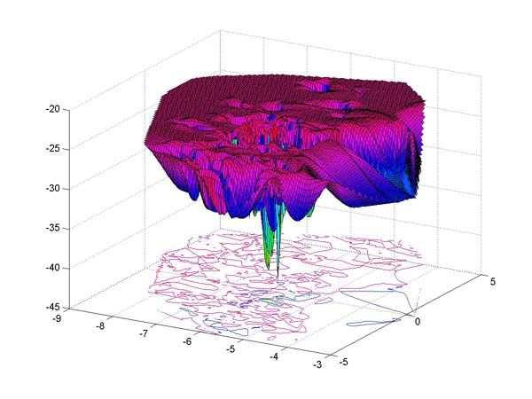
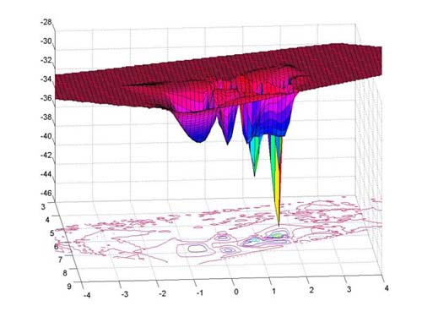
Center for
Computational
Biology and
Bioinformatics
Folding/unfolding energy landscapes
Thermodynamic equilibrium → native state has lowest free energy
Reference
B. Ozkan, K.A. Dill & I. Bahar, Protein Sci. 11, 1958-1970, 2002.

Slide 4
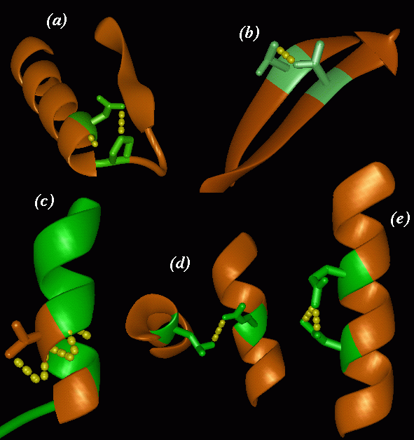
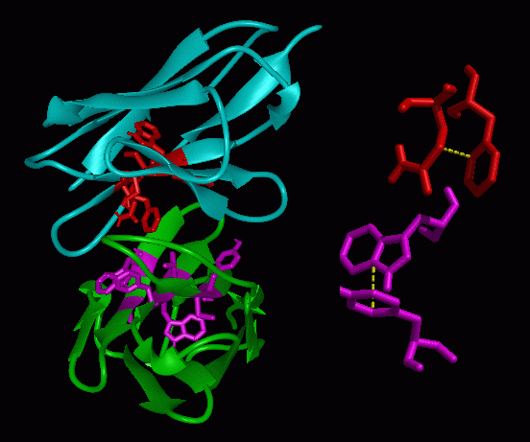
Knowledge-based studies
Exploiting PDB structures...

Slide 5
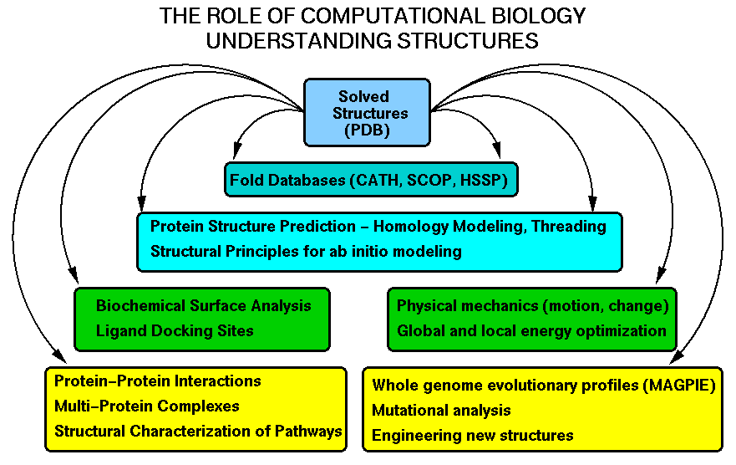
http://www-fp.mcs.anl.gov/~gaasterland/sg-review-slides.html

Slide 6
Protein folding problem:
“Predicting 3-dimensional structure from amino acid sequence”
A unique folded structure (native conformation, native fold) is assumed by a given sequence, although infinitely many conformations can be accessed.
Which? (Protein folding problem)
How, why? (Folding kinetics)
Basic postulate: Thermodynamic equilibrium
→ Global energy minimum
CASP (Critical Assessment of Structure Prediction)

Slide 7
Protein structure prediction
Three computational methods:
Homology modeling
Threading
Ab initio simulations

Slide 8







Homology/comparative modeling
MODELLER is used for homology or comparative modeling of protein three-dimensional structures (1). The user provides an alignment of a sequence to be modeled with known related structures and MODELLER automatically calculates a model containing all non-hydrogen atoms. MODELLER implements comparative protein structure modeling by satisfaction of spatial restraints (2, 3), and can perform many additional tasks, including de novo modeling of loops in protein structures, optimization of various models of protein structure with respect to a flexibly defined objective function, multiple alignment of protein sequences and/or structures, clustering, searching of sequence databases, comparison of protein structures, etc. MODELLER is written in Fortran 90 and runs on the Pentium PC's (Linux and Win XP), Apple Macintosh (OS X) and workstations from Silicon Graphics (IRIX), Sun (Solaris), IBM (AIX), and DEC Alpha (OSF/1).
(A. Sali)
http://guitar.rockefeller.edu/modeller/modeller.html

Slide 9

SWISS-MODEL
An Automated Comparative Protein Modelling Server
accessible via the ExPASy (Expert Protein Analysis System) web server
(by Peitsch et al.)
STEPS:
1. Search for suitable templates (from ExNRL-3D , using BLAST)
2. Check sequence identity with target
(SIM will select all templates with sequence identities above 25% and N> 20)
3. Create ProModII jobs
4. Generate models (ProModII) using known 3-d templates
5. Energy minimization with Gromos96
http://swissmodel.expasy.org/SWISS-MODEL.html

Slide 10
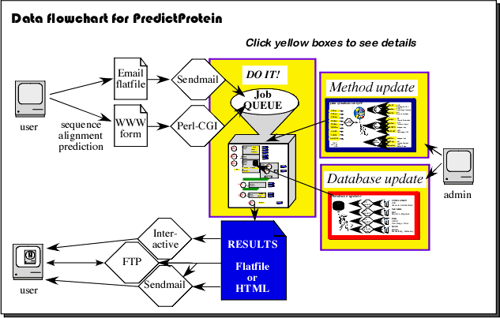
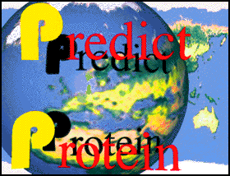
Predict Protein (Rost)
http://www.embl-heidelberg.de/predictprotein/

Slide 11
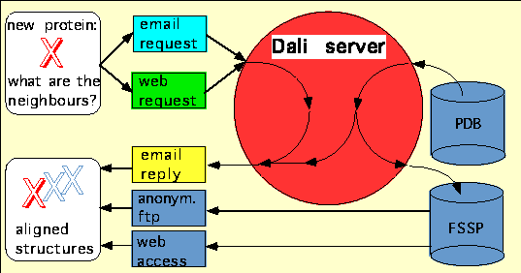
Structural Homology
Dali Server (Sander-Holm)
http://www2.ebi.ac.uk/dali/
L. Holm and C. Sander (1996) Mapping the protein universe. Science 273:595-602.

Slide 12
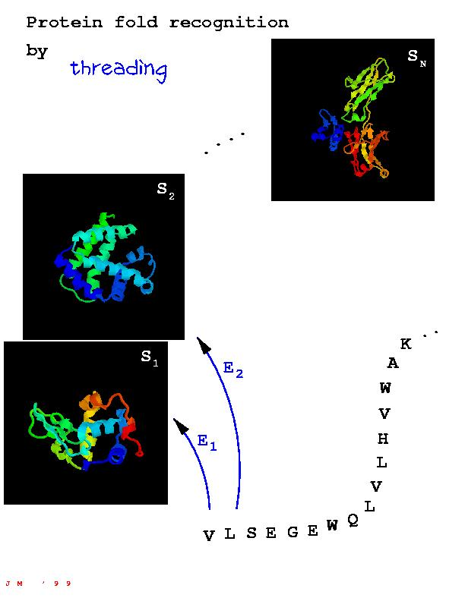
Threading (Fold recognition)
Loopp (Elber)
Threader (Jones)

Slide 13
Ab initio simulations
Protarch (Scheraga’s group)
Rosetta (Baker’s lab)
Touchstone (Skolnick)

Slide 14
Need for Low Resolution Approaches
Coarse-grained Models
with
Empirical Force Fields
are the most tractable - if not the only possible –
computational tools for investigating large systems,
and complex biological processes

Slide 15
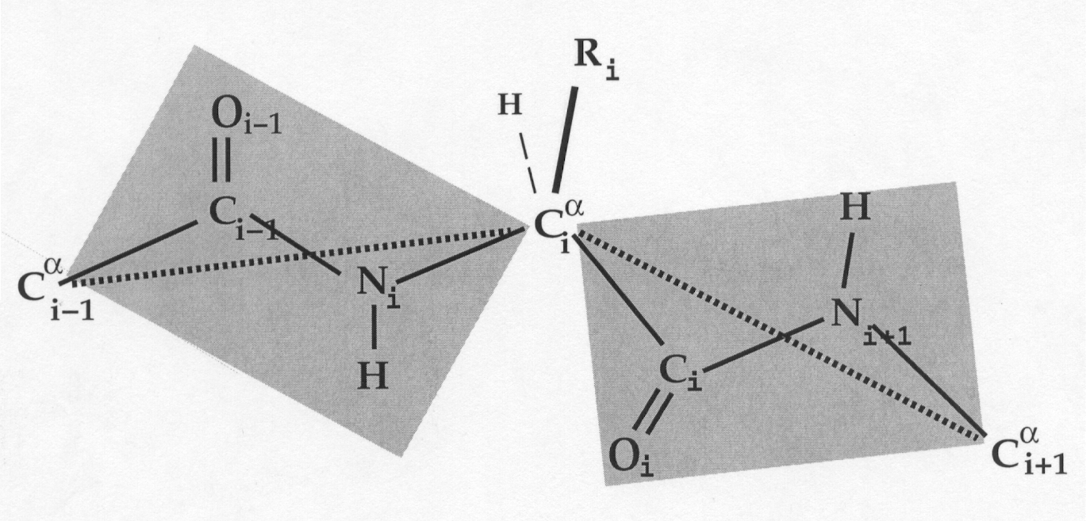
Virtual bond model
Single interaction site per residue, identified by the α- or β-carbon
Need for empirical potentials for inter-residue interactions

