Slide 1
Object-Oriented Development
Kannan Mohan
Department of CIS
Zicklin School of Business, Baruch College
Copyright © 2009 John Wiley & Sons, Inc.
Copyright © 2005 Pearson Education
Copyright © 2009 Kannan Mohan

Slide 2
Classes, Attributes, & Operations
Classes
Templates for instances of people, places, or things
Attributes
Properties that describe the state of an instance of a class (an object)
Operations
Actions or functions that a class can perform

Slide 3
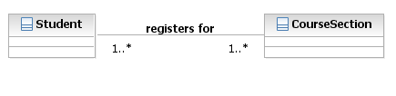
Example
Describe the system; not the code

Slide 4
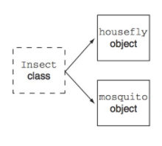
Example
Housefly could also be a class
Relative not absolute

Slide 5
Generalization / Specialization

Slide 6
Comparing Traditional and OO: Traditional Viewpoint
Focus on procedures
Functionality is vested in procedures (modules)
Data and Procedures separated
Data exist to be operated upon by procedures
Procedures know about the structure of data
Responsibility of what can be done to a piece of data is implicit

Slide 7
Traditional View – An Example
If CUST.credit > CUST.balance
ORD.status = “Approved”
else
ORD.status=“Not Approved”
Procedure
Data
CUST ORD
PRODUCT DEPT

Slide 8
Object-Oriented View – An Example
CUSTOMER
If Balance < Limit
Status = “Good”
Else
Status = “bad”
What is your credit status?
ORDER
If Answer= “Good”
Self.status= “Approved”
Else
Self.status=“Not Approved”
Good

Slide 9
How many classes? -depends on what business modle ur building

Slide 10
If A can describe B
Then A is an attribute and B is a class

