Slide 2
Topics
Introduction
Hardware and Software
How Computers Store Data
How a Program Works
Using Python

Slide 3
Hardware and Software
Hardware - typical major components:
Central processing unit
Main memory
Secondary storage devices
Input and output devices
Software
Application software
System software

Slide 4
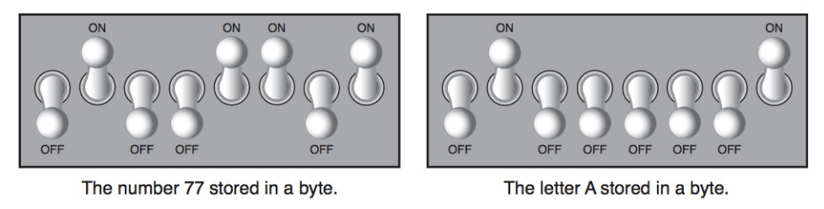
How Computers Store Data
Stored in sequences of 0s and 1s
Byte
Divided into eight bits
Bit: electrical component that can hold positive or negative charge, like on/off switch
The on/off pattern of bits in a byte represents data stored in the byte

Slide 5
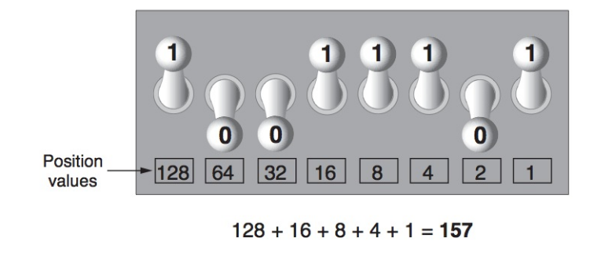
Storing Numbers
Binary numbering system
Position of digit j is assigned the value 2^{j-1}
To store larger numbers, use several bytes

Slide 6
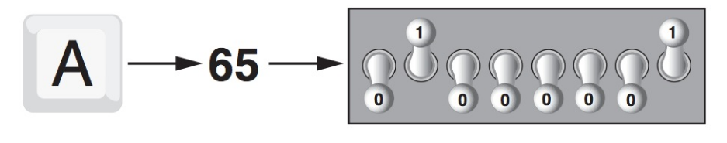
Storing Characters
Characters are converted to numeric code, numeric code stored in memory
ASCII: defines codes for only 128 characters
Unicode
Can represent characters for other languages

Slide 7
How a Program Works
CPU designed to perform simple operations on pieces of data
Examples: reading data, adding, subtracting, multiplying, and dividing numbers
Understands instructions written in machine language and included in its instruction set
Each brand of CPU has its own instruction set
To carry out meaningful calculation, CPU must perform many operations

Slide 8
How a Program Works (cont’d.)
Program must be copied from secondary memory to RAM each time CPU executes it
CPU executes program in cycle:
Fetch: read the next instruction from memory into CPU
Decode: CPU decodes fetched instruction to determine which operation to perform
Execute: perform the operation

Slide 9
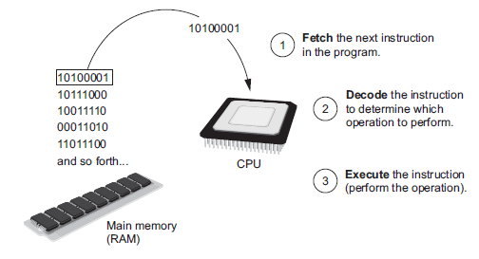
How a Program Works (cont’d.)
Figure 1-16 The fetch-decode-execute cycle

Slide 10
From Machine Language to Assembly Language
Impractical for people to write in machine language
Assembly language: uses short words (mnemonics) for instructions instead of binary numbers
Easier for programmers to work with
Assembler: translates assembly language to machine language for execution by CPU

Slide 11
High-Level Languages
High-Level language: allows simple creation of powerful and complex programs
No need to know how CPU works or write large number of instructions
More intuitive to understand

Slide 12
Key Words, Operators, and Syntax: an Overview
Key words: predefined words used to write program in high-level language
Each key word has specific meaning
Operators: perform operations on data
Example: math operators to perform arithmetic
Syntax: set of rules to be followed when writing program
Statement: individual instruction used in high-level language

Slide 13
Compilers and Interpreters
Programs written in high-level languages must be translated into machine language to be executed
Compiler: translates high-level language program into separate machine language program
Machine language program can be executed at any time

Slide 14
Compilers and Interpreters (cont’d.)
Interpreter: translates and executes instructions in high-level language program
Used by Python language
Interprets one instruction at a time
No separate machine language program
Source code: statements written by programmer
Syntax error: prevents code from being translated

Slide 15
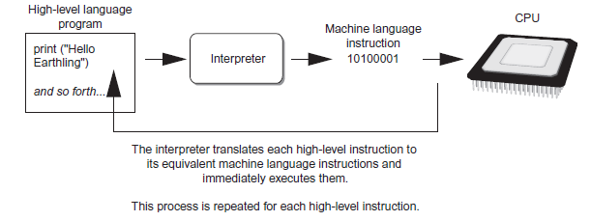
Compilers and Interpreters (cont’d.)
Figure 1-19 Executing a high-level program with an interpreter

Slide 16
Using Python
Python must be installed and configured prior to use
One of the items installed is the Python interpreter
Python interpreter can be used in two modes:
Interactive mode: enter statements on keyboard
Script mode: save statements in Python script

Slide 17
Interactive Mode
When you start Python in interactive mode, you will see a prompt
Indicates the interpreter is waiting for a Python statement to be typed
Prompt reappears after previous statement is executed
Error message displayed If you incorrectly type a statement
Good way to learn new parts of Python

Slide 18
Writing Python Programs and Running Them in Script Mode
Statements entered in interactive mode are not saved as a program
To have a program use script mode
Save a set of Python statements in a file
The filename should have the .py extension
To run the file, or script, type
python filename
at the operating system command line

