Slide 1

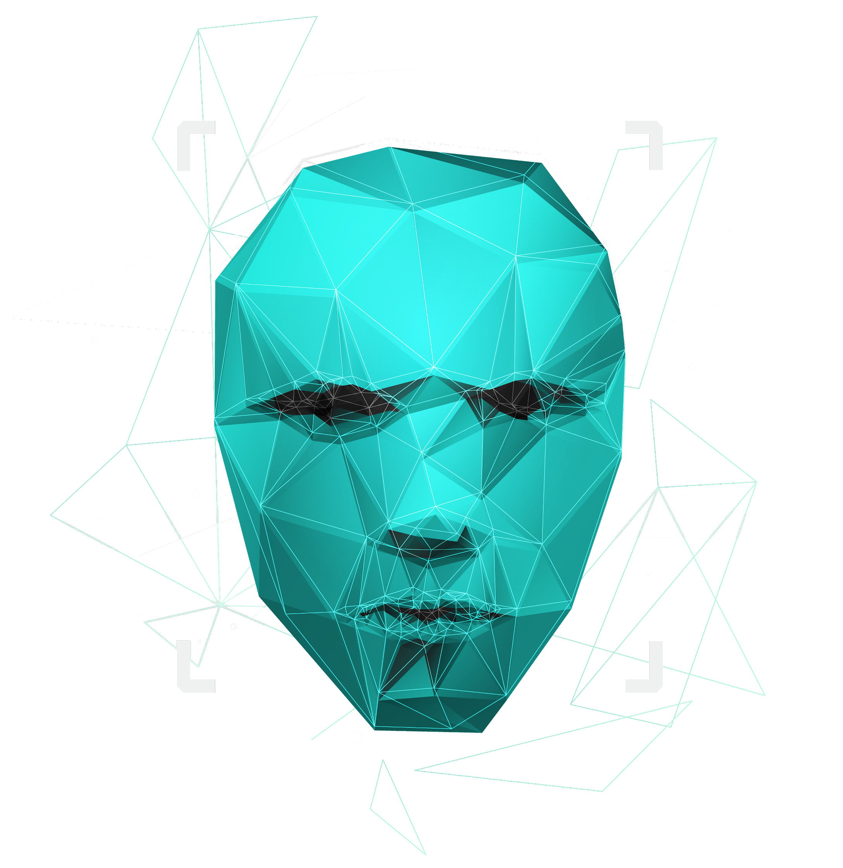
Project 3: Binary Classification of Subreddit Posts
Ng Jia Sheng

Slide 2

WELCOME
SWINDLER INC
SWINDLER INC
A dating App Perfect for the Busy Bees
Consult Our Dating Experts for Relationship Advises NOW!!

Slide 3

PROBLEM
Number of Enquiries for Relationship Advises
Flood of Enquiries Increased By A Staggering 500% (Genuine Questions and Spams)in 2021 against 2020!!

Slide 4


CONSEQUENCES
Dating Specialists are Overloaded with Requests
Manually Filter out unrelated Enquiries
Reduced Productivity
Rating for App has Dropped

Slide 5
SOLUTIONS
1. DATA COLLECTION
Proprietary Webscrapping Algorithm
2. MODELING
Binary Classification Model Based on Success Metrics
3. INTEPRETATION
Conduct Model Evaluation with our Cutting-Edge Algorithm

Slide 6
DATA COLLECTION
01
Proprietary Webscrapping Tools

Slide 7
8000 Posts Per Subreddit Over 1,136,000 Words From Both Subreddits Subreddit: Relationship_advise (Negative Class) Subreddit: Stupid_questions(Positive Class)

Slide 8
MODELING
02
Binary Classification Model Based on Success Metrics

Slide 9
SUCCESS METRICS
Precision | F1 | Accuracy
Not to miss any critical relationship inquiries because it is classified as spam. Minimize False Positive | Takes into account both precision and recall to give balance to our model | Intuitive Metric to understand model performance
DECREASING IMPORTANCE
Notes:
Precision = TP/(TP+FP)
Recall = TP /(TP+FN)

Slide 10
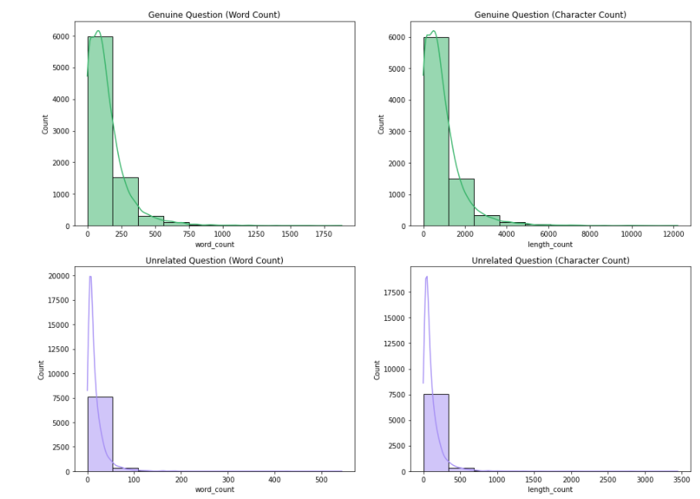
DISTRIBUTION CHART
Feature Engineering to Count Number of Characters Per Topic
Right Skewed Histogram

Slide 11
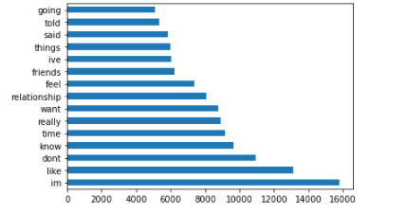
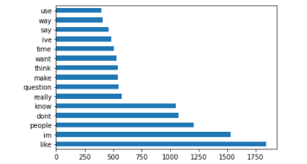
MOST FREQUENTLY USED WORDS
Genuine Questions
(Negative Class)
Spams
(Positive Class)

Slide 12
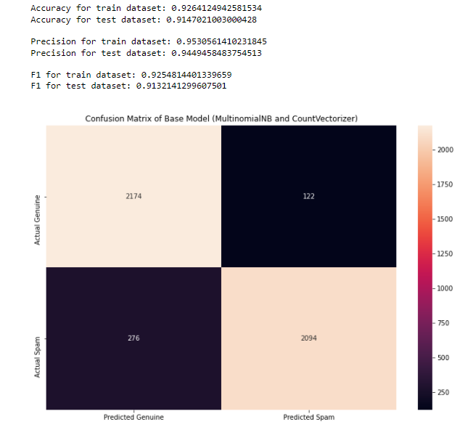
BASE MODEL

Slide 13
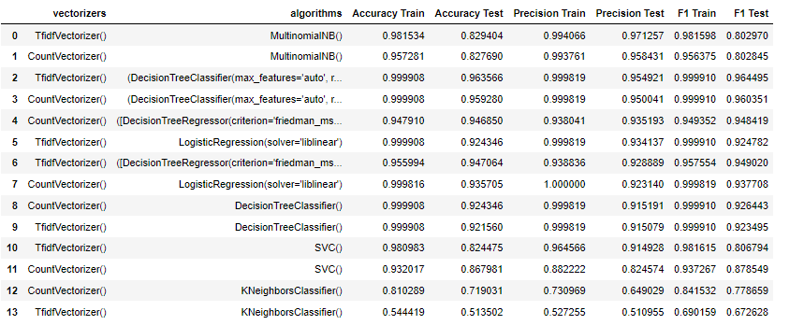
EVALUATING OTHER ALGORITHMS
Top 4 Algorithms selected for Hyperparameters Finetuning:
GradientBoostingClassifier, RandomForestClassifier, MultinomialNB and LogisticRegression
Notes:
Based on training metric-score and testing metric-scores (Precision, F1, and Accuracy), all models show signs of overfitting with the exception of the GradientBoostingClassifier model.

Slide 14
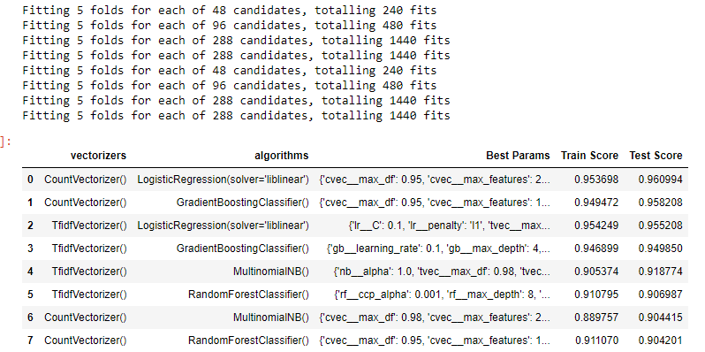
HYPERPARAMETERS TUNING
Logistic regression model with countvectorizer as our final model because it is the simpler/easier model for the audience to understand.
Notes:
Based on training metric-score and testing metric-scores (Precision, F1, and Accuracy), all models show signs of overfitting with the exception of the GradientBoostingClassifier model.

Slide 15
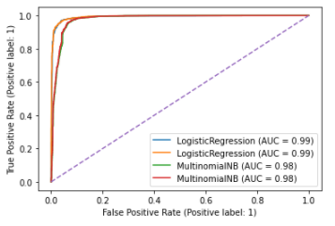
ROC Curve

Slide 16
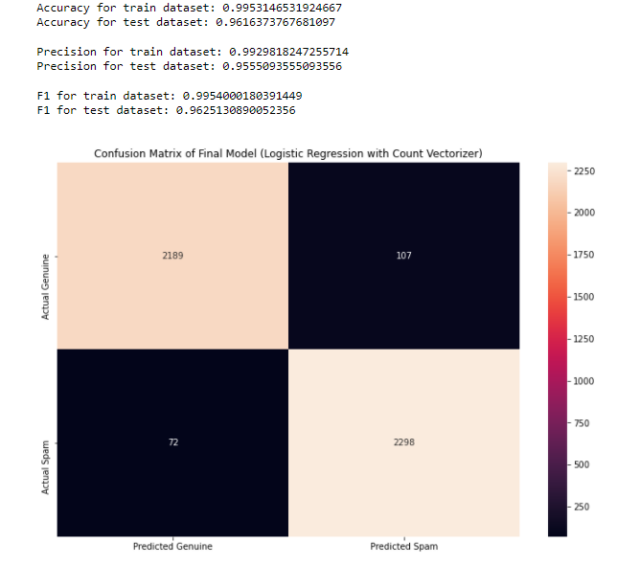
FINAL MODEL

Slide 17
INTEPRETATION
03
Conduct Model Evaluation with our Cutting-Edge Tools

Slide 18
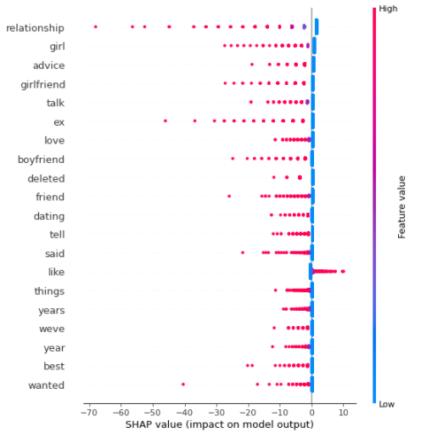
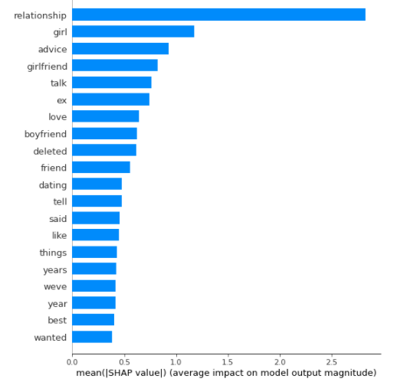
FINAL MODEL INTEPRETATION

Slide 19
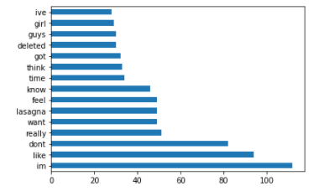
RECOMMENDATIONS
Expand STOPWORDS library to include most frequently misclassified words
Catboost algorithm to check for improvement of performance
Conduct lemmatization/Sentiment Analysis for both topics
Perform Gridsearch on all 7 classification models
Top Misclassified Words

Slide 20
THANKS!
Please keep this slide for attribution.

