Slide 1
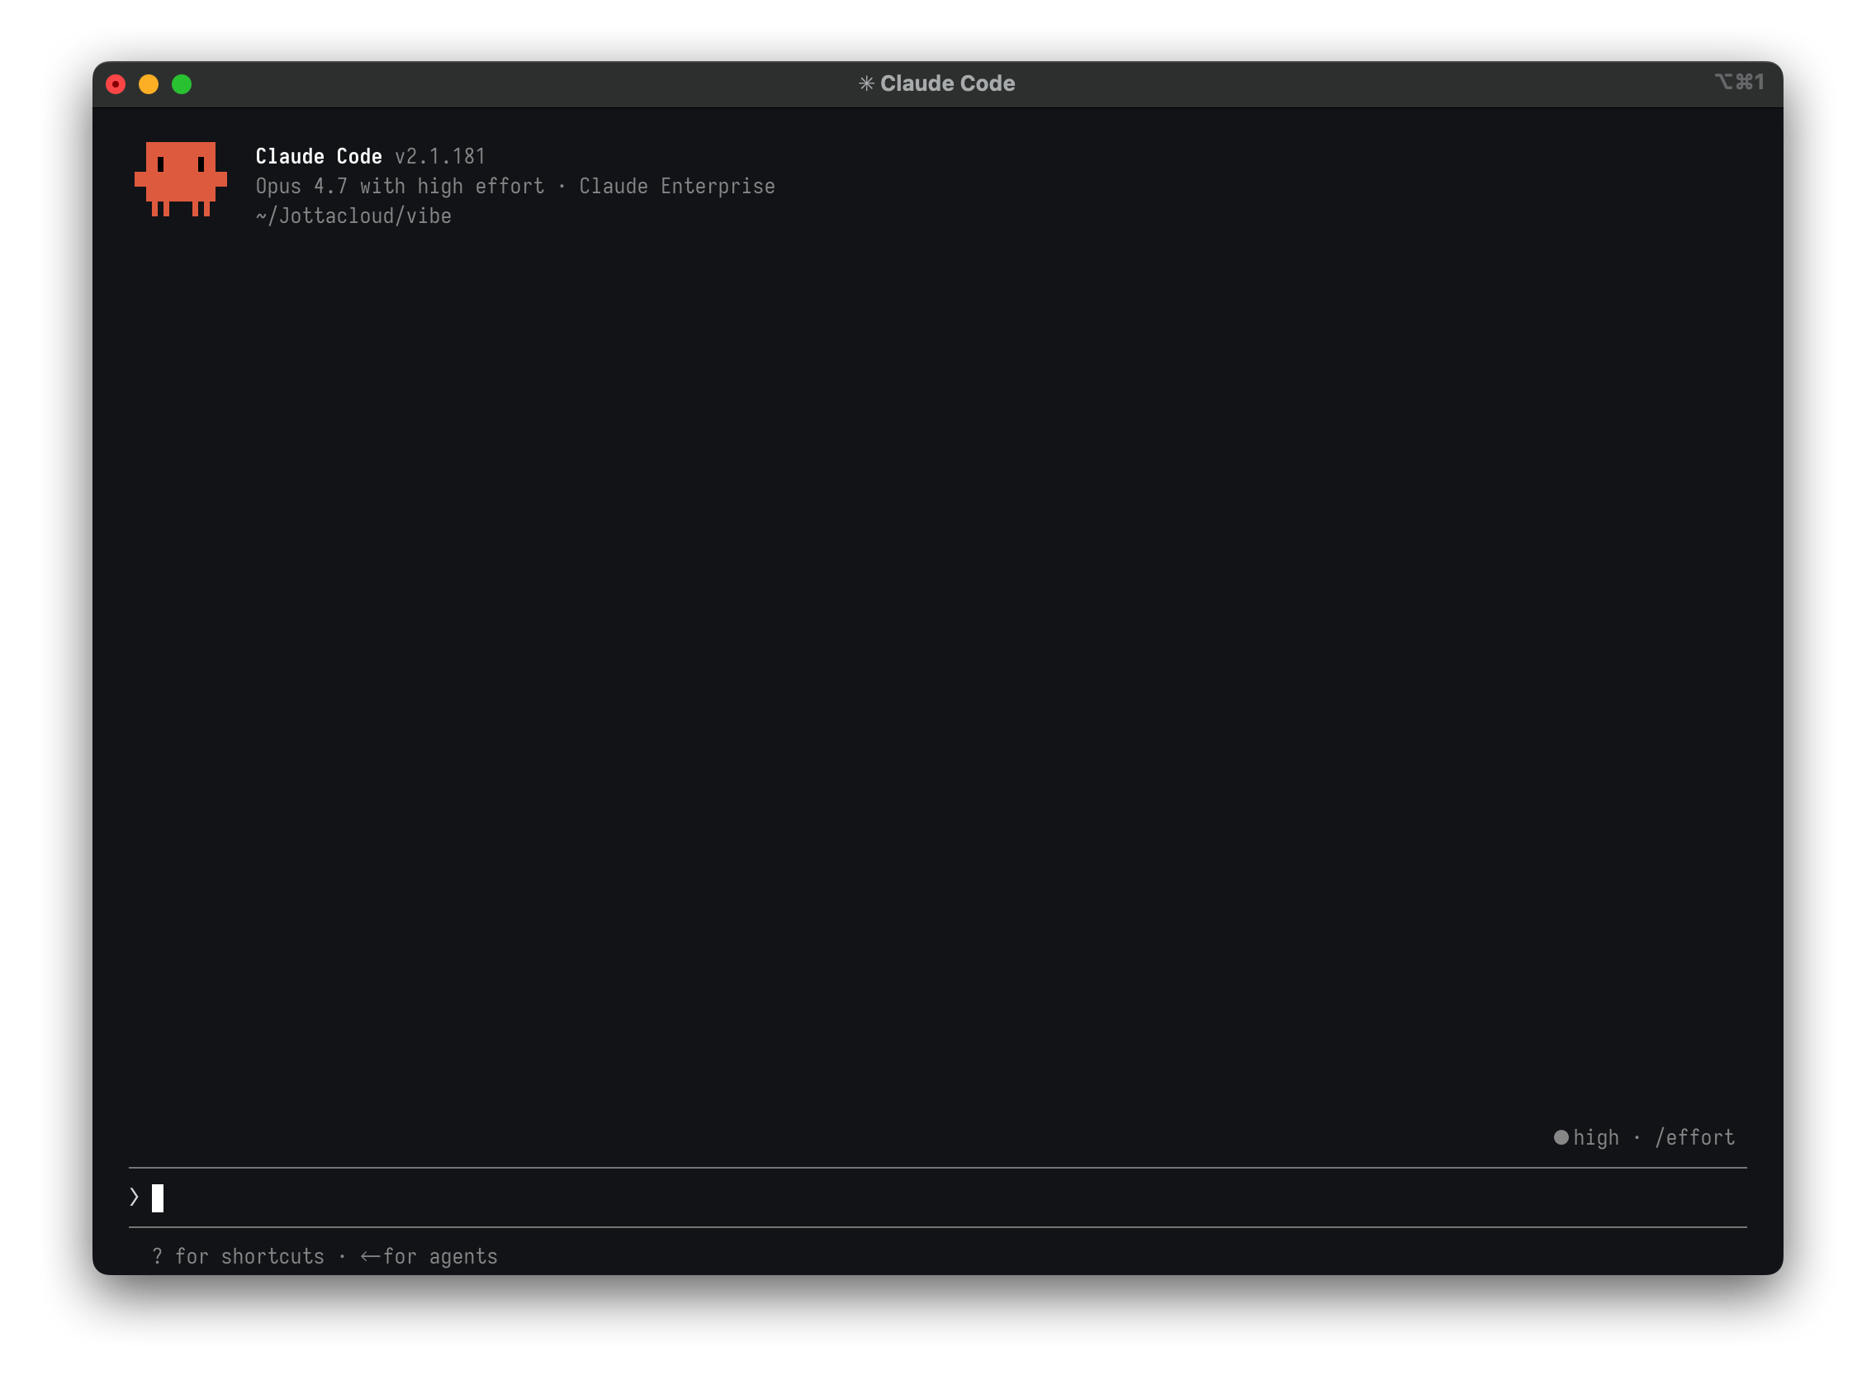
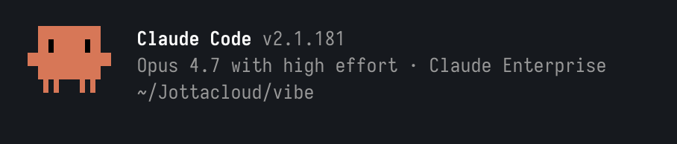
方法 1
Use Claude Code in Terminal
Claude Code in Terminal
version
Run Claude Code in Terminal
Model & effort
Account
1
Run Claude Code
Current folder
In any terminal, run `claude`
設 Claude Code 預設 model = Opus 4.7

Slide 2
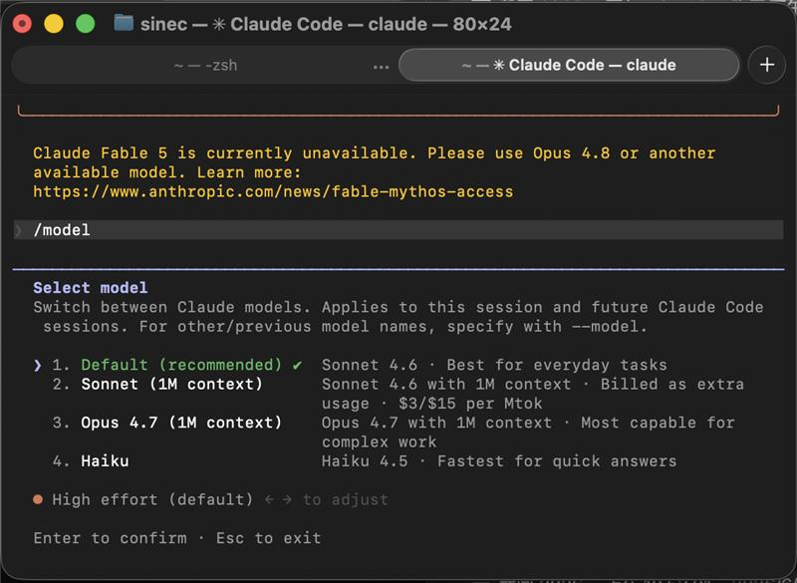
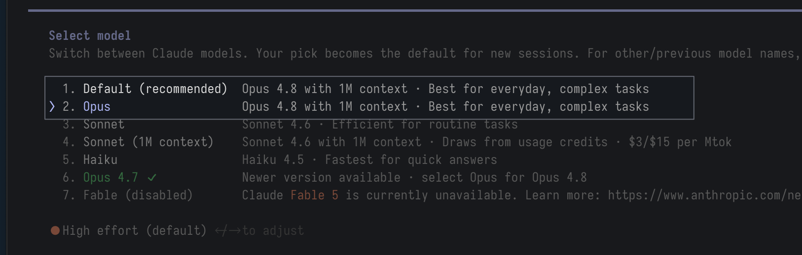
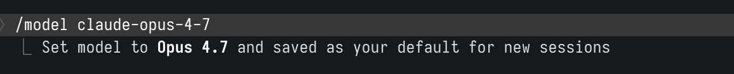

方法 1
Use Claude Code in Terminal
Claude Code in Terminal
One-time change
2
Input /model
List models you can choose
But!! Usually list only major generation(opus/ sonnet/haiku…), no minor(4.8/ 4.7/ 4.6…)
If you get Opus4.7 just choose it.
If only “Opus” -> go to Step3
3
Set to Opus 4.7
Input: ’ /model claude-opus-4-7’
✓ 驗證 在 Claude Code 內輸入 /status → 看 Model 那行是 claude-opus-4-7

Slide 3
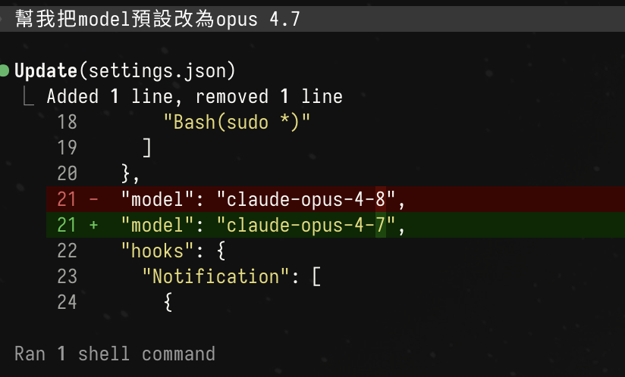
方法 1
Use Claude Code in Terminal
Claude Code in Terminal — Make it to default
One-time change
4
Ask your agent to do so
Write to ~/.claude/settings.json, it will active in the new session
Sometimes your agent will push back and try to convince you to stay in 4.8
5
Advanced: edit settings.json
Go to ~/.claude/settings.json
Change: "model": "claude-opus-4-7",

Slide 4
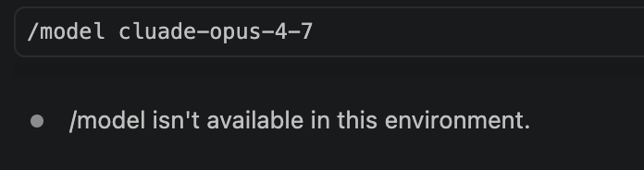
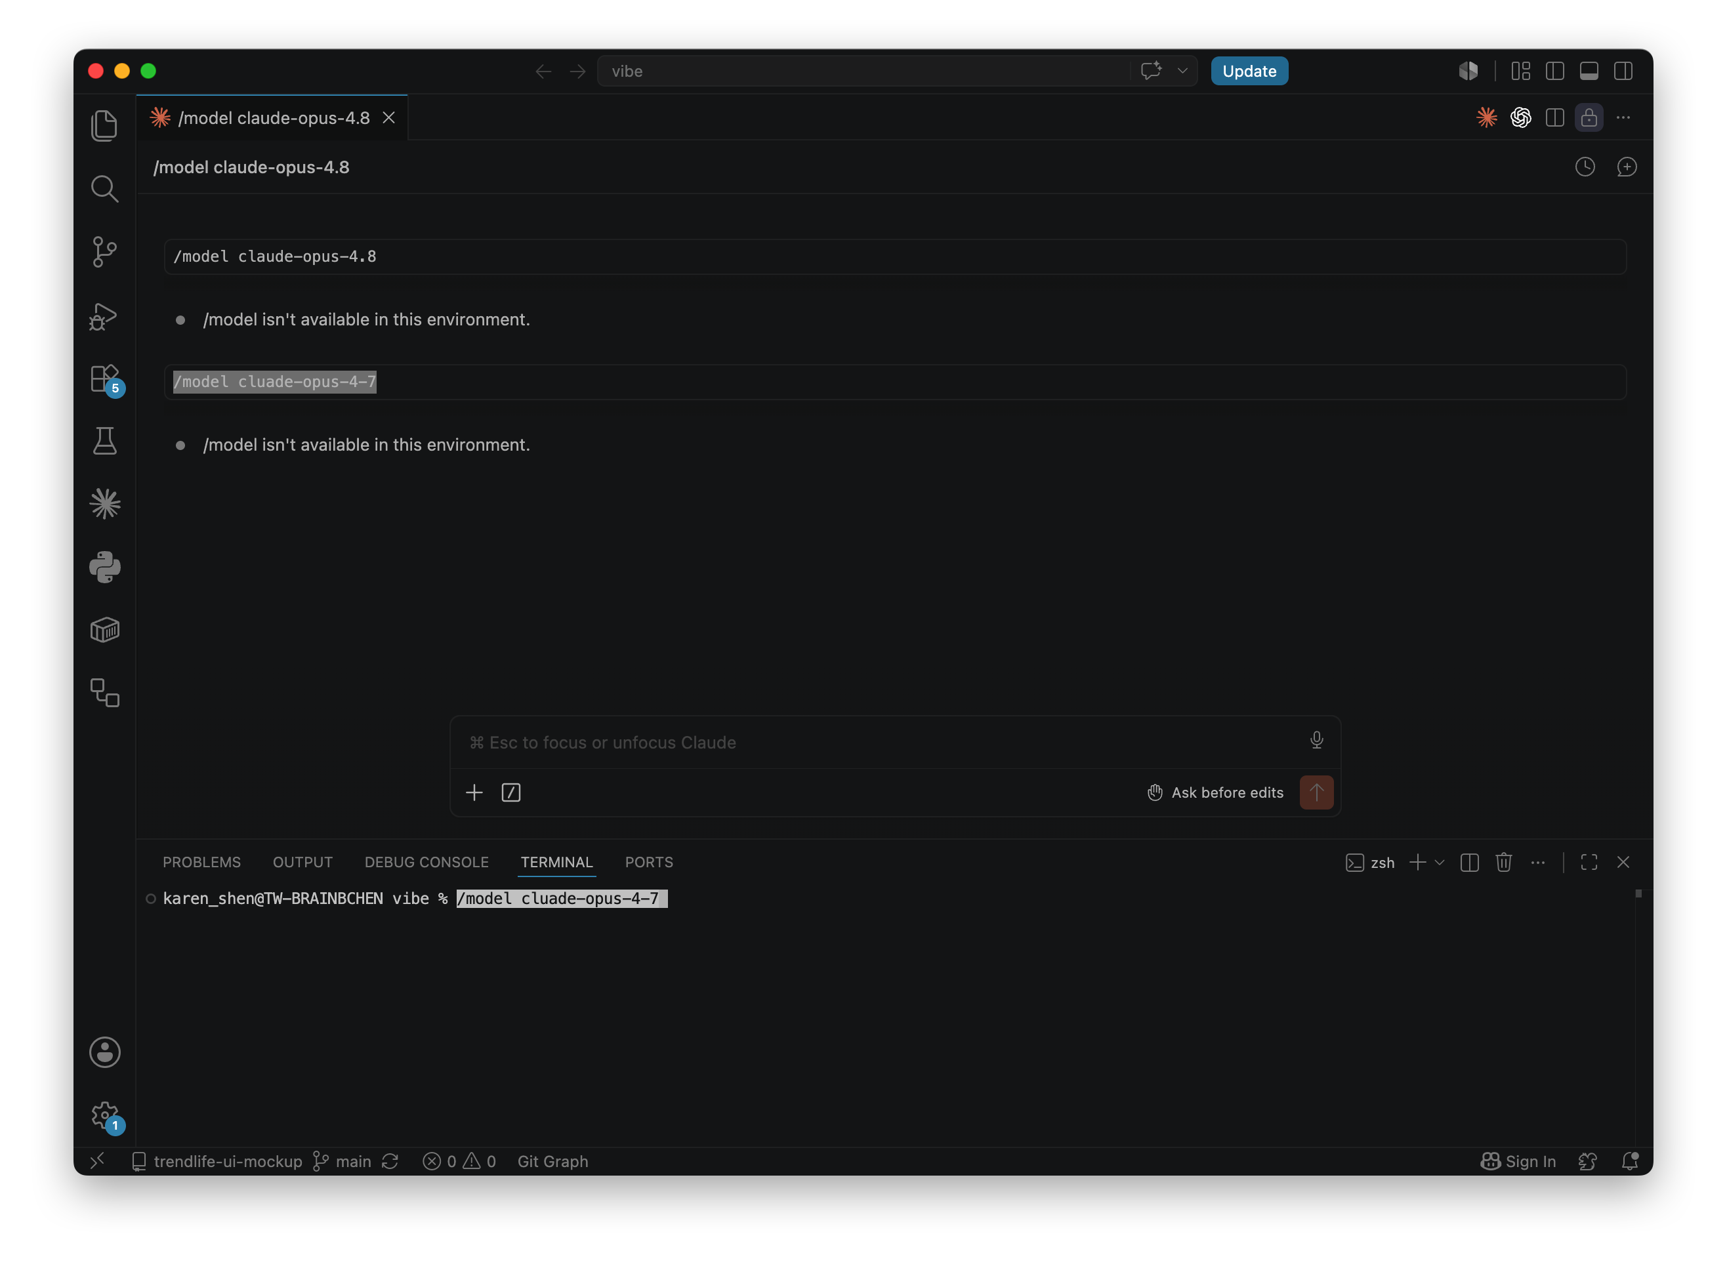



方法 2
VS Code
Claude Code In VS Code
VS code /model list only major generations too, and NOT support /model input
One-time change
1
use embedded terminal
In VS code, press “Ctrl+~”
In the embedded terminal: Input: ’ /model claude-opus-4-7’
2 / 4

Slide 5
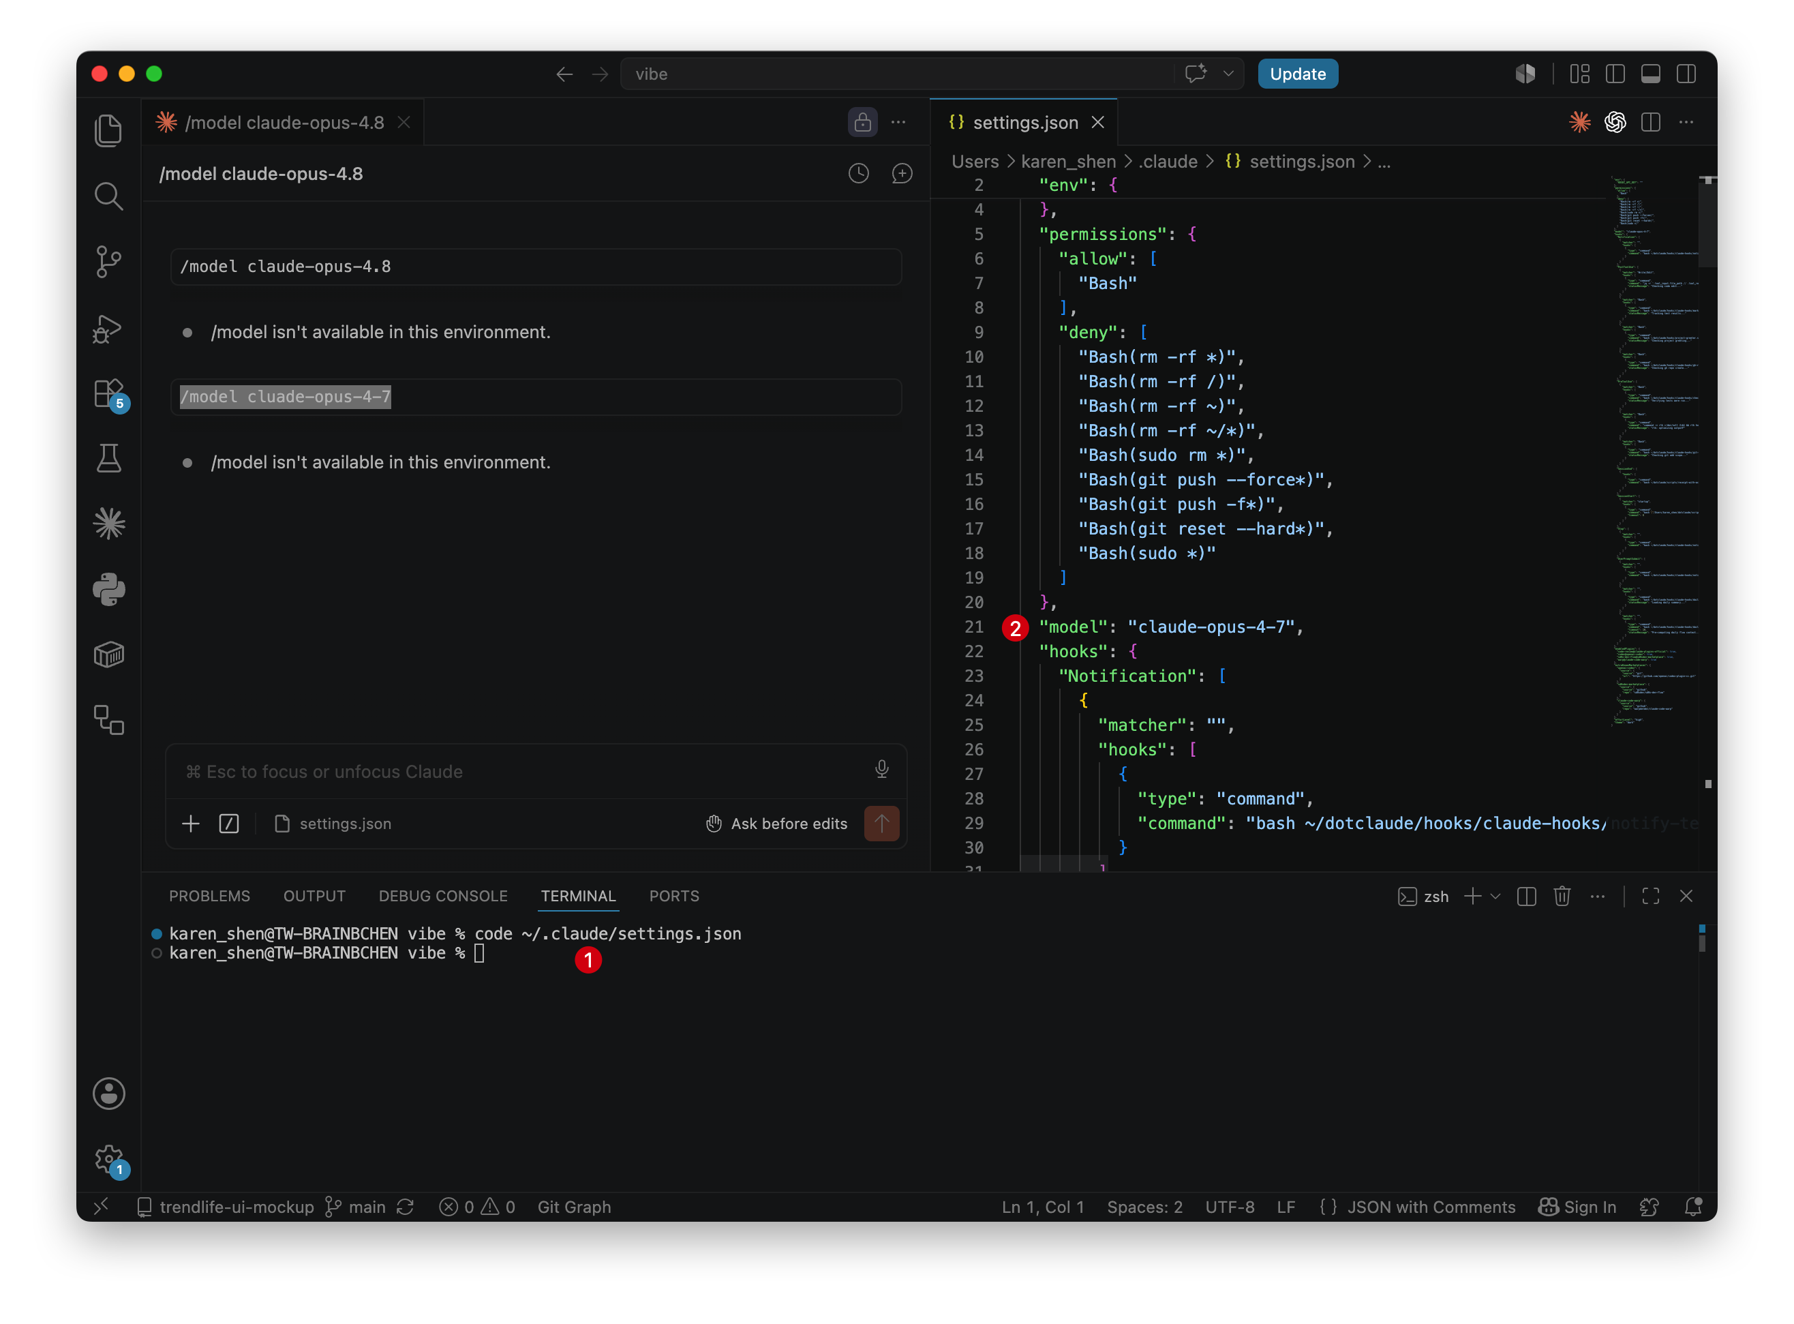
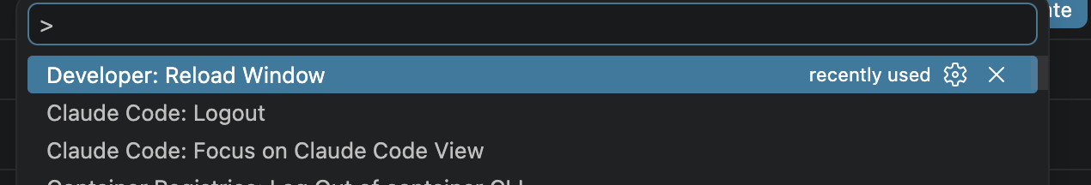
方法 2
用 VS Code 編輯設定檔
Claude Code In VS Code – make it default
Edit settings.json in VS code
1
Open settings.json in VS Code
In embedded terminal run：code ~/.claude/settings.json
2
Find: “model” or add one
Add "model": "claude-opus-4-7” on the top
3
Save（⌘S / Ctrl+S）
VS Code 會自動驗證 JSON 語法，紅線就是壞掉了
Or ask your agent to do above
4
Restart Claude Code
New session or:
Command+Shift+P -> choose “Developer: Reload Window” (keep the context)
2 / 4

Slide 6
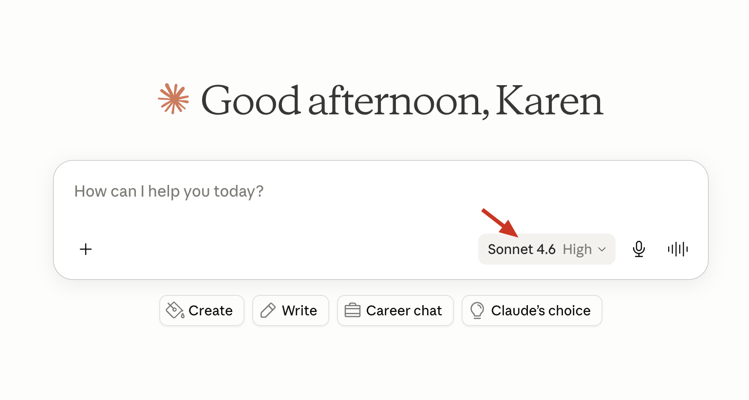
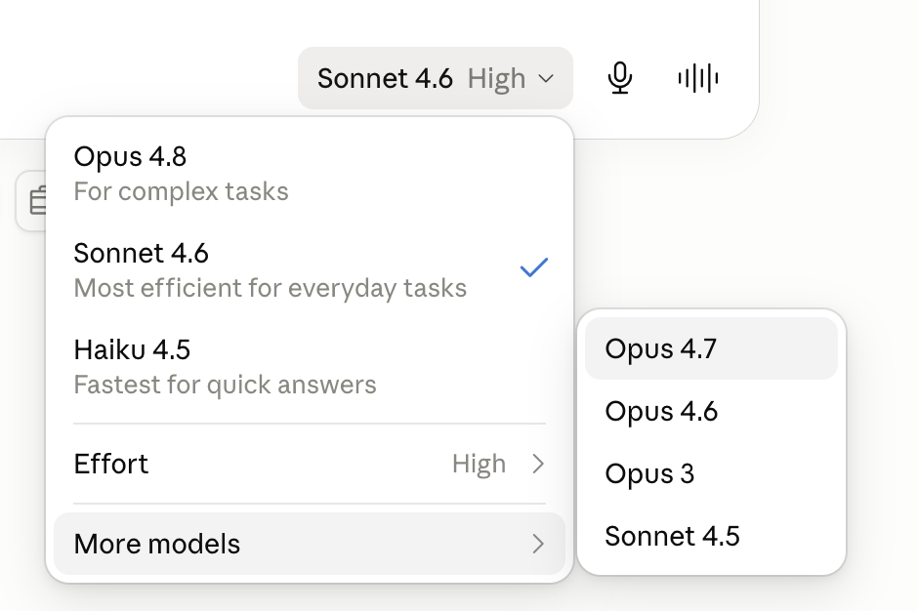
方法 3
Claude Desktop
At this moment(2026 June)
Opus4.7 with effort=high is a sweet balance to our budget
3 / 4

Slide 7
方法 4
Advanced - Cli setup
Terminal — jq
完全不開 GUI，可寫進 setup script
1
確認 settings.json 存在
$ shell
沒裝過 Claude Code 的話這檔案還沒生成
# 1. 確認檔案
$ ls ~/.claude/settings.json
# 2. 用 jq 改寫（保留其他欄位）
$ jq '.model = "claude-opus-4-7"' \
~/.claude/settings.json > /tmp/s.json \
&& mv /tmp/s.json ~/.claude/settings.json
2
用 jq 改寫 model 欄位
保留其他欄位，原子操作（temp file + mv）
3
驗證值
jq '.model' 應該回傳 "claude-opus-4-7"
4
重開 Claude Code
✓ 驗證 跑 jq '.model' ~/.claude/settings.json 應回傳 "claude-opus-4-7"
新 session 才會吃到新設定
設 Claude Code 預設 model = Opus 4.7

