Slide 1
Multi-Asset Meta-Labeling Research Pipeline
A weekly, seven-sleeve global allocation framework · research & educational use only
June 21, 2026

Slide 2
Objective & Approach
■ Allocate weekly across a diversified seven-sleeve global asset universe.
■ Split the two decisions a single model usually blurs:
– M1 — direction: which assets to favour (simple, high recall)
– M2 — conviction: is the view likely to pay, and how much to size
■ Meta-labeling design from systematic-PM literature (Lopez de Prado).
■ Principle: STATIC factors live in M1; DYNAMIC factors live in M2.
Takeaway: Two simple problems beat one hard one — M1 proposes, M2 filters and sizes.
Multi-Asset Meta-Labeling · June 21, 2026
1

Slide 3
Changes Since Last Review
■ M1 simplified to a single static factor (momentum + trend); macro & risk moved out.
■ ML layer kept to logistic regression only.
■ Static factors → M1; dynamic factors (macro, volatility, regime) → M2.
■ Macro / regime datasets now feed M2 (not used by earlier work).
■ Added simple evaluations — mean difference, MAE, Brier, calibration MAPE.
■ Out-of-sample confirmation — train/test split + 4-week embargo + walk-forward.
Takeaway: Every change follows one rule: static -> M1, dynamic -> M2, keep each layer simple.
Multi-Asset Meta-Labeling · June 21, 2026
2

Slide 4
Architecture
■ M1 — static, linear directional model (momentum + trend only).
■ M2 — dynamic, regime-aware meta-label (logistic regression):
– sees momentum, trend, macro, volatility separately + regime features
– weights factors differently across regimes (factor-timing)
■ Portfolio — benchmark-relative active weights, vol targeting, position caps, 2-layer costs.
■ Discipline — no look-ahead, 4-week macro lag, 4-week train/test embargo.
Takeaway: M1 is simple on purpose; all dynamic / regime intelligence is isolated in M2.
Multi-Asset Meta-Labeling · June 21, 2026
3

Slide 5
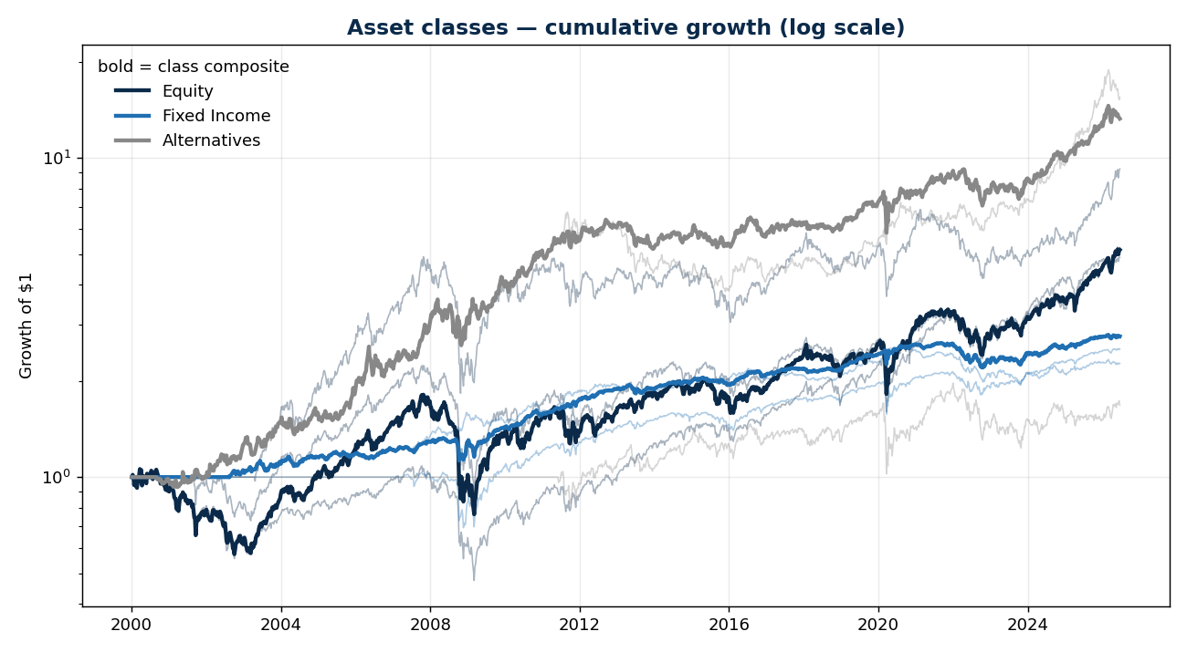
The Universe — Seven Sleeves, Three Classes
■ 7 assets grouped into 3 classes:
– Equity — SPY, VEA, VWO
– Fixed Income — TLT, HYG
– Alternatives — gold (GLD), REITs (VNQ)
■ Each class has a distinct risk-return profile:
– Equity is most volatile (deepest 2008 drawdown)
– Fixed Income is the smoothest sleeve
– Alternatives compounded the most post-2008
Takeaway: Different behaviour across classes is exactly why dynamic allocation across them can add value.
Multi-Asset Meta-Labeling · June 21, 2026
4

Slide 6
M1 — Static Directional Model: worked 3-asset example
Asset | 12w mom (z) | trend (z) | Technical | Rank | Tilt | Weight
S&P 500 | +1.08 | +0.99 | +1.03 | best | +10% | 43.3%
Gold | -0.90 | +0.02 | -0.44 | mid | 0% | 33.3%
7-10Y Treasury | -0.18 | -1.01 | -0.59 | worst | -10% | 23.3%
What it means: Score each factor, z-score across assets, rank, then tilt around the 1/7 benchmark. An underweight is an implicit short — no outright shorting needed.
Multi-Asset Meta-Labeling · June 21, 2026
5

Slide 7
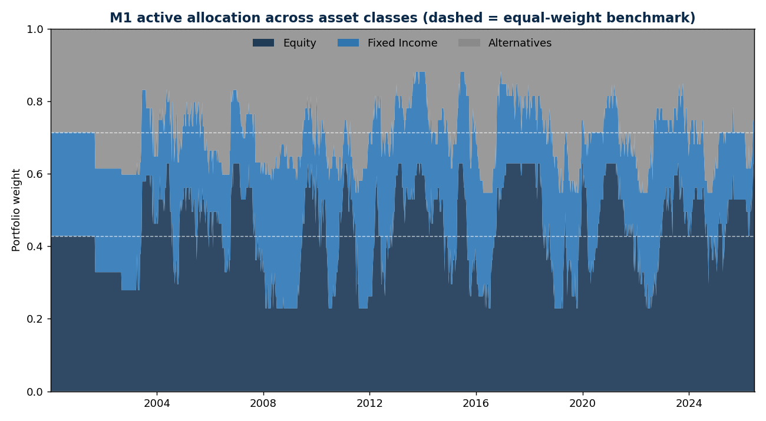
M1 in Action — Allocation Rotates Over Time
■ M1 is static, yet it still rotates allocation meaningfully week to week.
■ Dashed lines = equal-weight benchmark (Equity 42.9%, +FI 71.4%).
■ Equity swings well above and below its benchmark weight:
– leans in when price trends are strong
– backs off when they are not
■ All benchmark-relative — an underweight is a synthetic short, so we never short outright.
Takeaway: A simple static signal produces real, dynamic-looking allocation — no learning required.
Multi-Asset Meta-Labeling · June 21, 2026
6

Slide 8
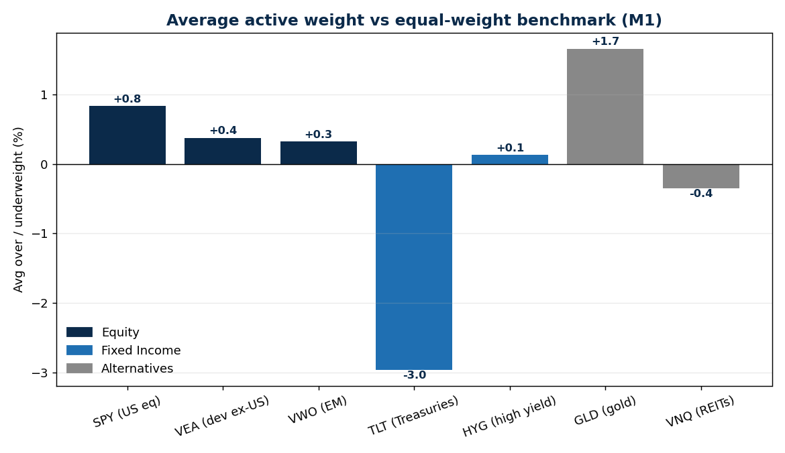
What M1 Structurally Does — Average Tilts
■ Average over/underweight vs the 1/N benchmark, per asset.
■ Most underweights Treasuries (TLT -3.0%).
■ Most overweights gold (+1.7%) and US equity (+0.8%).
■ This is the momentum/trend signal expressing itself:
– gold trended up over the sample
– long bonds trended down, especially 2022
■ Exactly the attribution SSGA cares about — we can name the P&L drivers.
Takeaway: We can point to which asset bets drive returns, not just a black-box weight vector.
Multi-Asset Meta-Labeling · June 21, 2026
7

Slide 9
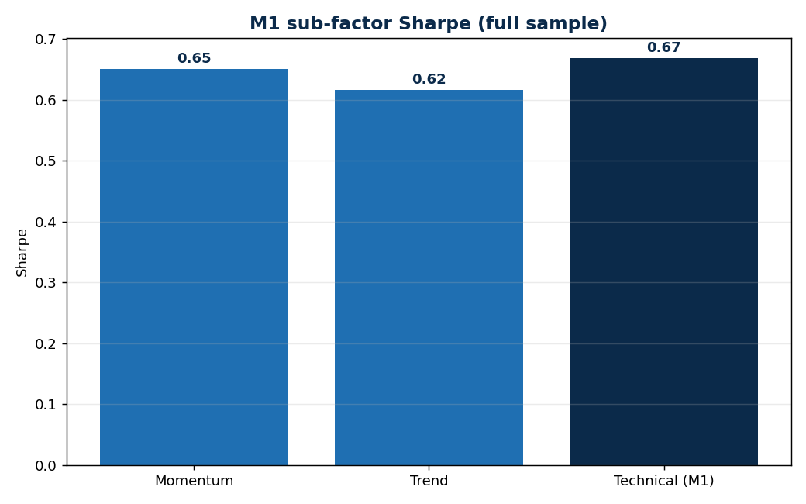
Why M1 Merges Momentum + Trend
■ Momentum and trend are collinear — they measure the same thing.
■ So we merge them into one 'technical' factor.
■ Merged beats either alone (Sharpe 0.67 vs 0.65 / 0.62).
■ Positive interaction (+0.01) — they reinforce, not cancel.
■ Keeping collinear factors separate would make attribution impossible.
Takeaway: Merging collinear factors is both cleaner for attribution and slightly better performing.
Multi-Asset Meta-Labeling · June 21, 2026
8

Slide 10
M2 — Dynamic Meta-Label
■ Target — did M1's benchmark-relative bet pay over the next 4 weeks?
■ Model — logistic regression (simple by design), refit on a rolling ~12-month window.
■ Features — momentum, trend, macro, volatility (each separate) + regime (VIX, curve, credit, growth, inflation).
■ Output — P(success), converted into a sizing multiplier on the M1 tilt.
■ Evaluated with multiple methods — F1, AUC-ROC, AUC-PR, calibration — not just accuracy.
Takeaway: M2 is where 'which factor works in which regime' is meant to be learned.
Multi-Asset Meta-Labeling · June 21, 2026
9

Slide 11
Universe & Data
Sleeve | Index | Series used (free) | History
U.S. Equity | S&P 500 | ^GSPC (index) | 2000+
Developed Intl | MSCI EAFE | EFA (ETF proxy) | 2001+
Emerging Mkts | MSCI EM | EEM (ETF proxy) | 2003+
U.S. Treasury 7-10Y | S&P UST 7-10Y | IEF (ETF proxy) | 2002+
High Yield | ICE BofA US HY | HYG (ETF proxy) | 2007+
Gold | Gold spot | GC=F (futures) | 2000+
U.S. REITs | Nasdaq US REIT | FRED index | 2011+
What it means: Free true-index history is short (HY index only 2023, MSCI EAFE/EM only 2012); we use the longest free series per sleeve. True long-history index needs Bloomberg.
Multi-Asset Meta-Labeling · June 21, 2026
10

Slide 12
Results — Strategy (full sample 2000-2026; OOS from 2021)
Strategy | Sharpe | Max DD | Sharpe (OOS) | Info Ratio (OOS)
Equal-Weight | 0.62 | -30% | 0.76 | —
Moderate Growth | 0.56 | -34% | 0.71 | -0.32
Institutional | 0.63 | -29% | 0.74 | -0.64
M1-only | 0.65 | -22% | 0.81 | +0.18
M1 + M2 | 0.61 | -25% | 0.78 | -0.00
What it means: M1 beats all baselines on risk-adjusted return and cuts drawdown the most (-22% vs -30%). Adding M2 makes every metric slightly worse.
Multi-Asset Meta-Labeling · June 21, 2026
11

Slide 13
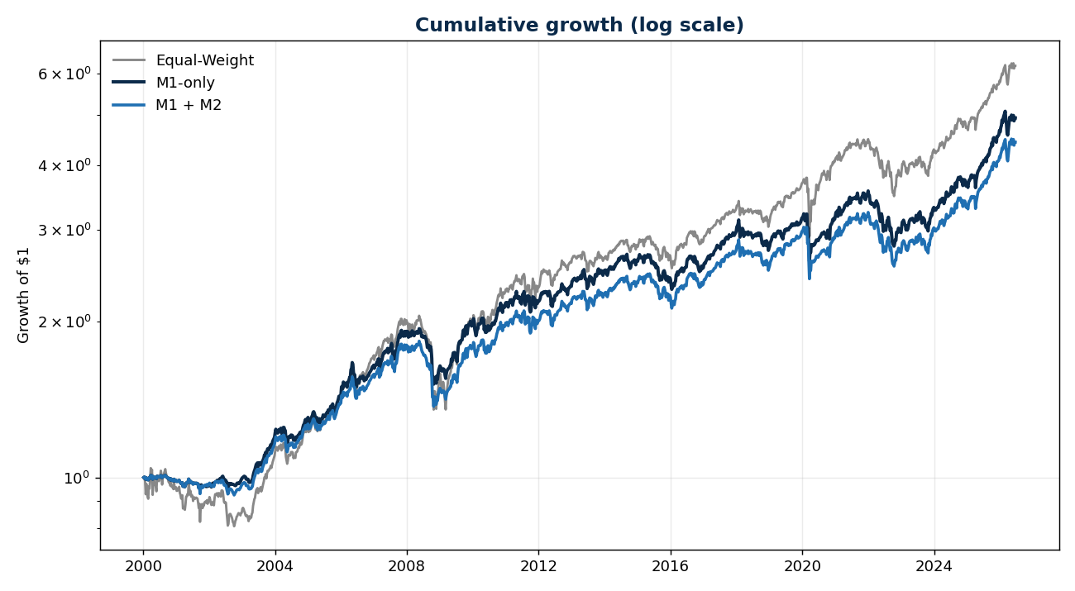
Headline Result — Growth of $1
■ Equal-Weight vs M1 vs M1+M2 (log scale).
■ On a risk-adjusted basis M1 wins:
– Sharpe 0.65 vs 0.62 for equal-weight
– max drawdown -21.8% vs -29.9% — much shallower
■ Out-of-sample (2021+), M1 is the only strategy with a positive info ratio (+0.18).
■ Raw growth favours equal-weight, but SSGA's lens is risk-adjusted + benchmark-relative.
Takeaway: M1 adds value where it matters to SSGA: risk-adjusted, benchmark-relative return.
Multi-Asset Meta-Labeling · June 21, 2026
12

Slide 14
Results — Walk-Forward (Sharpe by window)
Window | Equal-Weight | M1-only | M1 + M2
2014-2016 | 0.30 | 0.05 | 0.17
2016-2018 | 0.59 | 0.53 | 0.49
2018-2020 | 0.48 | 0.15 | 0.15
2021-now | 0.76 | 0.81 | 0.78
What it means: M1's edge over equal-weight is concentrated in 2021+, not uniform. Full-sample numbers flatter M1 than the regime-by-regime view.
Multi-Asset Meta-Labeling · June 21, 2026
13

Slide 15
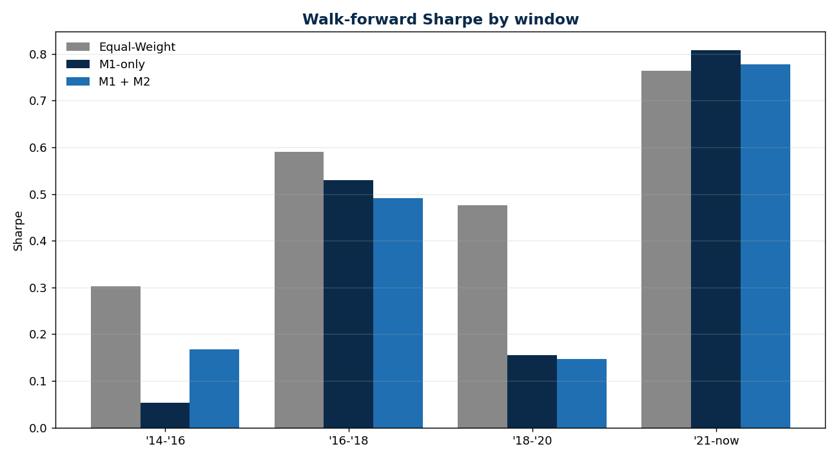
Robustness — Sharpe Across Regimes
■ We test four time windows, not one backtest, to check the edge isn't a fluke.
■ M1 is strongest in trending regimes ('21-now).
■ Weaker in choppy regimes ('18-'20) — consistent with a trend signal.
■ No window is catastrophic.
■ The edge is regime-dependent — which is precisely the problem M2 is meant to solve.
Takeaway: M1's edge is real but regime-concentrated; closing that gap is M2's job.
Multi-Asset Meta-Labeling · June 21, 2026
14

Slide 16
Key Finding — M2 Does Not Add Value Yet
■ M2's probabilities carry no information — realized success is flat across every predicted bucket:
– predicted 0.14 → realized 0.44 | predicted 0.82 → realized 0.43
■ AUC-ROC = 0.50 full / 0.46 out-of-sample — i.e. random, slightly worse OOS.
– Simple error metrics agree — Brier 0.31, calibration MAPE ≈ 0.49 (probabilities ~49% off).
■ M2 underperforms M1-only in every walk-forward window.
■ Held under both proxy and real macro data — robust, not a tuning artifact.
Takeaway: The meta-label as specified (per-asset, 4-week, benchmark-relative) extracts no conditional signal.
Multi-Asset Meta-Labeling · June 21, 2026
15

Slide 17
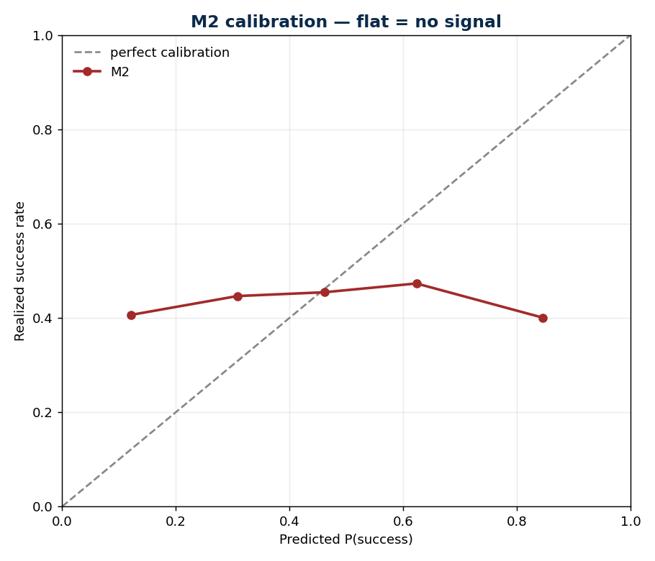
The Evidence — M2 Calibration Is Flat
■ Predicted P(success) vs realized success rate.
■ A flat line means the probabilities carry no information.
– predicted 0.14 -> realized 0.44
– predicted 0.82 -> realized 0.43
■ AUC ~ 0.50 — essentially a coin flip.
■ Not a dead end — it is the open research question; the project's value is making M2 work.
■ May be data-driven: free ETF proxies + short macro history, not Bloomberg index data.
Takeaway: Honest status: M2 has no signal yet. Reformulating it is the core next step.
Multi-Asset Meta-Labeling · June 21, 2026
16

Slide 18
Attribution — Factors & Costs
■ M1 decomposed into its two sub-signals (full-sample Sharpe):
– momentum 0.61 · trend 0.65 · combined technical 0.65
■ Interaction is positive (+0.015) — momentum and trend reinforce, not redundant.
■ Cost layers (annualized): gross 6.48% → net of expense 6.39% → net of all 6.19%.
– transaction cost (~29 bps) is a larger drag than the expense ratio (~9 bps)
Takeaway: The directional value is real and complementary; costs are modest and turnover-driven.
Multi-Asset Meta-Labeling · June 21, 2026
17

Slide 19
Limitations
■ Research-grade data (free index / ETF-proxy series); true long-history index needs Bloomberg.
■ Historical simulation only — no capacity, market impact, borrow, or live execution.
■ M1's edge is regime-concentrated (recent), not uniform across history.
■ M2 is not yet usable; its prediction target needs reformulation.
■ Some diagnostics are full-sample; production needs broader walk-forward / purged CV.
Takeaway: Solid on each step — we report what works and what does not, without overselling.
Multi-Asset Meta-Labeling · June 21, 2026
18

Slide 20
Questions for Discussion
■ M2 reformulation — which direction?
– a regime gate (scale total active risk down in stress), or
– a factor-timer (momentum vs trend by regime), or a different target / horizon?
■ Is the 4-week, benchmark-relative success label the right thing to predict?
■ M1's edge is recent-regime concentrated — acceptable, or do we need cross-regime robustness?
■ Data — prioritize Bloomberg true-index history (pre-2012)? Which sleeves first?
■ Universe — stay at 7, or add IG credit + broad commodity (9)?
■ Benchmark / tracking-error budget for the information-ratio framing?
Takeaway: We are solid on M1 and the framework; M2's design is the open research decision.
Multi-Asset Meta-Labeling · June 21, 2026
19

