Slide 1
Revision

Slide 2
State Management

Slide 3
Usage of Query String
Query String is a convenient way of transferring small amounts of information between requests. This is useful when you want to embed a hyperlink in email or social networks, with some data (e.g. user name) required to open a web page.
URL query strings are public (can be seen from the address bar of web browser), never use query strings for sensitive data (e.g. password, identity number).
Note: Query String is limited by the space in browser's address bar.
Notes:
Query strings are useful for passing pieces of information from one web page to another. The information in a query string are visible in the address bar of a web browser. So do not use query strings to pass sensitive data to the server.

Slide 4
What is Session State?
Can store values that need to be persisted for the full duration of a user's session
These variables are unique to each user session and can be accessed in any MVC controller or view within an application
E.g. store user-specific data if a user needs to go through a multistep process to register at a web application
Can set and access session information from within an ASP.NET Core application
Session is kept within the process memory in the server, or in a database
Notes:
Session state is maintained on behalf of each client within an ASP.NET Core application. When a new client begins to interact with the application, a new session ID is generated and associated with all subsequent requests from that same client. This means that you can store values for the duration of a particular session. Session state is ideal for storing user data that is specific to a session and for data that doesn't require permanent storage across sessions.

Slide 5
Establishment & Expiry of Session
When is a session established?
A new session is established when a page is requested first time from a website
Same session is re-used every time you hit another page
When does a session expire?
User ends his session by logging out, clearing the Session ID which is stored as a cookie in the web client.
If browser does not request a page from the server for a ‘specified’ period of time (time out, default is 20 minutes).
Notes:
A new session is created when a page is requested for the first time. The session is then reused for subsequent requests for all pages.
The application retains a session for a limited time after the last request. The application either sets the session timeout or uses the default value of 20 minutes. Session data is deleted either when you clear the session in code or when the session expires.

Slide 6
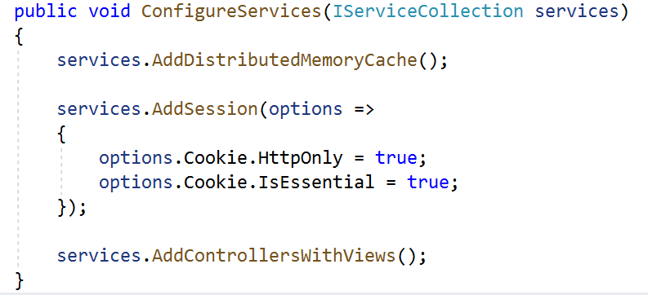
Configure Session State
To use Session state in your application, you must configure the required Session services, the Session middleware and a distributed cache implementation.
In Startup.cs file:
Notes:
To use Session state in your application, you must configure the required Session services: the Session middleware and a distributed cache implementation.
To enable the session middleware, Startup must contain a call to add a distributed memory cache and a call to Add Session in Configure Services.

Slide 7
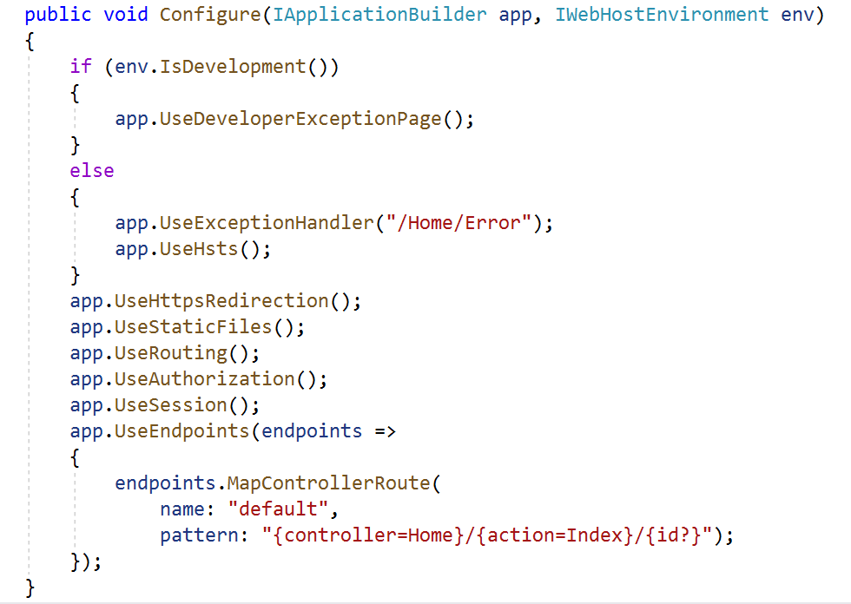
Configure Session State
In Startup.cs file:
Notes:
You also need to call UseSession in the Configure method of the Startup class. The order of middleware is important. Call Use Session after Use Routing and before Use Endpoints.

Slide 8
How to Set a Value in Session State?
Set a value for session state in a controller’s action, via the HttpContext class:
[HttpPost]
public ActionResult AdminLogin(IFormCollection formData)
{
int id = 1;
string myName = "John";
// Store the integer Id to session state
// with key = "AdminID"
HttpContext.Session.SetInt32("AdminID", id);
// Store the string myName to session state
// with key = "LoginName“
HttpContext.Session.SetString("LoginName", myName);
return RedirectToAction("AdminMain");
}
Notes:
Session state is accessed from an MVC Controller class with Http Context dot Session. Http Context holds information about the current HTTP request.
You use the Set Int32 method to store an integer and the Set String method to store a string.

Slide 9
How to Read from Session State?
In a view:
Note: Need the Microsoft.AspNetCore.Http namespace in _ViewImports.cshtml file in order to access the Context class in view
<p>
@{
// Read the “AdminID” from session state and store
// it in a variable named as “Id”
var Id = Context.Session.GetInt32("AdminID");
// Read “LoginName” from session state and store
// it in a variable named as “myName”
var myName =
Context.Session.GetString("LoginName");
}
Welcome @myName, UserId: @Id.ToString()
</p>
Notes:
To use Http Context in a view, you need to import the required namespace by adding a using directive.

Slide 10
What is TempData?
TempData in ASP.NET MVC can be used to store temporary data which can be used in the subsequent request.
TempData will be cleared out after the completion of a subsequent request. (i.e., after it is read in the subsequent request.)
TempData is useful when you want to transfer data from one action method to another action method of the same or a different controller.
TempData is a dictionary object with key-value pairs and stored in short lives session.
Notes:
TempData is useful for redirection when data is required for more than a single request. You can use it to pass data from one action to another action of the same or different controller. TempData stores data until it's read in another request.

Slide 11
Data Passing between Controllers and Views
Session State
Controller Action A
ViewData, Model
View
A
Query String, HttpPost
Temp
Data
Query String, HttpPost
Controller Action B
View
B
ViewData, Model
Note: View A is the corresponding view for Controller Action A and View B is the corresponding view for Controller Action B. Both controller actions A and B can be in the same controller or belong to two different controllers.
Notes:
TempData is used to pass data between 2 controller actions (of the same controller or different controllers).
On the other hand, to pass data from a controller’s action to its corresponding view, use ViewData or some instance of the Model class.
To pass data from a view to a controller’s action, use Query String or HTTP Post.
Key-Value pairs stored in Session state can be accessed by any controller action and view.
Views cannot interact with each other directly. Their interactions must go through the corresponding controller’s action of the target view.

Slide 12
ADO.NET

Slide 13
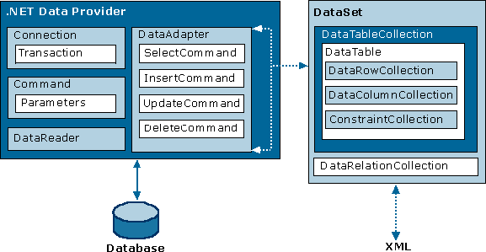
Core ADO.NET Classes
Connection - for connecting to a database.
Command - for issuing SQL commands to execute against a database.
DataReader - for data streaming (i.e. one-direction reading)
DataAdapter – serves as a bridge for fetching or updating data between a dataset and the database.
DataSet - a memory-resident data store. User will be able to access the data even he/she is disconnected from the database.
Notes:
13
The two main components of ADO.NET for accessing and manipulating data are the .NET Framework data providers and the DataSet.
The .NET Framework Data Providers are components that have been explicitly designed for data manipulation and fast, forward-only, read-only access to data. The Connection object provides connectivity to a data source. The Command object enables access to database commands to return data or modify data. The DataReader provides a high-performance streaming of data from the data source. Finally, the DataAdapter provides the bridge between the DataSet object and the data source. The DataAdapter uses Command objects to execute SQL commands at the data source to both load the DataSet with data and reconcile changes that were made to the data in the DataSet back to the data source.
The ADO.NET DataSet is explicitly designed for data access independent of any data source. As a result, it can be used with multiple and differing data sources, used with XML data, or used to manage data local to the application. The DataSet contains a collection of one or more DataTable objects consisting of rows and columns of data, and also primary key, foreign key, constraint, and relation information about the data in the DataTable objects.
DataSet (disconnected environment) is best used when you need to:
cache data locally in your application so that you can manipulate it,
perform extensive processing on data without requiring an open connection to the data source, which frees the connection to be used by other clients.
If you do not require the functionality provided by the DataSet, you can improve the performance of your application by using the DataReader to return your data in a forward-only, read-only manner. By using the DataReader, you can boost performance because you will save memory that would be consumed by the DataSet, and avoid the processing that is required to create and fill the contents of the DataSet.
In this module, we focus on retrieving data via DataReader.

Slide 14
Database Connection String
Connection String
contains the information that the provider need to know to be able to establish a connection to the database
Examples:
Data Source=(localdb)\MSSQLLocalDB; Initial Catalog=NPBookWeb; Integrated Security=True
Data Source=DatabaseServer; Initial Catalog=NPBookWeb; Uid=dba; Pwd=password
Server Name \ Instance Name
Database Name
Windows Authentication
SQL Authentication
Notes:
When your application connects to a database or a data file you let ADO.Net utilize a provider to do the job for you. The connection string contains the information that the provider need to know to be able to establish a connection to the database or the data file.
Because there are different providers and each providers have multiple ways to make a connection there are many different ways to write a connection string. It's like the address when sending a regular mail. Depending on the origin and destination and who is going to make the transport you need to write down the address in different ways.
For example; the provider needs the address to the server (or the path to the data file) to connect to. This parameter is often named "Server" or "Data Source". The value specified for this key in the connection string is passed on to the provider and this is how its possible for the provider to know where to connect.
The following database connection string is used to connect to a database file named as “NPBookWeb” resides in the Microsoft SQL Server LocalDb provided by Visual Studio. Access to the LocalDb is through the Windows Account of the machine (i.e. Integrated Windows Authentication):
Data Source=(localdb)\MSSQLLocalDB; Initial Catalog=NPBookWeb; Integrated Security=True
The following database connection string is used to connect to a database named as “NPBookWeb” resides in a remote Microsoft SQL Server named as “DatabaseServer”, using SQL Authentication to access to the remote database server:
Data Source=DatabaseServer; Initial Catalog=NPBookWeb; Uid=dba; Pwd=password

Slide 15
Executing SELECT SQL
Use the ExecuteReader() method of SqlCommand to execute a SELECT SQL and populate a SqlReader object for reading the data subsequently.
SqlCommand command = connection.CreateCommand();
command.CommandText = @“SELECT StaffId, Name
FROM Staff";
connection.Open();
SqlDataReader reader = command.ExecuteReader();
(Code to be continued on next slide)
Notes:
The ExecuteReader() method in SqlCommand class sends the SELECT SQL statements to the Connection Object and populate a SqlDataReader Object based on the SQL statement.

Slide 16
SqlDataReader
The SqlDataReader reads data in forward-only stream of rows from a SQL Server database.
(Code continued from previous slide)
List<Staff> staffList = new List<Staff>();
while (reader.Read()) {
staffList.Add(
new Staff {
StaffId = reader.IsDBNull(0) ?
reader.GetInt32(0) : (int?) null,
Name = reader.IsDBNull(1) ?
reader.GetString(1) : string.Empty,
}
);
}
reader.Close();
Staff Table:
StaffId | Name
Notes:
The SqlDataReader provides an unbuffered stream of data that allows program to efficiently process results from a data source sequentially. The SqlDataReader is a good choice when you're retrieving large amounts of data because the data is not cached in memory, and hence save the server's memory space.
Use the SqlDataReader.Read() method to obtain a row from the query results. You may put the Read() method in a “while” loop and the SqlDataReader will read a row in each iteration until the last row. You can access each column of the returned row by passing the ordinal number of the column to the SqlDataReader, take the example on the slide, we access the “StaffId” by specifying column 0 (first column) and “Name” by specifying column 1 (second column). For best performance, the SqlDataReader provides a series of methods that allow you to access column values in their native data types (GetDateTime(), GetDouble(), GetString(), GetInt32(), and so on). Using the typed accessor methods when you know the underlying data type reduces the amount of type conversion required when retrieving the column value.
For column that may contains null value, we use the C# conditional operator C#‘s conditional operator (Pattern: BooleanExpression ? expression if true : expression if false) and the IsDBNull() method to test the value before assigning the value to a model object. We need to do so because a database null value is not acceptable by the model object.
Always call the Close() method when you have finished using the SqlDataReader object. While a SqlDataReader is opened, the SqlConnection is in use exclusively by that SqlDataReader. You cannot execute any commands for the SqlConnection, including creating another SqlDataReader, until the original SqlDataReader is closed.

Slide 17
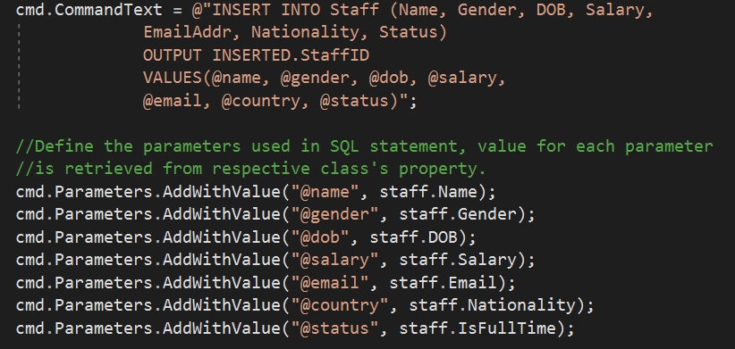

Slide 18
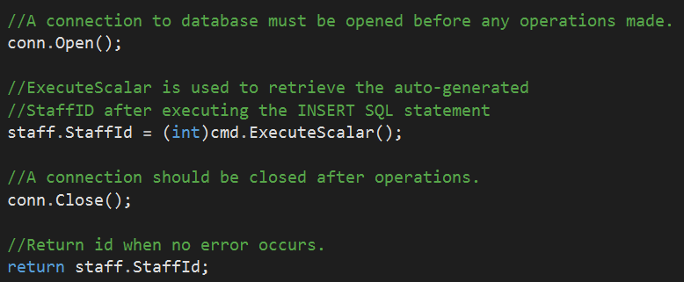

Slide 19
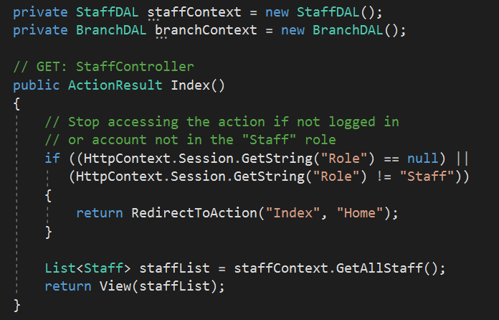

Slide 20
VIEWMODEL

Slide 21
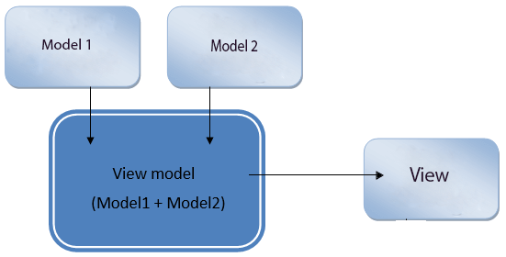
What ViewModel is
In ASP.NET Core MVC, ViewModels are used to shape multiple entities from one or more models into a single object. This conversion into single object provides us better optimization.
if we want to display more than one Model into a single View, we have to pass a ViewModel to that View, so that we can take benefits of both the models into a single object.
Notes:
In real-world applications, a single model may not contain all the data required for a view. In such situations, we need to add a ViewModel. A ViewModel is like a model that contains data from more than one models to suit a particular view.

Slide 22
Advantages of Using ViewModel
Remove Logic from View
Without view model, the if-else logic that displays product rating as number of * (the example in Slide 8) will be written in the view.
Separation of Concern - a view should focuses on the UI and not containing too much programming logic.
Security
ViewModel only contains properties required for a view display and hence can hide the potentially dangerous properties like UserRole, IsAdmin that may be present in domain models.
Loose Coupling
ViewModel reduces coupling between data layer and presentation layer. If a domain model is changed, it only affect the code that maps between that domain model and the ViewModel.
Notes:
We will talk about some advantages of using view models. A ViewModel is useful when you have a complex user interface. Since a view model is not tied to any model, it gives you flexibility to use it according to your needs.
When using a ViewModel, we do not need extra code related to the data in the View or Controller. This gives us Separation of Concerns and makes our code more maintainable.

Slide 23
Where we should use ViewModel?
We can use ViewModel in the following scenarios:
Managing or creating dropdown lists for a specific entity
Creating Master-Details View in data-driven websites
Create real data with paging information in same group
Used in a website to show user profile widget
Dashboards which includes different source of data
Aggregate data for reporting
Notes:
We looked at three examples earlier. Here we list several reasons for using view models

Slide 24
WEB API

Slide 25
What are APIs?
API (Application Programming Interface)
Some kind of interface which has a set of functions that allow programmers to access specific features or data of an application, operating system or other services.
APIs are everywhere.
Contract provided by one piece of software to another
Structured request and response.
Notes:
APIs are everywhere – Computer, Smart

Slide 26
Understanding REST – Uniform Interface
Request Verbs – HTTP provides 4 basic methods for CRUD (create, read, update, delete) operations:
GET: Retrieve representation of resource from a remote resource
PUT: Update/modify existing resource (or create a new resource) on the remote server
POST: Create a new resource that is sent to the server
DELETE: Delete an existing resource from the remote server

Slide 27
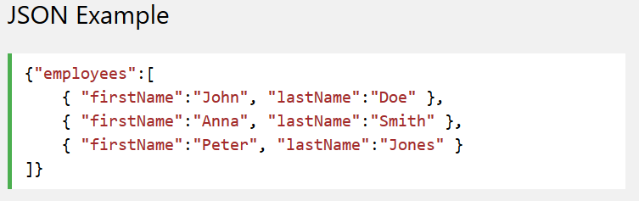
Content Negotiation in Web API
Content Negotiation is the process of selecting the best representation for a given response when there are multiple representations available.
For Web API, the usual media type (representation) for a piece of content from a response in the JSON (JavaScript Object Notation) format.
Notes:
We know that there are three pillars of the internet, they are:
- The resource
- The URL
- The representation
The first two are very straight forward but the last one is a little confusing to understand. The representation is very important in the modern web. Why? People are currently not only using Desktop computers to browse the web, they are using various types of devices to consume web applications. And the interesting fact is that the various devices expect data in various formats. For example a few want data in normal HTML format and some in normal text format. Others need the JSON format and still others in XML format. The formal definition of Content Negotiation as “the process of selecting the best representation for a given response when there are multiple representations available”. The question is, how does the Web API know what the client expects? By checking below the header of the request object: Content-type: which request to API to represent data in this type. Accept: The acceptable media types for the response, such as “application/json,” “application/xml,” or a custom media type such as "application/vnd.example+xml". Accept-Charset: The acceptable character sets, such as UTF-8 or ISO 8859-1. Accept-Encoding: The acceptable content encodings, such as gzip. Accept-Language: The preferred natural language, such as “en-us”.
(Source: http://www.c-sharpcorner.com/UploadFile/dacca2/understand-content-negotiation-in-web-api/)

Slide 28
Content Negotiation in Web API
When exchanging data between a browser and a server, the data can only be text.
JSON is text, it can easily be sent to and from a server, and used as a data format by any programming language since it is language-independent.
The process of converting an object to a JSON text string is called Serialization.
The process of converting a JSON text string back to an object is called Deserialization.

