Slide 1
Beyond Loss Curves:
Thermodynamics of Pretraining
Physics-grounded spectral diagnostics for LLM pretraining monitoring 12 Models | 3 Architectures | 70M-65B | ~250 Checkpoints

Slide 2
The $500M Blind Spot
Training a frontier LLM: $100-500M, months on thousands of GPUs.
The ONLY real-time diagnostic: training loss.
But loss CANNOT tell you:
- Is structure forming or degrading? (memorization vs learning)
- When should I decay the LR? (arbitrary schedules)
- Is this model structurally ready? (no cross-model comparison)
- Are there hidden pathologies? (no early warning)
Piloting a $500M aircraft with nothing but an altimeter

Slide 3
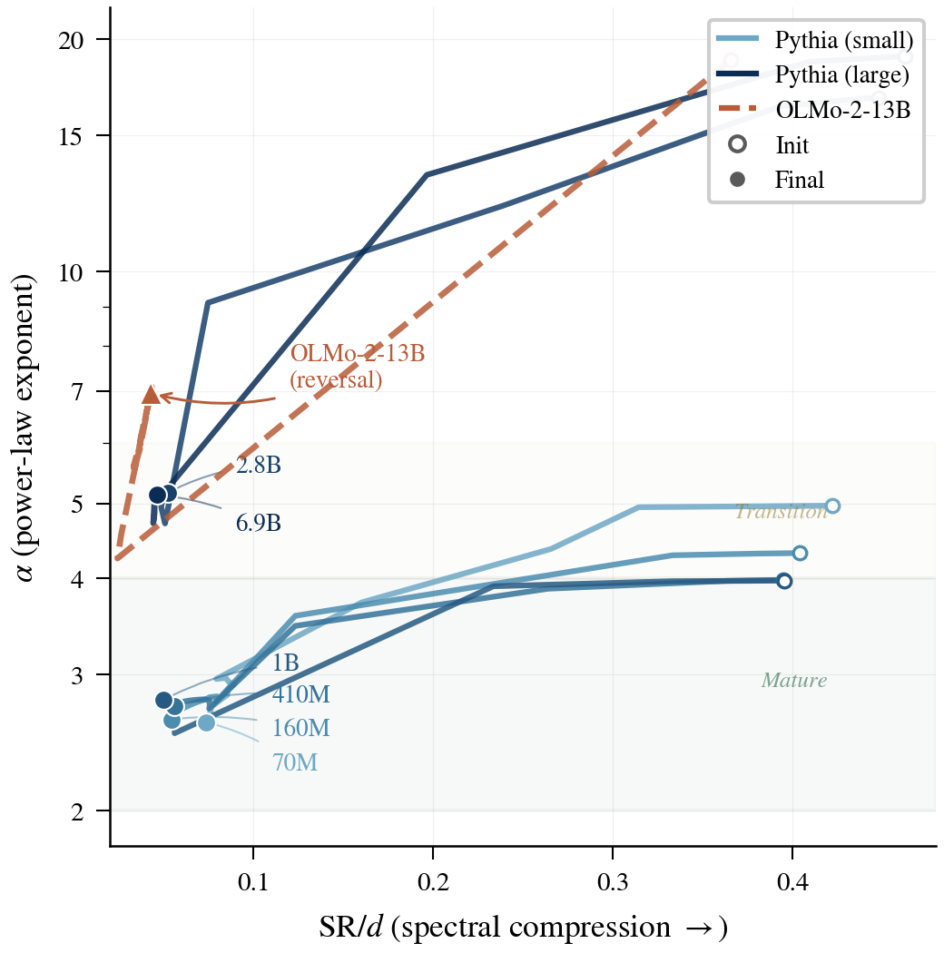
Two Spectral Metrics = Complete Picture
SR/d (Stable Rank / Hidden Dim)
Compression progress: how much capacity is used
SR = exp(Renyi-2 entropy) -- mathematical identity
Init ~40% -> Trained ~5%
alpha (Power-Law Exponent)
Structural quality: heavy-tail = well-organized features
alpha > 6: random | [4,6]: partial | [2,4]: mature | <2: collapse
Key: This is NOT analogy -- it IS thermodynamics.
Cost: <0.05% of training compute.

Slide 4
Five Key Contributions
P1: Universal Compression Law
SR/d = 0.040 + 0.61/sqrt(d), Delta_H2 = -2 nats universally
P2: Performance Predictor
r = -0.92 with downstream benchmarks (N=102, p<1e-41)
P3: alpha Reversal = Degradation Signal
Invisible to loss. 13B shows largest reversal (Delta_alpha = +2.71)
P4: Adaptive LR Schedule
alpha-Guided matches WSD, +1.95% benchmark vs cosine, zero hyperparams
P5: Post-hoc Training Audit
5-min measurement diagnoses K2-65B -- validated by external benchmarks

Slide 5
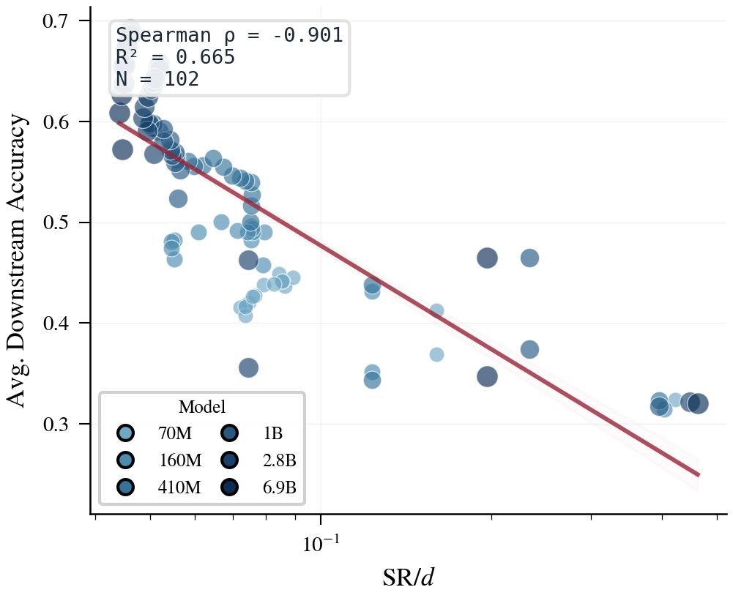
Experimental Coverage
12 Models | 930x scale | 3 architectures | GPT-NeoX + LLaMA + OLMo2
Model Arch d Params D/N SR/d alpha Status
Pythia-70M GPT-NeoX 512 70M 4261 0.074 2.60 Mature
Pythia-1B GPT-NeoX 2048 1.0B 297 0.050 2.78 Mature
Pythia-6.9B GPT-NeoX 4096 6.9B 44 0.046 5.13 Immature
OLMo-2-13B OLMo2 5120 13B 365 0.043 6.95 Degrading
OLMo-2-32B OLMo2 5120 32B 189 0.043 5.25 Immature
K2-65B LLaMA 8192 65B 21 0.036 5.09 Insufficient
Mistral-7B Mistral 4096 7.2B ~1100 0.040 6.13 MLP immature

Slide 6
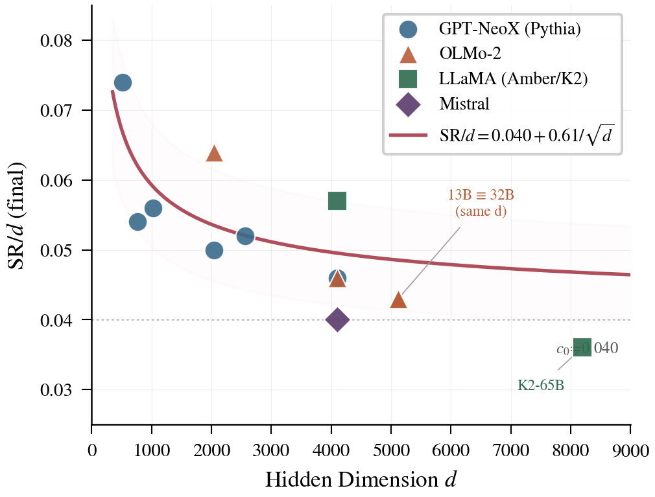
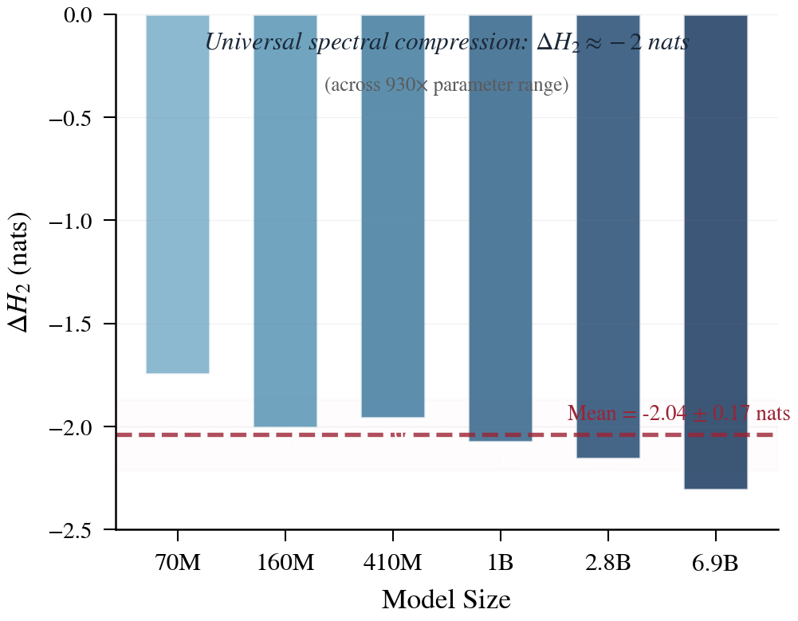
P1: Universal Compression Law
SR/d = 0.040 + 0.61 / sqrt(d)
Determined by hidden dim d alone
Independent of depth, params, training budget
Key test: OLMo-2-13B vs 32B
Same d=5120, different depth -> identical SR/d=0.043
Hold-out: Mistral-7B (GQA, unseen arch)
Square-layer SR/d = 0.040, matches prediction
Delta_H2 = -2.0 nats universally
Training erases 87% of initial random degrees of freedom

Slide 7
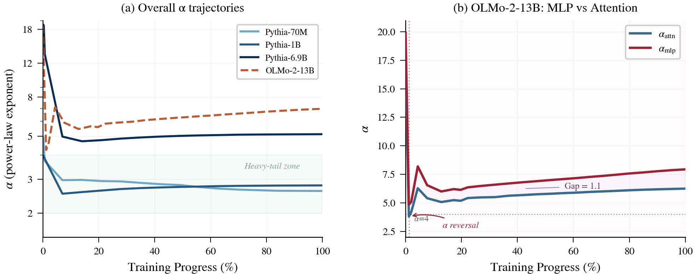
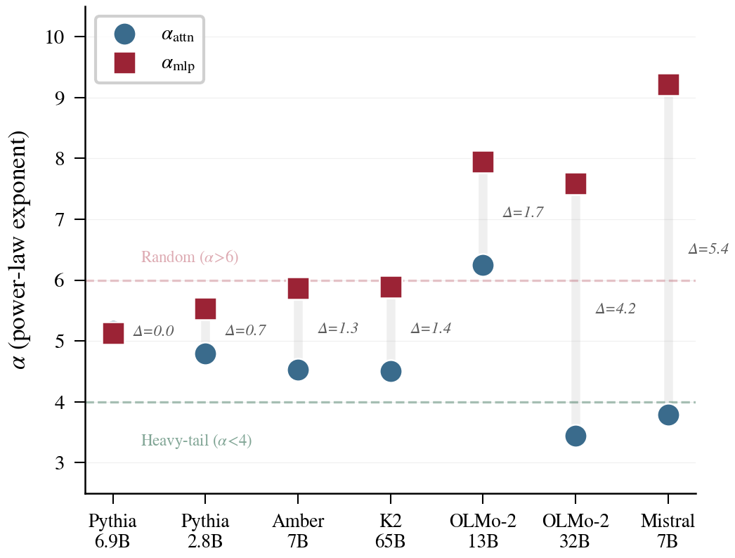
P3: alpha Reversal -- Invisible Degradation
When d_alpha/dt > 0: structure is DEGRADING
Even while loss keeps decreasing!
Model D/N a_min a_final Delta_a
Pythia-70M 4261 2.60 2.60 0
Pythia-1B 297 2.52 2.78 +0.26
Pythia-2.8B 108 4.71 5.16 +0.45
OLMo-2-32B 189 2.90 5.25 +2.35
OLMo-2-13B 365 4.25 6.95 +2.71
32B entered heavy-tail (a=2.9) then REVERSED OUT
Bigger models are MORE fragile, not less
MLP/Attn gap reaches 5.4 at Mistral scale

Slide 8
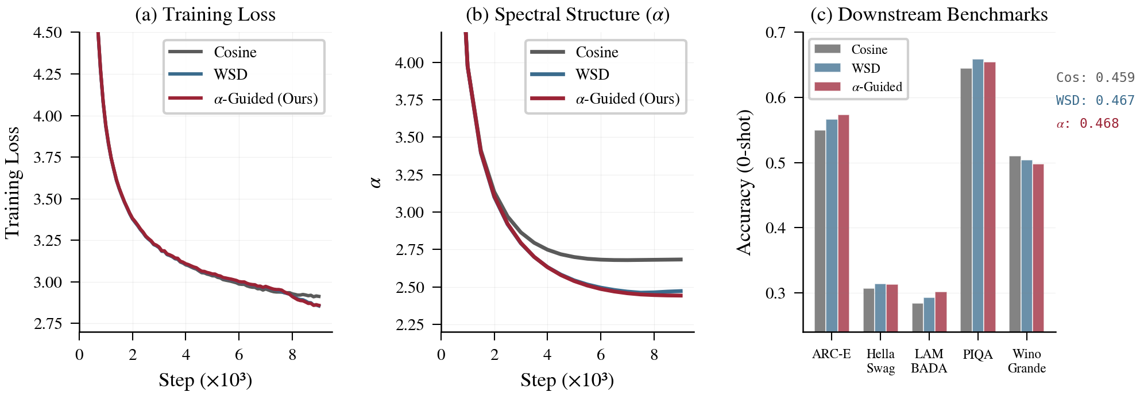
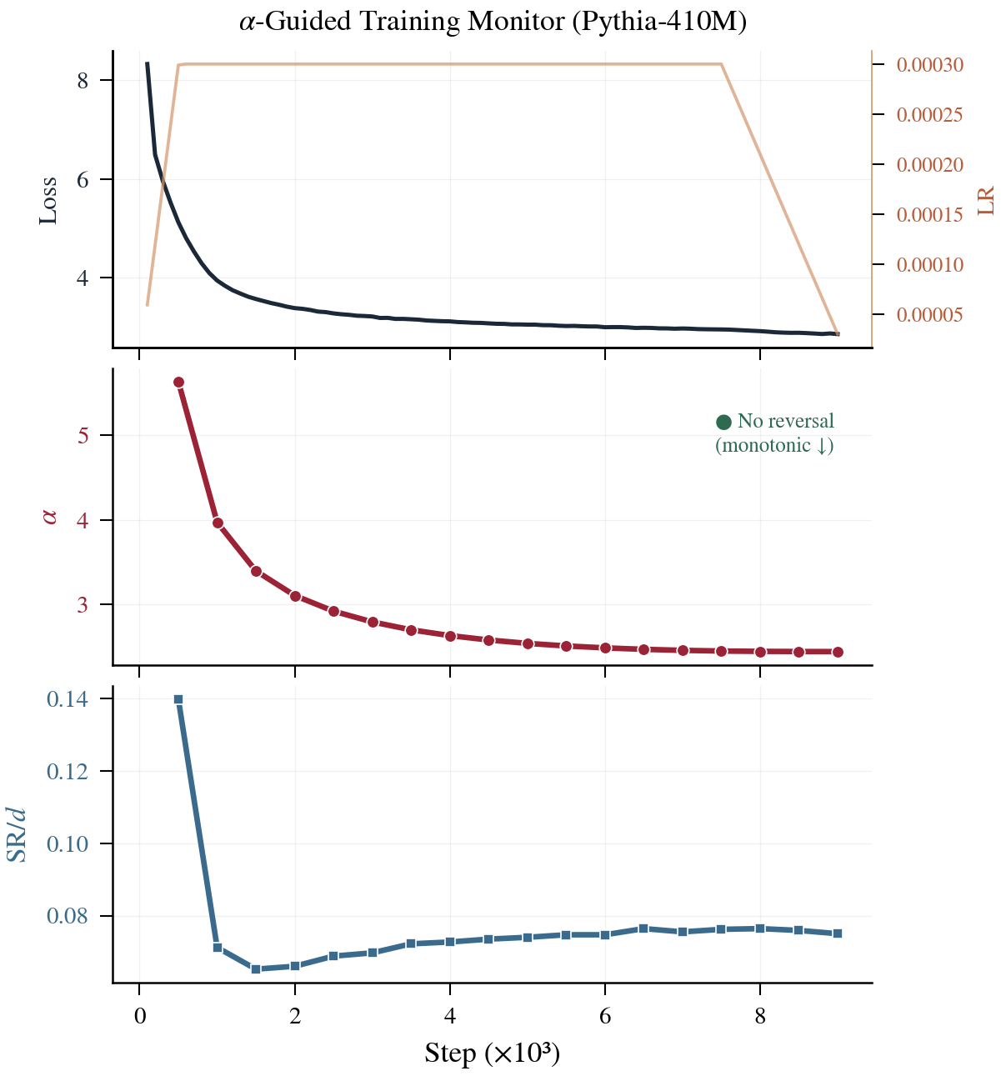
P4: alpha-Guided Adaptive Schedule
Pythia-410M | FineWeb-Edu | 9.9B tokens | 2 seeds
Schedule Loss alpha Decay at
Cosine 2.913 2.683 Step 500 (6%)
WSD 2.855 2.472 Step 7200 (80%)
alpha-Guided 2.859 2.442 Step 7500 (83%)
Delta vs Cosine: -0.054 loss, -0.24 alpha
Downstream (5 benchmarks, 0-shot):
alpha-Guided vs Cosine: +1.95%
LAMBADA improvement: +6.3%
alpha-Guided vs WSD: +0.11% (equivalent)
= WSD performance with ZERO schedule hyperparameters

Slide 9
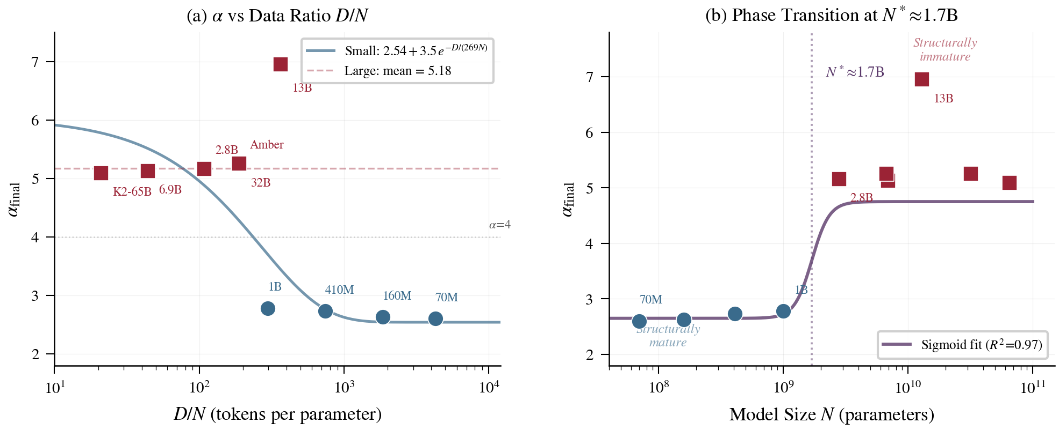
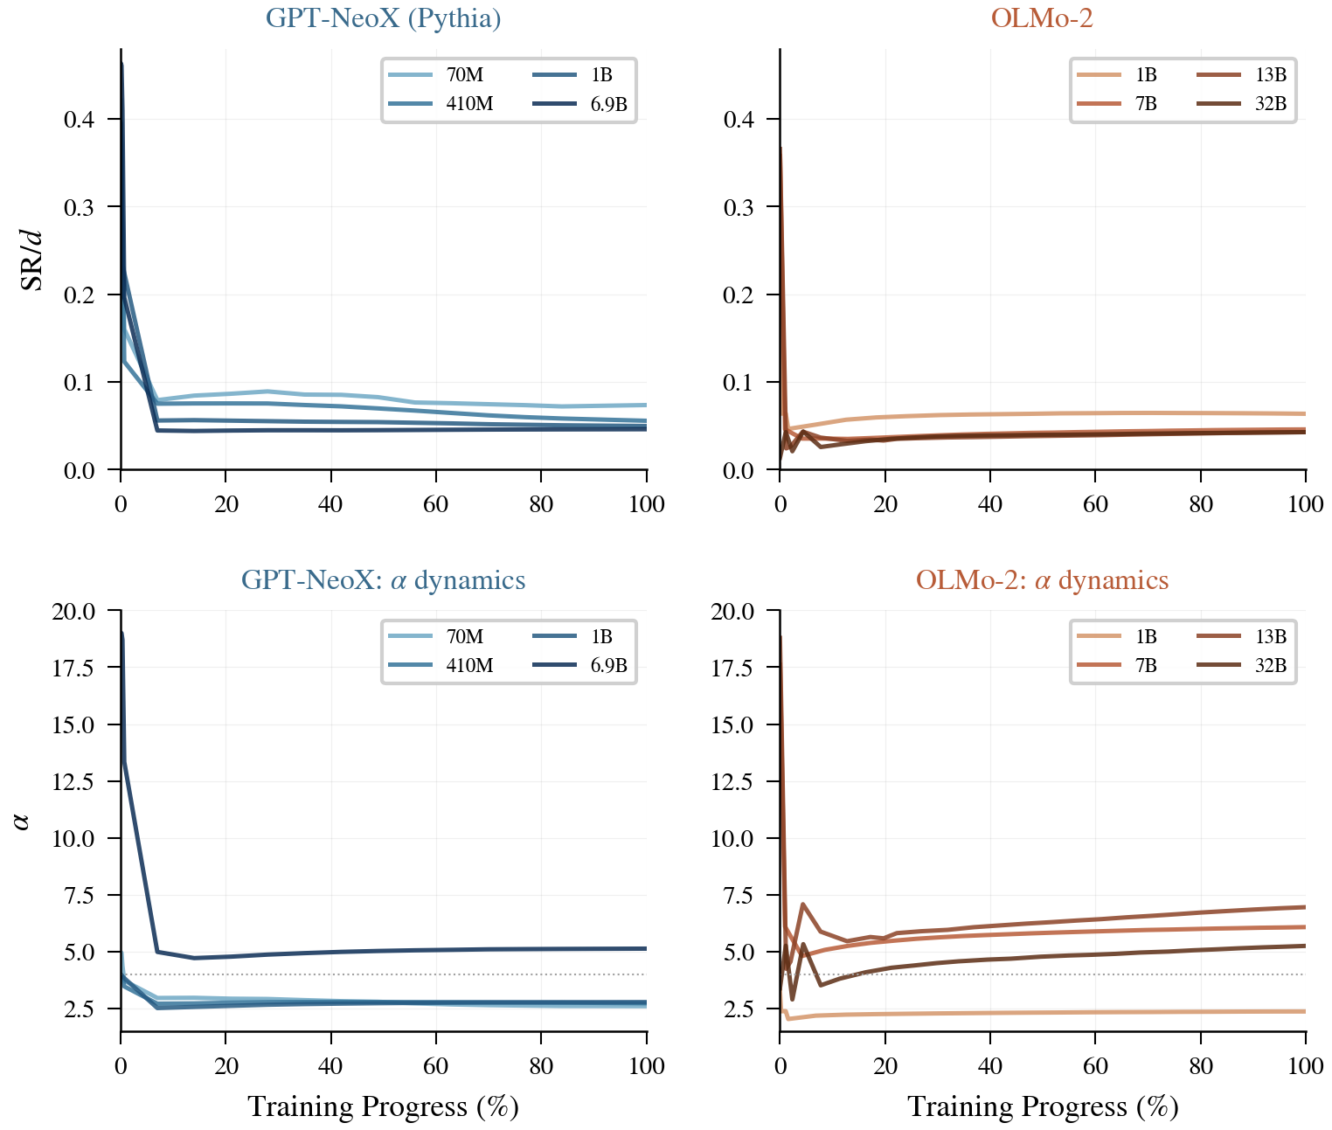
Phase Transition at N ~ 1.7B
N <= 1B: easily reach alpha < 3 (mature)
Regardless of training budget
N > 1.7B: stuck at alpha > 5 (immature)
Even with D/N = 365 tokens/param
Sigmoid fit: R-squared = 0.97
Implications:
Chinchilla (D/N=20) -> alpha~5.8 (immature)
Structural maturity requires D/N >= 500
Larger models need MORE tokens/param, not fewer
Frontier models may be systematically undertrained

Slide 10
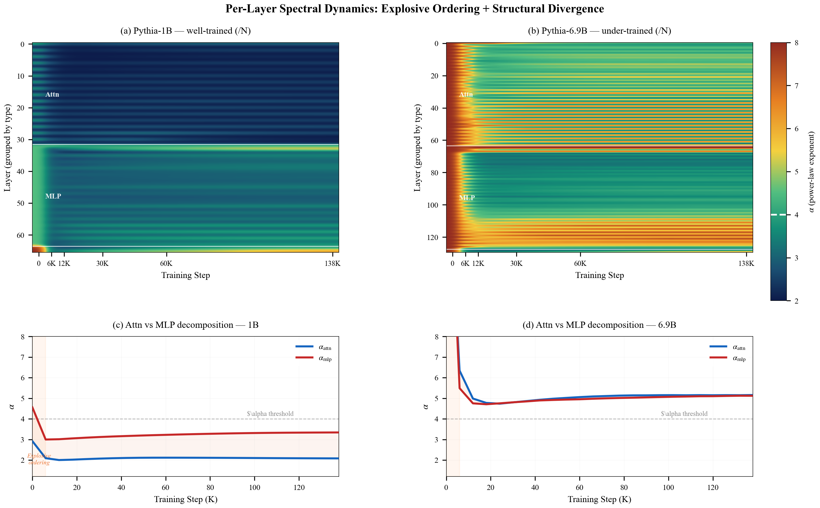
Per-Layer Spectral Heatmap

Slide 11
Summary & Next Steps
Loss tells you how well the model FITS the data.
Spectral metrics tell you how well it
ORGANIZED ITSELF to generalize.
Key Takeaways:
Universal compression: SR/d = f(d)
alpha reversal = invisible degradation
alpha-Guided = WSD without tuning
5-min post-hoc audit tool
MLP is the structural bottleneck
Overhead: <0.05% of training compute
In Progress:
1B Scale-Up (running now)
Validate at 2.5x larger scale
Causality Experiment
Fork at reversal: obey vs ignore
More architectures
Gemma-2-9B, Llama-3-8B
MoE extension
Expert specialization signatures

