Slide 1
Beyond Loss Curves
Spectral Monitoring for LLM Pretraining
14 Models
4 Architectures
~340 Checkpoints
2 Scales Validated
Jiaqi Liu
01 / 37

Slide 2
The "Blind Flight" of Pretraining
Model | Cost | GPUs | Time
GPT-4 | ~$100M+ | Tens of thousands A100 | 3-6 mo
Llama-3-70B | ~$30M | 16K H100 | ~3 mo
DeepSeek-V3 | ~$5.5M | 2048 H800 | 2 mo
$100M+ Investment
Only 1 instrument: training loss
Throughout training, the core metric for judging is typically just: training loss
02 / 37

Slide 3
Four Blind Spots of Loss
Blind Spot 1
Blind Spot 2
Blind Spot 3
Blind Spot 4
Loss ↓ ≠ Better Model
Incomparable Across Models
No Signal for LR Decay
No Early Warning
Memorization also reduces loss, but generalization structure degrades
Loss=3.0 for 1B vs. 70B mean entirely different things
Cosine/WSD are pre-set by humans, lacking model-intrinsic signals
Structure degrades while loss still drops—until irreversible
Key Insight: Intelligence is not memorizing information, but discovering structure,
We need to measure structure directly
03 / 37

Slide 4
PART I
Two Core Metrics
Two Spectral Metrics: SR/d & α
04 / 37

Slide 5
Metric 1: SR/d
Normalized Stable Rank
SR(W) = ||W||²F / σ₁² →
SR/d = SR(W) / d_model
~0.40
Random Initialization
Physical meaning: Fraction of available dimension space the matrix uses
Mathematical identity: SR = exp(H₂), i.e., Rényi-2 exponential of spectral entropy
Compute cost: O(mn), 7B all layers ~5 min
↓ Training ↓
~0.05
Fully Trained
Compression ~8× → ΔH₂ ≈ -2.0 nats (Universal across all models!)
SR/d ↓ = spectral entropy decreasing = information compressing
05 / 37

Slide 6
Metric 2: α
Power-Law Exponent
α Range | State | Meaning
> 6 | Random | Near Marchenko-Pastur
4 ~ 6 | Bulk+Spikes | Partially structured
2 ~ 4 | Heavy-Tail | Well self-regularized ✓
< 2 | Over-trained | Rank collapse risk
P(λ) ~ λ⁻ᵅ (ESD of WᵀW)
Physical meaning: Structural quality of weight matrices
Theoretical basis: Heavy-Tail Self-Regularization (HTSR)
α ↓ = heavy-tail ↑ = generalization ↑
Key finding: α is not monotonically decreasing— it reverses in large models (Reversal)!
Martin & Mahoney (JMLR 2021) Well-trained layers follow power-law distributions
06 / 37

Slide 7
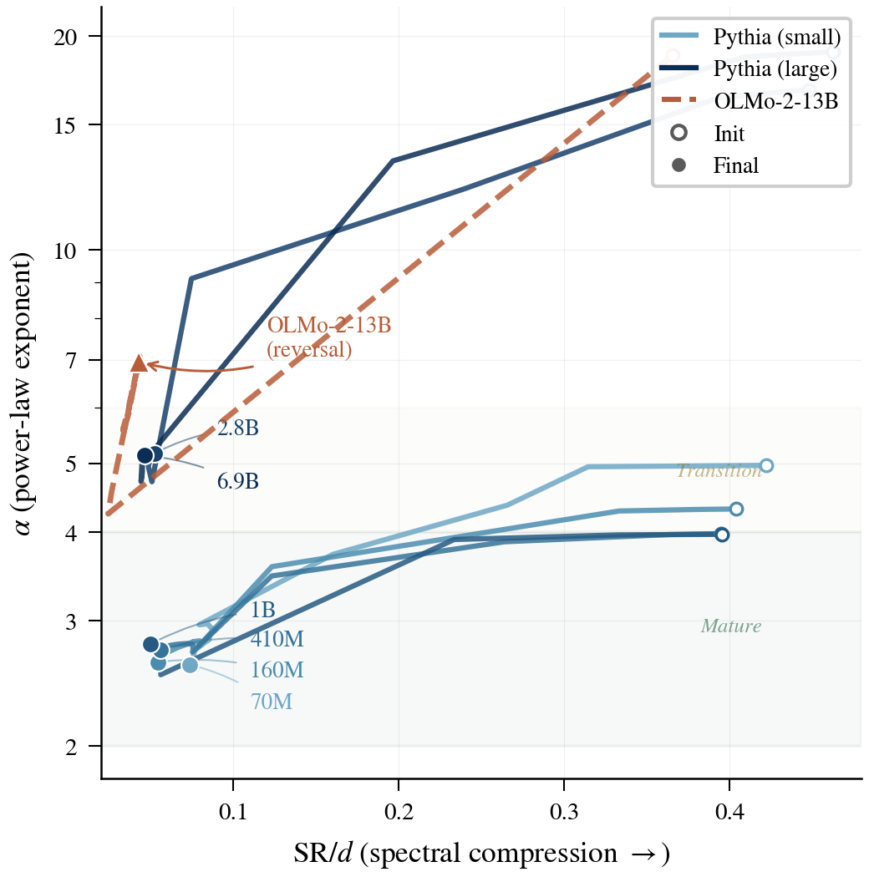
Two Metrics in Concert
Spectral Phase Portrait
Well-trained small models (70M–1B) converge to the lower-left "mature" region (α < 4, SR/d < 0.08)
Under-trained large models (2.8B, 6.9B) stall in the "transition" zone
OLMo-2-13B reverses direction after reaching its α minimum, moving away from maturity
All models share the compression axis (SR/d converges universally), but diverge on the structural quality axis (α).
07 / 37

Slide 8
PART II
Key Findings
Key Findings from 14 Models × 4 Architectures
08 / 37

Slide 9
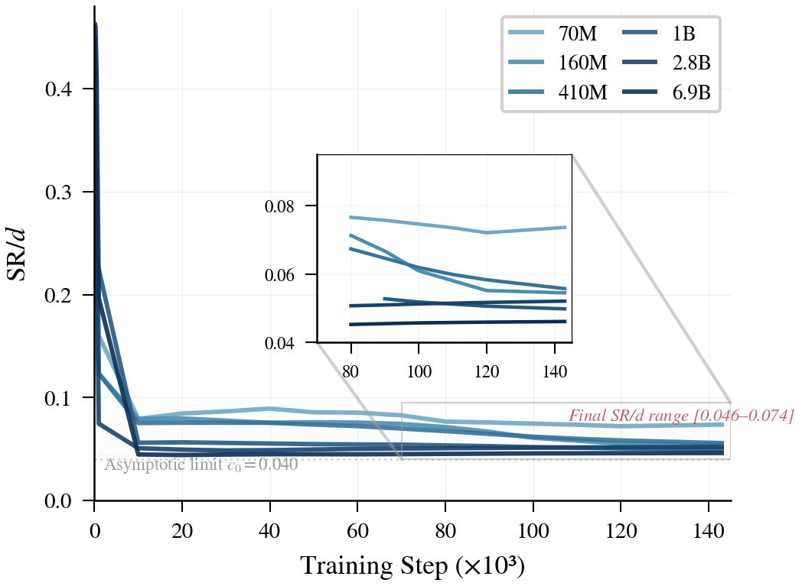
Finding 1: SR/d Universal Convergence
Universal Convergence
SR/d(∞) = 0.040 + 0.61 / √d
All 14 models converge to 0.04-0.07
Determined solely by layer width d, independent of depth
OLMo-2-13B and 32B (same d=5120): Identical SR/d (0.043)
Universal Compression Law: ΔH₂ = -2.04 ± 0.17 nats
All Transformers compress exactly ~2 nats of spectral entropy
09 / 37

Slide 10
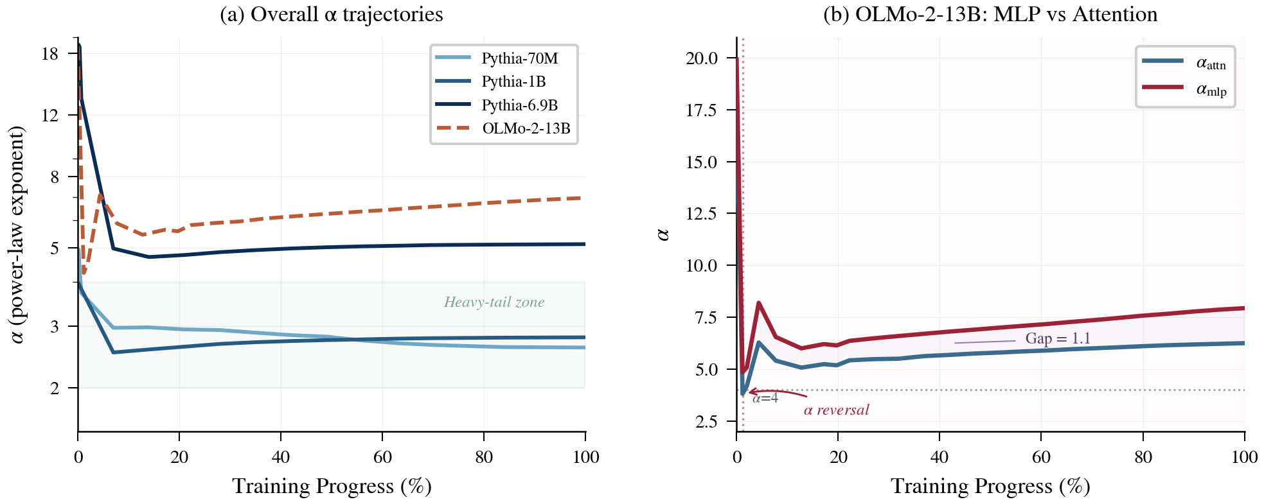
Finding 2: α Reversal
Structural Degradation Signal
Loss decreases, but structure degrades!
OLMo-2-13B: α reverses from 4.25 to 6.95 (Δα=+2.71)
5/8 large models show reversal, consistent across architectures
MLP-driven: α_mlp rises while α_attn stays stable
Intuition
Stacking blocks in a noisy room: Once useful learning is done(no gradient direction), noise shakes apart fine structure(α↑). Reducing LR = less vibration = protects structure
10 / 37

Slide 11
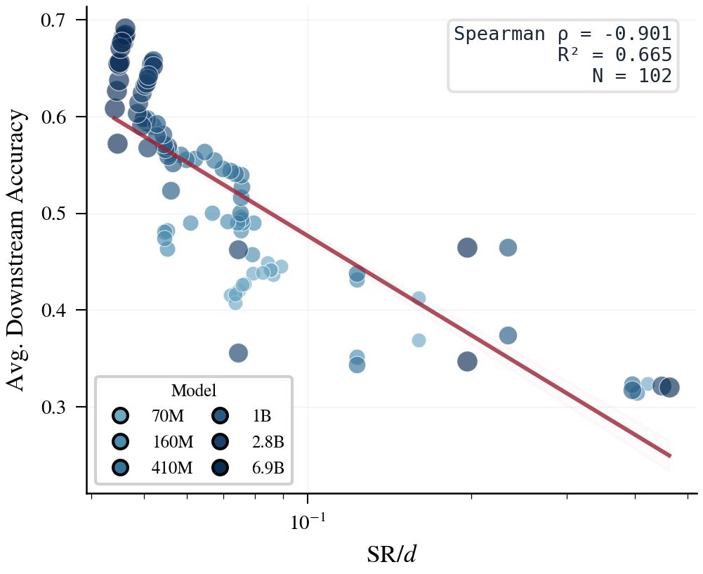
Finding 3: Predicting Downstream Performance
Predictive Power
−0.90
0.63
0.84
Spearman ρ
R² (univariate)
R² (+log N)
N=102 (6 models × 17 checkpoints × 5 benchmarks)
Perf ≈ -0.248·log₁₀(SR/d) + 0.062·log₁₀(N) - 0.365
No training/test data or loss needed—predicts 84% of downstream variance from weights alone
11 / 37

Slide 12
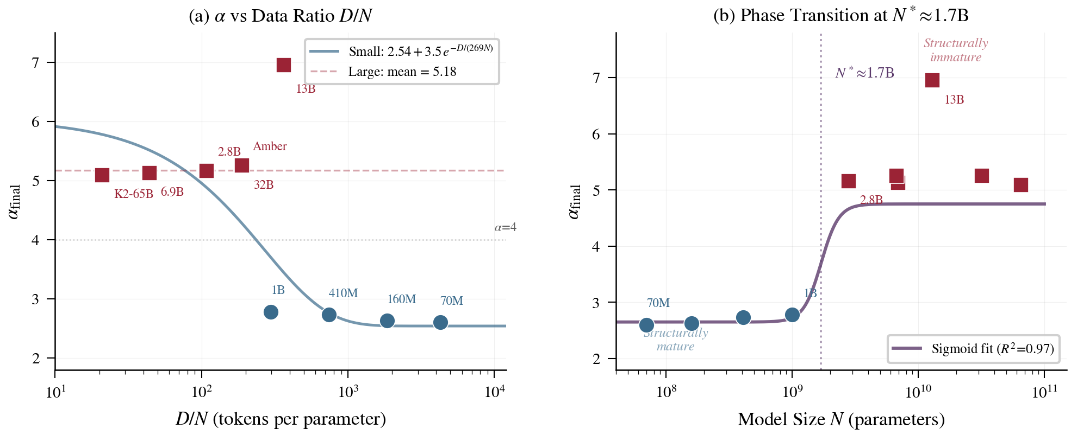
Finding 4: Structural Phase Transition
Phase Transition at N ≈ 1.7B
< 1.7B: α can drop to <3 (structurally mature)
> 1.7B: α stuck >5 (structurally immature)
α(N) ≈ 2.65 + 2.1 × σ((log₁₀N - 9.23) / 0.07)
"Large models are hard to train" is not just a data issue —large models are fundamentally harder to structure
Sigmoid fit R² = 0.97
12 / 37

Slide 13
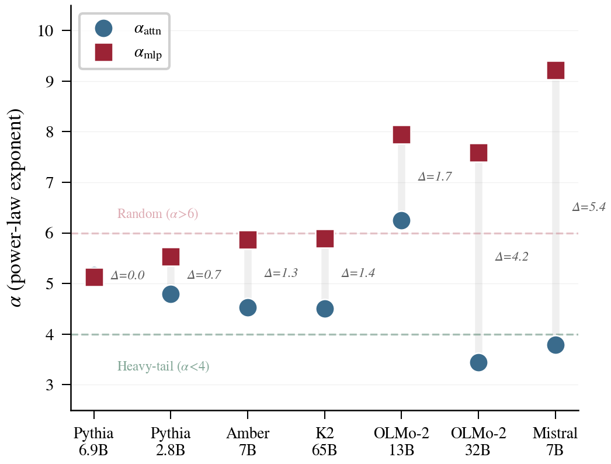
Finding 5: MLP as Structural Bottleneck
MLP as Structural Bottleneck
Model | α_attn | α_mlp | Gap
OLMo-2-1B | 1.35 | 3.56 | 2.21
OLMo-2-32B | 3.44 | 7.59 | 4.15
Mistral-7B | 3.79 | 9.22 | 5.43
Attention already structured (α<4), MLP still random (α>7)
→ Prioritize increasing MLP capacity (wider FFN / MoE)
13 / 37

Slide 14
PART III
From Diagnosis to Action
α-Guided Adaptive LR Schedule
14 / 37

Slide 15
α-Guided Schedule
Data-Driven LR Decay
Key Advantages
Measure α every 500 steps
(2-layer SVD, ~5s)
Auto-adapts to different scales: 410M→83%, 1B→74%
Auto-adapts to different data: No manual tuning needed
Signal derived from the model's own structure
↓
Detect: dα/dt > 0 for 3+ consecutive checks?
↓
Theoretical Basis
Trigger LR Decay (linear → η_min)
α reversal = SGD noise > spectral gap
Reducing η → noise ∝ η² decreases → restores SNR > 1 (Wedin's sin-Θ theorem bounds subspace rotation)
15 / 37

Slide 16
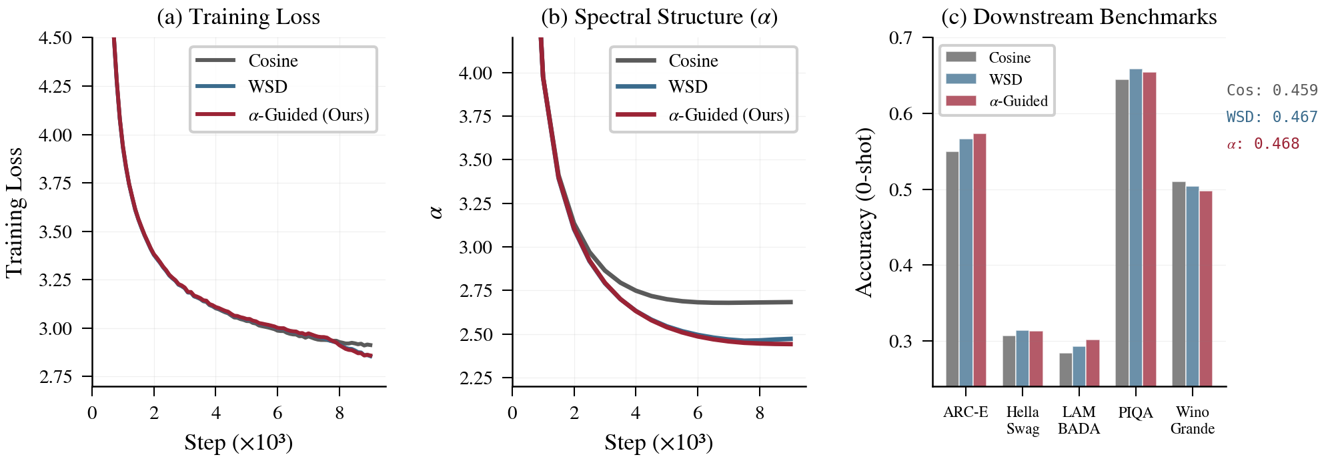
Validation: 410M 3-Way Comparison
FineWeb-Edu, 10B tokens, 2 seeds
Schedule | Loss | α | Avg ↑
Cosine | 2.931 | 2.68 | 0.459
WSD | 2.874 | 2.47 | 0.467
α-Guided | 2.877 | 2.44 | 0.468
+1.95%
+6.3%
≈ WSD
vs Cosine
LAMBADA ↑
Auto-matches
16 / 37

Slide 17
Scale-Up: 1B Validation
Advantage Amplifies with Scale
Cross-Scale Trend
Schedule | Loss | α | SR/d | Avg ↑
Cosine | 2.739 | 4.05 | 0.056 | 0.486
WSD | 2.701 | 4.01 | 0.054 | 0.494
α-Guided | 2.709 | 3.87 | 0.054 | 0.498
Comparison | 410M | 1B
α-Guided vs Cosine | +1.95% | +2.56%
α-Guided vs WSD | +0.11% | +0.98%
Decay point | 83% | 74%
LAMBADA ↑ | +6.3% | +10.2%
α-Guided clearly surpasses WSD (+0.98%), not just matching
Advantage amplifies with scale: expected to be more significant at 7B+
17 / 37

Slide 18
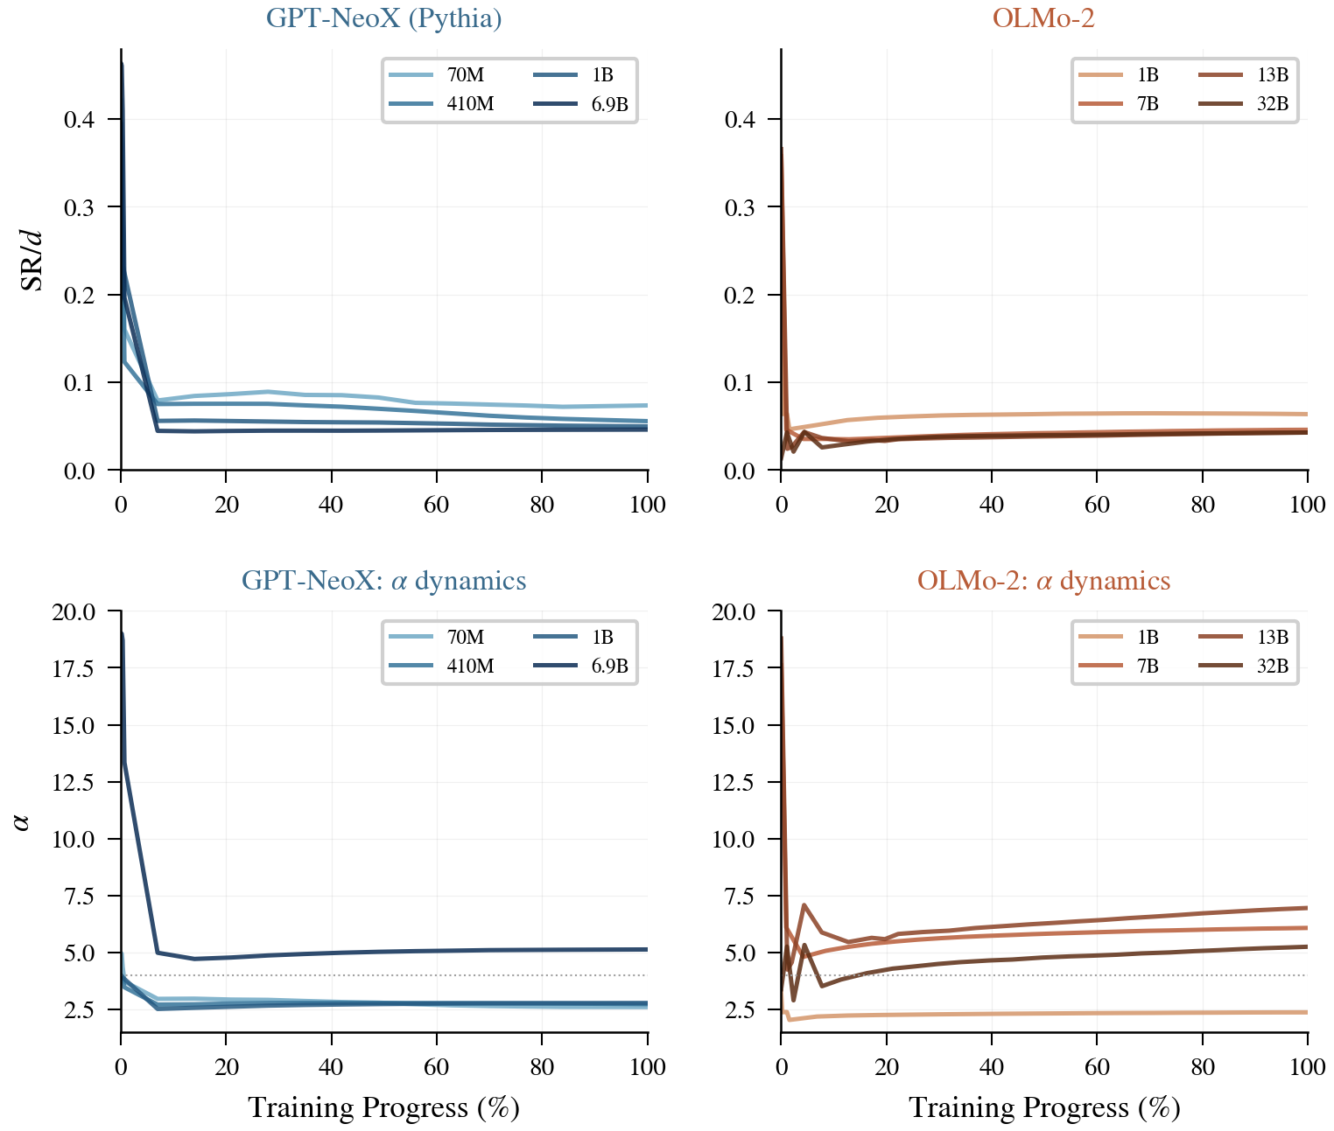
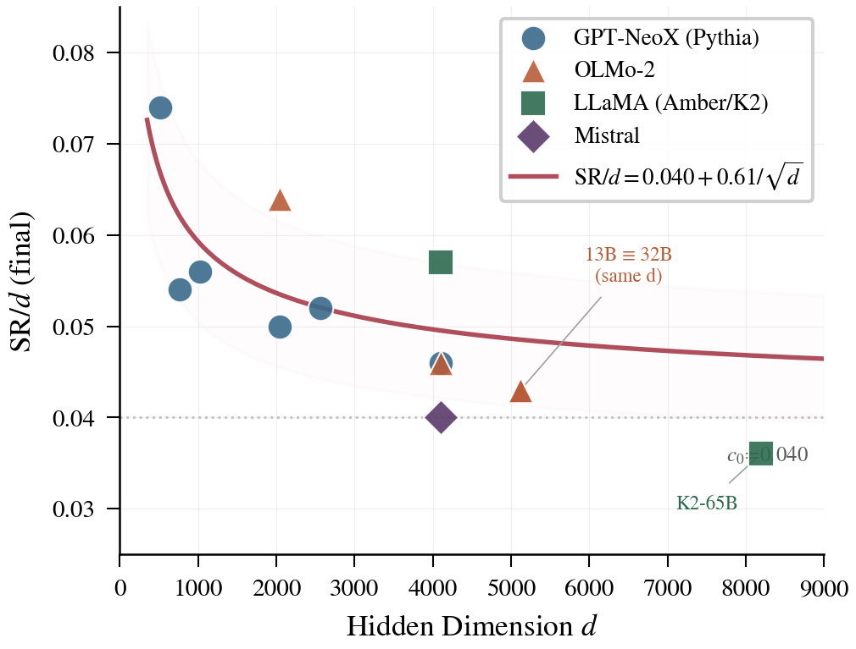
Cross-Architecture Validation
Cross-Architecture Validation
GPT-NeoX (Pythia)
OLMo-2
Mistral (GQA)
6 scales, 150 ckpts
4 scales, 100 ckpts
v0.1 + v0.3, Δα < 0.02
18 / 37

Slide 19
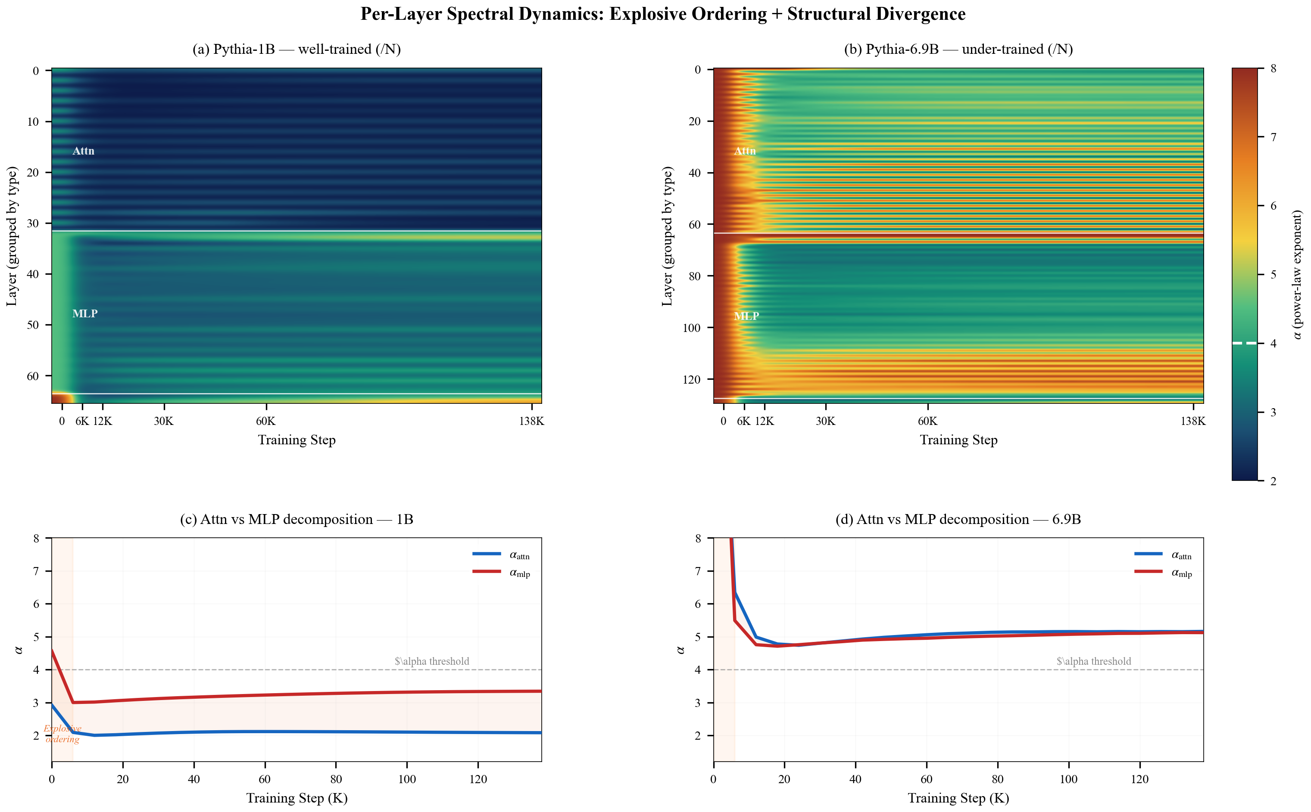
Spectral Structure Heatmap
Per-Layer Spectral Dynamics
Nearly all structural ordering occurs in the "burst phase" (steps 0 → 6K); the subsequent 132K steps produce negligible spectral change
Attention layers (blue arrows) α values consistently lower than MLP layers (red arrows)
Per-layer α heatmaps of Pythia-1B (top) and Pythia-6.9B (bottom) across 24 training checkpoints α heatmap
19 / 37

Slide 20
PART IV
Practical Value
Practical Applications for Pretraining Engineers
20 / 37

Slide 21
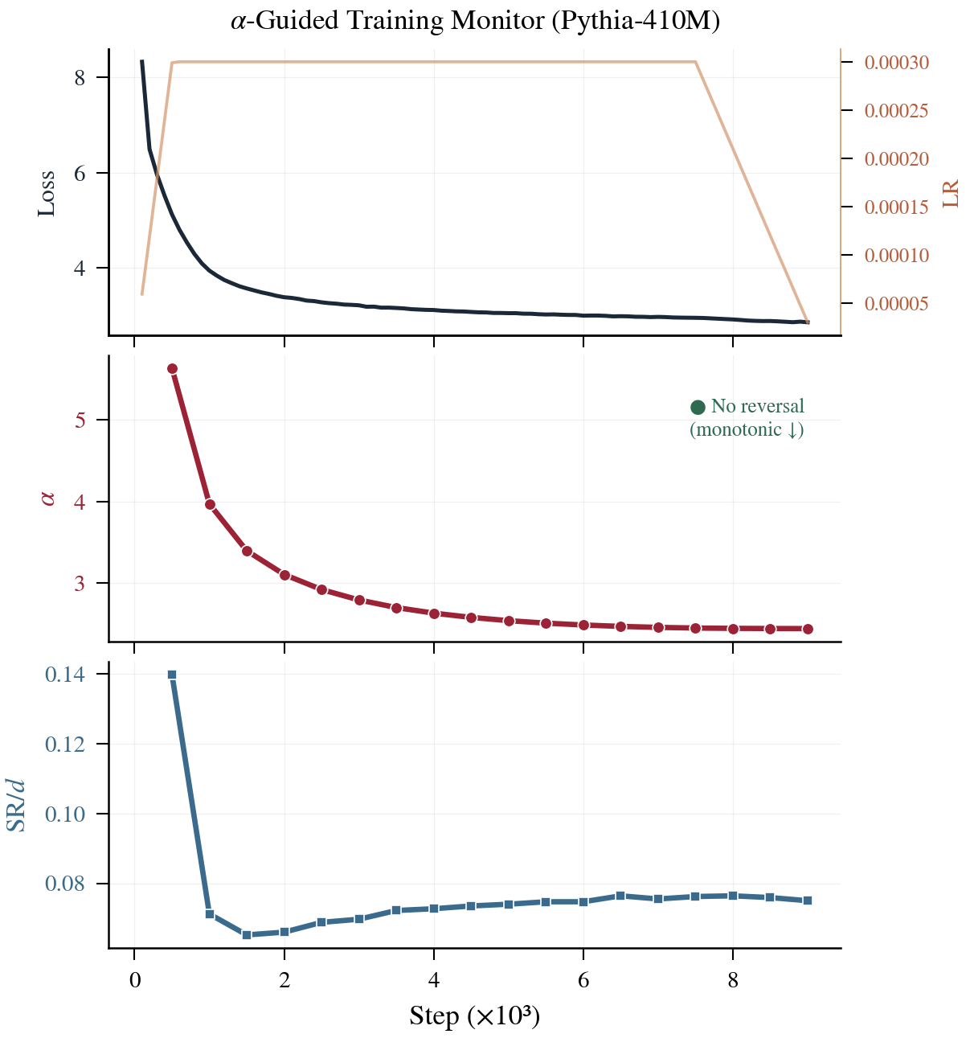
Training Monitoring Dashboard
Health Monitoring Dashboard
🟢 HEALTHY
dα/dt < 0 → Continue training
🟡 PLATEAU
|dα/dt| ≈ 0 → Consider decay
🔴 REVERSAL
dα/dt > 0 ×3 → Decay LR immediately
⚫ EXHAUSTED
α > 4 + ↑ → Needs more capacity
Cost: < 0.05% training compute
21 / 37

Slide 22
Post-hoc Model Health Check
5-Minute Model Audit
Case Study: K2-65B Diagnosis
Full Model Audit Table
SR/d | 0.036 | Below target
α | 5.09 | Immature
Reversal | Δα = +0.65 | Degraded
Model | SR/d | α | Verdict
Pythia-1B | 0.050 | 2.78 | ✅ Mature
OLMo-2-1B | 0.064 | 2.37 | ✅ Mature
OLMo-2-13B | 0.043 | 6.95 | ❌ Immature
OLMo-2-32B | 0.043 | 5.25 | ⚠️ Immature
K2-65B | 0.036 | 5.09 | ❌ Severely undertrained
Diagnosis: Undertrained (only 1.4T tokens, D/N=21)
External validation: K2 underperforms on 15/21 benchmark vs. Llama-2-70B
5-min measurement = days of benchmark evaluation
22 / 37

Slide 23
Recommendations for Pretraining
Actionable Recommendations
Rec 1: Avoid Cosine
Rec 2: Train Far Beyond Chinchilla
Rec 3: Focus on MLP Capacity
Cosine decays LR too early , wasting the "structural formation golden period".
WSD or α-Guided keeps high LR until 74-83% → benchmark +2-2.6%
Structural maturity requires 15-25× Chinchilla recommended amount 1B: ~300B tokens 7B: ~3.5T tokens 13B: far beyond 5T tokens
In large models, Attn is structured, MLP is the bottleneck (gap up to 5.4) → Wider FFN / MoE to increase MLP capacity
Summary: Pre-release 5-min spectral check — SR/d close to 0.040 + 0.61/√d and α < 4 → well trained
23 / 37

Slide 24
Comparison with Existing Methods
Comparison with Existing Methods
Capability | Loss | WeightWatcher | Scaling Laws | Ours
Real-time monitoring | ✓ | ✗ (post-hoc) | ✗ | ✓
Cross-model comparable | ✗ | ✓ | ✗ | ✓
Detect structural degradation | ✗ | ✗ | ✗ | ✓ (α reversal)
Predict downstream perf. | ✗ | Partial (r~0.7) | Loss only | ρ=-0.90, R²=0.84
Guide training decisions | ✗ | ✗ | Data amount only | ✓ (+2.56% @1B)
Overhead | 0 | Minutes | 0 | <0.05% compute
First to upgrade post-hoc spectral analysis into a real-time training guidance tool, surpassing all baselines in prediction accuracy and actionability
24 / 37

Slide 25
Theoretical Foundation
Theoretical Foundation
Information-Theoretic Identity
Wedin Subspace Stability
SR(W) = exp(H₂) = 1 / Σ pᵢ² where pᵢ = σᵢ² / ||W||²F
||sinΘ(Uk, U'k)|| ≤ η·||∇L|| / γk(W)
α-guided reduces η when γk shrinks → minimizes subspace rotation
SNR Explanation of α Reversal
SNR(t) = ||E[∇L]||² / Var[∇L] α reversal ⟺ SNR(t) < 1
Langevin Dynamics
SGD = gradient descent + effective temperature diffusion: dσᵢ = -η ∂L/∂σᵢ dt + √(2ηTeff) dBᵢ Higher Teff → spectrum blurs → α ↑
Reducing η makes noise ∝ η² ↓ → restores SNR > 1
25 / 37

Slide 26
Summary & Contributions
Summary
Four Levels of Contribution
Descriptive: SR/d universal convergence + α reversal
Predictive: Predicts 84% downstream variance from weights alone
Prescriptive: α-guided +2.56% @ 1B
Diagnostic: 5 min post-hoc model audit
14
4
Models
Architectures
~340
930×
Scientific Significance
Checkpoints
Scale Range
Universal compression law: ΔH₂ ≈ -2 nats
Structural phase transition: N ≈ 1.7B threshold
Loss ≠ Quality direct evidence
SR = exp(H₂) rigorous bridge
26 / 37

Slide 27
Thank You
Beyond Loss Curves: Spectral Monitoring for LLM Pretraining
From weight matrix spectra alone: diagnose training health, predict downstream performance, guide LR decisions—at <0.05% training compute
27 / 37

Slide 28
PART V
MoE Extension
Do the Spectral Laws Hold for Mixture-of-Experts?
28 / 37

Slide 29
MoE Extension: Experiment Design
OLMoE-1B-7B
Motivation
Phased Roadmap
Dense spectral laws (SR/$d$, α) are validated.
Do they transfer to sparse experts, where each token sees only top-k of N experts?
Phase 0 Proof of concept
✓ DONE
OLMoE loads, fused-expert tensors handled
Phase 1 Training dynamics
✓ DONE
Model: allenai/OLMoE-1B-7B-0924
6.9B total · 1.3B active · 64 experts · top-8
d=2048 · intermediate=1024 · 16 MoE layers
10 checkpoints, step 5K → 1.22M (≈1.2T tokens)
10 checkpoints measured (57 min, CPU)
Phase 2 Cross-model
✓ DONE
Mixtral + Phi-3.5-MoE: α scales with expert width
What we measure
Per-expert α & SR/$d$ · Router SR/$d$ · EPR (energy
equipartition) · ψ order parameter · cross-expert alignment
Phase 3 Architecture
PLANNED
Shared vs routed experts
29 / 37

Slide 30
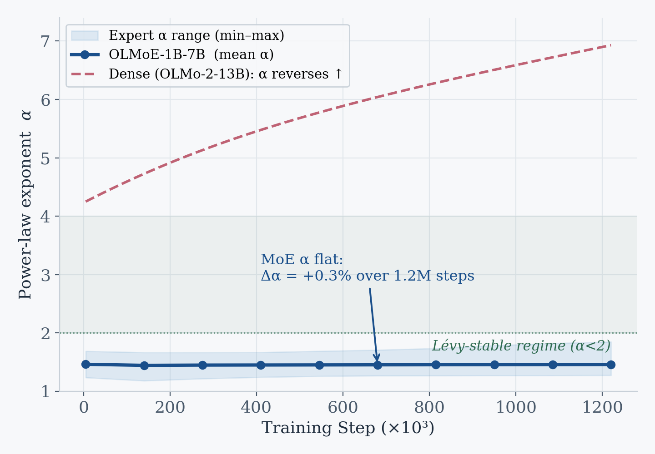
Finding A: MoE α Never Reverses
Structural Stability
Expert α stays at 1.44–1.46 for the entire run
Δα = +0.3% over 1.2M steps — no phase transition
Dense models reverse (OLMo-2-13B: Δα=+2.71);
MoE experts are born in the Lévy regime (α<2)
MoE experts are “born solid”: structure is fixed at init,
training only rotates it — α-reversal early warning does not apply.
30 / 37

Slide 31
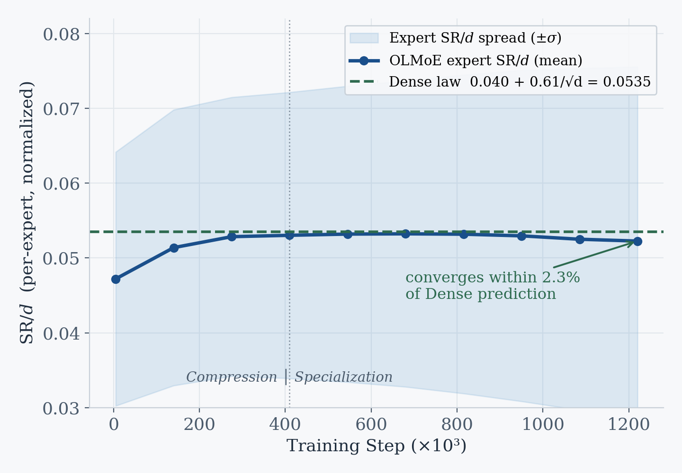
Finding B: SR/d Obeys the Dense Law
Cross-Architecture Universality
0.040 + 0.61/√d = 0.0535
Per-expert SR/$d$ converges to 0.052
within 2.3% of the Dense prediction (d=2048)
Two phases: compression (→410K) then
specialization (slow decline + rising spread)
The universal compression law is architecture-agnostic —
it holds per-expert, not just for dense matrices.
31 / 37

Slide 32
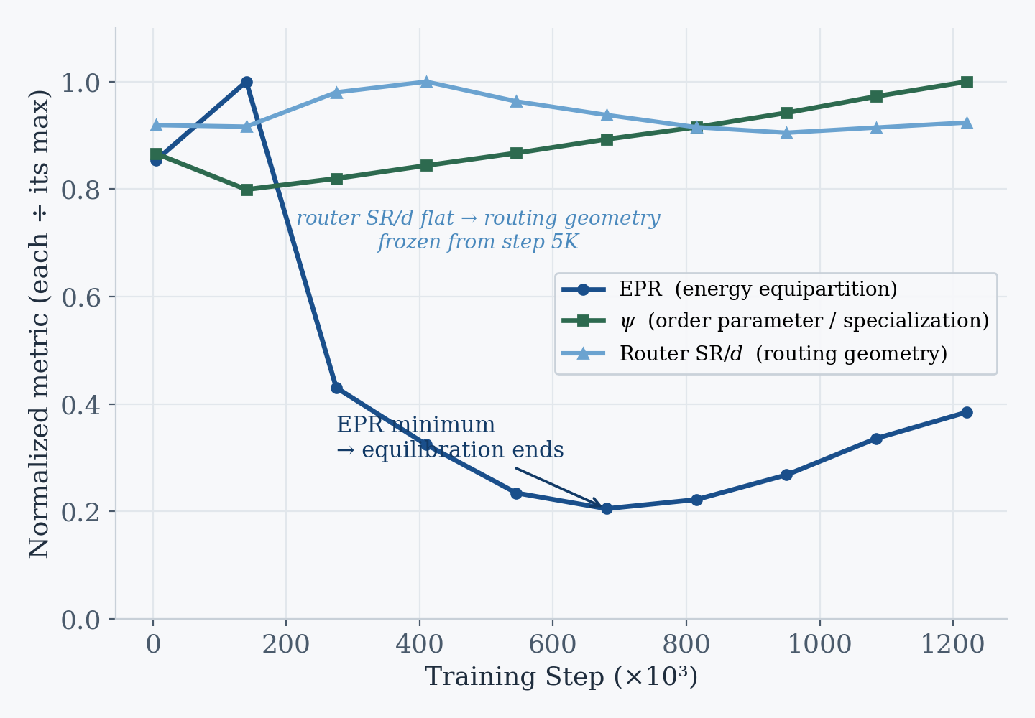
Finding C: EPR & ψ Track Specialization
Two-Phase Dynamics
EPR U-curve: equilibration → specialization
ψ rises +15%: experts sharpen their main
singular direction (functional specialization)
Router SR/$d$ frozen from step 5K — routing
geometry fixed extremely early
With α flat, EPR is the sensitive health signal
for MoE — monitor it, not α, for expert collapse.
32 / 37

Slide 33
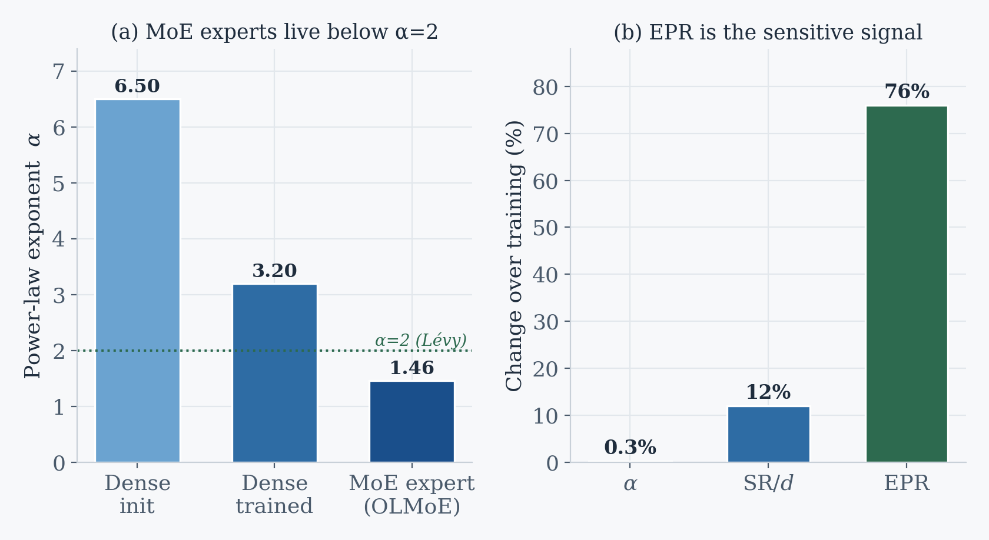
Finding D: MoE vs Dense Contrast
Summary of Differences
Dense: α drops 6.5→3.2 then reverses
MoE: α flat at 1.46 (below Lévy α=2)
Dynamic range: α 0.3% · SR/$d$ 12% · EPR 76%
First per-expert α measurement reported —
fills a clear gap in the HT-SR literature
MoE training is a different regime: no relaxation,
ballistic SR/d convergence (β=1.85), info-bottleneck α.
33 / 37

Slide 34
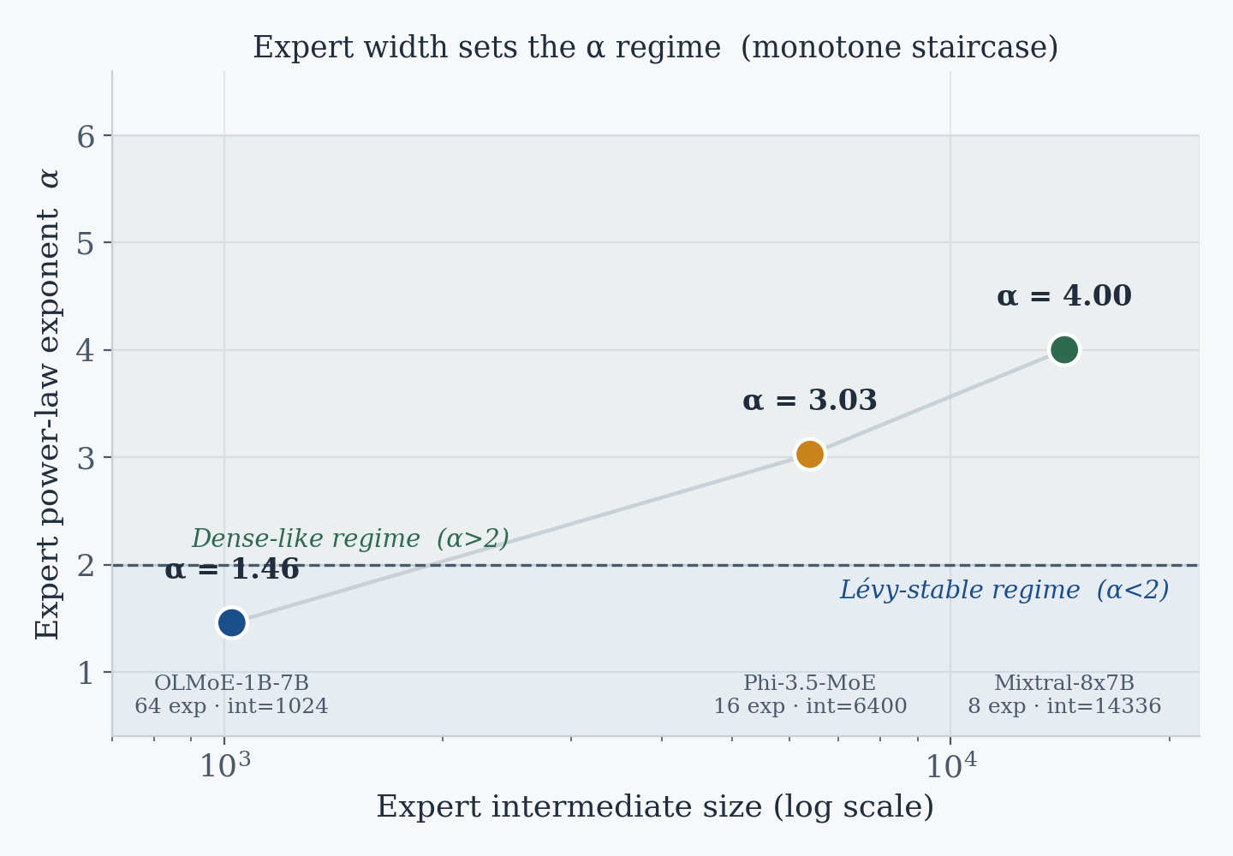
Finding E: Expert Width Sets the α Regime
Phase 2 · Cross-Model
int 1024 → 6400 → 14336 ⇒ α 1.46 → 3.03 → 4.00
Three models form a clean monotone staircase
OLMoE int=1024 → α=1.46 (Lévy)
Phi-3.5 int=6400 → α=3.03 (transition)
Mixtral int=14336 → α=4.00 (Dense-like)
Set by per-expert width, not total model size
α<2 in MoE is an information-bottleneck effect,
not over-fitting — narrow experts force a heavy tail.
34 / 37

Slide 35
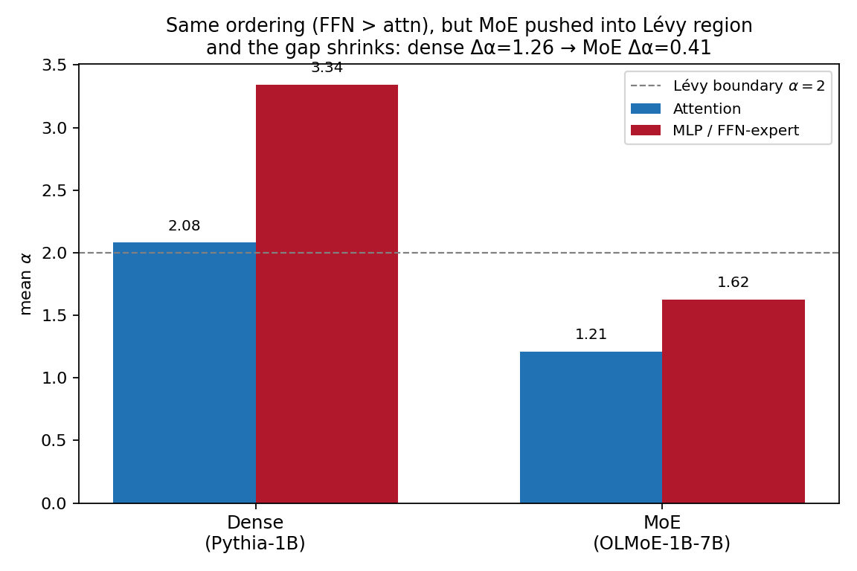
Finding F: Same Ordering, Lévy-Shifted
Per-Layer Breakdown
FFN > attn in BOTH; gap Δα 1.26 → 0.41
Ordering is preserved: FFN α > attn α in both
(dense MLP 3.34 > attn 2.08; MoE 1.62 > 1.21)
But MoE pushes every component below α=2
and shrinks the attn–FFN gap (1.26 → 0.41)
Within attn: q/k (α≈1.1) < v/o (α≈1.27)
MoE doesn’t reverse the hierarchy — it compresses
everything into the heavy-tailed Lévy regime.
35 / 37

Slide 36
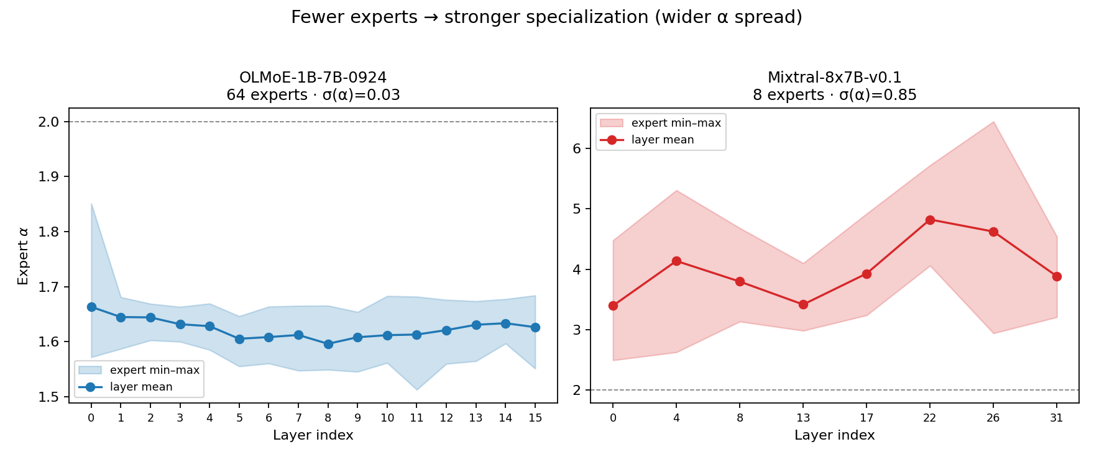
Finding G: Fewer Experts, More Specialized
Per-Expert Divergence
OLMoE σ(α)=0.02 vs Mixtral σ(α)=0.85
OLMoE (64 experts): experts near-identical
spectra — fine-grained MoE homogenizes
Mixtral (8 experts): α spans 2.5–6.5 —
coarse MoE drives strong specialization
Mixtral FFN α rises with depth (→6), like dense
Expert granularity is a specialization knob:
few wide experts diverge, many narrow ones converge.
36 / 37

Slide 37
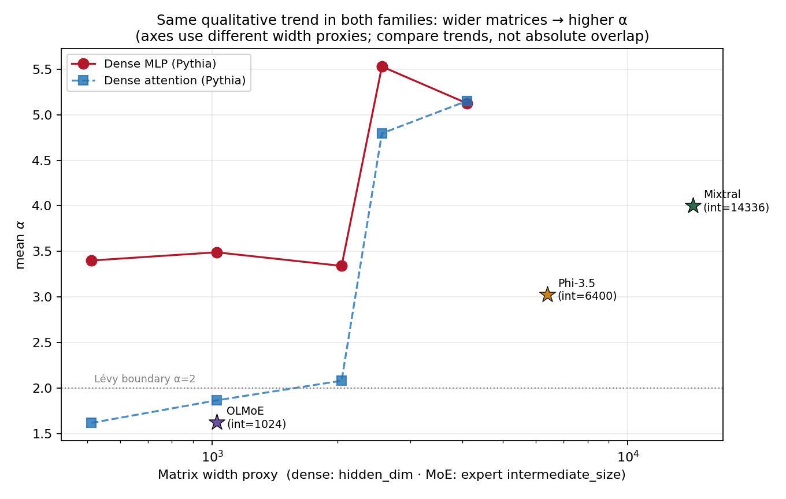
Finding H: Width Sets the α Regime — Universally
Dense + MoE Unified
narrow matrix → Lévy (α<2) · wide matrix → α 4–5
Same trend in both families: wider → higher α
Dense Pythia: hidden 512→4096 ⇒ attn α 1.6→5.2
MoE: expert int 1024→14336 ⇒ α 1.46→4.00
α<2 is not MoE-specific — small dense
models’ attention is heavy-tailed too
The α regime is set by per-matrix width,
not by MoE vs dense — a single unifying knob.
37 / 37

