Slide 1
CAPSTONE 2 PRESENTATION
TITLE:
Understanding guests’ Trust towards Airbnb Host Through Topic Modeling
PRESENTED BY:
CHOONG KAH MANN (TP053986)

Slide 2
CAPSTONE
TITLE
Understanding guests’ Trust towards Airbnb Host Through Topic Modeling

Slide 3
INTRODUCTION
Sharing-accommodation was introduced and popularized by Airbnb in 2008.
The success of sharing accommodation depends heavily on the feeling of trust from both the hosts and guests.
The feeling of trust between the hosts and guests that both parties will adhere to the regulations and fulfil their promises.

Slide 4

Airbnb has implemented a rating system that will allow both the guests and hosts to review each other after the stay (Two-way review system).
Resulted in a positive bias in the reviews of Airbnb.
Rating system’s reliability is questioned as the guests may deem the reviews to be lacking in honesty and transparency.
SAFETY AND CREDIBILITY
ISSUES

Slide 5
Company lose market share as guests begin to question the company’s main source of credibility, which is the review system.
Over reliant on the review system in improving trustworthiness is not sufficient to establish trust among consumers.
Airbnb hosts’ profile may act as a complement to the review system to generate customers’ trust towards the host and the company
PROBLEM STATEMENT

Slide 6

WHY HOST PROFILES?
Lack of research conducted on customers’ trust towards Airbnb and the hosts.
The risk and stakes involved for Airbnb is much higher.
Past research conducted on e-Commerce sites/other online platforms cannot be applied to Airbnb.
It is natural for people to seek out information to lower the feeling of uncertainty that often leads to distrust.
With the credibility of the review system in doubt, the next best source of information is the Airbnb hosts’ profile.

Slide 7
RESEARCH OBJECTIVES
1
2
3
The current project aims to produce an analytical model that analyses the impact of the Airbnb hosts’ profile on their perceived trustworthiness. In order to fulfil the aim above, the following objectives must be achieved. The objectives are:
To perform an in-depth analysis on Airbnb hosts profiles and its’ impact on trustworthiness through topic modelling and regression methods.
To provide recommendations on ways to improve Airbnb hosts profiles to increase trustworthiness of Airbnb hosts.

Slide 8
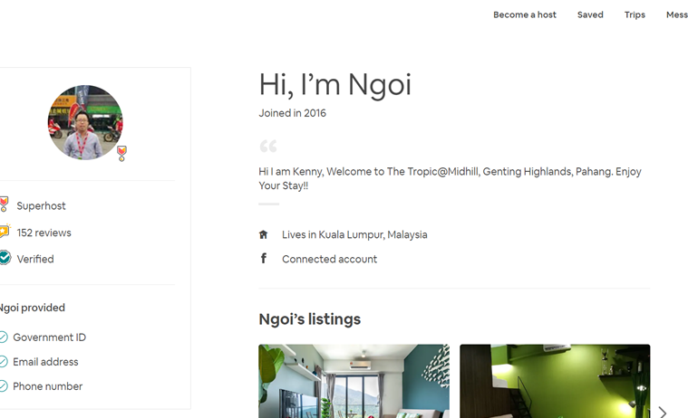
HOW TO EVALUATE THE PROFILES?
THAT’s WHY!
The study on online dating profiles by Hancock, Toma, and Ellison (2007) suggested that providing more information on their profile tend to be deemed as more trustworthy in the eyes of the customers.
Several studies conducted on e-commerce found out that more detailed and longer descriptions of items are often associated with higher sales volume.
Providing more personal information and writing longer self-introductions on their profile may help reduce the uncertainty felt by potential customers.
Airbnb hosts’ profile contains information such as a profile picture, host status, number of reviews, contact details, and a short introductory section.

Slide 9
HOW TO EVALUATE THE PROFILES? (CONTINUE)
THAT’s WHY!
Verification items that hosts provide on their profile may also serve as a tool to reduce the sense of uncertainty by many potential guests.
Verifications are items to validate the hosts’ identity, which includes the hosts’ identification number, phone number, email address, or social media handles.
By providing more verification items, it conveys the message that the hosts’ identity is authentic and do exist in real life. And the willingness to provide their identity also indicate that the host is willing to be held accountable for their actions
Studies reported that individuals are more likely to deem individuals similar to themselves in terms of values, personality, and appearance as more trustworthy (Ma et al., 2017).
Therefore, it is possible that the type of topics mentioned in the hosts’ self-introduction influence the level of trustworthiness projected to the viewers.

Slide 10
PROXY TO MEASURE PERCEIVED TRUSTWORTHINESS
It is still important to note that the actual trustworthiness of the Airbnb hosts cannot be possibly measured.
The feeling of trust that the guests have developed towards the hosts remains as a perception formed purely by the guests’ personal judgment.
Many past researches on e-commerce have made used of proxies in order to measure the perceived trustworthiness of online sellers by using information such as sales volume or revenue (Filieri, 2016). This type of method was used based on the assumptions that the feeling of trust must occur before any transaction can occur in such online platforms.

Slide 11
PROXY TO MEASURE PERCEIVED TRUSTWORTHINESS (CONTINUE)
It is logical to presume that the Airbnb guests have made a judgment on the hosts’ character based on the host’s profile and have chosen to trust the host will deliver the promised standards of services before making the decision to reserve their listing.
However, Airbnb has not made the number of bookings of each host publicly available to other users.
In order to overcome this issue, an estimation of the number of bookings may be made from the number of reviews that each host has received.
To ensure that there will not be a bias towards the older hosts, it may be better to monitor the number of new reviews that each selected host have received over a period of time.

Slide 12
SCOPE
The current project limits the scope of analysis to only Airbnb hosts within Malaysia. Considering that trust formation may be different for different countries due to cultural differences (Hallikainen and Laukkanen, 2018; Hofstede, 1980), the current project chose one location to minimize the potential noise in the data. Furthermore, the focus of the current project is the impact Airbnb hosts profile and its’ potential influence on guests’ trust formation. Therefore, extraneous factors that may influence the results such as location, amenities, types of accommodation, and type of hosts are controlled and made constant for all the chosen hosts. In other words, all chosen hosts in the current project provide basic amenities such as heater, Wifi, and air-conditioning. Besides, the type of accommodation is also controlled to only hosts that are renting out an entire apartment or house. Finally, to monitor the growth in number of bookings, 300 hosts from all parts of Malaysia are monitored for 5 months.

Slide 13

SCOPE I
Data that records the various elements of the Airbnb host profile like host name, contact details, and number of reviews, is needed. As such information is available online, the current project has used text mining technique to obtain the data from the online platform of Airbnb.
Current project has used Python programming language to perform tasks from data collection, data pre-processing, and data modelling.
DATASET AND DATA COLLECTION TOOLS

Slide 14

SCOPE II
Contractions expansion (“isn’t” to “is not”)
Conversion to lowercase
Symbols replacement (“&” to “and”)
Remove punctuation
Numbers replacement (“8” to “eight”)
DATA PRE-PROCESSING STEPS

Slide 15
SCOPE III
Tukey (1997) definition for outliers is adhered. Specifically, datapoints that are outside of the 1.5 interquartile range are deemed as outliers. To ensure that the outliers do not affect the data models, the outliers are treated with capping method.
Capping is the replacement of the outliers with the values at the both extremes of the 1.5 interquartile range, which are the 1st and 95th quartile.
OUTLIERS TREATMENT

Slide 16

SCOPE IV
Pre-processing of categorical variables begins with binning the continuous variable to form a binary variable. As the current project has framed the model as a classification model, the continuous variable is grouped to form a binary variable through binning. The mean of the variable is used as the cut-off point to split the variable.
Categorical variable with multiple variables is split into individual columns through one-hot encoding. One hot encoding is chosen because label encoding is more suited for ordinal variable where the order of the levels conveys some information.
FEATURE ENGINEERING

Slide 17
SCOPE V
Bracket removal
Tokenization
Lemmatization
Term-document matrix generation
TEXTUAL DATA PRE-PROCESSING

Slide 18
MODELING TECHNIQUES
LATENT DIRICHLET ALLOCATION (LDA)
LOGISTIC REGRESSION
MODEL SELECTION AND EVALUATION METRICS
Model perplexity
Log-likelihood
Accuracy
ROC score
Sensitivity and Specificity

Slide 19
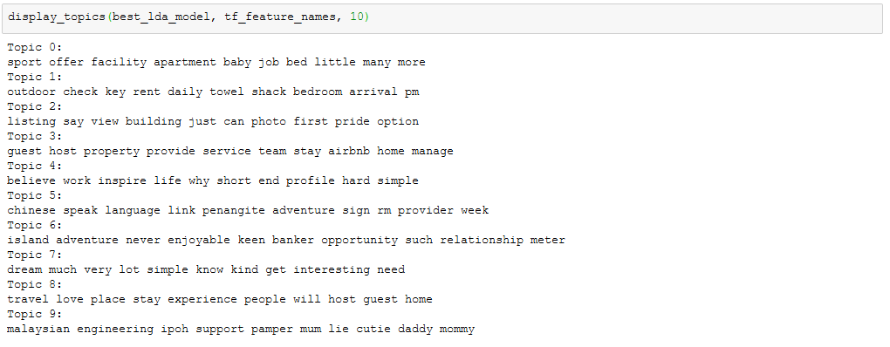
LDA Models (Baseline & Grid-search)
MODEL | Number of topics | Learning rate | Model perplexity | Log-likelihood
1 (Baseline) | 20 | - | 320.6 | -47805.96
2 (Grid Search) | 10 | 0.7 | 177.05 | -10707.20
The best performing learning rate and number of topics have been displayed. The model perplexity and log-likelihood score have also been significantly improved from the baseline model. The table above summarizes the model perplexity and log-likelihood of the two models.

Slide 20
Regression models (Baseline & LASSO)
It appears that the regularized model obtained more improvement in terms of accuracy, precision, and ROC but has slightly reduced recall. In this case, it may indicate that the regularized model has slightly reduced ability to detect all the relevant cases. However, the cases that have been detected have increased accuracy in terms of predicting the correct class. Likewise, the ROC of the regularized model is higher in comparison to the baseline model.
 | Dataset | Accuracy | Precision | Recall | ROC
Baseline | Train Test | 53.46 53.33 | 54.75 54.43 | 58.12 60.85 | 53.49 52.92
Grid Search | Train Test | 56.80 60.00 | 58.94 69.57 | 55.96 48.49 | 56.84 61.28

Slide 21
RESULT & ANALYSIS

Slide 22
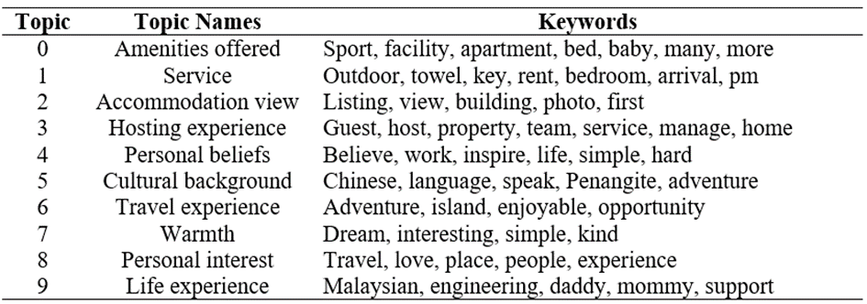
RESULT & ANALYSIS
The topics mentioned by the Airbnb hosts can be divided into two main categories:
accommodation-related topics
their personal stories
Also a type of Airbnb hosts that are different from the private hosts. These hosts are different as they typically have several listings on the platform which are professionally managed by a group of hosts. Furthermore, this type of hosts usually highlights their hosting experience and wide variety of property type, which is more similar to hotels than Airbnb.
Such points are considered attractive as Airbnb is deemed to be less than hotel because the guests are often required to make their own check-ins and arrange their own transportation to the accommodation. By making such service available, it makes Airbnb appear to be an alternative to hotels with a much more competitive price tag.
Another group of Airbnb hosts who discuss about personal related issues typically mention about their occupation, personality, interest, and cultural background. For these groups of Airbnb hosts, topics such as their previous travel experience, languages they speak, as well as their personal beliefs were usually mentioned.

Slide 23
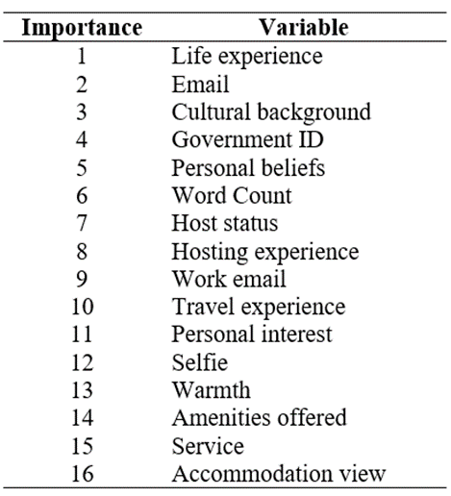
RESULT & ANALYSIS (CONTINUE)
It is clear that certain topics in the Airbnb host’s self introduction plays an important role in the subsequent growth in number of reviews.
Out of the 5 most important variables, 3 of the variables are the type of topics mentioned in the Airbnb hosts’ self introduction while the remaining 2 are email and government ID.
All 5 of the most important variables have shown negative coefficient. In this case, the presence of these variables make the likelihood of the host receiving higher number of reviews less likely.
the variables that may increase the likelihood of the host receiving higher number of reviews are variable 6 onwards in the below table.
Surprisingly, the topics about amenities, accommodation, and service available along with the accommodation have the least amount of importance in terms of predicting the Airbnb hosts’ likelihood to receive high number of reviews.

Slide 24
DISCUSSION

Slide 25
DISCUSSION
Findings above is somewhat different from what was suggested in the research. According to past studies on e-commerce and online profiles, more information provided is often associated with higher perceived trustworthiness (Hancock, Toma, and Ellison, 2007).
It is unexpected to see that such verification items have negative impact on the growth of the Airbnb hosts’ new reviews. Despite having lesser importance, Airbnb hosts that provide a personal photo are more likely to have higher number of new reviews.
Such contradicting findings resonates with research evidence that suggests that individuals often trust people that they can relate to or are similar to them (Koh, Li, Livan, and Capra, 2019).
In fact, some studies have also suggested that having information such as pictures or videos can increase the social presence that is often lacking in most sharing accommodation. In turn, the increased presence can improve the level of perceived trustworthiness of the hosts (Hassanein et al, 2009).
This has also contradicted the general perception that the guests make their purchase decision on the accommodation-related factors. Considering the findings above, it is important for the hosts to also allocate their attention in their profiles as well as the self-introduction.

Slide 26
RECOMMENDATIONS

Slide 27
RECOMMENDATIONS
Not all type of topics can have a favorable effect in encouraging the formation of trust among the potential guests.
The list of topics that have a negative impact are:
Life experience
Personal beliefs
Cultural background
Meanwhile, the type of topics that were found to have a positive impact on the likelihood of the Airbnb hosts receiving high amount of new reviews are:
Hosting experience
Travel experience
Personal interest
Warmth
Amenities offered
Service
Accommodation view
The guests may interpret wide experience in hosting and travelling may positively contribute to the hosts’ abilities in creating hospitable environment for the guests
The word count is also found to be relatively important in predicting the likelihood of the hosts receiving high number of new reviews. Particularly, higher number of word count was found to increase the likelihood of the hosts receiving higher number of new reviews.
findings above have suggested that disclosing more information is not entirely helpful. Rather, disclosing more on the right type of information is the key in encouraging the level of perceived trustworthiness among the guests.

Slide 28
LIMITATIONS AND FUTURE IMPLICATIONS

Slide 29
Limitations and future implications
1
2
3
Regression model has produced interesting findings where the model has shown better performance on the testing dataset.
Although unusual, this pattern has been associated with underfitting (Van der Aalst et al., 2010).
Underfitting occurs when the model is unable to capture the amount of variance within the dataset.
Study by Li and Duan (2009) have suggested a penalty method to overcome underfitting, which is a method that is similar to regularization.
Alternatively, the early stopping method introduced by Pretchelt (1999) can also be used as a measure to overcome the issue of underfitting. The early stopping method involves the usage of a subset of the training dataset to identify the best number of learning iterations that produces best performance

Slide 30
Limitations and future implications
4
5
6
There may be several ways where future research can extend on the current project to yield more findings.
For instance, the current project did not include the guests’ cultural background and personality. In this case, guests from different cultural backgrounds or have different personality characteristics may tend to evaluate others’ trustworthiness differently.
Furthermore, the findings can also be further extended by including the properties of the pictures provided on the profile such as the gender or facial expression on the subsequent level of trustworthiness can also be analyzed.

Slide 31
THANKS
Does anyone have any questions?

