Slide 1
Beanbag: Operation-based Synchronization with Intra-Relation Support
Yingfei Xiong
Ph.D. Student
University of Tokyo

Slide 2
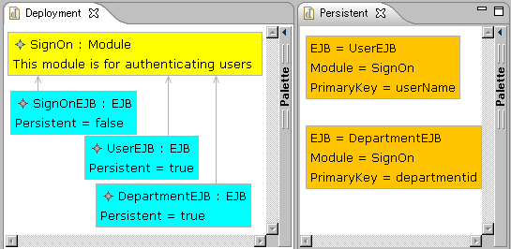
Example: An EJB Modeling Application (Enterprise JavaBeans)

Slide 3
Inter-Relations on Data
Equal
Equal

Slide 4
Inter-Relations on Data
User
User

Slide 5
Intra-relations on data
Dependent
Equal

Slide 6
Intra-relations on data
SignModule
SignModule

Slide 7
Intra-relation and bidirectional transformation
bidirectional
transformation
A
Related
X
Containtment
MOF
B
Related
Y
How many roundtrips are needed is unknown.

Slide 8
Intra-Relations Call for Operation-based Synchronization
?
SignOn
SignModule

Slide 9
Intra-Relations Call for Operation-based Synchronization
SignModule

Slide 10
Intra-Relations Have Mutual Effect with Inter-Relations

Slide 11
Intra-Relations Has Mutual Effect with Inter-Relations
SignModule
SignModule
SignModule

Slide 12
Intra-Relations Has Mutual Effect with Inter-Relations
Equal
Equal
Equal

Slide 13
Intra-Relations often Lead to Multiple Choices

Slide 14
Intra-Relations often Lead to Multiple Choices

Slide 15
Intra-Relations often Lead to Multiple Choices

Slide 16
Intra-Relations often Lead to Multiple Choices
false

Slide 17

Our Contribution: Beanbag
Beanbag is a new language for operation-based synchronization with intra-relations.
Beanbag(お手玉，沙包) is also a traditional Asian game for keeping several beanbags consistent
The picture is obtained from www.city.kodaira.tokyo.jp
Notes:
time limit – on site

Slide 18
An Overview of Beanbag
Users
Updates
Synchronizer
Compile
------------
------------
------------
------------
Application Data
Beanbag Program
Updates
Notes:
after this show EJB again

Slide 19
Features of Beanbag
Users
Operation-based Synchronization with no propagation direction imposed
Intra-relations and inter-relations are captured in a unified way
Updates
Synchronizer
Compile
------------
------------
------------
------------
Application Data
Beanbag Program
Updates
Allow fine control over synchronization behavior
Notes:
after this show EJB again

Slide 20
Beanbag Program for the EJB
main(ejbs, modules, entitybeans) {
containmentRefs<attr="Module">(ejbs, modules);
for [ejb, entitybean] in [ejbs, entitybeans] {
persistent(ejb, entitybean, modules) |
nonPersistent(ejb, entitybean) |
{ejb = null; entitybean = null}
}
}
Notes:
change to the new version

Slide 21
Beanbag Program for the EJB
persistent(ejb, entitybean, modules) {
var moduleRef, moduleName, module;
ejb."Persistent" = true;
entitybean."EJBName" = ejb."Name";
moduleRef = ejb."Module";
!modules.moduleRef = module;
entitybean."ModuleName" = module.”Name”;
}
nonPersistent(ejb, entitybean){
ejb."Persistent" = false;
entitybean = null;
}

Slide 22
Describing Updates
Assign a unique id for each object
4
5
1
6
2
3

Slide 23
Describing Updates
Describing attribute modification
4
5
1
User
6
2
3
ejbs: {2->{“Name”->!”User”}}
modules: void
entityBeans: void

Slide 24
Describing Updates
Describing deletion
4
5
1
6
2
3
ejbs: void
modules: {4->!null}
entityBeans: void

Slide 25
Describing Updates
Describing Insertion
4
5
1
6
2
7
3
AccessRight : EJB
Persistent = true
ejbs: {7->{“Name”->!”AccessRight”,“Persistent”->!true}}
modules: void
entityBeans: void

Slide 26
An Update Propagation of EJB Tool
ejbs: {2->{“Name”->!”User”}}
modules: void
entityBeans: void
EJB Program
------------
------------
------------
------------
User
4
5
Compile
1
Synchronizer
User
2
6
3
ejbs: {2->{“Name”->!”User”}}
modules: void
entityBeans: {5->{“Name”->!”User”}}

Slide 27
Properties of Synchronization
Adapted from our previous work on state-based synchronization [Xiong07]:
Stability
Preservation
Consistency
Can be used in bidirectional situation and multidirectional situation
sync : Update^{n} -> Update^{n}

Slide 28
Stability
sync(void,…,void)=(void,…,void)
If there is no update, the synchronizer produce no update.

Slide 29
Preservation
sync(u₁…u_{n})=(u’₁,…,u’_{n})=>∀i. u_{i} ⊑u’_{i}
We cannot overwrite user updates
UserEJB
PersonEJB

Slide 30
Consistency (Propagation)
sync(u₁…u_{n})=(u’₁,…,u’_{n})=>consistent(u’₁(d₁), …,u’_{n}(d_{n}))
After updating, the data should satisfy the consistency relation
PersonEJB
PersonEJB
PersonEJB
Equal
PersonEJB

Slide 31
Review: Multiple Choices

Slide 32
Review: Multiple Choices
false

Slide 33
Beanbag Program for the EJB
main(ejbs, modules, entitybeans) {
containmentRefs<attr="Module">(ejbs, modules);
for [ejb, entitybean] in [ejbs, entitybeans] {
persistent(ejb, entitybean, modules) |
nonPersistent(ejb, entitybean) |
{ejb = null; entitybean = null}
}
}
main(ejbs, modules, entitybeans) {
containmentRefs<attr="Module">(ejbs, modules);
for [ejb, entitybean] in [ejbs, entitybeans] {
persistent(ejb, entitybean, modules) |
{ejb = null; entitybean = null} |
nonPersistent(ejb, entitybean)
}
}
Notes:
change to the new version

Slide 34
How we compile a Beanbag program
Basic relations (like a=b, a.”name”=b) | Primitive synchronizers
Gluing constructs (like conjunction “;”) | gluing their inner synchronizers into a bigger synchronizer
Consider an example:
{ var c;
c=a.”Name”;
c=b.”Name”;
}

Slide 35
c=a.“Name”
a: {“Persistent”->!true}
c: !”X”
c=a.“Name”
a: {“Persistent”->!true, “Name”->!”X”}
c: !”X”

Slide 36
c=a.“Name”
a: {“Name”->!”Y”}
c: !”X”
c=a.“Name”
Failure!

Slide 37
Conjunction
a: void
b: {“name”->!”x”}
b: {“name”->!”x”}
c: void
a: void
c: !x
{var c;
c=a.”name”;
c=b.”name”}
c=b.”name”
c=a.”name”
a: {“name”->!”x”}
b: {“name”->!”x”}
b: {“name”->!”x”} c: !”x”
a: {“name”->!”x”} c: !”x”

Slide 38
Disjunction
a: !”y”
a: !”y”
a: !”y”
{a=“x” | a=“y”}
a=“x”
a=“y”
a: !”y”
Failure!
a: !”y”

Slide 39
The “for” Statement
dictA: {1->!”x”}
dictB: {2->!”y”}
a: !”x”
b: void
a: void
b: !”y”
for [a, b] in
[dictA, dictB]
{a = b}
a=b
a=b
dictA: {1->!”x”, 2->!”y”}
dictB: {1->!”x”, 2->!”y”}
a: !”x”
b: !”x”
a: !”y”
b: !”y”
for key 1
for key 2

Slide 40
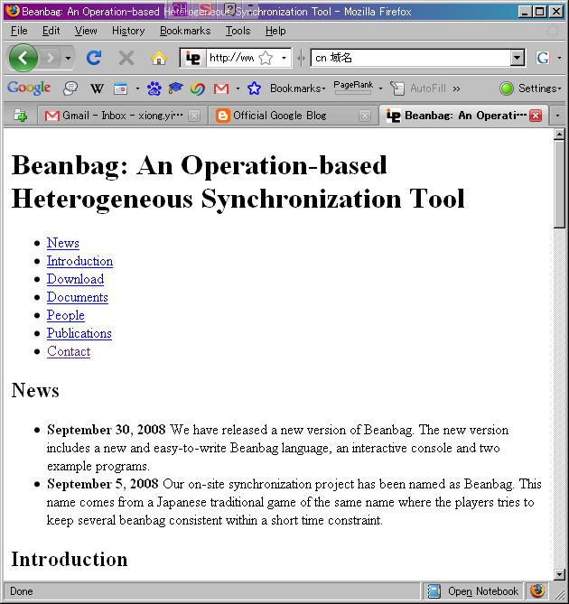
Implementation
We have implemented Beanbag in Java
We have applied Beanbag to two case studies
The implementation is published under MIT license
URL: http://www.ipl.t.u-tokyo.ac.jp/~xiong/beanbag.html

Slide 41
Experiments
QVT attribute change
QVT deletion
QVT insertion
Beanbag insertion
Beanbag attribute change
Beanbag deletion
Beanbag vs medini QVT

Slide 42
Conclusion
We propose a new language, Beanbag, to support synchronization with intra-relations
Beanbag captures inter-relations and intra-relations in a unified way
Beanbag supports operation-based synchronization with no propagation direction imposed
Beanbag allows fine control over synchronization behavior

Slide 43
Thank you for your attention!

