Slide 1
Beanbag : Support Synchronization in Software Engineering Applications
Yingfei Xiong
3rd Year Ph.D. Student
University of Tokyo

Slide 2
Beanbag : Transformation between Views in Each Phase of ABC
Yingfei Xiong
3rd Year Ph.D. Student
University of Tokyo

Slide 3
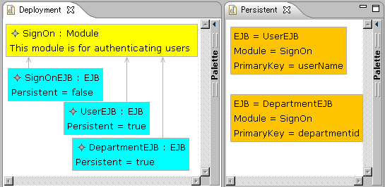
Example: An EJB Modeling Tool (Enterprise JavaBeans)
SignModule
PersonEJB
SignModule
PersonEJB
SignModule

Slide 4
Requirements
Some consistency relation exists over data
Equal
Equal

Slide 5
Requirements
When users update some parts, we need to update some other parts
PersonEJB
PersonEJB

Slide 6
Requirements(Preservation)
We cannot overwrite user updates
UserEJB
PersonEJB

Slide 7
Requirements (Consistency)
After updating, the data should satisfy the consistency relation
PersonEJB
PersonEJB
PersonEJB
Equal
PersonEJB

Slide 8
Existing Bi-Tran Approaches
Synchronizing between off-the-shelf applications
Independent of applications
Working on external copies of data
Application A
Bi-Trans
Application B
------------
------------
------------
------------
------------
------------
------------
------------
Data of
Application A
XML
XML
Data of
Application B

Slide 9
Synchronization in Software Engineering Applications
Synchronization is part of the application, and is considered from requirements.
Synchronizer is tightly integrated into the application
Synchronizer
Application
Application Data

Slide 10
Characteristics
Equal
Equal
Needs to deal with inter-relations as well as intra-relations

Slide 11
Characteristics
User
User
Needs to deal with inter-relations as well as intra-relations

Slide 12
Characteristics
Dependent
Equal
Needs to deal with inter-relations as well as intra-relations

Slide 13
Characteristics
SignModule
SignModule
Needs to deal with inter-relations as well as intra-relations

Slide 14
Characteristics
?
SignOn
SignModule
Calls for operation-based synchronization

Slide 15
Characteristics
SignModule
Calls for operation-based synchronization

Slide 16
Characteristics
Often has multiple choices in synchronization

Slide 17
Characteristics
Often has multiple choices in synchronization

Slide 18
Characteristics
Often has multiple choices in synchronization

Slide 19
Characteristics
false
Often has multiple choices in synchronization

Slide 20

Our Contribution: Beanbag
A framework supporting synchronization in software engineering applications
Beanbag(お手玉，沙包) is also a traditional Asian game for keeping several beanbags consistent
The picture is obtained from www.city.kodaira.tokyo.jp
Notes:
time limit – on site

Slide 21
An Overview of Beanbag
Users
Updates
Synchronizer
Compile
------------
------------
------------
------------
Application Data
Beanbag Program
Updates
Notes:
after this show EJB again

Slide 22
Features of Beanbag
Users
Operation-based Synchronization with no propagation direction imposed
Intra-relations and inter-relations are captured in a unified way
Updates
Synchronizer
Compile
------------
------------
------------
------------
Application Data
Beanbag Program
Updates
Allow fine control over synchronization behavior
Notes:
after this show EJB again

Slide 23
Beanbag Program for the EJB
main(ejbs, modules, entitybeans) {
containmentRefs<attr="Module">(ejbs, modules);
for [ejb, entitybean] in [ejbs, entitybeans] {
persistent(ejb, entitybean, modules) |
nonPersistent(ejb, entitybean) |
{ejb = null; entitybean = null}
}
}
Notes:
change to the new version

Slide 24
Beanbag Program for the EJB
persistent(ejb, entitybean, modules) {
var moduleRef, moduleName, module;
ejb."Persistent" = true;
entitybean."EJBName" = ejb."Name";
moduleRef = ejb."Module";
!modules.moduleRef = module;
entitybean."ModuleName" = module.”Name”;
}
nonPersistent(ejb, entitybean){
ejb."Persistent" = false;
entitybean = null;
}

Slide 25
Describing Updates
Assign a unique id for each object
4
5
1
6
2
3

Slide 26
Describing Updates
Describing attribute modification
4
5
1
User
6
2
3
ejbs: {2->{“Name”->!”User”}}
modules: void
entityBeans: void

Slide 27
Describing Updates
Describing deletion
4
5
1
6
2
3
ejbs: void
modules: {4->!null}
entityBeans: void

Slide 28
Describing Updates
Describing Insertion
4
5
1
6
2
7
3
AccessRight : EJB
Persistent = true
ejbs: {7->{“Name”->!”AccessRight”,“Persistent”->!true}}
modules: void
entityBeans: void

Slide 29
An Update Propagation of EJB Tool
ejbs: {2->{“Name”->!”User”}}
modules: void
entityBeans: void
EJB Program
------------
------------
------------
------------
User
4
5
Compile
1
Synchronizer
User
2
6
3
ejbs: {2->{“Name”->!”User”}}
modules: void
entityBeans: {5->{“Name”->!”User”}}

Slide 30
Review: Multiple Choices

Slide 31
Review: Multiple Choices
false

Slide 32
Beanbag Program for the EJB
main(ejbs, modules, entitybeans) {
containmentRefs<attr="Module">(ejbs, modules);
for [ejb, entitybean] in [ejbs, entitybeans] {
persistent(ejb, entitybean, modules) |
nonPersistent(ejb, entitybean) |
{ejb = null; entitybean = null}
}
}
main(ejbs, modules, entitybeans) {
containmentRefs<attr="Module">(ejbs, modules);
for [ejb, entitybean] in [ejbs, entitybeans] {
persistent(ejb, entitybean, modules) |
{ejb = null; entitybean = null} |
nonPersistent(ejb, entitybean)
}
}
Notes:
change to the new version

Slide 33
How we compile a Beanbag program
Basic relations (like a=b, a.”name”=b) | Primitive synchronizers
Gluing constructs (like conjunction “;”) | gluing their inner synchronizers into a bigger synchronizer
Consider an example:
{ var c;
c=a.”Name”;
c=b.”Name”;
}

Slide 34
c=a.“Name”
a: {“Persistent”->!true}
c: !”X”
c=a.“Name”
a: {“Persistent”->!true, “Name”->!”X”}
c: !”X”

Slide 35
c=a.“Name”
a: {“Name”->!”Y”}
c: !”X”
c=a.“Name”
Failure!

Slide 36
Conjunction
a: void
b: {“name”->!”x”}
b: {“name”->!”x”}
c: void
a: void
c: !x
{var c;
c=a.”name”;
c=b.”name”}
c=b.”name”
c=a.”name”
a: {“name”->!”x”}
b: {“name”->!”x”}
b: {“name”->!”x”} c: !”x”
a: {“name”->!”x”} c: !”x”

Slide 37
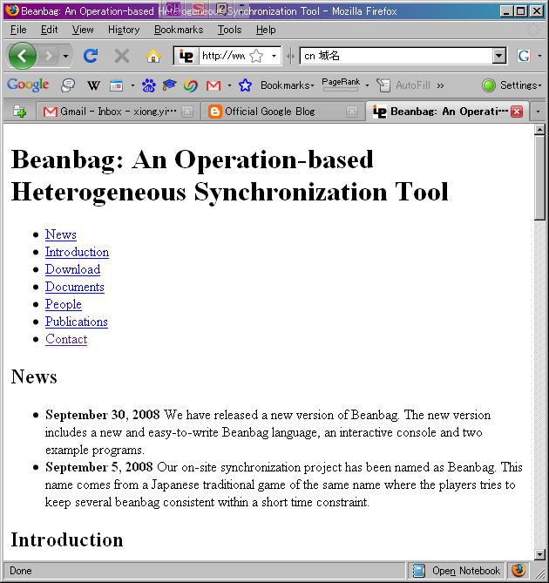
Find out more
We have implemented Beanbag in Java and published under MIT license
http://www.ipl.t.u-tokyo.ac.jp/~xiong/beanbag.html
Copies of technique reports are available in the front desk

Slide 38
Conclusion
We propose a new language, Beanbag, to support synchronization in software engineering applications
Beanbag captures inter-relations and intra-relations in a unified way
Beanbag supports operation-based synchronization with no propagation direction imposed
Beanbag allows fine control over synchronization behavior

