Slide 1
A Dynamic-Priority based Approach to Fixing Inconsistent Feature Models
Bo Wang¹, Yingfei Xiong², Zhenjiang Hu³, Haiyan Zhao¹,
Wei Zhang¹, Hong Mei¹
1. Institute of Software, Peking University (China)
2. Generative Software Development Laboratory, University of Waterloo (Canada)
2. GRACE Center, National Institute of Informatics (Japan)

Slide 2
Outline
Background & Motivation
Approach Overview
Implementation based on SkyBlue
Case Studies
Conclusion

Slide 3
Background
A Feature Model = Features + Relationships
captures the end-user’s understanding of the general capabilities of the products in a domain.
captures the common and variable requirements of the products in a domain.
Reuse the requirements
Notes:
In the first few slides, I will introduce 1) feature models and 2) inconsistency in feature models.
I think most of the participants in the workshop are not familiar with feature models.

Slide 4
Example: Mobile Phone
Mobile Phone
Legend
Optional Feature
GPS
Screen
Calls
Media
Mandatory Feature
Require
Exclude
Basic
Color
High
Resolution
Camera
MP3
Complex Constraints:
All-Group({Screen}) requires Single-Group({Basic, Color, High Resolution})
All-Group({Media}) requires Multi-Group({Camera, MP3})
From David Benavides
Notes:
Introduce the basic modeling elements of feature models.
feature; 2) Refinement Relationships; 3)Mandatory Features
4)Require Constraint; 5) Excludes Constraint
6) Composite Constraints
Purpose:
1) Give the attendants a impression of feature models.
2) Let the attendants know that feature models are complex and it may difficult to maintain the consistency of large feature models.

Slide 5
Example: A Product Configuration
√
Mobile Phone
Legend
X
√
√
√
Optional Feature
GPS
Screen
Calls
Media
Mandatory Feature
Require
Exclude
X
X
√
√
X
Basic
Color
High
Resolution
Camera
MP3
Complex Constraints:
All-Group({Screen}) requires Single-Group({Basic, Color, High Resolution})
All-Group({Media}) requires Multi-Group({Camera, MP3})
Notes:
Introduce how to reuse requirements through selecting and deselecting features.
Purpose:
Introduce the usage and importance of feature models.

Slide 6
Inconsistency in Feature Models
Inconsistency
A feature model contains inconsistencies, if the model includes contradictory information.
Inconsistency leads to the fact that no consistent product configuration can be derived from the feature model.
Notes:
Define the “Inconsistency” in our paper.

Slide 7
Example
A
B
C
D
E
F
G
An Inconsistent Feature Model
Notes:
An example to show the inconsistency in feature models.
When “c excludes d” is added into the feature model, no valid products can be derived from this feature model.

Slide 8
Motivation
It is difficult for domain engineers to fix inconsistent feature models
How to detect the inconsistency?
How to find a solution?
Is there any alternative solution?
Fixing inconsistency is especially difficult for large feature models.
Real-would feature models often grow beyond one thousand of features
The largest one reported has more than 5000 features
(Czarnecki, She, FM for the Linux Kernel)

Slide 9
Motivation
Existing feature model automatic analysis focus on
inconsistency detection.
providing reasons for the inconsistencies
Automatic support is needed to help domain engineers fix inconsistent feature models.

Slide 10
Our Approach
We propose a dynamic priority-based approach to help domain engineers fix inconsistent feature models interactively.
Dynamic priority and Interactive Fixing Process
Incremental inconsistency checking
Recommend solutions
Choose other solutions through changing priorities
(Extension of) Constraint Hierarchy Algorithm(SkyBlue)

Slide 11
Approach Overview
N
Add a Constraint (with Priority)
Check Inconsistency
Inconsistent?
Recommend a Solution
Y
Satisfied?
Use priorities to express the domain engineers’ confidence on the constraints in the feature model
Change the Priorities
Automatic Step
Manual Step
Notes:
Rotatively

Slide 12
An Example
Default Priority: 3
Root Feature
Priority 6
A
3
3
3
4
3
5
5
B
C
D
E
5
3
Add excludes between C and D
F
G
Composite Constraint:
All-Set(B) c-requires Single(F,G) Priority: 4

Slide 13
An Example
Recommended Solution:
Root Feature
Priority 6
A
Delete Constraint
“B requires C”
3
3
3
4
3
5
5
B
C
D
E
5
3
F
G
Composite Constraint:
All-Set(B) c-requires Single(F,G) Priority: 4

Slide 14
An Example
Root Feature
Priority 6
A
3
3
3
4
4
5
5
B
C
D
E
5
3
F
G
Composite Constraint:
All-Set(B) c-requires Single(F,G) Priority: 4

Slide 15
An Example
Recommended Solution:
Root Feature
Priority 6
A
Delete Constraint
“Mandatory B”
3
3
3
4
4
5
5
B
C
D
E
5
3
F
G
Composite Constraint:
All-Set(B) c-requires Single(F,G) Priority: 4

Slide 16
An Example
Root Feature
Priority 6
A
3
3
4
4
5
5
B
C
D
E
5
3
F
G
Composite Constraint:
All-Set(B) c-requires Single(F,G) Priority: 4

Slide 17
Outline
Background & Motivation
Approach Overview
Implementation based on SkyBlue
Case Studies
Conclusion

Slide 18
SkyBlue (1/3)
A constraint algorithm widely used in GUI Construction
Very efficient: Incremental Consistency Checking
Constraint Hierarchy Algorithm
Each constraint is equipped with a set of methods
Constraint：Feature A excludes Feature B
Methods：
A.bindstate := unbind
B.bindstate := unbind
Aexcludes B
Legend:
A
B
A
B
bind
Constraint Graph
unbind
Feature Model

Slide 19
SkyBlue (2/3)
SkyBlue checks the consistency by selecting a proper method for each constraint in the constraint graph.
A
Legend:
Root A
(Strongest)
bind
A
unbind
Mandatory
(Strong)
Mandatory
(Strong)
B
C
B exclude C
(Medium)
B
C
Conflict!
Conflict!
Feature Model
Constraint Graph
Notes:
Introduce the process of selecting methods for constraints.
Show the conflict during the process of selecting methods.
Introduce the LGB.
Show the link between the LGB and the PCS and CFM.

Slide 20
SkyBlue (3/3)
SkyBlue can
detect inconsistency
unenforce weaker constraints to fix inconsistency
The unenforced constraints cannot be enforced, unless their contradictory stronger constraints are deleted.
We recommend deleting the unenforced constraints to fix inconsistency in feature models.

Slide 21
Our Implementation
How to extend SkyBlue to support fixing inconsistency in feature models?
Define the methods for constraints in feature models
Revise the algorithm of selecting methods for constraints

Slide 22
Define the methods (1/2)

Slide 23
Define the methods (2/2)
All-Set(A,B) composite-excludes Alternative-Set(C,D)
Four methods:
1) {Unbind(A)}; 2){Unbind(B)};
3) {Unbind(C), Unbind(D)};
4){Bind(C), Bind(D)}

Slide 24
Outline
Background & Motivation
Basic Idea of Our Approach
Challenges in Our Approach
Case Studies
Conclusion

Slide 25
Case Study
An preliminary case study
Construct feature models for the web store domain
Five participants
identify feature, refinements, simple constraints, composite constraints
Record usage logs
the scale of feature models, the number of the detected inconsistencies, the number of the recommended solutions, ect
Investigate through questionnaires
Notes:
And so forth

Slide 26
Case Study
Case study results
the participants need recommended solutions when fixing inconsistency
our system can help fix inconsistencies
assigning priorities sometimes bring burden
lack of the standards for the priorities of constraints
adjusting priorities is relatively easier

Slide 27
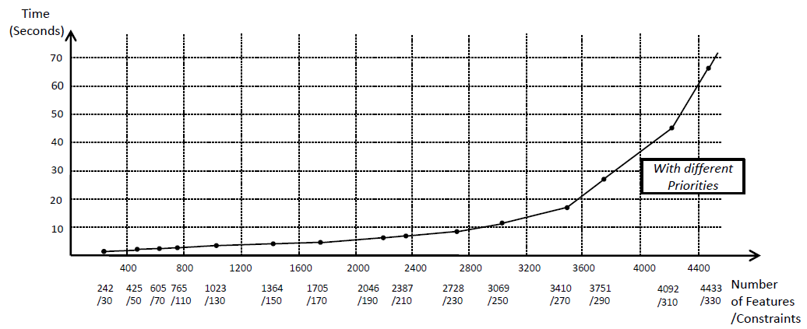
Experimental Results
Generate feature models randomly.
Up to 4000 features and 330 explicit constraints.

Slide 28
Conclusion
Conclusion
Adopt constraint hierarchy theory to fix inconsistency in feature models
Provide a dynamic-priority based mechanism to find the desirable solution
Extend SkyBlue to support fixing inconsistency in feature models

Slide 29
Thank you!
Q&A
wangbo07@sei.pku.edu.cn
Notes:
Thank you.
Any questions?

