Slide 1
Optimization in Pattern Recognition
Version: 2.0

Slide 2
Usage
Machine Learning problems, once formulated, can be solved as optimization problems.
Neural Network
Reinforcement Learning
Meta Learning
Variational Inference
Markov Chain Monte Carlo
Notes:
NN: any continuous function from input to output can be implemented in a three-layer net
RL: how software agent in the environment to maximize the reward
Meta L: learning to learn
Variational L: maps from a space of function to a real number to avoid integration of the P(X)
MCMC:
Monte Carlo: estimating a fixed parameter by repeatedly generating random numbers if the direct computation is impossible
Markov Chain: memoryless, only based on current state
https://www.cs.purdue.edu/homes/ribeirob/courses/Fall2018/lectures/MCMC.html

Slide 3
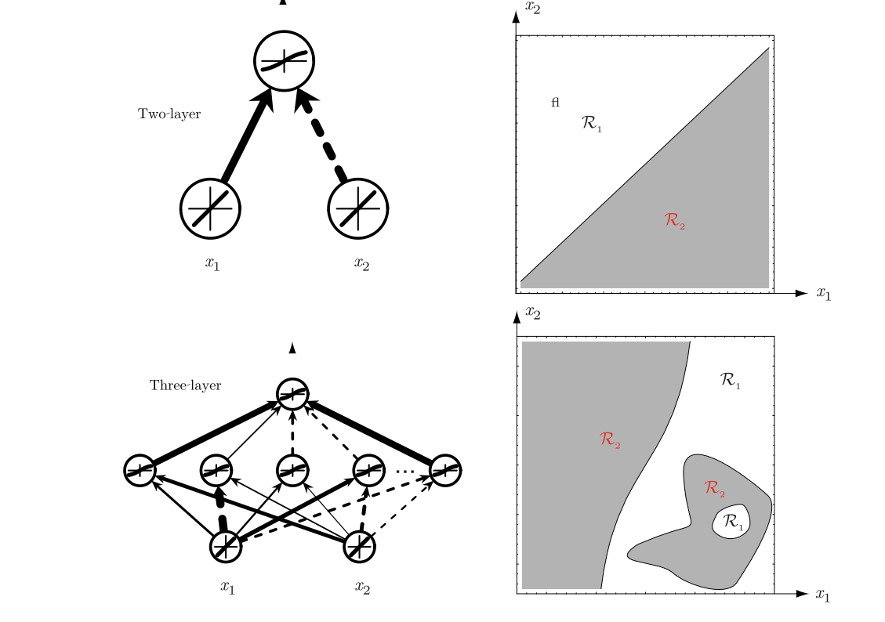
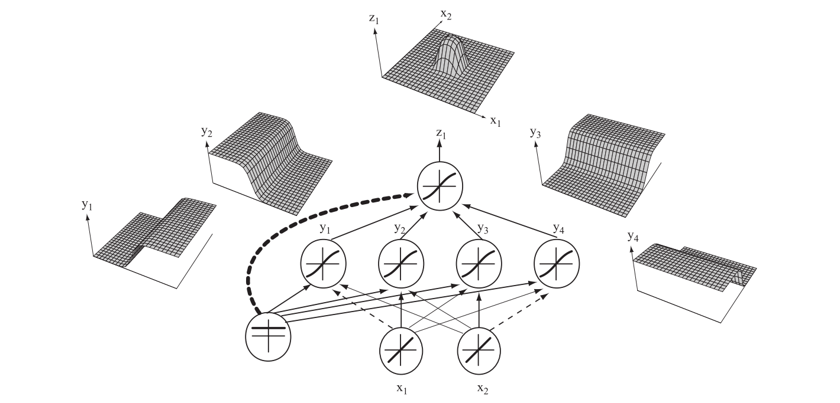
Neural Networks
any continuous function from input to output can be implemented in a three-layers net
Notes:
Exclusive-all problem could be solved by 3-level NN

Slide 4
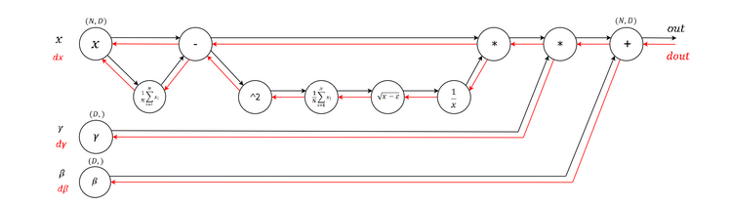
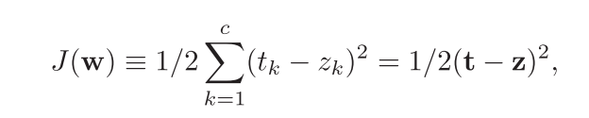

Back Propagation
The weights are initialized with random values and are changed in a direction that will reduce the error.
Notes:
∂ \partial

Slide 5
Category
Gradient decent perspective:
First-order Methods
Higher-order Methods
Heuristic derivative free methods
Notes:
- Conjugate GD: ﻿employs a series of line searches in weight or parameter space.

Slide 6
Problems
Insufficient Data
  High variance and overfitting
Nonconvex Optimization
Deviation caused by batch-based method
How to improve the performance of higher-order methods
Notes:
In Slide Show mode, select the arrows to visit links.

Slide 7
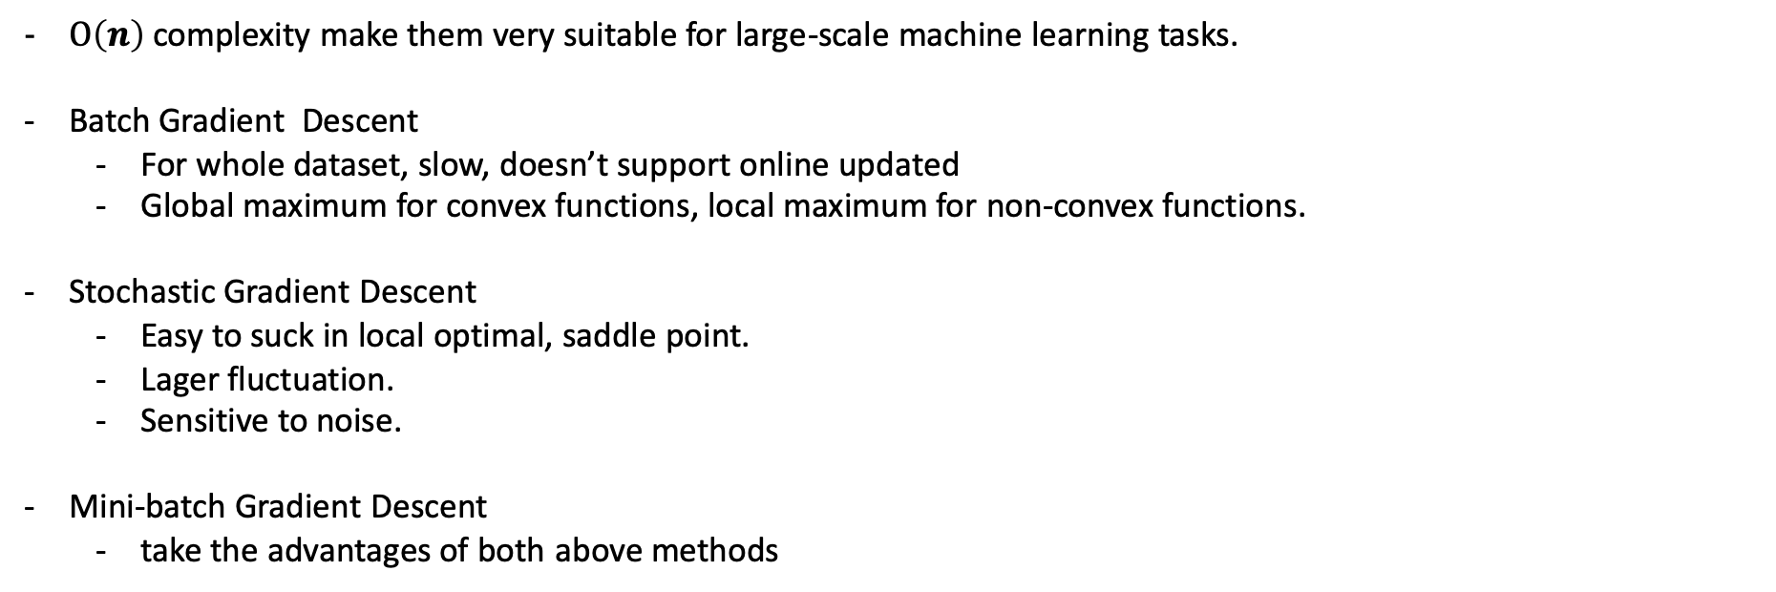
First-order methods:
$Ο\left(n\right)$ complexity make them very suitable for large-scale machine learning tasks.
Batch Gradient Descent
  For whole dataset, slow, doesn’t support online updated
  Global maximum for convex functions, local maximum for non-convex functions.
Stochastic Gradient Descent
  Easy to suck in local optimal, saddle point.
  Lager fluctuation.
  Sensitive to noise.
Mini-batch Gradient Descent
  ﻿take the advantages of both above methods

Slide 8
Adam
Combine the advantages of following optimizers
  AdaGrad: works well with sparse gradient
  RMSProp: works well in on-line and non-stationary set
﻿Some of Adam’s advantages are that the magnitudes of parameter updates are invariant to rescaling of the gradient, its step sizes are approximately bounded by the step size hyperparameter, it does not require a stationary objective, it works with sparse gradients, and it naturally performs a form of step size annealing.
Notes:
stationary process: whose unconditional joint probability distribution does not change when shifted in time. Consequently, parameters such as mean and variance also do not change over time.

Slide 9
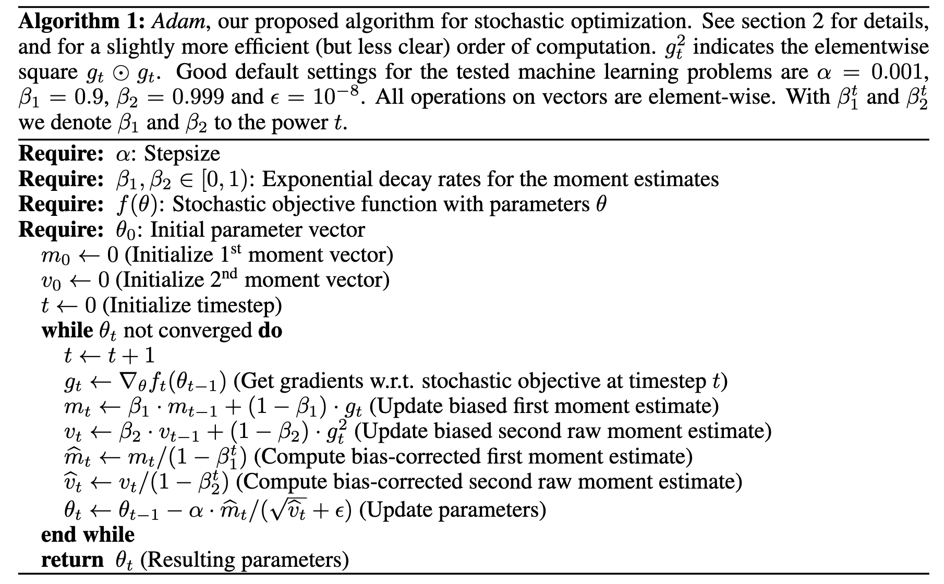
Notes:
Adaptive Moment Estimation

Slide 10
High-order methods:
Should be considered, if an objective function is highly non-linear and ill-conditioned.
More complicate than first-order methods.
Fast converging to more accuracy solution under strongly convex condition.
Newton’s Method
  Having to store the Hessian Matrix during each iteration.
Quasi-Newton’s Method
  Improved version of Newton’s method. Doesn’t compute Hessian Matrix directly.
Conjugate Gradient Descent
  ﻿Uses conjugate instead of Hessian Matrix.
  line-search based.
  Unstable to noise.
Notes:
Newton’s Method: ${Ο(n}^{3})$ (Inverse Matrix)
Newton’s Method: ${Ο(n}^{2})$

Slide 11
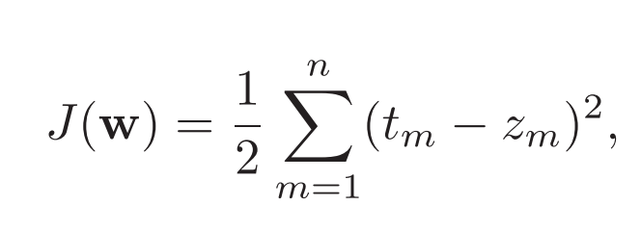
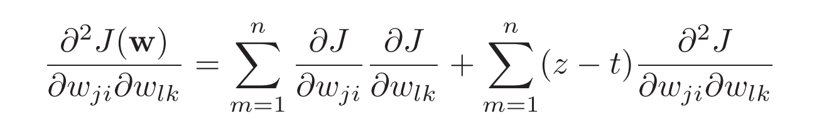
Hessian Matrix
For the criterion function:
The elements in Hessian Matrix are:

Slide 12
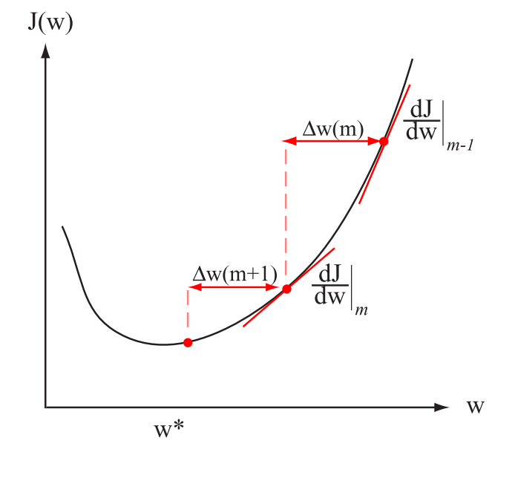
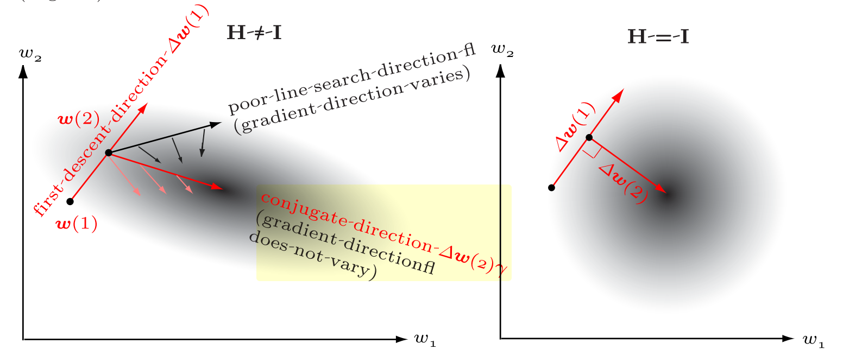
fig.1
Chart Explanation
fig.2.a
fig.2.b
Notes:
Left: ﻿The quickprop weight update takes the error derivatives at two points separated by a known amount, and by Eq. 51 makes its next weight value. If the error can be fully expressed as a second-order function, then the weight update
Right: ﻿Conjugate gradient descent in weight space employs a sequence of line searches. If ∆w(1) is the first descent direction, the second direction obeys ∆wt(1)H∆w(2) = 0. Note especially that along this second descent, the gradient changes only in magnitude, not direction; as such the second descent does not “spoil” the contribution due to the previous line search. In the case where the Hessian is diagonal (right), the directions of the line searches are orthogonal.

Slide 13
Derivative-free methods:
If ﻿the derivative of the objective function may not exist or is not easy to calculate, nevertheless, we still want the optimal point.
Heuristic algorithms
  Inspired by empirical rules and choose methods that already works well rather than derives solutions systematically.
  Classical Simulated Annealing Arithmetic, Genetic Algorithms, Colony Algorithms...
Add-on constrains to search space
  Attach some constrains to make the problem differentiable.
  Coordinate Descent
    In each iteration, the update is only executed along one axis.
    ﻿Has limitations when performing on the non-smooth objective function, which may fall into a non-stationary point.
    Difficulty to parallelism.

Slide 14
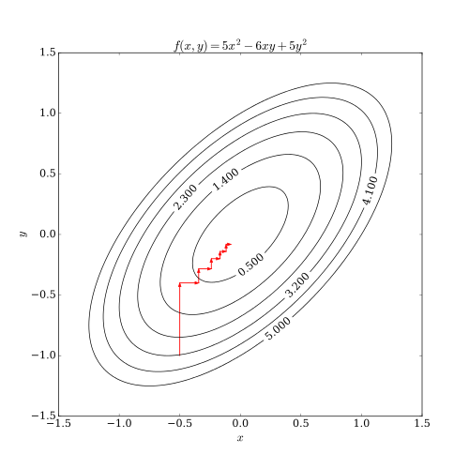
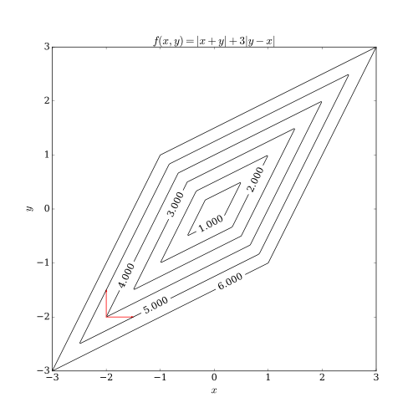
Chart Explanation
fig.1
fig.2
Notes:
right: One of them is having a non-smooth multivariable function. The following picture shows that coordinate descent iteration may get stuck at a non-stationary point if the level curves of a function are not smooth. Suppose that the algorithm is at the point (-2, -2); then there are two axis-aligned directions it can consider for taking a step, indicated by the red arrows. However, every step along these two directions will increase the objective function's value (assuming a minimization problem), so the algorithm will not take any step, even though both steps together would bring the algorithm closer to the optimum. While this example shows that coordinate descent is not necessarily convergent to the optimum, it is possible to show formal convergence under reasonable conditions.^{[3]}

Slide 15
Reference
Sun, S., Cao, Z., Zhu, H., & Zhao, J. (2019). A Survey of Optimization Methods from a Machine Learning Perspective. IEEE transactions on cybernetics.
Kingma, D. P., & Ba, J. A. (2019). A method for stochastic optimization. arXiv 2014. arXiv preprint arXiv:1412.6980.
Duda, R. O., Hart, P. E., & Stork, D. G. (2012). Pattern classification. John Wiley & Sons.
Notes:
In Slide Show mode, select the arrows to visit links.

