Slide 1
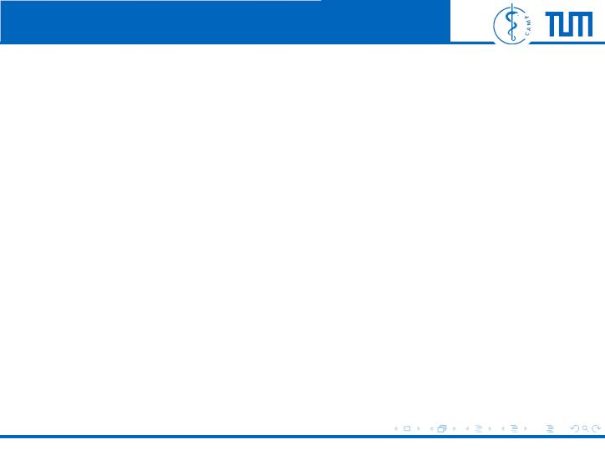
Computer Aided Medical Procedures | Technische Universit¨at Mu¨nchen
Fast Approximate Energy Minimization
via Graph Cuts
Felix Wechsler
Computer Aided Medical Procedures
Technische Universit¨at Mu¨nchen
November 15, 2017
Felix Wechsler
Energy Minimization via Graph Cuts
1 / 24

Slide 2

Computer Aided Medical Procedures | Technische Universit¨at Mu¨nchen
Outline
1 Basics
2 Swap Algorithm
3 Graph Cutting
4 Implementation
5 Experiments
Used paper: Boykov, Veksler, and Zabih, “Fast Approximate Energy
Minimization via Graph Cuts”
Felix Wechsler
Energy Minimization via Graph Cuts
2 / 24

Slide 3
Computer Aided Medical Procedures | Technische Universit¨at Mu¨nchen
Basics
Felix Wechsler
Energy Minimization via Graph Cuts
3 / 24

Slide 4
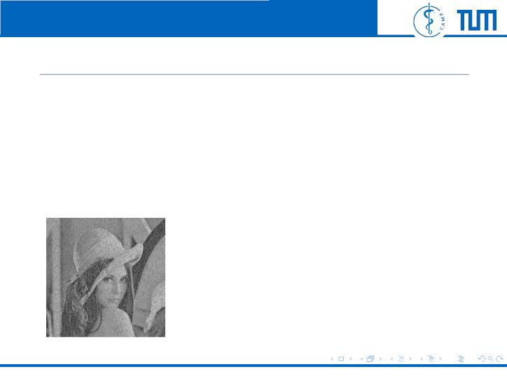
Computer Aided Medical Procedures | Technische Universit¨at Mu¨nchen
Standard CV Problem
• Tackling noisy images
• Piecewise smooth variation of intensity
=⇒ energy minimization
Felix Wechsler
Energy Minimization via Graph Cuts
3 / 24

Slide 5
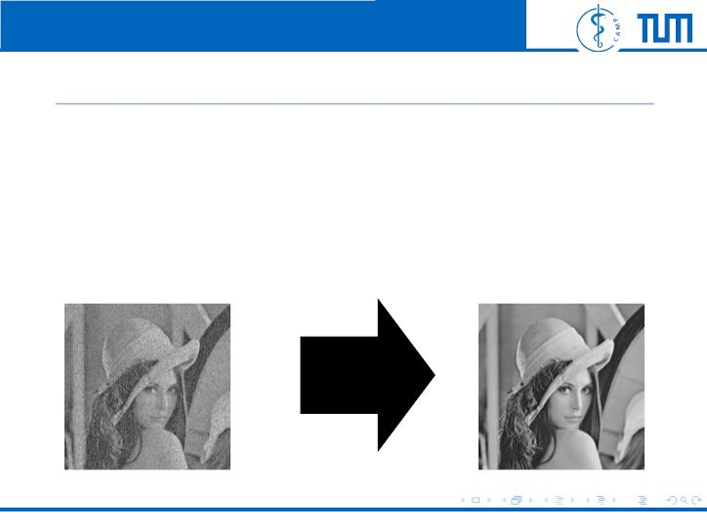
Computer Aided Medical Procedures | Technische Universit¨at Mu¨nchen
Standard CV Problem
• Tackling noisy images
• Piecewise smooth variation of intensity
=⇒ energy minimization
Felix Wechsler
Energy Minimization via Graph Cuts
3 / 24

Slide 6
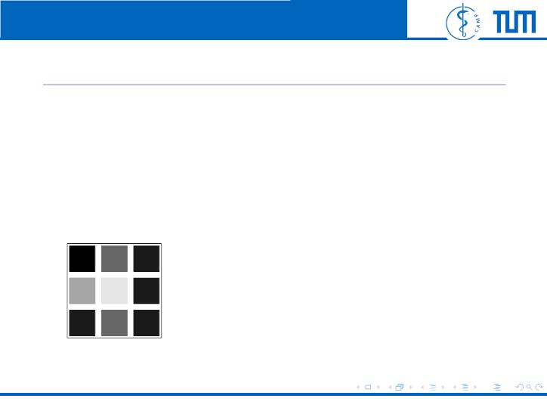
Computer Aided Medical Procedures | Technische Universit¨at Mu¨nchen
Labeling
• Every pixel p ∈ P has label f ∈ L
p
• Labeling of image is called f
• Label is intensity in image restoration
6
2
5
4
1
4
5
5
5
labeling f
Felix Wechsler
Energy Minimization via Graph Cuts
4 / 24

Slide 7
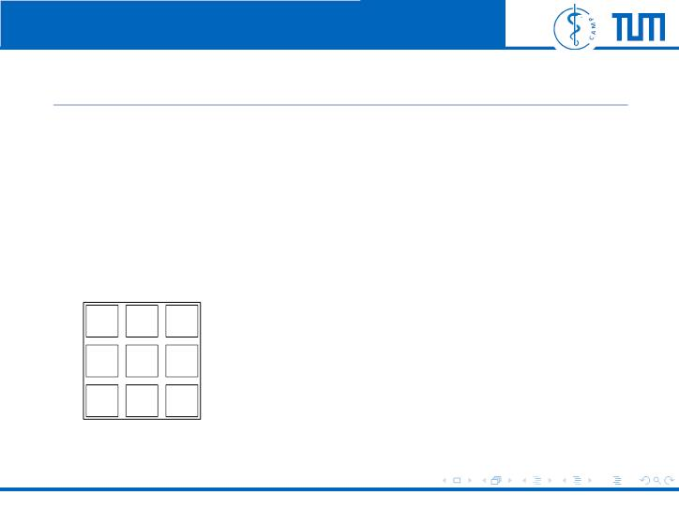
Computer Aided Medical Procedures | Technische Universit¨at Mu¨nchen
Labeling
• Every pixel p ∈ P has label f ∈ L
p
• Labeling of image is called f
• Label is intensity in image restoration
6
2
5
4
1
4
5
5
5
labeling f
Felix Wechsler
Energy Minimization via Graph Cuts
4 / 24

Slide 8
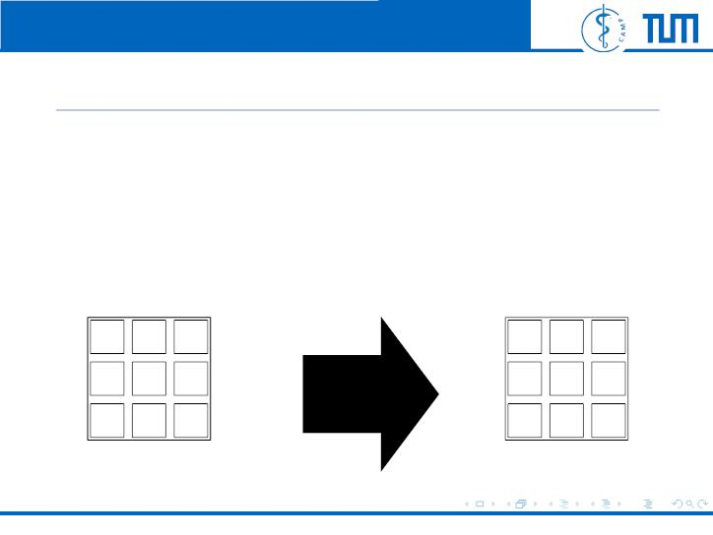
Computer Aided Medical Procedures | Technische Universit¨at Mu¨nchen
Labeling
• Every pixel p ∈ P has label f ∈ L
p
• Labeling of image is called f
• Label is intensity in image restoration
6
2
5
4
1
4
5
5
5
5
4
5
4
4
4
5
5
5
labeling f
ˆ
labeling f
Felix Wechsler
Energy Minimization via Graph Cuts
4 / 24

Slide 9
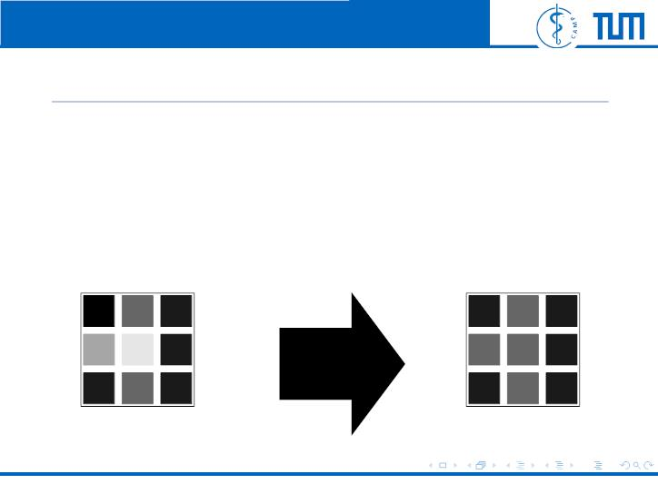
Computer Aided Medical Procedures | Technische Universit¨at Mu¨nchen
Labeling
• Every pixel p ∈ P has label f ∈ L
p
• Labeling of image is called f
• Label is intensity in image restoration
6
2
5
4
1
4
5
5
5
5
4
5
4
4
4
5
5
5
labeling f
ˆ
labeling f
Felix Wechsler
Energy Minimization via Graph Cuts
4 / 24

Slide 10

Computer Aided Medical Procedures | Technische Universit¨at Mu¨nchen
Energy Function
E(f) = E_{smooth}(f) + E_{data}(f)
(1)
(2)
• E_{smooth} =ˆ smoothness of image
• E_{data} =ˆ disagreement between f and image data
X
E_{data}
=
D (f )
p p
p∈P
2
• i.e.: D (f ) = (f − i )
p
p
p
p
f_{p} label pixel p
i_{p} original intensity of pixel p
Felix Wechsler
Energy Minimization via Graph Cuts
5 / 24

Slide 11
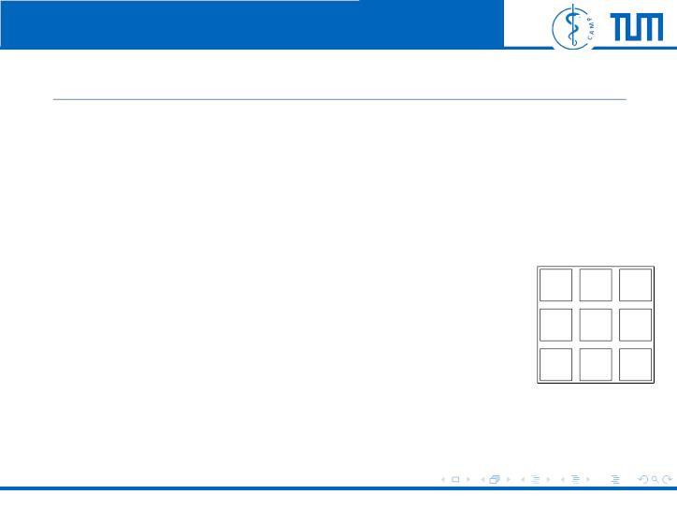
Computer Aided Medical Procedures | Technische Universit¨at Mu¨nchen
Smoothness Term
X
E_{smooth}
=
V_{p,q}(f , f )
(3)
p
q
{p,q}∈N
6
2
5
4
5
5
5
^{• V}_{p,q}: potential function
1
4
• N: set of pair of adjacent pixels
Felix Wechsler
Energy Minimization via Graph Cuts
6 / 24

Slide 12
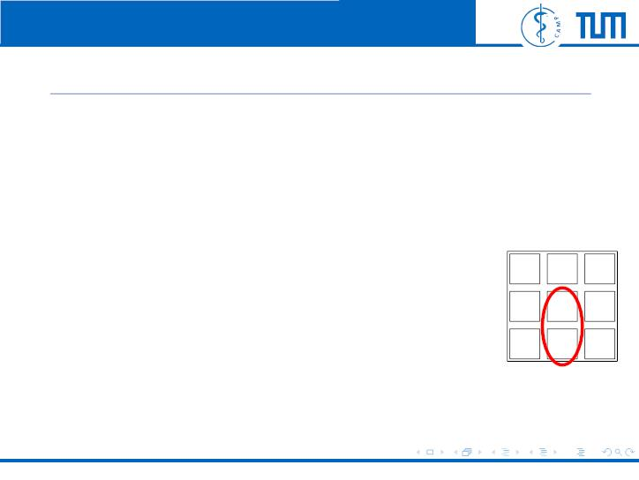
Computer Aided Medical Procedures | Technische Universit¨at Mu¨nchen
Smoothness Term
X
E_{smooth}
=
V_{p,q}(f , f )
(3)
p
q
{p,q}∈N
6
2
5
4
5
5
5
^{• V}_{p,q}: potential function
1
4
• N: set of pair of adjacent pixels
Felix Wechsler
Energy Minimization via Graph Cuts
6 / 24

Slide 13
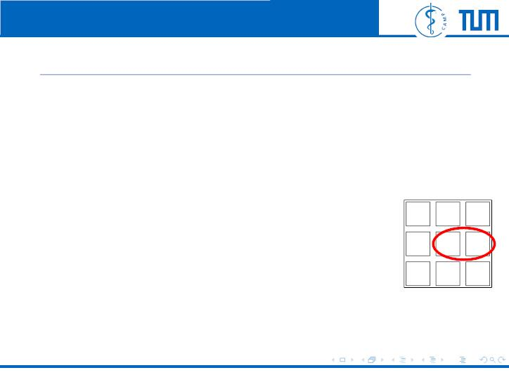
Computer Aided Medical Procedures | Technische Universit¨at Mu¨nchen
Smoothness Term
X
E_{smooth}
=
V_{p,q}(f , f )
(3)
p
q
{p,q}∈N
6
2
5
4
5
5
5
^{• V}_{p,q}: potential function
1
4
• N: set of pair of adjacent pixels
Felix Wechsler
Energy Minimization via Graph Cuts
6 / 24

Slide 14

Computer Aided Medical Procedures | Technische Universit¨at Mu¨nchen
Smoothness Term
X
E_{smooth}
=
V_{p,q}(f , f )
(3)
p
q
{p,q}∈N
6
2
5
4
5
5
5
^{• V}_{p,q}: potential function
1
4
• N: set of pair of adjacent pixels
Felix Wechsler
Energy Minimization via Graph Cuts
6 / 24

Slide 15
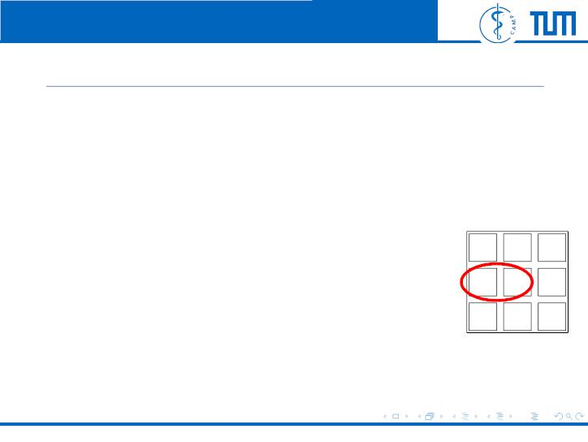
Computer Aided Medical Procedures | Technische Universit¨at Mu¨nchen
Smoothness Term
X
E_{smooth}
=
V_{p,q}(f , f )
(3)
p
q
{p,q}∈N
6
2
5
4
5
5
5
^{• V}_{p,q}: potential function
1
4
• N: set of pair of adjacent pixels
Felix Wechsler
Energy Minimization via Graph Cuts
6 / 24

Slide 16
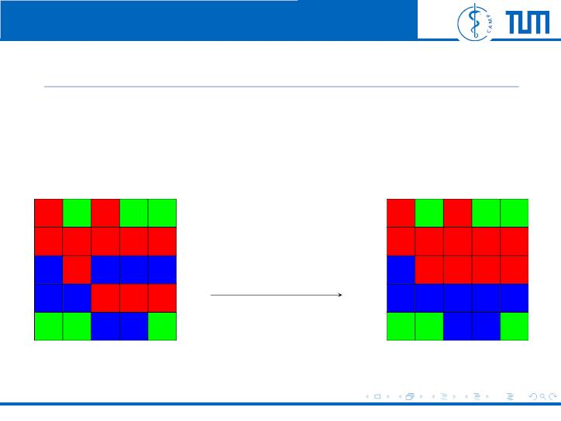
Computer Aided Medical Procedures | Technische Universit¨at Mu¨nchen
α-β-swap
• α=ˆred and β=ˆblue
• P_{αβ} is set of all pixels with label α or β
One α-β-swap
Original Image
Optimized Image
Felix Wechsler
Energy Minimization via Graph Cuts
7 / 24

Slide 17
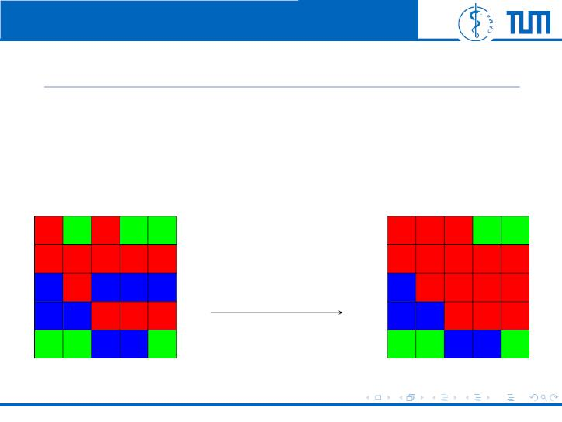
Computer Aided Medical Procedures | Technische Universit¨at Mu¨nchen
α-expansion
• α=ˆred
• ﬁnd optimum by expanding label α to other pixels
One α-expansion
Original Image
Optimized Image
Felix Wechsler
Energy Minimization via Graph Cuts
8 / 24

Slide 18
Computer Aided Medical Procedures | Technische Universit¨at Mu¨nchen
Swap Algorithm
Felix Wechsler
Energy Minimization via Graph Cuts
9 / 24

Slide 19
Computer Aided Medical Procedures | Technische Universit¨at Mu¨nchen
Swap Algorithm
1. Start with arbitrary labeling
2. success := 0
3. for all {α, β} ⊂ L
ˆ
0
3.1 ﬁnd f = arg min E(f ) within one α-β-swap
ˆ
ˆ
3.2 if E(f) < E(f) then f = f
4. if success == 1 then goto 2
5. return f
Felix Wechsler
Energy Minimization via Graph Cuts
9 / 24

Slide 20
Computer Aided Medical Procedures | Technische Universit¨at Mu¨nchen
Properties of Swap Algorithm
2
• complexity is in one cycle O(|L| )
• termination is in O(|P|) cycles
• most of the improvements occur in ﬁrst cycle
• ﬁnds local minimum
Felix Wechsler
Energy Minimization via Graph Cuts
10 / 24

Slide 21
Computer Aided Medical Procedures | Technische Universit¨at Mu¨nchen
Graph Cutting
Felix Wechsler
Energy Minimization via Graph Cuts
11 / 24

Slide 22
Computer Aided Medical Procedures | Technische Universit¨at Mu¨nchen
Construction of Graph
Felix Wechsler
Energy Minimization via Graph Cuts
11 / 24

Slide 23

Computer Aided Medical Procedures | Technische Universit¨at Mu¨nchen
Construction of Graph
• Introduce pixels
p
q
...
w
y
z
Felix Wechsler
Energy Minimization via Graph Cuts
11 / 24

Slide 24
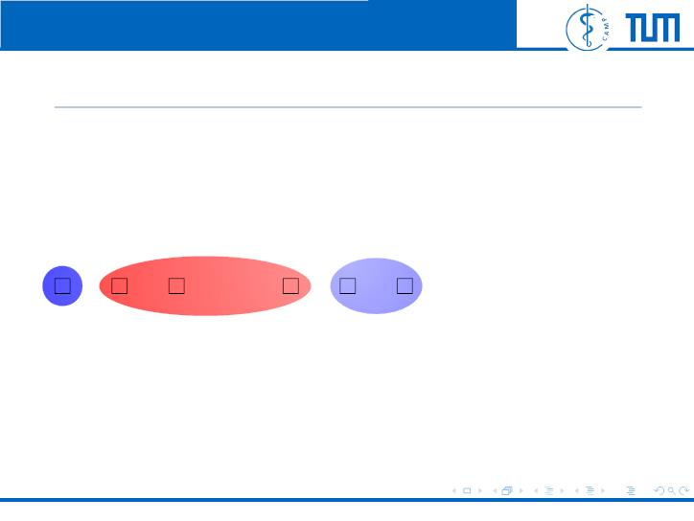
Computer Aided Medical Procedures | Technische Universit¨at Mu¨nchen
Construction of Graph
• Introduce pixels
p
q
...
w
y
z
P_{β}
P_{α}
Felix Wechsler
Energy Minimization via Graph Cuts
11 / 24

Slide 25

Computer Aided Medical Procedures | Technische Universit¨at Mu¨nchen
Construction of Graph
• Introduce pixels
• Connect neighbours
^{e}p,q
...
e_{r,s}
P_{α}
p
q
w
y
z
P_{β}
Felix Wechsler
Energy Minimization via Graph Cuts
11 / 24

Slide 26
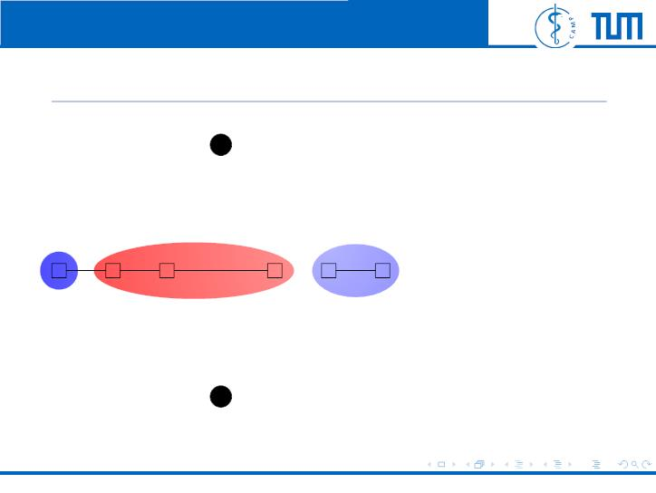
Computer Aided Medical Procedures | Technische Universit¨at Mu¨nchen
Construction of Graph
α
• Introduce pixels
• Connect neighbours
^{e}p,q
...
e_{r,s}
P_{α}
p
q
w
y
z
• Introduce two
P_{β}
terminal nodes
β
Felix Wechsler
Energy Minimization via Graph Cuts
11 / 24

Slide 27
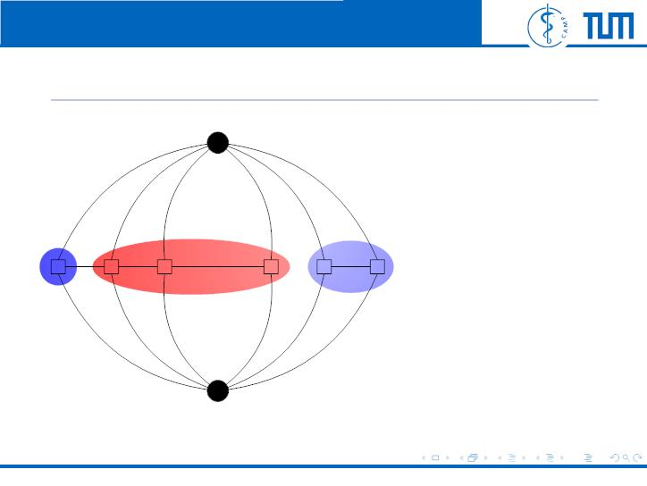
Computer Aided Medical Procedures | Technische Universit¨at Mu¨nchen
Construction of Graph
α
t^{α}
p
t^{α}
q
t^{α}
s
α
w
α
r
t
t
• Introduce pixels
• Connect neighbours
^{e}p,q
...
e_{r,s}
P_{α}
p
q
w
y
z
• Introduce two
P_{β}
terminal nodes
• Connect terminals
β
w
β
r
and pixels
β
t
t
β
p
t_{q}
β
s
t
t
β
Felix Wechsler
Energy Minimization via Graph Cuts
11 / 24

Slide 28
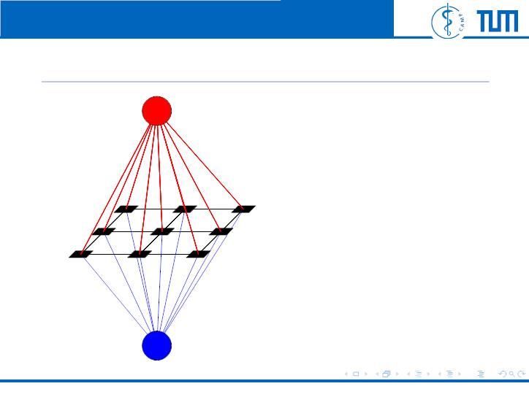
Computer Aided Medical Procedures | Technische Universit¨at Mu¨nchen
Construction of Graph
α
• Introduce pixels
• Connect neighbours
• Introduce two
terminal nodes
• Connect terminals
and pixels
β
Felix Wechsler
Energy Minimization via Graph Cuts
11 / 24

Slide 29

Computer Aided Medical Procedures | Technische Universit¨at Mu¨nchen
Edge Weights
edge
weight
for
P
α
∈ Pα,β
t
t
^{D}p^{(α) +}
^{V}p,q^{(α, f}q⁾
p
p
q∈N
p
q∈/P
α,β
β
p
P
^{D}p^{(β) +}
^{V}p,q^{(β, f}q⁾
^{p ∈ P}α,β
q∈N
p
q∈/P
α,β
^{e}p,q
V_{p,q}(α, β)
{p, q} ∈ N ∧ p, q ∈ P_{α,β}
Felix Wechsler
Energy Minimization via Graph Cuts
12 / 24

Slide 30
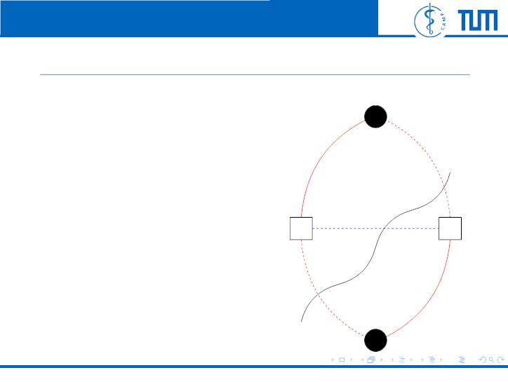
Computer Aided Medical Procedures | Technische Universit¨at Mu¨nchen
Possible Cuts
α
t^{α}
p
t^{α}
q
ˆ
0
• Find f = arg min E(f )
within one α-β-swap
→ do minimal graph cut
→ f = β and f = α
^{e}p,q
p
q
p
q
cut
t^{β}
p
t^{β}
q
β
Felix Wechsler
Energy Minimization via Graph Cuts
13 / 24

Slide 31
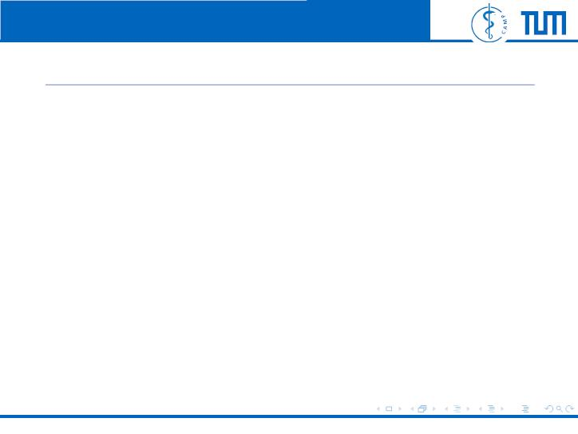
Computer Aided Medical Procedures | Technische Universit¨at Mu¨nchen
Minimum Cut
Cost of Minimut cut:
X
ꢀ
ꢀ
X
ꢀ
α
β
ꢀ
|C| =
|C ∩ e_{p,q}
ꢀC ∩ {t , t }ꢀ +
|
(4)
(5)
p
p
p∈P
{p,q}∈N
{p,q}⊂P
α,β
α,β
which can be rewritten to:
|C| = E(f^{C}) − K
• fC labeling after cut
• K is constant for all cuts C =ˆ independent of C
=⇒ Finding min C is equivalent to ﬁnding energy min
Felix Wechsler
Energy Minimization via Graph Cuts
14 / 24

Slide 32
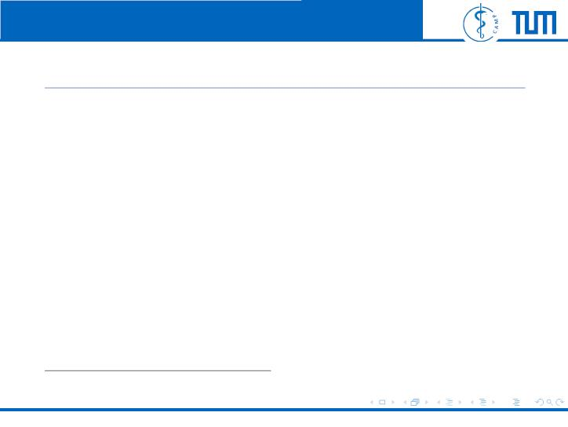
Computer Aided Medical Procedures | Technische Universit¨at Mu¨nchen
Finding Minimum Cut
• famous Max-ﬂow min-cut theorem
• Algorithms: Push-relabel-based or Ford-Fulkerson-based
algorithms
1
• Kolmogorovs library Maxflow is optimized for our graphs
2
• PyMaxflow is a python wrapper for Maxflow
¹Kolmogorov, Maxﬂow
²http://pmneila.github.io/PyMaxflow/
Felix Wechsler
Energy Minimization via Graph Cuts
15 / 24

Slide 33
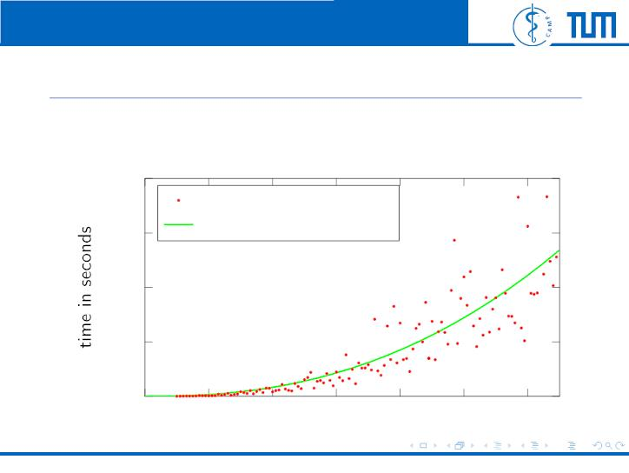
Computer Aided Medical Procedures | Technische Universit¨at Mu¨nchen
Scaling of graph-cut with PyMaxflow
PyMaxflow scales more than quadratic =⇒ conﬁrms Boykov and
Kolmogorov
20
data
ﬁt function f = k · x^{2.37}
15
10
5
0
0
200
400
600
800 1,000 1,200
Image width in pixel
Felix Wechsler
Energy Minimization via Graph Cuts
16 / 24

Slide 34
Computer Aided Medical Procedures | Technische Universit¨at Mu¨nchen
Implementation
Felix Wechsler
Energy Minimization via Graph Cuts
17 / 24

Slide 35

Computer Aided Medical Procedures | Technische Universit¨at Mu¨nchen
Own Implementation
• Implementation in Python available on fcv.sumpi.org
• uses PyMaxflow’s minimizing graph cut³
• objective: test diﬀerent energy functions and images
³http://pmneila.github.io/PyMaxflow/
Felix Wechsler
Energy Minimization via Graph Cuts
17 / 24

Slide 36

Computer Aided Medical Procedures | Technische Universit¨at Mu¨nchen
Energy Function
In paper used
2
D (f ) = (f − i )
(6)
(7)
p
p
p
p
V (f , f ) = c · |f − f |
p
q
p
q
but ﬁrst is quadratic, second linear.
=⇒ another energy function which eliminates mismatch
q
ˆ
D (f ) = |f² − i²|
(8)
p
p
p
p
f_{p} label of pixel p
i_{p} original intensity of pixel p
c some constant
Felix Wechsler
Energy Minimization via Graph Cuts
18 / 24

Slide 37
Computer Aided Medical Procedures | Technische Universit¨at Mu¨nchen
Experiments
Felix Wechsler
Energy Minimization via Graph Cuts
19 / 24

Slide 38
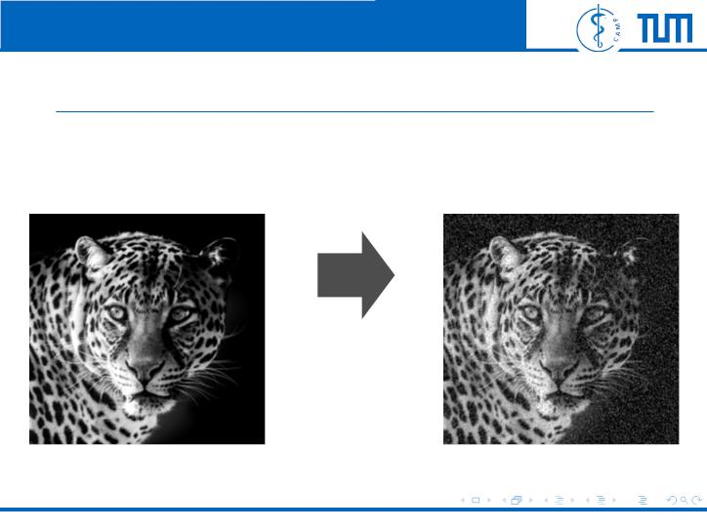
Computer Aided Medical Procedures | Technische Universit¨at Mu¨nchen
ˆ
Denoising Leopard using D (f )
p
p
Image with 500x489 pixels in grayscale:
20% pixels
are randomly
changed
Felix Wechsler
Energy Minimization via Graph Cuts
19 / 24

Slide 39
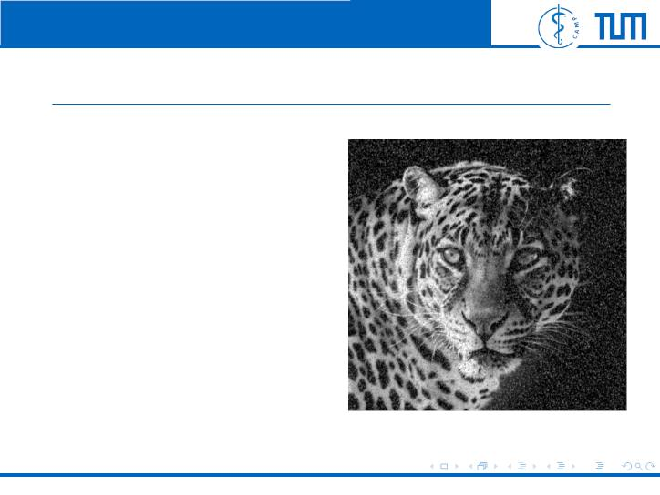
Computer Aided Medical Procedures | Technische Universit¨at Mu¨nchen
ˆ
Denoising Leopard using D (f )
p
p
Noisy leopard
Felix Wechsler
Energy Minimization via Graph Cuts
20 / 24

Slide 40
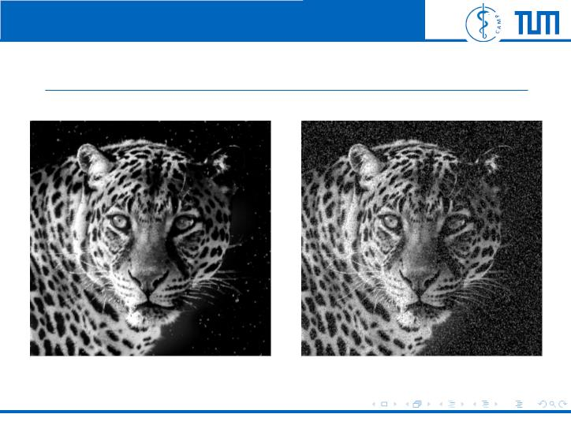
Computer Aided Medical Procedures | Technische Universit¨at Mu¨nchen
ˆ
Denoising Leopard using D (f )
p
p
Denoised after 1 cycle
Noisy leopard
Felix Wechsler
Energy Minimization via Graph Cuts
20 / 24

Slide 41

Computer Aided Medical Procedures | Technische Universit¨at Mu¨nchen
ˆ
Denoising Leopard using D (f )
p
p
Denoised after 2 cycles
Noisy leopard
Felix Wechsler
Energy Minimization via Graph Cuts
20 / 24

Slide 42

Computer Aided Medical Procedures | Technische Universit¨at Mu¨nchen
ˆ
Denoising Leopard using D (f )
p
p
Denoised after 3 cycles
Noisy leopard
Felix Wechsler
Energy Minimization via Graph Cuts
20 / 24

Slide 43

Computer Aided Medical Procedures | Technische Universit¨at Mu¨nchen
ˆ
Denoising Leopard using D (f )
p
p
Denoised after 4 cycles
Noisy leopard
Felix Wechsler
Energy Minimization via Graph Cuts
20 / 24

Slide 44

Computer Aided Medical Procedures | Technische Universit¨at Mu¨nchen
ˆ
Denoising Leopard using D (f )
p
p
Denoised after 5 cycles
Noisy leopard
Felix Wechsler
Energy Minimization via Graph Cuts
20 / 24

Slide 45

Computer Aided Medical Procedures | Technische Universit¨at Mu¨nchen
ˆ
Denoising Leopard using D (f )
p
p
Denoised after 6 cycles
Noisy leopard
Felix Wechsler
Energy Minimization via Graph Cuts
20 / 24

Slide 46

Computer Aided Medical Procedures | Technische Universit¨at Mu¨nchen
ˆ
Denoising Leopard using D (f )
p
p
Denoised after 7 cycles
Noisy leopard
Felix Wechsler
Energy Minimization via Graph Cuts
20 / 24

Slide 47

Computer Aided Medical Procedures | Technische Universit¨at Mu¨nchen
ˆ
Denoising Leopard using D (f )
p
p
Denoised after 8 cycles
Noisy leopard
Felix Wechsler
Energy Minimization via Graph Cuts
20 / 24

Slide 48

Computer Aided Medical Procedures | Technische Universit¨at Mu¨nchen
ˆ
Denoising Leopard using D (f )
p
p
Denoised after 9 cycles
Noisy leopard
Felix Wechsler
Energy Minimization via Graph Cuts
20 / 24

Slide 49

Computer Aided Medical Procedures | Technische Universit¨at Mu¨nchen
ˆ
Denoising Leopard using D (f )
p
p
Denoised after 10 cycles
Noisy leopard
Felix Wechsler
Energy Minimization via Graph Cuts
20 / 24

Slide 50
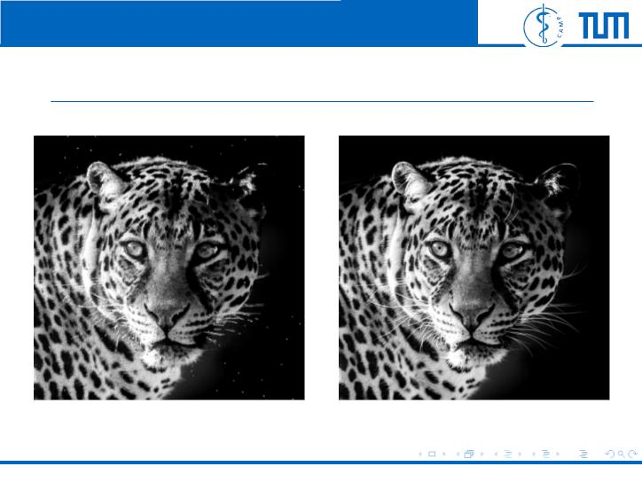
Computer Aided Medical Procedures | Technische Universit¨at Mu¨nchen
ˆ
Denoising Leopard using D (f )
p
p
Denoised after 10 cycles
Orginal leopard
Felix Wechsler
Energy Minimization via Graph Cuts
20 / 24

Slide 51
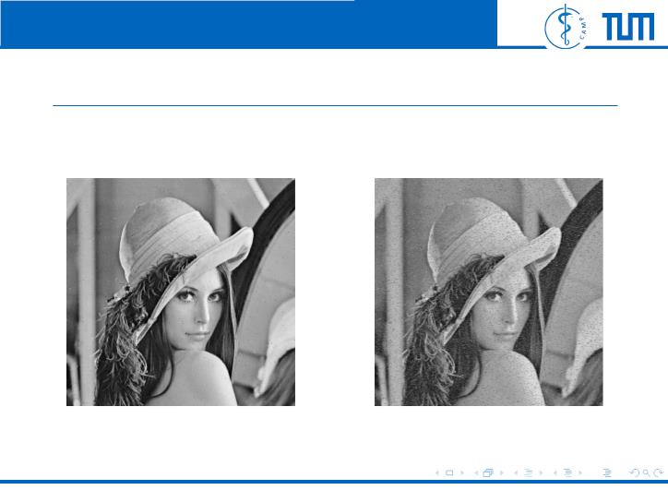
Computer Aided Medical Procedures | Technische Universit¨at Mu¨nchen
ˆ
Denoising Lena D (f )
p
p
Lena in 500x500 pixels
Denoised after 10 cycles
10% noisy Lenna
Felix Wechsler
Energy Minimization via Graph Cuts
21 / 24

Slide 52

Computer Aided Medical Procedures | Technische Universit¨at Mu¨nchen
ˆ
Denoising Lena D (f )
p
p
Lena in 500x500 pixels
Denoised after 10 cycles
Orginal Lenna
Felix Wechsler
Energy Minimization via Graph Cuts
21 / 24

Slide 53
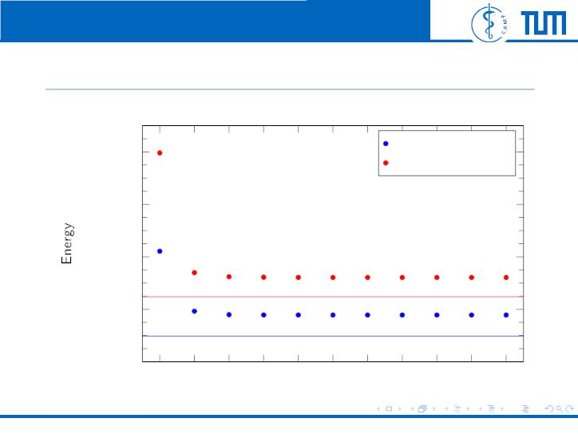
Computer Aided Medical Procedures | Technische Universit¨at Mu¨nchen
Energy over Cycles
Straight line is energy of original clear image
7
House 20% noise
4 · 10
3 · 10
2 · 10
1 · 10
Leopard 20% noise
7
7
7
0
0
1
2
3
4
5
6
7
8
9
10
Number of cycles
Felix Wechsler
Energy Minimization via Graph Cuts
22 / 24

Slide 54
Computer Aided Medical Procedures | Technische Universit¨at Mu¨nchen
Conclusion
Felix Wechsler
Energy Minimization via Graph Cuts
23 / 24

Slide 55
Computer Aided Medical Procedures | Technische Universit¨at Mu¨nchen
Conclusion
E(f) = E_{smooth}(f) + E_{data}(f)
Felix Wechsler
Energy Minimization via Graph Cuts
23 / 24

Slide 56
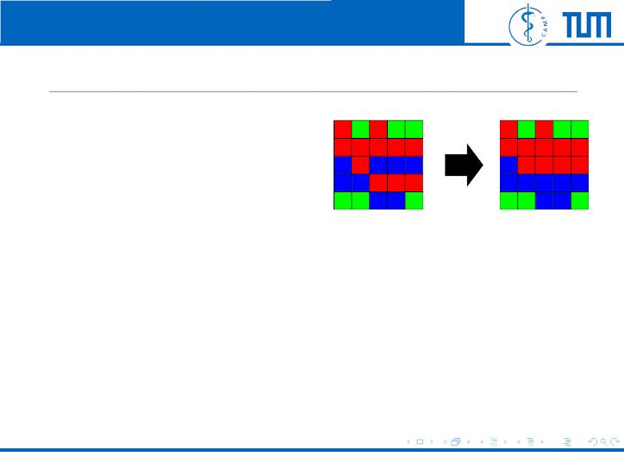
Computer Aided Medical Procedures | Technische Universit¨at Mu¨nchen
Conclusion
E(f) = E_{smooth}(f) + E_{data}(f)
labeling f
labeling fˆ
Felix Wechsler
Energy Minimization via Graph Cuts
23 / 24

Slide 57
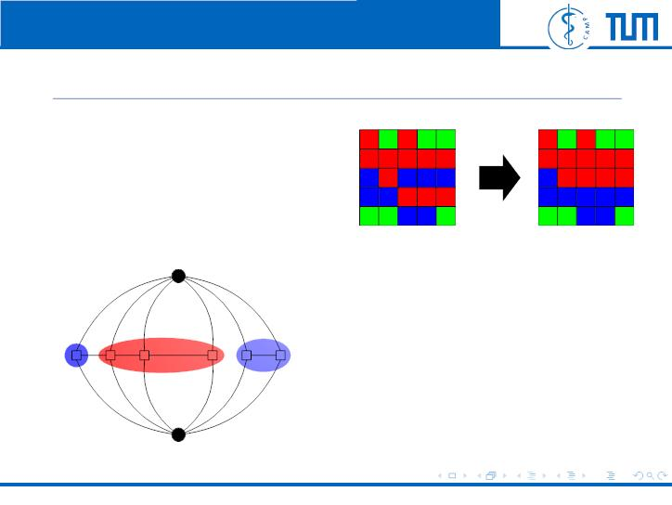
Computer Aided Medical Procedures | Technische Universit¨at Mu¨nchen
Conclusion
E(f) = E_{smooth}(f) + E_{data}(f)
labeling f
labeling fˆ
t^{α}
p
t^{α}
q
α
t^{α} t^{α}
t^{α}
s
w
r
p
^{e}p,q
q
...
P_{β}
w
y
e_{r,s}
P_{α}
z
t^{β}
p
t^{β}
q
t_{w}
β
t^{β}
r
β
s
β
t
Felix Wechsler
Energy Minimization via Graph Cuts
23 / 24

Slide 58
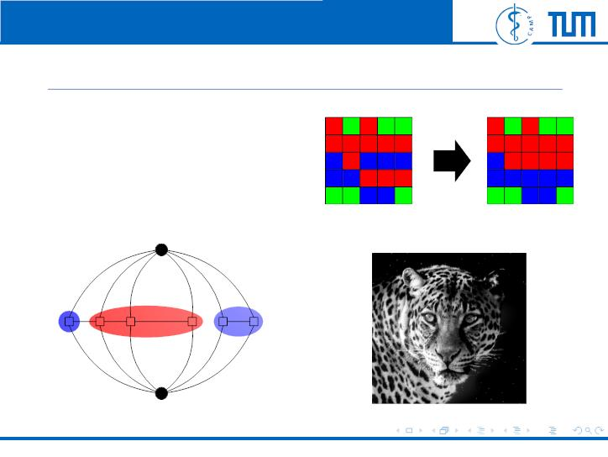
Computer Aided Medical Procedures | Technische Universit¨at Mu¨nchen
Conclusion
E(f) = E_{smooth}(f) + E_{data}(f)
labeling f
labeling fˆ
t^{α}
p
t^{α}
q
α
t^{α} t^{α}
t^{α}
s
w
r
p
^{e}p,q
q
...
P_{β}
w
y
e_{r,s}
P_{α}
z
t^{β}
p
t^{β}
q
t_{w}
β
t^{β}
r
β
s
β
t
Felix Wechsler
Energy Minimization via Graph Cuts
23 / 24

Slide 60
Computer Aided Medical Procedures | Technische Universit¨at Mu¨nchen
Appendix
Felix Wechsler
Energy Minimization via Graph Cuts
25 / 24

Slide 61
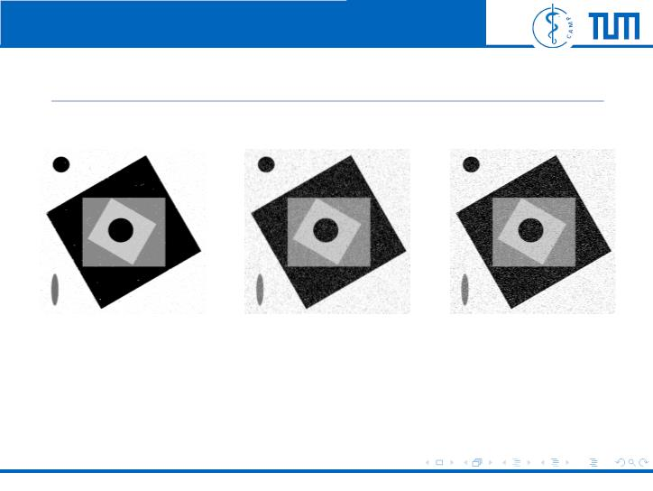
Computer Aided Medical Procedures | Technische Universit¨at Mu¨nchen
More examples
Denoised after 10
Denoised after 10
15% noised shapes
ˆ
cycles using D (f )
cycles using D (f )
p
p
p
p
and euclidean
distance for V
Felix Wechsler
Energy Minimization via Graph Cuts
25 / 24

Slide 62

Computer Aided Medical Procedures | Technische Universit¨at Mu¨nchen
More examples
Denoised after 10
Denoised after 10
15% noised shapes
ˆ
cycles using D (f )
cycles using D (f )
p
p
p
p
and c = 45 in
V (f , f )
p
q
Felix Wechsler
Energy Minimization via Graph Cuts
25 / 24

Slide 63

Computer Aided Medical Procedures | Technische Universit¨at Mu¨nchen
More examples
Denoised after 10
Denoised after 10
15% noised shapes
ˆ
cycles using D (f )
cycles using D (f )
p
p
p
p
and c = 80 in
V (f , f )
p
q
Felix Wechsler
Energy Minimization via Graph Cuts
25 / 24

Slide 64
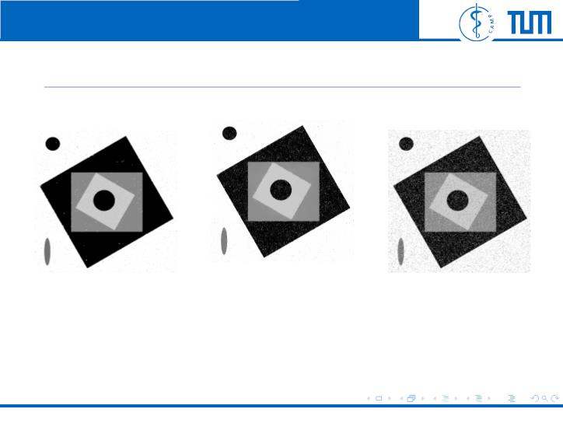
Computer Aided Medical Procedures | Technische Universit¨at Mu¨nchen
More examples
Denoised after 10
Denoised after 10
15% noised shapes
cycles using D (f )
ˆ
p
p
cycles using D (f )
p
p
and min 500
euclidean distance
for V (f , f )
p
q
Felix Wechsler
Energy Minimization via Graph Cuts
25 / 24

Slide 65
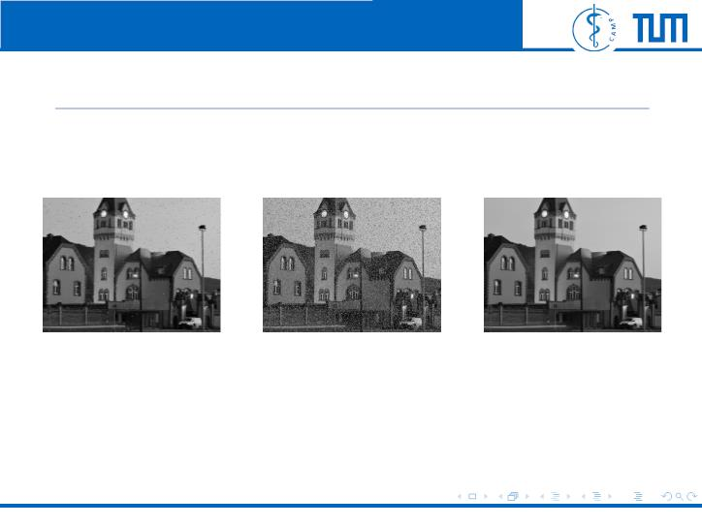
Computer Aided Medical Procedures | Technische Universit¨at Mu¨nchen
Example House
Denoised after 10
20% noised house
Original house
ˆ
cycles using D (f )
p
p
Felix Wechsler
Energy Minimization via Graph Cuts
26 / 24

Slide 66
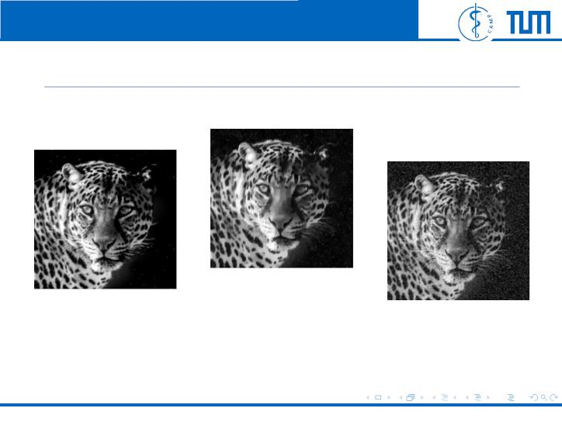
Computer Aided Medical Procedures | Technische Universit¨at Mu¨nchen
Comparison House
Denoised after 10
Denoised after 10
ˆ
cycles using D (f )
p
p
Original image
ˆ
cycles using D (f )
and
V = 80 · |f − f |
p
p
p
q
Felix Wechsler
Energy Minimization via Graph Cuts
27 / 24

