Slide 1
A Unified and Discriminative Model for Query Refinement
Jiafeng Guo¹, Gu Xu², Xueqi Cheng¹,Hang Li²
¹Institute of Computing Technology, CAS, China
²Microsoft Research Asia, China
Notes:
Good afternoon, it’s my pleasure to give the presentation about my research work “A…”. This work is collaborated with …

Slide 2
Outline
Motivation
Our Approach
Experimental Results
Conclusion
Notes:
My presentation includes the following section

Slide 3
Outline
Motivation
Our Approach
Experimental Results
Conclusion
Notes:
First part is the motivation

Slide 4



Introduction
New York Times
Search Query
university of california kelley blue book prison break best movie download free music free online games ny times …… ……
Information Retrieval
Word Mismatch
match
Notes:
In modern information retrieval, search is formalized as a problem of document ranking on the degree of matching between query terms and document terms. Therefore, how to resolve a word mismatch problem becomes one of the biggest challenges for IR. For example, if the user types ny times while a document contains “new york times”, typically this document would not be retrieved at a search system.

Slide 5
Cont’
ill-formed queries
Word Stemming
Words to be stemmed:
data mine → data mining
Spelling Error Correction
Misspelled words:
sytem number→ system number
Word Splitting
Word Merging
Mistakenly merged words:
nypark→ ny park
Mistakenly split words:
on line game → online game
Query Refinement
Acronym Expansion
Phrase Segmentation
Acronym to be Expanded:
nfs→ need for speed
Phrase to be quoted:
the office show → “the office” show
Notes:
In fact, many ill-formed queries can be found from the query logs, for example, words with spelling error or words need to be merged. We can define corresponding refinement tasks for these ill-formed cases. The question is whether we can offer a solution during search which automatically reformulates queries, in order to better represent users' search needs. This is what we mean by query refinement here.

Slide 6
Previous Work
Query Refinement:
Spelling error correction:
[1] Exploring distributional similarity based query spelling correction (Li et al. ACL ’06)
[2] Spelling correction as an iterative process that exploits the collective knowledge of web users (Cucerzan et al. EMNLP ‘04)
[3] Learning a spelling error model from search query logs (Ahmad et al. EMNLP ‘05)
[4] Improving query spelling correction using web search results (Chen et al. EMNLP ‘07)
Word stemming:
[5] Context sensitive stemming stemming for web search (Peng et al. SIGIR ‘07)
Query segmentation:
[6] Query segmentation for web search (Risvik et al. WWW ‘03)
[7] Learning noun phrase query segmentation (Bergsma et al. EMNLP ‘07)
Separate Tasks
A unified framework
Existing
Our Goal
Generative Models
Discriminative Model
Work | Task | Approach
[1][2][3] | spelling correction | generative
[1][3] | spelling correction | discriminative
[5] | word stemming | generative
[6] | phrase segmentation | generative
[7] | phrase segmentation | discriminative
Notes:
There is previous work on query refinement, including spelling error correction, word stemming, query segmentation. However, the issue was tackled either in separated tasks or by employing generative models. Therefore, our goal is to provide a unified and discriminative model for query refinement.

Slide 7


Cont’
Why unified framework?
Cascaded Model ?
Various query refinement tasks
Incorporate different tasks easily
Mutual dependencies between tasks
Ignore the dependencies between the tasks
Address tasks simultaneously to boost accuracy
Accumulate errors through the processes
A case of Query Refinement
Original:
Papers
on
machin
learn
Spelling error
correction
word
stemming
Refined:
Papers
on
“machine
learning”
Phrase
segmentation
Notes:
Then you may ask two questions. why we need a unified framework? And why we use a discriminative model? First, with a unified framework, we can incorporate different tasks easily and address tasks simultaneously to boost accuracy. An alternative approach would be the cascaded model. However, the cascaded models ignore the dependencies between the tasks and get the error accumulated. For the second question, since query refinement by nature is a structured prediction problem. We use discriminative model to enjoy all the merits of discriminative learning. The bad news is that a direct application would not work, therefore we propose the CRF-QR model for query refinement.

Slide 8
Cont’
Why discriminative model?
By nature a structured prediction problem
Enjoy all the merits of discriminative learning
A direct application of existing models would not work
Conditional Random Fields for Query Refinement (CRF-QR)
A case of Query Refinement
Original:
Papers
on
machin
learn
Spelling error
correction
word
stemming
Refined:
Papers
on
“machine
learning”
Phrase
segmentation
Notes:
Then you may ask two questions. why we need a unified framework? And why we use a discriminative model? First, with a unified framework, we can incorporate different tasks easily and address tasks simultaneously to boost accuracy. An alternative approach would be the cascaded model. However, the cascaded models ignore the dependencies between the tasks and get the error accumulated. For the second question, since query refinement by nature is a structured prediction problem. We use discriminative model to enjoy all the merits of discriminative learning. The bad news is that a direct application would not work, therefore we propose the CRF-QR model for query refinement.

Slide 9
Outline
Motivation
Our Approach
Experimental Results
Conclusion
Notes:
Now I will describe our approach in detail

Slide 10
Our Approach
A case of Query Refinement
Original:
Papers
on
machin
learn
Spelling error
correction
word
stemming
Refined:
Papers
on
“machine
learning”
Phrase
segmentation
Structured Prediction problem
Notes:
First I will show you a case. Where the original and refined queries are like this. We need to conduct various tasks to accomplish the refinement. We can see that query refinement is by nature a structured prediction problem, where we are given a sequence of query words, we want to predict the sequence of refined query words. Meanwhile we can see there are mutual dependencies between tasks, for example, spelling error correction needs help from word stemming and vice versa.

Slide 11

Conventional CRF
the online paper mp3 book think
download lyrics new pc com
Space of y
harry free journal university net
… … … … … …
y_{i-1}
y_{i}
y_{i+1}
Conditional Probability Model
Refined query words
Learning is Intractable !
Conventional CRF
Query words
x_{i-1}
x_{i}
x_{i+1}
the online paper mp3 book think
Space of x
download lyrics new pc com
harry free journal university net
… … … … … …
Notes:
If we use sequence x to denote the query words, and sequence y to denote the refined query words, a straightforward approach would be to employ a conditional probability model p(y|x) for query refinement. Specifically, we can define it as a CRF model on a chain. And our goal is to find the sequence y star satisfying this equation. However, the problem with this model is that the space of y is as large as the space of x, which means any query word can be mapped to any other word. Therefore, a large amount of data is needed for training and the learning is intractable!

Slide 12
CRF-QR Basic Model
o_{i-1}
o_{i}
o_{i+1}
y_{i-1}
y_{i}
y_{i+1}
x_{i-1}
x_{i}
x_{i+1}
Introducing Refinement Operations
Notes:
The key idea of CRF-QR is that we introduce refinement operations o into the conditional probability model, which is used to constrains the mapping between x and y.

Slide 13
Refinement Operations
Task | Operation | Description
Spelling Error Correction | Deletion | Delete a letter in the word
 | Insertion | Insert a letter into the word
 | Substitution | Replace a letter in the word with another letter
 | Transposition | Switch two letters in the word
Word Splitting | Splitting | Split one word into two words
Word Merging | Merging | Merge two words into one word
Phrase Segmentation | Begin | Mark a word as beginning of phrase
 | Middle | Mark a word as middle of phrase
 | End | Mark a word as end of phrase
 | Out | Mark a word as out of phrase
Word Stemming | +s/-s | Add or Remove suffix `-s'
 | +ed/-ed | Add or Remove suffix `-ed'
 | +ing/-ing | Add or Remove suffix `-ing'
Acronym Expansion | Expansion | Expand acronym
Notes:
The operations are defined for each refinement task as shown in this table.

Slide 14






Conditional Function
o_{i-1}
o_{i}
o_{i+1}
y_{i-1}
y_{i}
y_{i+1}
Conditional Function
Potential Function
x_{i-1}
x_{i}
x_{i+1}
Basic CRF-QR model
Notes:
With the incorporation of the refinement operations, our goal becomes to find the sequence y star satisfying this equation. The conditional function corresponding to the graphical model is like this, where phi are potential functions over the maximum cliques in the graph. And each potential function is assumed as exponential functions where f and h are feature functions and lambda are parameters. And finally we get the basic CRF-QR model in this form.

Slide 15
Function of Operations
lean
walk
machined
super
soccer
machining
data
the
learning
paper
mp3
book
think
macin
clearn
machina
lyrics
learned
machi
new
pc
com
lear
harry
machine
journal
university
net
blearn
course
… … … … … … …
Learning becomes efficient!
…
y
…
Deletion
+ed
Insertion
+ing
+ed
Deletion
Insertion
+ing
operations
operations
x
machin
learn
1. o constrains the mapping from x's to y's (Reduce Space)
2. o indexes the mapping from x's to y's (Common Property)
Notes:
Now I will explain why with the operation o, our model is feasible for learning. Take this example, where the query words are like this, and originally, the space y includes all possible words. With the embedding of refinement operations, the mapping from x to y will not be completely free. We can see o actually constrains the mapping from xs to ys and largely reduce the space of y for given x. Moreover, since the number of operations is small, the mapping relationship between x and y can be indexed by the operations. Therefore, the learning of CRF-QR becomes efficient.

Slide 16


Learning and Prediction
Learning:
Labeled data (x, y, o)
Maximize the regularized log-likelihood function
Quasi-Newton Method
Global optimal is guaranteed
Prediction:
Viterbi algorithm
Notes:
For learning the model, we use quasi-newton method, since the log-likelihood function is convex, it is guaranteed to find global optimal solution. For prediction we use viterbi algorithm.

Slide 17


Features
o_{i-1}
o_{i}
o_{i+1}
Feature Type 1:
y_{i-1}
y_{i}
y_{i+1}
x_{i-1}
x_{i}
x_{i+1}
Feature Type 2:
Lexicon-based feature
Word-based feature
Query-based feature
Position-based feature
Corpus-based feature
Notes:
About the features, for feature type 1, which represents the relationship between adjacent refined words, we use bigram to model it. For feature type 2, which is index by the refinement operations, we use different types of binary features as follows.

Slide 18
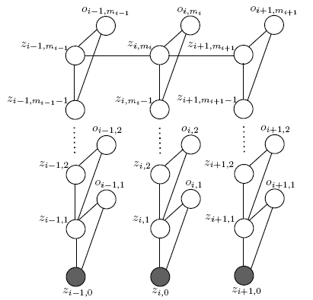

CRF-QR Extended model
multiple refinement tasks needed
Basic
y_{i-1}
y_{i}
y_{i+1}
hotel book
Original Query
Expected Query
hotel bopk
hotel booking
book
booking
hotel book
book
Extended
x_{i-1}
x_{i}
x_{i+1}
bopk
Notes:
The basic model assumes that only one refinement task can be applied to a query word. Actually, we need multiple refinement tasks for each query word. for example, if the original query and expected refined query are like these, in basic model, we are not able to find the expected query, while in the extend model we can. Therefore we consider the extend model where we allow multiple sequences of operations on each query word. We retain all the possible refined words and make a prediction at the final stage. We can have the model represented in this form and the learning and prediction is almost the same as the basic model. and we use this extended model in our experiments later.

Slide 19
Outline
Motivation
Our Approach
Experimental Results
Conclusion
Notes:
Now I will show you the experimental results.

Slide 20
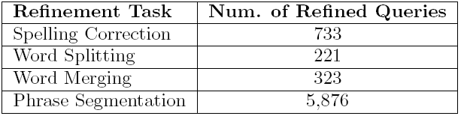
Experimental Result
Data Set
Random select 10,000 queries
Average length: 2.8 words
Four human annotators
Four refinement types:
Spelling error correction
Word merging
Word splitting
Phrase segmentation
Training 7000 Testing 3000
Notes:
The data set includes ten thousand queries randomly selected from the query log of a commercial web search engine. We asked four human annotators to manually refine the queries according to four refinement types. We only consider these tasks since we can define a clear spec for them.

Slide 21
Baseline Method
Cascaded approach
Build one sub-model for each task
Same structure and feature set for each sub-model
Sequentially connect the sub-models in different orders
Generative approach
Source channel model for spelling error correction, word splitting and word merging
Channel model: Assume equal translation probabilities
Source model: Language probabilities
Mutual Information for phrase segmentation (cf. [5])
Spelling Error Correction
Word Splitting
Word Merging
Word Splitting
Spelling Error Correction
Word Splitting
…
Word Merging
Word Merging
Spelling Error Correction
Phrase Segmentation
Phrase Segmentation
Phrase Segmentation
Notes:
There are two baseline methods. One is the cascaded model, for which we build one sub-model for each task where each sub-model has the same structure and feature set as the basic model but only consider one refinement task. We sequentially connect the sub-models in different orders. Another baseline method is the generative approach, where we use source channel model for spelling error correction, word splitting and merging, for query segmentation, we use mutual information as previous work.

Slide 22
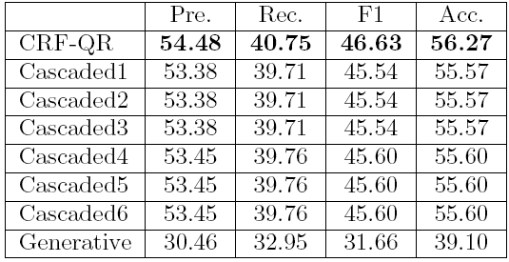
Experiment on Query Refinement
Comparisons between CRF-QR and Baselines on Query Refinement at Query level (%)
Relative Improvement: F1 Score 2.26% Accuracy 1.21%
Notes:
First, we did experiments on query refinement, we can see that our approach outperforms all the other baseline methods in terms of all measures and all the improvement is statistical significant.

Slide 23
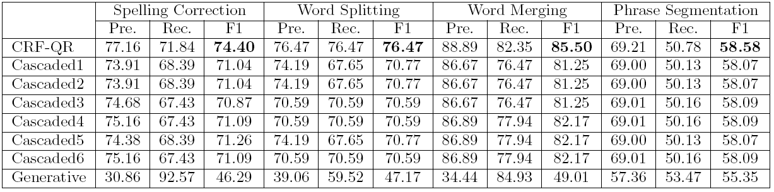
Cont’
Comparisons between CRF-QR and Baselines on Query Refinement Tasks (%)
CRF-QR performs best!
Notes:
If we break down to see the performance on each refinement task, again we can see that CRF-QR performs best on each task.

Slide 24
Case Study
Why CRF-QR can outperform the Baseline methods?
Cascaded approach suffers from the neglect of mutual dependencies between tasks
E.g. nypark hitel → ny “park hotel”
Cascaded approach accumulate errors
E.g. bankin las vegas → banking “las vegas” (bank in “las vegas”)
Generative approach produces more incorrect results
E.g. pick up stix → pick up six door to door → “door to” door
Notes:
We did some case study to see why CRF-QR can outperform the baseline methods. There are several reasons, for example, the cascaded approach failed on such cases where spelling error correction and word splitting are dependent on each other.

Slide 25
Error Analysis
(1) Errors were mainly made by one of the refinement tasks
E.g. parnell roberts → pernell roberts
Adding new features
Increasing data size for language model training
(2) Competition between refinement tasks
E.g. skate board dudes → “skate board” dudes (skateboard dudes)
Adding new features
Increasing training data size
(3) Some queries were difficult to refine even for humans
E.g. ohio buckeye card → “ohio buckeye” card (ohio “buckeye card”)
Notes:
We also did some error analysis on our approach and find we can reduce some types of errors by adding new features and increasing the size of training data.

Slide 26
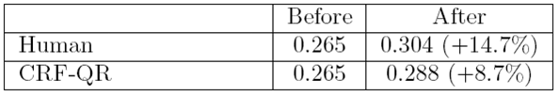
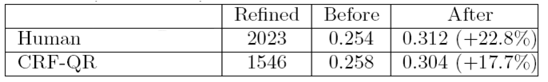
Experiment on Relevance Search
Measure: NDCG
Results on Relevance Search with Entire Query Set (NDCG@3)
Results on Relevance Search with Refined Queries (NDCG@3)
Notes:
We did another set of experiments to see whether our approach can help improve search relevance . We use NDCG as our measure. We submit the query before refinement and after it to the search engine and got the returned results. We ask human annotators to make judgments on the top 3 results. And from these results we can see that our approach can significantly improve the search relevance.

Slide 27
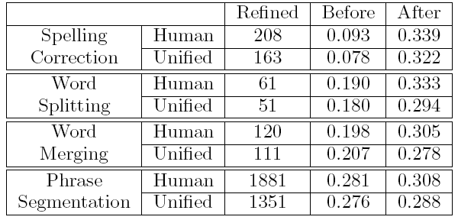
Cont’
Results on Relevance Search by Query Refinement Tasks (NDCG@3)
Notes:
Moreover, we can also break down to see that each refinement task can help improve the search relevance.

Slide 28
Outline
Motivation
Our Approach
Experimental Results
Conclusion
Notes:
Finally ,the conclusion.

Slide 29
Conclusion
Query Refinement
Automatically reformulate ill-formed queries
Better represent users’ search needs
CRF-QR model
Unified
Discriminative
Experimental results
Query Refinement
Relevance Search
Notes:
We addressed the issue of query refinement in our work. Which is to automatically reformulate ill-formed queries to better represent users’ search needs. We proposed CRF-QR for this problem , which is a unified and discriminative model suitable for query refinement. Experiment results show that significant improvements can be obtained by our approach both on query refinement and relevance search.

Slide 30
Thank You!

