Slide 1
Named Entity Recognition in Query
Jiafeng Guo¹, Gu Xu², Xueqi Cheng¹,Hang Li²
¹Institute of Computing Technology, CAS, China
²Microsoft Research Asia, China
Notes:
Good morning everyone. I will present our work, named entity recognition in query.

Slide 2
Outline
Problem Definition
Potential Applications
Challenges
Our Approach
Experimental Results
Summary
Notes:
Here is the outline of the talk. I will first give a formal definition of named entity recognition in query. Then, I show how it can help real applications.
Named entity recognition has been studied for years. Comparing with existing work, what’s the challenges of the problem. Finally, I introduce our solution, experimental results, and summarize the talk.

Slide 3
Outline
Problem Definition
Potential Applications
Challenges
Our Approach
Experimental Results
Summary

Slide 4
Problem Definition
Named Entity Recognition in Query (NERQ)
Identify Named Entities in Query and Assign them into Predefined Categories with Probabilities
Harry Potter
0.5
0.1
0.4
Movie
Book
Game
Harry Potter Walkthrough
0.0
1.0
0.0
Movie
Book
Game
Notes:
Named entity recognition in query is to identify named entities in queries, and assign them into predefined categories with probabilities. For example, given query “harry potter”, we should identify the whole query is a named entity, and it more likely refers to movie and book, but less likely a game. If the query is harry potter walkthrough, we should segment the named entity “harry potter”, and classify it as game because the indication from its context walkthrough.

Slide 5
Outline
Problem Definition
Potential Applications
Challenges
Our Approach
Experimental Results
Summary

Slide 6
NERQ in Searching Structured Data
harry potter walkthrough
Unstructured Queries
Smarter Dispatch
This query prefers the results from the “Games” database
Better Ranking
“harry potter” should be used as key to match the records in the database, and further ranked by “walkthrough”
Books
Movies
Games
NERQ Module
Structured Databases
(Instant Answers, Local Search Index, Advertisements and etc)
Notes:
First of all, nerq would help structured data search. The structured data can be instant answers in web search, or local search index, or advertisements. When use input something, nerq wil help on two things. First of all, it can dispatch the request smarter. In this case, we will know that the results from game database will be preferred. Also it can help ranking by treating the entity part differently.

Slide 7
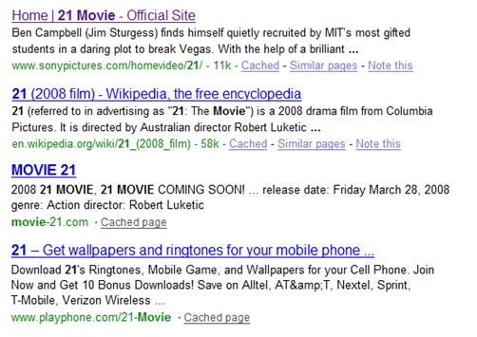
NERQ in Web Search
Search results can be better if we know that
“21 movie” indicates searcher wants the movie named 21
Notes:
Nerq can also help web search. Suppose we have the query “21 movie”. Human can easily tell the last two results are irrelevant. We can improve the search results if we know the intent of the query is to find the name named 21.

Slide 8
Outline
Problem Definition
Potential Applications
Challenges
Our Approach
Experimental Results
Summary

Slide 9
Challenges
NER (Named Entity Recognition)
Well formed documents (e.g. news articles)
Usually a supervised learning method based on a set of features
Context Feature: whether “Mr.” occurs before the word
Content Feature: whether the first letter of words is capitalized
NERQ
Queries are short (2-3 words on average)
Less context features
Queries are not well-formed (typos, lower cased, …)
Less content features
Notes:
NER is a traditional problem in NLP, and has been studied for years.

Slide 10
Outline
Problem Definition
Motivation and Potential Applications
Challenges
Our Approach
Experimental Results
Summary

Slide 11
Our Approach to NERQ
q
Harry Potter Walkthrough
e
t
“Harry Potter” (Named Entity) + “# Walkthrough” (Context)
c
“Game” Class
Goal of NERQ becomes to find the best triple (e, t, c)* for query q satisfying
Notes:
The results of nerq to split the query into the named entity part, e, and context part t. Also assign a class c to the named entity e. So, we can formulize the problem of nerq as this. In all possible e,t,c triples for query q, find the one gives the maximum likelihood. Finally, the problem becomes to correct estimate the three terms.

Slide 12
Training With Topic Model
Ideal Training Data T = {(e_{i}, t_{i}, c_{i})}
Real Training Data T = {(e_{i}, t_{i}, *)}
Queries are ambiguous (harry potter, harry potter review)
Training data are a relatively few
Notes:
Ideally, if we have this type of training data, it is easy, just maximize the joint probability. However, in real cases, we can hardly have such kind of training data. There are two reasons. First of all the queries are often ambiguous. One can hardly label them, for example harry potter can be a book, a movie and a game. Secondly, even without the ambigous problem, It is still hard to collect enough training data to estimate the probabilities. We can consider c is hidden, and take a summation. Finally have this.

Slide 13
Training With Topic Model (cont.)
e
t
c
harry potter
kung fu panda
iron man
……………………
……………………
…………………………………………
……………………
# wallpapers
# movies
# walkthrough
# book price
……………………
……………………
…………………………………………
Movie
Game
Book
……………………
# is a placeholder for name entity. # means “harry potter” here
Topics
Notes:
We can take a closer look on it. Each e here is a named entity, let’s consider it as a id of a document. Here, we group all the context belonging to one entity, let’s consider them as virtual words. Each topic will have it own distribution over these words. For example, movies would prefer the context like # movies. So, this part actually forms a topic model. It seems that we can solve the problem through a topic model.

Slide 14
Weakly Supervised Topic Model
Introducing Supervisions
Supervisions are always better
Alignment between Implicit Topics and Explicit Classes
Weak Supervisions
Label named entities rather than queries (doc. class labels)
Multiple class labels (Binary Indicator)
Kung Fu Panda
?
?
Movie
Game
Book
Distribution Over Classes
Notes:
However, normally, topic model are unsupervised. We would like to introduce supervisions into the topic model. First, supervisions are always good. But more importantly, we need supervisions to align the implicit topics with our predefined categories.
So, what’s kind of supervision we can leverage? We can easily have labels on named entities rather than queries. It can be considered as the document-level labels rather than the word level. Due to the ambiguity of named entities, we will have multiple labels on named entities, and they will be binary indicators. People can hardly give the exact probabilities, but can easily say kung fu panda is a movie and game, but not a book. It is a weak supervision. In the four distributions, the first thee ones are all compactable with the binary labels.

Slide 15
Weakly Supervised LDA (WS-LDA)
LDA + Soft Constraints (w.r.t. Supervisions)
Soft Constraints
LDA Probability
Soft Constraints
Document Probability
on the i-th Class
Document Binary Label
on the i-th Class
Topic
1 1 0 0
Notes:
To guide the LDA training with these weak supervisions, we proposed weakly supervised LDA. We convert the supervisions into soft constraints. The final objective function becomes LDA log likelihood plus soft constrains. the soft constraints are defined in this way. z bar i is the expected document probability on ith class, and y_i is the binary label on the ith class. Let’s consider four topics. If we have a label like this, the soft constraints is actually the sum of this part. It encourage the document have bigger probabilities on labeled classes.

Slide 16
System Flow Chat
Online
Offline
Create a “context” document for each seed and train WS-LDA
Input Query
Set of named entities with labels
Evaluate each possible triple (e, t, c)
Contexts
Find new named entities by using obtained contexts and estimate p(c|e) using WS-LDA and p(e)
Results
Entities
Notes:
Here is the system flow of nerq system. First of all, we start from limited number of entities with multiple labels. We use those entities to scan the query log, extract contexts associated with each name entities. Then we can train a WSLDA model on that data. Then we have P t give c.
We then use obtained contexts to scan the query log again. For each potential named entity we can use the LDA model to inference P c give e. P e is estimated by the frequency of e in this paper.
In the online stage, we can quickly calculate the probability of all possible triples, and output the ones have the largest probabilities.

Slide 17
Outline
Problem Definition
Motivation and Potential Applications
Challenges
Our Approach
Experimental Results
Summary

Slide 18
Experimental Results
Data Set
Query log data
Over 6 billion queries and 930 million unique queries
About 12 million unique queries
Seed named entities
180 named entities labeled with four classes
120 named entities are for training and 60 for testing

Slide 19
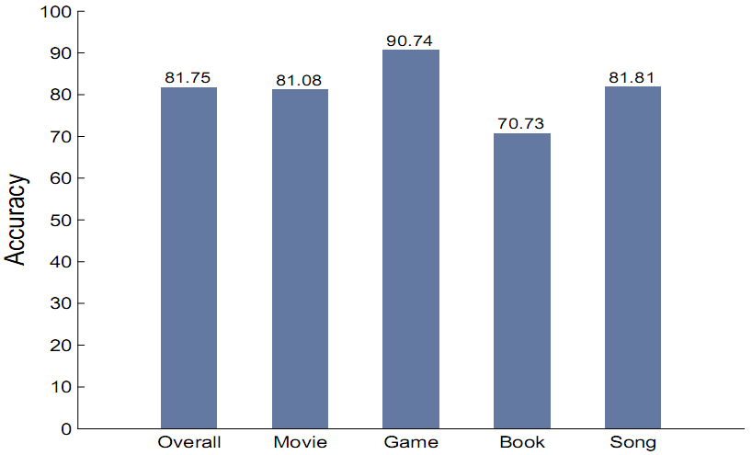
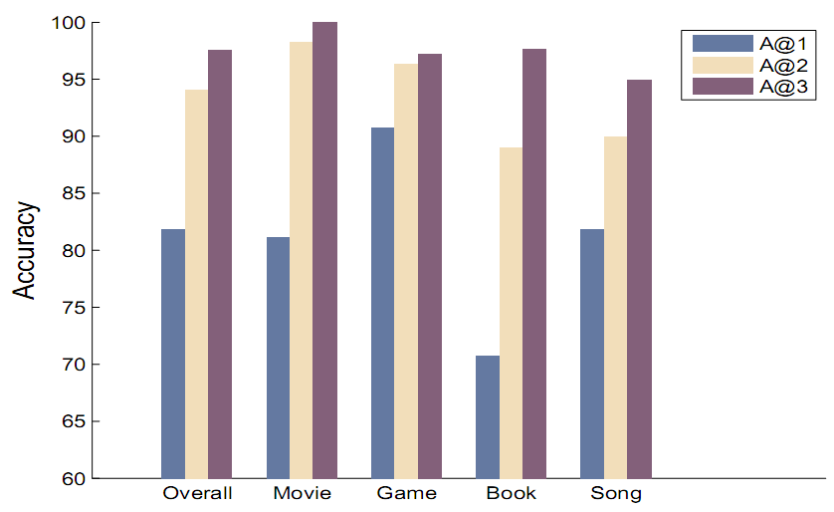
Experimental Results (cont.)
NERQ Precision
Notes:
We first take a look on the precision of our NERQ solution. We use top N accuracy as the measure. We consider the algorithm results are correct if the correct results can be found in algorithm top N results. We can see that even the top n accuracy seems very good.

Slide 20
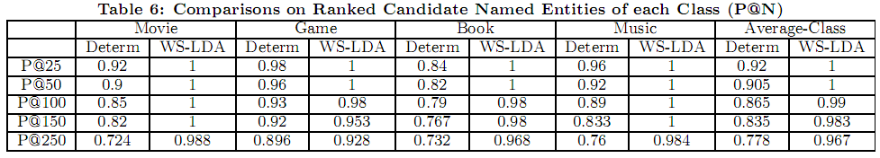
Experimental Results (cont.)
Named Entity Retrieval and Ranking
class distribution
Aggregation of seed context distributions (Pasca, WWW07)
p(t |c) from WS-LDA model
q(t |e) as entity distribution
Jensen-Shannon similarity between p(t |c) and q(t |e)
Notes:
Pasca ever proposed a deterministic approach to mine the named entities from query log. Our approach is in part inspired by her work but takes a probabilistic approach to model the ambiguity of named entities.
We can use our estimated probabilities to do Named Entity Retrieval and Ranking. We use the same method proposed by Pasca and also compare with it. We can see that our algorithm can also give better results in terms of P@N

Slide 21
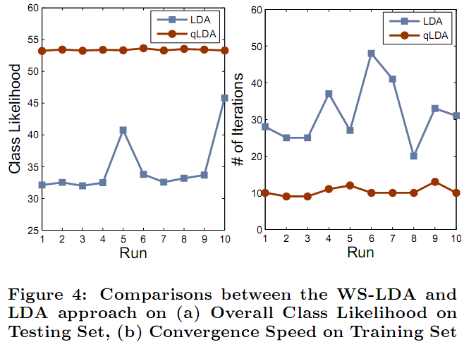
Experimental Results (cont.)
Comparison with LDA
Class Likelihood of e:

Slide 22
Outline
Problem Definition
Motivation and Potential Applications
Challenges
Our Approach
Experimental Results
Summary

Slide 23
Summary
We first proposed the problem of named entity recognition in query.
We formulized the problem into a probabilistic problem that can be solved by topic model.
We devised weakly supervised LDA to incorporate human supervisions into training.
The experimental results indicate that the proposed approach can accurately perform NERQ, and outperforms other baseline methods.

Slide 24
Thanks!

