Slide 1


A Unified Framework of Recommending Diverse and Relevant Queries
Institute Of Computing Technology Chinese Academy Of Sciences
Speaker: Xiaofei Zhu
Institute of Computing Technology
Chinese Academy of Sciences, P.R. China
(Joint work with Jiafeng Guo, Xueqi Cheng)
Notes:
网络数据实验室。今天我报告的题目是：关注多样性和相关性的一致性查询推荐框架。

Slide 2
Outline
Introduction
Our Approach
Experiments
Summary

Slide 3
Outline
Introduction
Our Approach
Experiments
Summary

Slide 4
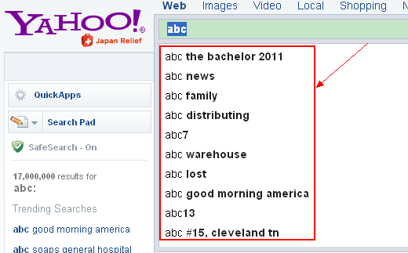
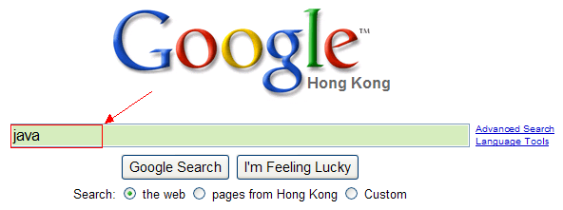
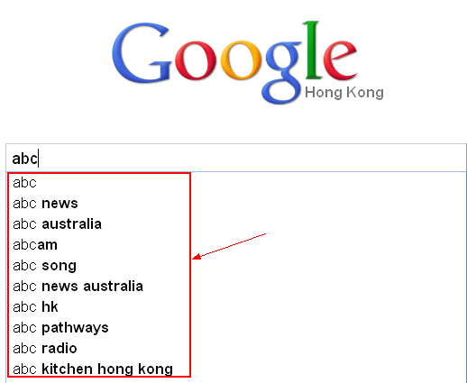

Motivation
Given query : ‘abc’
'abc shows'
'abc television'
'abc tv'
'abc news'
'abc breaking news'
e.g.
rank
(1) Only recommend relevant queries is enough?
Very short
Relevance is enough?
Very short
words are ambitious
words are ambitious
users lack of domain-specific knowledge
users lack of domain-specific knowledge
Notes:
Search engine has become an indispensable tool for Web users to seek their desired information.
However, it is never easy for users to formulate a proper query to search because query is usually very short and words are ambiguous. Furthermore, users sometimes cannot express their search intent precisely due to the lack of domain-specific knowledge. Therefore, how to help users formulate a suitable query has been recognized as a challenging problem.
To overcome this problem, a valuable technique, query recommendation, has been employed by most commercial search engines, such as Google, Yahoo!, and Bing, to improve usability. Query recommendation aims to suggest queries that may better reflect users' information needs to help them find what they need more quickly.
Traditional approaches mainly focused on recommending alternative queries with close search intent to the original query. However, to only take relevance into account may generate redundant recommendations to users.
For example, when a user issues a query ‘abc', the system may recommend him/her ‘abc television’and ‘abc tv', which are both very relevant to ‘abc' but of the equivalent meaning. Recommending such queries at the same time will decrease the recommendation quality since they provide almost the same information to users.
Therefore, it is important to provide diverse as well as relevant query recommendations. By reducing the redundancy, we are able to cover multiple potential search intents of users and minimize the risk that users will not be satisfied.

Slide 5
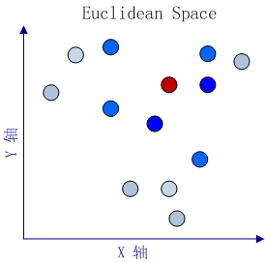
Motivation
(2) Is Euclidean space suitable?
The Red node is the input query.
More blue, more relevant
Notes:
In addition, previous query recommendation approaches mostly relied on measuring the similarity between queries in the Euclidean space, either based on query terms or click-through data. However, there is no convincing evidence that the query space is Euclidean.
(Furthermore, there also some works using query graph to do query recommendation, e.g., query flow graph or click graph.)

Slide 6
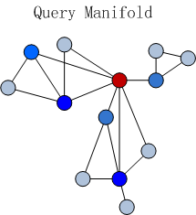
Motivation
The Red node is the input query.
More blue, more relevant
Notes:
Inspired by the research work on document modeling, it is more natural and reasonable to assume that the query space is a manifold. The local geometric structure is essential to reveal the relationship between queries. In our study, we find that ranking queries in terms of the intrinsic global manifold structure is superior to the pair-wise distance in the Euclidean space.

Slide 7
Contribution
Query Recommendation
relevance
diversity
Manifold ranking
Import stop points
A novel unified framework
Manifold ranking with stop points
Notes:
In this paper, we propose to recommend relevant and diverse queries based on the intrinsic query manifold. To the best of our knowledge, this paper is the first article attempt to utilize manifold ranking for query recommendation.
We propose a novel unified model, named manifold ranking with stop points, for query recommendation.
[1]To address relevance, our approach leverages a manifold ranking process over query manifold, which can naturally make full use of the relationships among queries to find relevant and salient queries.
[2]Meanwhile, we introduce the stop points into query manifold to capture the diversity during the ranking process. The stop points are points that stop spreading their ranking scores to their nearby neighbors during the manifold ranking process. By turning ranked queries into stop points, the ranking scores of other queries close to these stop points (i.e., queries which share similar search intent with the ranked queries) will be naturally penalized during the ranking process based on the intrinsic query manifold.
Therefore, our approach can generate query recommendations by simultaneously considering both diversity and relevance between queries in a unified way.
Like traditional manifold ranking algorithm, the new proposed ranking approach also shows a nice convergence property.

Slide 8
Outline
Introduction
Our Approach
Experiments
Summary

Slide 9
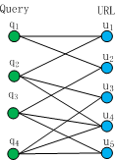
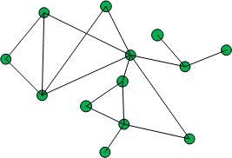
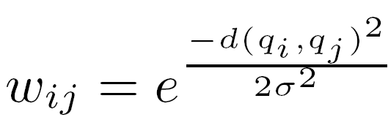
Our Approach
query₁
query₂
query_{n}
Affinity matrix W
Notes:
We use the click-through data to help us find similar queries. The basic idea is that if two queries share many clicked URLs, they have similar search intent to each other. Therefore, we model queries in terms of query-URL vectors, instead of query-term vectors.
The distance between two queries is then measured by the Euclidean distance between their normalized feature vectors.
With the definitions above, we construct the k-nearest-neighbor query graph as follows. Firstly, each query is represented as a data point on the manifold. We then connect any two points with an edge if they are among the k nearest neighbors to each other (k = 50 in our case).
We define an affinity matrix W for the query manifold.

Slide 10

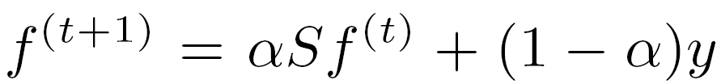

Our Approach
Traditional manifold ranking process
W- affinity matrix
D – diagonal matrix
Step 1:
Step 2:
Step 3:
Notes:
In the traditional manifold ranking process, all the points spread their ranking scores to their neighbors via the weighted graph.
The spread process is repeated until a global stable state is achieved, and all the points are ranked according to their final ranking scores.
With the traditional manifold ranking process, we can obtain relevant and salient queries for recommendation given the input query.

Slide 11
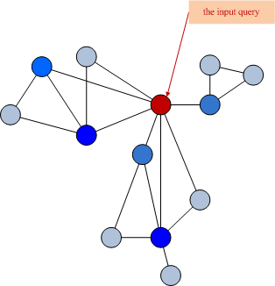
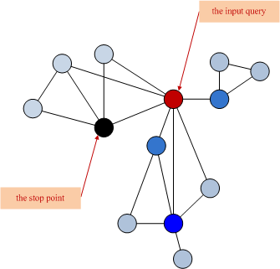
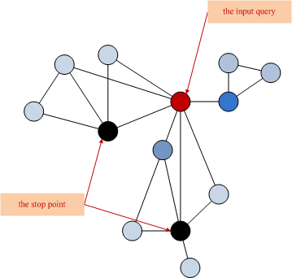
Our Approach
Manifold ranking with stop points
Notes:
To explicitly address the diversity of query recommendation, we introduce stop points into query manifold and propose a novel ranking approach, named manifold ranking with stop points.
The stop points are a special type of points on query manifold, which stop spreading their ranking scores to their neighbors during the manifold ranking process. Intuitively, we can imagine the stop points as the “black holes” on the manifold, where no ranking scores would be able to “escape” from them.
By turning ranked queries into stop points, the ranking scores of other queries close to the stop points (i.e., queries which share similar search intent with the ranked queries) will be naturally penalized during the ranking process based on the intrinsic query manifold.

Slide 12
Our Approach
(1)
(2)
(3)
(4)
Notes:
To derive the new iteration algorithm for manifold ranking with stop points. We rewrite the original iteration equation in traditional manifold ranking.
Let T denote the set of stop points, and R denote the set of free points (all the data points excluding the stop points). The normalized matrix S in traditional manifold ranking can then be reorganized as a block matrix, and the original iteration equation in step 2 can be written as the equation(2).
where fR and fT denote the ranking scores of points in set R and T respectively, and y_R and y_T denote the prior on the points in set R and T respectively.
Since stop points never spread their scores to their nearby points, we set S_RT = S_TT = 0, then we get the new iteration equation for manifold ranking with stop points, see equation (3).
As we turn the queries already selected for recommendation into stop points, the ranking scores of stop points are no longer useful for us since the stop points would not be selected later again. All we care about is the ranking scores of the free points in set R. Therefore, we only need to compute fR with the iteration equation (4).
The parameter alpha specifies the relative contributions to the ranking scores from neighbors and the initial ranking scores.

Slide 13
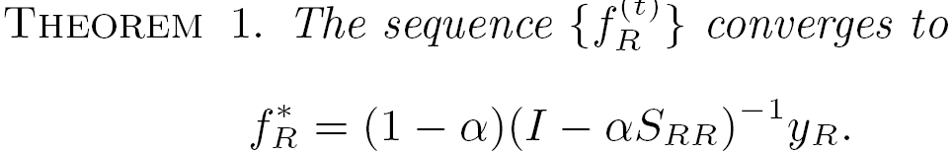
Our Approach
Notes:
It is important to know that, with the stop points introduced, the new iteration algorithm still has a nice convergence property, which means it can achieve a global stable state. This convergence property is shown in Theorem 1. We can proof the sequence {fR(t)} is convergence.
We can use this closed form to compute the ranking scores fR for all the free points directly. In large scale real-world problems, however, an iterative algorithm is preferable due to computational efficiency.

Slide 14
Detailed Algorithm
Until k recommendations acquired

Slide 15
Outline
Introduction
Our Approach
Experiments
Summary

Slide 16
Experiments
Data Set
  15 million queries (from US users) sampled over one month in May, 2006.
  Clean the raw data
    ignoring non-English queries
    replacing all non-alphanumeric characters in each query with whitespace.
    frequency less than 3 was removed
  After cleaning
    191,585 queries, 251,427 URLs and 318,947 edges.
    1.66 distinct URLs,1.27 distinct queries.
Notes:
Our experiments are based on the Microsoft 2006 RFP dataset which contains about 15 million queries (from US users) that were sampled over one month in May, 2006.
We cleaned the raw data by ignoring non-English queries, converting letters into lower case, and replacing all non-alphanumeric characters in each query with whitespace.
To further reduce the noise in clicks, the click-through between a query and a URL with a frequency less than 3 was removed.
After cleaning, we obtained the click-through data with totally 191,585 queries, 251,427 URLs and 318,947 edges. On average, each query clicks 1.66 distinct URLs, and each URL is clicked by 1.27 distinct queries.

Slide 17
Experiments
Baselines
  Pair-wise Based
    Naïve : only considers relevance
    MMR (Maximal Marginal Relevance) : a linear combination of relevance and diversity
  Graph Based
    Hitting time: boost long tail queries
    Grasshopper(Graph Random-walk with Absorbing StateS that HOPs among PEaks for Ranking) : absorbing random walk on the graph
Notes:
To evaluate the performance of our approach, called Mani_stop for short, for query recommendation, we adopt four baselines for comparison:
【Naive】Naive represents each query as a URL vector and directly measures the Euclidean distance between queries. For a given query, queries with smallest distance scores are ranked higher and selected as recommendations. Different from other baseline, this model only considers relevance for recommendation without emphasizing diversity.
【MMR】Maximal Marginal Relevance (MMR) is the most well-known method used for result set diversification. It has been widely used in the text summarization community. It measures the relevance and diversity independently and then provides a linear combination, called “marginal relevance”, as the metric. Then it utilizes a greedy strategy that iteratively selects the best scoring object.
【Hitting time】 Hitting_time recommends queries by using the hitting time from candidate queries to the test query as a measure for ranking. The basic idea of Hitting time is to boost long tail queries for recommendation.
【Grasshopper 】Grasshopper is the closest work to, which applies an absorbing random walk on the graph. (In order to achieve diversity, it turns the selected object into an absorbing state and then selects the next object based on the expected number of visits to each node before absorption.) Although our work share similar idea with this approach in handling ranked objects, they are largely different in ranking strategy. Grasshopper uses two different measures, i.e., stationary distribution and expected number of visits, to select the top ranked object. In contrast, all the objects are ranked with a consistent strategy (i.e., using their ranking scores) in our approach.
【DivRank】:A recent improvement on diversity ranking using random walk based approach is DivRank. DivRank employs a time-variant random walk process, which uses the rich-gets-richer mechanism in ranking. However, the main drawback is that the computation of the expected number of visits is intractable and has to resort to some approximation strategies.

Slide 18
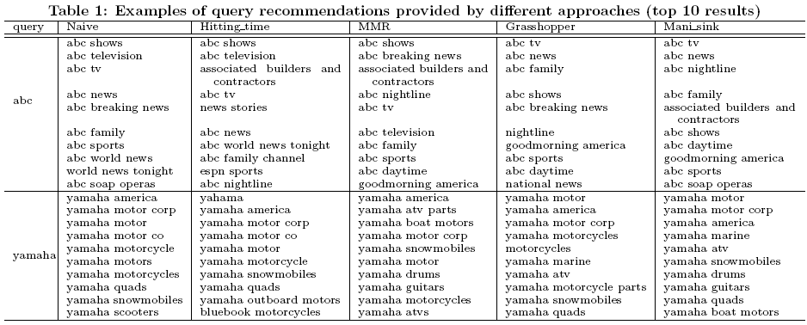
Case Study
Notes:
Table 1 shows two samples from our test queries including their top 10 recommendations generated by five methods.
From the results we clearly see that Naive approach tends to recommend closely related but somewhat redundant queries. For example, for the test query `abc', we can find equivalent recommendations like `abc tv' and `abc television', or recommendations sharing very close meaning like `abc news’, `abc breaking news' and `abc world news’.
Meanwhile, we can easily find that the three other baseline approaches (Hitting time, MMR, Grasshopper) recommended queries with better diversity. However, there is still some redundancy in these approaches. For example, for the test query `abc', `abc tv' and `abc television' are both recommended by Hitting time and MMR,
Moreover, the recommendation provided by Hitting time may not so closely related to the original query, e.g. recommendation of ‘espn sports' with respect to ‘abc’. Among all these approaches, we observe that our Mani stop approach obtains best performance, where more diverse as well as closely related queries can be found in its recommendation results.

Slide 19
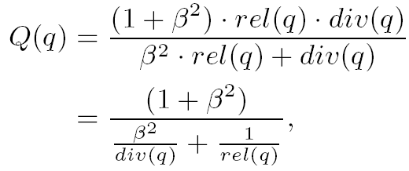
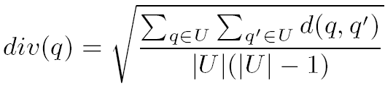
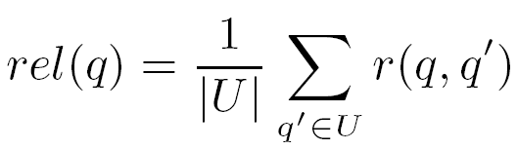
Experiments
Automatic Evaluation
  Open Directory Project(ODP) <-> Relevance
  Commercial search engine (i.e., Google) <-> Diversity
Evaluation metrics
  Relevance
  Diversity
  Q-measure
Notes:
Evaluating the quality of query recommendation is difficult, since there is usually no ground truth of recommendations. Here, we conduct both automatic evaluation and manual evaluation over query recommendation for more objective comparison between different approaches.
Since there is no evaluation metric that seems to be universally accepted as the best for measuring the performance of algorithms that aim to obtain diverse rankings. Therefore, for automatic evaluation, we adopt the following three metrics (Relevance, Diversity and Q-measure) to help evaluate the relevance and diversity in recommendation.
【Relevance】
We adopt the same method used by Baeza-Yates(巴埃萨-亚特) to evaluate the relevance of recommended queries. Specifically, we measure the relevance of two queries based on the similarity between their corresponding categories provided by ODP. Then for the test query, the relevance of its recommendations is defined as the average relevance between the given query and its recommendations.
【Diversity】
We measure the diversity of recommended queries based on the differences between their top ranked search results provided by Google. Specifically, given two queries, we compute the proportion of different URLs among their top k ( k = 10 in our case) search results.
Then for an input query, the diversity of its recommendations is defined as average the proportion of different URLs between all query pairs in its recommendations.
【Q-measure】
The two metrics above measure the relevance and diversity of recommendations respectively. It is better to have a measure which can combine these two aspects to have a comprehensive evaluation of the effectiveness of recommendation methods. Here we use a new metric to assess relevance and diversity tradeoff, referred as Q-measure. Formally, it is defined as the weighted harmonic mean of relevance and diversity.
where βis a parameter which can be used to control the tradeoff between relevance and diversity. If the value of β > 1, Q-measure then emphasizes the diversity. In our experiment settings, we have β= 1 which equally emphasize importance of relevance and diversity.

Slide 20
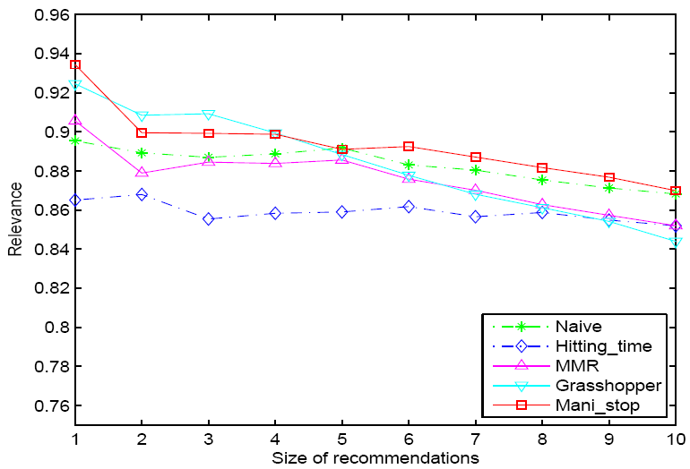
Experiments
Figure 1: Average Relevance of Query Recommendation over Different Recommendation Size under Five Approaches.
Notes:
Performance
T-test
Figure 1 shows the average relevance values of query recommendations under five different methods.
We notice that Mani stop can achieve better performance in relevance as compared with MMR and Naive methods, which directly measure the relevance between queries in a Euclidean space.
It demonstrates the effectiveness of the intrinsic query manifold in capturing the relevance between queries.
(We also note that the relevance of Grasshopper drops very quickly as the recommendation number increases, which makes its relevance performance not very stable.
Besides, the relevance value of Hitting time is lower than that of all the other four approaches on average. The major reason is that Hitting time employs the expected hitting time from other queries to the give query to rank recommendations, so that it can boost long tail queries for recommendation. However, the recommendations with low hitting time to the given query may not be necessarily closely related, and thus hurt the relevance performance. )

Slide 21
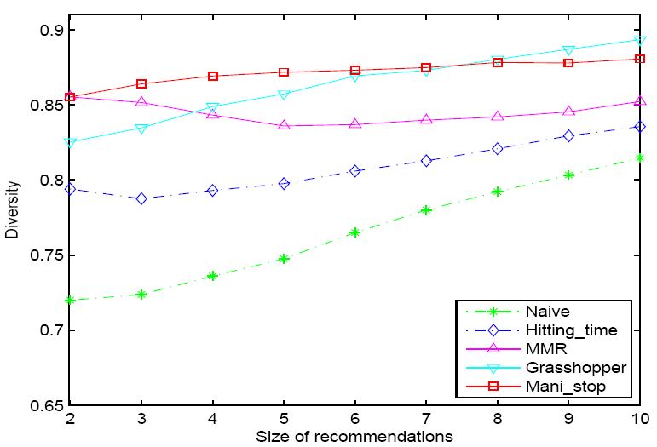
Experiments
Figure 2: Average Diversity of Query Recommendation over Different Recommendation Size under Five Approaches.
Notes:
The average diversity values of query recommendations under the five different approaches are shown in Figure 2. Not surprisingly, Our method obtains the highest diversity on average by introducing the stop points into query manifold.
(the diversity of Naive is the lowest one in the five approaches, since Naive only focuses on recommending queries according to their relevance with the input query. Hitting time obtains better diversity by boosting the long tail queries for recommendation, but the improvement is limited. Both MMR, Grasshopper and Mani stop can receive higher diversity value by explicitly address the diversity in ranking. Among these three approaches, Mani stop obtains the highest diversity on average (0.872) by introducing the stop points into query manifold.)

Slide 22
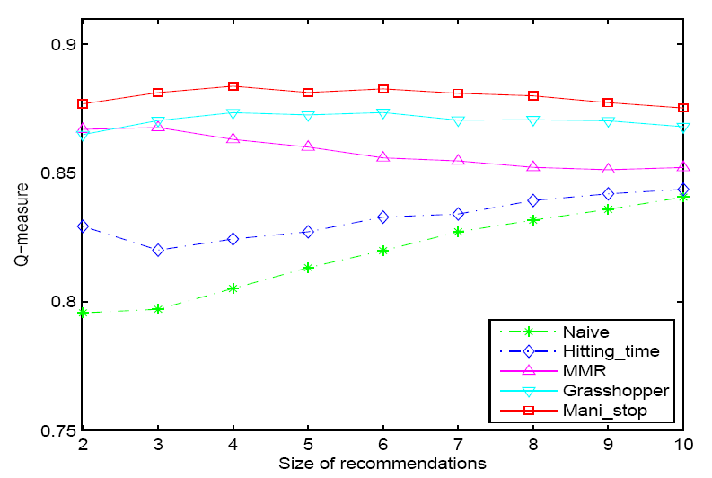
Experiments
Figure 3: Average Q-measure of Query Recommendation over Different Recommendation Size under Five Approaches.
Notes:
To better evaluate the overall effectiveness of different approaches, we show the Q-measure (a weighted harmonic mean of relevance and diversity) in Figure 3.
Among the five approaches, the proposed Mani stop approach consistently outperforms the other four baseline approaches in terms of Q-measure. We conduct t-test (p_value <= 0.05) over the results and find that the performance improvement is significant as compared with the baselines. These above results clearly confirm that our Mani stop approach can effectively generate highly diverse as well as closely related query recommendations.
(From the results, we can see that Hitting time works better than the Naive approach. Both MMR and Grasshopper can further outperform Hitting time, while Grasshopper obtains better results than MMR by leveraging a “soft" penalization.
)

Slide 23
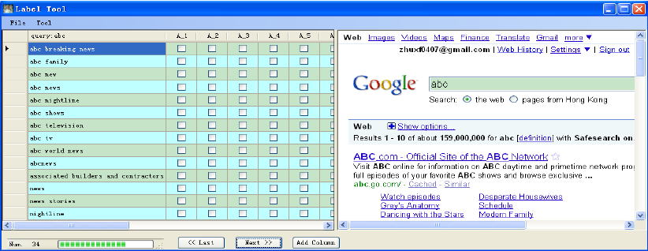
Experiments
Manual Evaluation
  Recommendation pool
  3 human judges
  Label tool
Recommendation pool
search results
Notes:
We further conduct manual evaluation for comparing different recommendation methods. For each query, we create a recommendation pool by merging the topmost (e.g., 10 in our work) recommendations from all the methods.
Then we invite 3 human judges to label the recommendations in the pool manually.
We create a label tool as shown in Figure 5 to help ease the labeling process. For each test query, the human judges are presented with the recommendation pool (the left panel), and the search results of the query from a commercial search engine (the right panel).
When labeling a recommendation, the human judge first takes a relevance assessment on the recommendation. If the recommendation is irrelevant to the test query at all, he just skips it. If relevant, he then needs to compare this recommendation with previous labeled recommendations and mark it in the same column as the one with the same search intent, or mark it in a new column (as a new intent), otherwise.
The human judges are allowed to use a search engine of their choice for better understanding the meaning of the query and the recommendations.

Slide 24
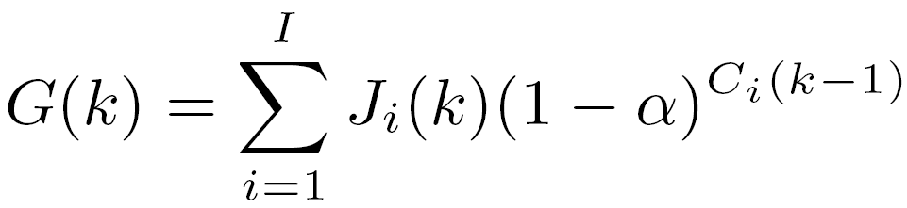

Experiments
Evaluation Metrics
  α-nDCG (α -normalized Discounted Cumulative Gain )
  Intent-Coverage
Notes:
With the human labeled data, here we evaluate the quality of the recommendations produced by different approaches using the following two measures: a-nDCG and Intent-Coverage.
【a-nDCG】
The a-nDCG, which rewards diversity in ranking, is a new version of the nDCG, the normalized Discounted Cumulative Gain measure. When a = 0, the a-nDCG measure corresponds to the standard nDCG, and when a is closer to 1, the diversity is rewarded more in the metric.
The key difference between a-nDCG and nDCG is that they use different gain value. For each recommendation, the gain value G(k) of a-nDCG is defined as follows:
where Ci(k-1) is the number of relevant recommendations found within the top k-1 recommendations for intent I, Ji(k) is a binary variable indicating whether the recommendation at rank k belongs to intent i or not, and I is the total number of unique intents for each test query.
【Intent-Coverage】
Intent-Coverage measures the proportion of unique intents covered by the top k recommended queries for each test query. Since each intent represents a specified user information need, higher Intent-Coverage indicates larger probability to satisfy different users.
The Intent-Coverage is formally defined as:
where Bi(k) is a binary variable indicating whether the intent i found within the top k recommendations or not, and I is the total number of unique intents for each test query.

Slide 25
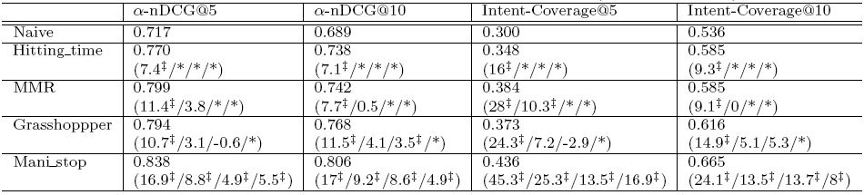
Experiments
Table 2: Performance of recommendation results over a sample of queries under five different approaches.
Notes:
In our experiments, we compare the performance of different methods in terms of a-nDCG@5, a-nDCG@10, Intent-Coverage@5, and Intent-Coverage@10. Table 2 reports the performance of different recommendation approaches under manual evaluation. The numbers in the parentheses are the relative improvements compared with baseline methods.
Compared with the four baseline methods, our Mani_stop approach achieves the best performance in terms of all measures, which is consistent with results reported in the automatic evaluation. We also conduct the t-test (p-value < 0.05) and find that the improvements over all baseline methods are significant.
It shows that by exploiting the intrinsic global query manifold structure and employing manifold ranking with stop points, we can recommend highly diverse as well as closely related queries.

Slide 26
Outline
Introduction
Our Approach
Experiments
Summary

Slide 27
Summary
A Novel Unified Model
  Relevant and salient queries
  Diverse
Experimental results
  Automatic evaluation
  Manual evaluation
Notes:
【A novel unified model】
We proposed a unified model which can simultaneously considering both diversity and relevance.
Our approach leverages a manifold ranking process over query manifold, which can naturally make full use of the relationships among queries to find relevant and salient queries. Meanwhile, we introduce the stop points into query manifold to capture the diversity during the ranking process.
Like traditional manifold ranking algorithm, the new proposed ranking approach also shows a nice convergence property.
【Automatic and Manual Evaluations】
We conducted both automatic and manual evaluations to demonstrate the effectiveness of our approach.
【Experimental results】
Experimental results on a large scale query log of a commercial search engine show that our approach can effectively generate highly diverse as well as closely related query recommendations.

Slide 28
Thank you!
Q&A
zhuxiaofei@software.ict.ac.cn

