Slide 1
More Than Relevance:
High Utility Query Recommendation By Mining Users' Search Behaviors
Xiaofei Zhu, Jiafeng Guo, Xueqi Cheng, Yanyan Lan
Institute of Computing Technology, CAS

Slide 2



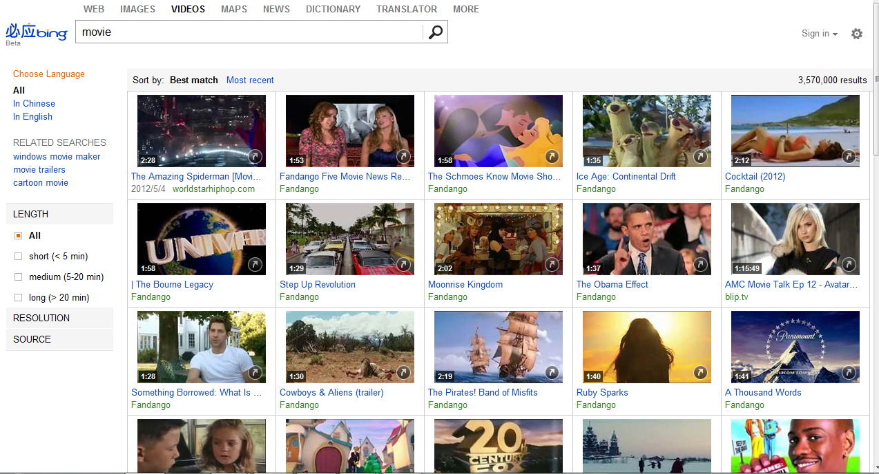

Motivation
Information Seeking Tasks
Find Web pages
Query
Locate resources
not easy to formulate properly
The ultimate goal of query recommendation
Assist users to reformulate queries so that they can acquire their desired information successfully and quickly
Access Info of topics

Slide 3
Motivation
  Relevant query recommendation:
  Providing alternative queries similar to a user’s initial query
Problem:
relevant query → satisfy users’ needs
X
not necessarily
Recommendations
Search results
Not directly toward the goal!
query 1
doc 1
doc 2
Original query
query 2
doc 3
query 3
doc 4
Relevant to users’ needs
Irrelevant to users’ needs
Notes:
【1】The ultimate goal of query recommendation is to assist users to reformulate queries so that they can accomplish their search task successfully and quickly
【2】Traditional query recommendation methods usually focus on recommend relevant queries，while without considering whether these recommended queries can return useful search results.

Slide 4
Motivation
Query Utility Definition:
The information gain that a user can obtain from the search results of the query according to her original information needs.
  High Utility Recommendation:
  Providing queries that can better satisfy users’ information needs
Recommendations
Search results
Directly toward the goal!
query 1
doc 1
doc 2
Original query
query 2
doc 3
query 3
doc 4
Relevant to users’ needs
Irrelevant to users’ needs
Notes:
【1】The ultimate goal of query recommendation is to assist users to reformulate queries so that they can accomplish their search task successfully and quickly
【2】Traditional query recommendation methods usually focus on recommend relevant queries，while without considering whether these recommended queries can return useful search results.

Slide 5
Motivation
true effectiveness of query recommendation
High Utility Recommendation
Emphasize users’ post-click satisfaction
Recommendations
Search results
query 1
doc 1
doc 2
Original query
query 2
doc 3
query 3
doc 4
Relevant to users’ needs
Irrelevant to users’ needs
Notes:
i.e., whether users will be satisﬁed by the recommendation after clicking it. We argue that users’
post-click satisfaction reﬂects the true eﬀectiveness of query recommendation

Slide 6
Challenges for high utility recommendation
  → How to infer query utility?
  Query Utility Model
  → How to evaluate?
  Two evaluation metrics

Slide 7






Our Approach
  how to infer query utility？
Key Idea: Through user’s search behaviors
A typical search session
  1. Attract more clicks
  2. Clicked results are relevant
ok
poor
better
Red - relevant √ - clicked
Perceived Utility
Posterior Utility
model the attractiveness
of the search results
model the satisfaction
of the clicked search results
Query Utility
Notes:
【1】Here we investigate search sessions to see what makes a query useful for users according to their original information needs. A typical search session is illustrated in the Figure.
【2】Given some information needs, a user submits an initial query to the search engine, and obtains some returned results. Here the documents which are relevant to the user's information needs are shown in red, otherwise in black. The user then goes through the search results, and clicks the second and third results for further inspecting (i.e.,~denoted by ticks before the results) as they seem to be relevant. The user obtains some useful information from the third result but is not satisfied yet. Therefore, the user reformulates the second query and submits it to the search engine. However, this time she finds no results are related and thus no clicks are performed on the results. Therefore, the third query is generated by the user. From the returned results, she finds two possibly relevant results, i.e.,~the first and third results, and clicks them for further inspecting. The user then accumulates enough information she needs and finishes the search process.
【3】From the above search session, we can see that the first and third queries are useful for the user according to her original information needs. It shows that the usefulness of a query should satisfy two conditions: 1) The query's search results should be attractive to the user, so that she would like to click the results for further inspecting, such as the first and third queries. If the search results do not attract the user to click, as in the second query case, the query will not be useful for the user even it contains relevant search results. 2) The clicked search results can actually satisfy the user to some extent by providing relevant information to her original needs, e.g.,~the first and third search results under the third query. Otherwise, the user cannot obtain any useful information after clicking, e.g.,~the second search result of the first query.
【4】Based on the above analysis, we further divide the utility of a query into two components. One is related to the attractiveness of the query's search results before the user actually inspects the contents of the corresponding URLs, referred as perceived utility, which models the probability that users click the search results of a query given their original needs. The other is related to the satisfaction from the clicked search results, referred as \textit{posterior utility}, which captures the actual information gain users obtain from the clicked search results given their original needs. The query utility is then defined as the product of the two components, which is the expected information gain users obtain from the search results of the query according to their original information needs.

Slide 8
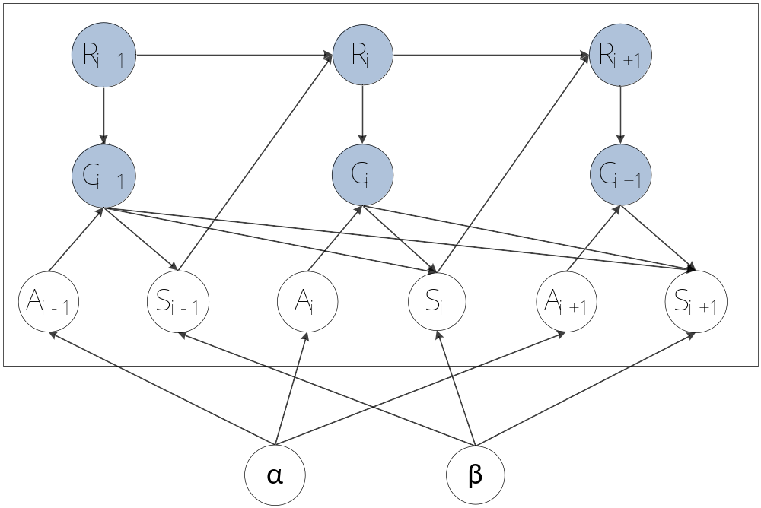




Query Utility Model (dynamic Bayesian network)
  how to infer query utility？
Perceived Utility α : control the probability of the attractiveness
Posterior Utility β : control the probability of users’ satisfaction
R_{i}： whether there is a reformulation at position i
C_{i}：whether the user clicks on some of the search results of the reformulation at position i;
Query Utility μ_{t}=α_{t}*β_{t}
A_{i}：whether the user is attracted by the search results of the reformulation at position I;
S_{i}：whether the user’s information needs have been satisfied at position i;
  The expected information gain users obtained from the search results of the query according to their original information needs
Notes:
【1】Based on the above analysis, we now introduce a novel dynamic Bayesian network, referred as Query Utility Model (QUM), to learn query utility based on users' search behaviors.
【2】This Figure plots the graphical model of QUM for a particular search session. For a particular search session, we define four binary random variables, $R_i$, $C_i$, $A_i$ and $S_i$ to model reformulation, click, attractiveness and satisfaction events at the i-th reformulation position:
R_i: whether there is a reformulation at position i;
C_i: whether the user clicks on some of the search results of the reformulation at position i;
A_i: whether the user is attracted by the search results of the reformulation at position i;
S_i: whether the user's information needs have been satisfied at position i;
where the first two events are observable from search sessions and the last two events are hidden.
【3】The full model specification that accompanies this Figure is as follows:
The user will reformulate queries sequentially, and stop reformulation if her information needs have been satisfied.
公式1：There are some clicks on the search results of a reformulated query if and only if the user reformulates the query and is attracted by the search results (1).
公式2：The probability of the attractiveness only depends on the search results of the reformulated query (2), which is controlled by the variable $\alpha_{\phi(i)}$, i.e.,~the perceived utility of the query at position i. Note here \phi(i) denotes the index of the query at the position i in a search session.
公式3：After the user clicks and inspects the search results, there is certain probability she will be satisfied at the current position.
The probability of users’ satisfaction at position i depends on how much utilities she has accumulated from the previously clicked search results (3). Note here C_{1:i} denote the vector (C_1,C_2,\cdots,C_i), \beta_{\phi(i)} denotes the posterior utility of the query at position i, I(C_k=1) is an indicator function, and \sigma(x) is the logistic function.
公式4：Once the user is satisfied, she will not reformulate the next query (4).
【4】In our model, there are two parameters $\alpha_t$ and $\beta_t$ related to the utility of a query. The first one models the perceived utility, as it reflects the attractiveness of a query's search results (i.e.,~the probability that users click the search results of the query given their original needs). The second one models the posterior utility, since it captures the satisfaction of a user from the clicked search results (i.e.,~the information gain users obtain from the clicked search results given their original needs). As aforementioned, we define the utility of a query as the expected information gain users obtained from the search results of the query according to their original information needs, which is the product of the two facts.

Slide 9
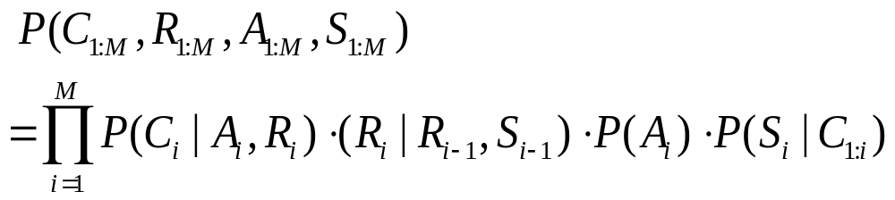
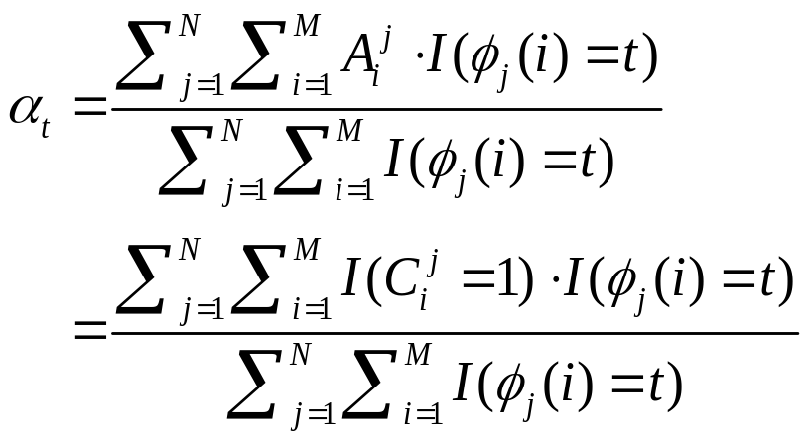
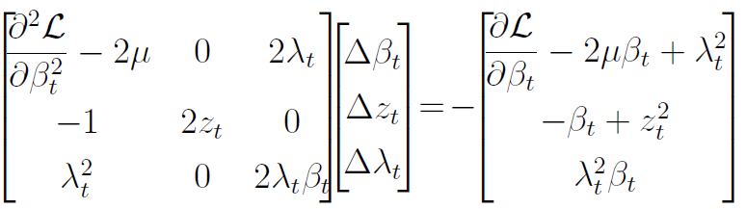
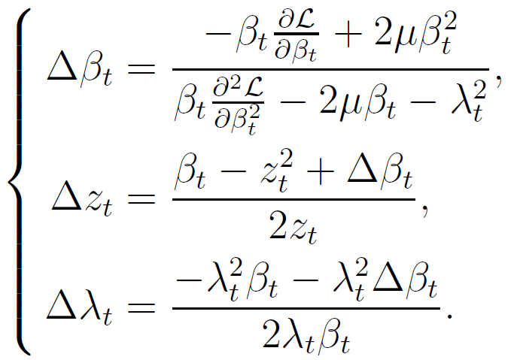
Parameter Estimation
  how to infer query utility？
Maximum Likelihood Estimation
Newton-Raphson Algorithm
Notes:
【1】We use the maximum likelihood estimation to estimate the model parameters $\alpha$ and $\beta$. For a specific search session with $M$ reformulations,the joint probability of all the variables is given by:

Slide 10
Evaluation
  how to evaluate？
Query Level Judgment
Original query
Recommendations
query 1
Relevant or Not?
Relevant = 1
Partial Relevant = 0.5
query 2
Relevant or Not?
Irrelevant = 0
query 3
Relevant or Not?
Notes:
【1】The Query Relevant Ratio (QRR) metric measures the probability that a user clicks relevant results when she uses query $q$ for her search task. A higher QRR means that a user will be more likely to click useful results with respect to the original information needs.
【2】The Mean Relevant Document (MRD) metric measures the average number of relevant results a user clicks when she uses query $q$ for her search task. A higher MRD means that a user will find more relevant results according to the original information needs.

Slide 11
Evaluation
  how to evaluate？
Document Level Judgment
Original query
Recommendations & Clickthrough
query 1
doc 1
doc 2
doc 3
Relevant or Not?
query 2
doc 1
Relevant or Not?
query 3
doc 1
doc 2
Relevant or Not?
Notes:
【1】The Query Relevant Ratio (QRR) metric measures the probability that a user clicks relevant results when she uses query $q$ for her search task. A higher QRR means that a user will be more likely to click useful results with respect to the original information needs.
【2】The Mean Relevant Document (MRD) metric measures the average number of relevant results a user clicks when she uses query $q$ for her search task. A higher MRD means that a user will find more relevant results according to the original information needs.

Slide 12
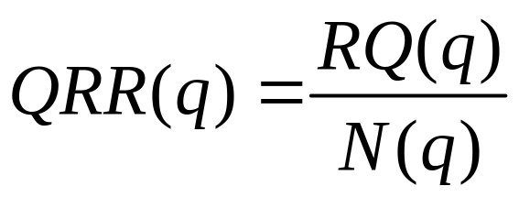
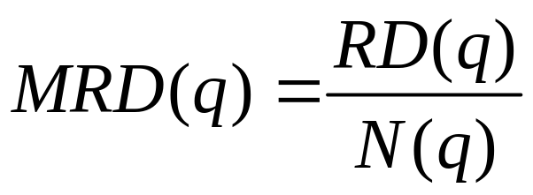
Evaluation
  how to evaluate？
  QRR (Query Relevant Ratio)
Measuring the probability that a user finds(clicks) relevant results when she uses query q for her search task.
  MRD (Mean Relevant Document)
Measuring the average number of relevant results a user finds(clicks) when she uses query q for her search task.
Notes:
【1】The Query Relevant Ratio (QRR) metric measures the probability that a user clicks relevant results when she uses query $q$ for her search task. A higher QRR means that a user will be more likely to click useful results with respect to the original information needs.
【2】The Mean Relevant Document (MRD) metric measures the average number of relevant results a user clicks when she uses query $q$ for her search task. A higher MRD means that a user will find more relevant results according to the original information needs.

Slide 13
Experiments
Dataset: UFindIt log data (SIGIR’11 Best Paper)
  A period of 6 months, consisting 1484 search sessions conducted by 159 users (reformulation and click).
  Manual relevant judgments on results with respect to the original needs
Data Processing:
  We process the data by ignoring some interleaved sessions, remove sessions which have no reformulations, and sessions started without queries, after processing, we obtain:
    1,298 search sessions
    1,086 distinct queries
    1,555 distinct clicked URLs
  For each test query, the average number of search sessions is 32 and the average number of distinct candidate queries is 26.
Notes:
【1】This dataset collected over a period of 6 months, consisting 1484 search sessions conducted by 159 users. Users' reformulation, click and answer behaviors are all recorded in this process, and the relevant results are manually judged.
【2】We process the data by ignoring some interleaved sessions, where the participants search for multiple information needs in one search process. We also remove sessions which have no reformulations, and sessions started without queries. After processing, we obtain $1,298$ search sessions, $1,086$ distinct queries and $1,555$ distinct clicked URLs. For each test query, the average number of search sessions is $32$ and the average number of distinct candidate queries is $26$.

Slide 14
Baseline Methods
  Frequency-based methods
  Adjacency (ADJ) (WWW 06)
  Co-occurrence (CO) (JASIST 03)
  Graph-based methods
  Query-Flow Graph (QF) (CIKM 08)
  Click-through Graph (CT) (CIKM 08)
  Component utility methods
  Perceived Utility (PCU)
  Posterior Utility (PTU)
Notes:
【1】To evaluate the performance of our QUM method, we compare it with four baseline query recommendation methods. These baseline methods can be grouped into two categories, namely frequency-based methods and graph-based methods:
【2】Frequency-based methods:
Adjacency (ADJ): Given a test query $q$, the top frequent queries in the same session adjacent to $q$ are recommended to users.
Co-occurrence (CO): Given a test query $q$, the top frequent queries co-occurred in the same session with $q$ are selected as recommendations
【3】Graph-based methods:
Query-Flow Graph (QF): This is a state-of-the-art query recommendation method proposed by Boldi et al.~\cite{boldi08:query}. In QF, a query-flow graph is first constructed based on collective search sessions, and a random walk is then performed on this graph for query recommendation.
Click-through Graph (CT): This is another state-of-the-art query recommendation method proposed by Mei et al.~\cite{mei08:query}. In CT, a query-URL bipartite graph is first constructed by mining query logs, a random walk is then performed on this graph and the hitting time is leveraged as a measure to select queries for recommendation.
【4】Besides, to further investigate the influence of the two component utilities (i.e.,~perceived utility and posterior utility) in our QUM method, we also use them separately to recommend queries as two baselines, namely Perceived Utility method (PCU) and Posterior Utility method (PTU).

Slide 15
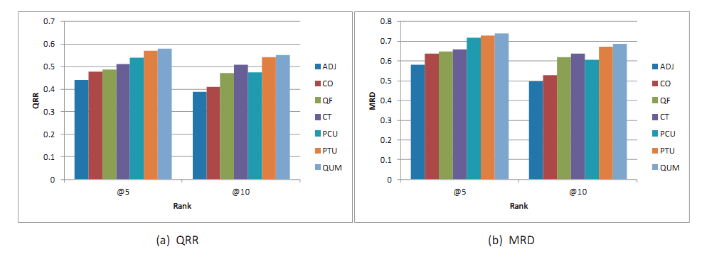
Experimental Results
Comparison of the performance of all approaches (ADJ,CO,QF,CT,PCU,PTU,QUM) in terms of QRR and MRD.
Our QUM method
The performance improvements are significant
(t-test，p-value <= 0.05)

Slide 16
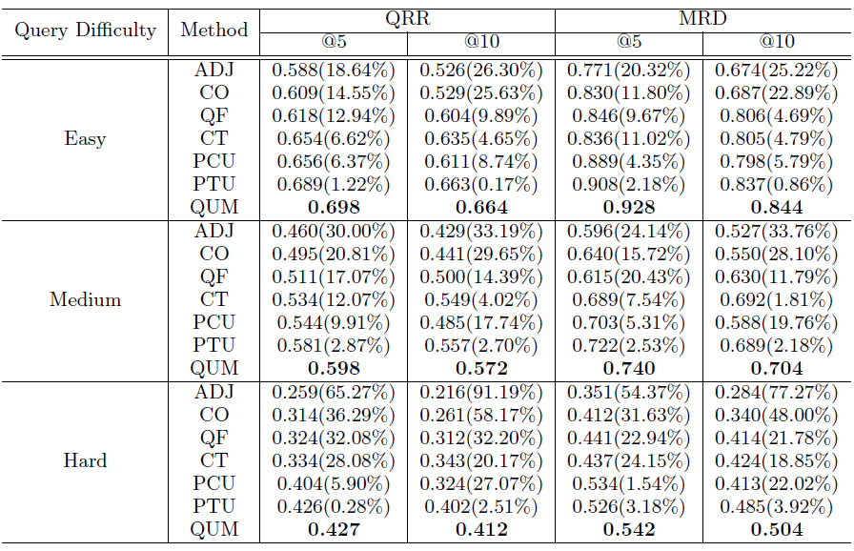
Experimental Results
The improvement is larger on difficult queries!
Notes:
【1】To further investigate the performance of our QUM method in high utility query recommendation, we break down the comparison among different approaches according to the query difficulty.
【2】QUM method consistently shows better performance than all the other methods under all the query difficulty levels.
【3】Interestingly, we can find that with the increase of the query difficulty, the improvements of our QUM method over other recommendation methods also increase. It shows that when users' search task is difficult, it would be more beneficial to directly recommend high utility queries beyond relevant queries.

Slide 17
Conclusions
  Contribution
  Recommend high utility queries rather than only relevant queries: to directly toward the ultimate goal of query recommendation;
  A novel dynamic Bayesian network (i.e., QUM) to mine query utility from users’ reformulation and click behaviors;
  Introduce two evaluation metrics for utility based recommendation
  Evaluate the performance on a real query log and show the effectiveness
  Future work
  Extend our utility model to capture the specific clicked URLs for finer modeling
Notes:
【1】In this paper, we argue that we shall recommend high utility queries rather than only relevant queries, to directly achieve the ultimate goal of query recommendation, i.e., to assist users to reformulate queries so that they can acquire their desired information successfully and quickly.
【2】We formally define the query utility and identify its two components (i.e.,~perceived utility and posterior utility). We then propose a novel dynamic Bayesian network QUM to infer query utility from users' search behaviors for recommendation.
【3】We evaluate the performance on a real query log, and the experimental results show that the proposed approach can outperform the state-of-the-art baselines in providing useful recommendations.
【1】For the future work, one major aspect is to improve our generative model to better capture query utility. As aforementioned, we may further extend our utility model to capture the specific clicked URLs for finer modeling.
【2】Besides, we may introduce a persistent parameter into our model to capture the case that the user stops searching because of impatience.
【3】Moreover, it would be interesting to take into account diversity in our model to reduce the redundancy in a set of recommended high utility queries.

Slide 18
Thanks! guojiafeng@ict.ac.cn

