Slide 1


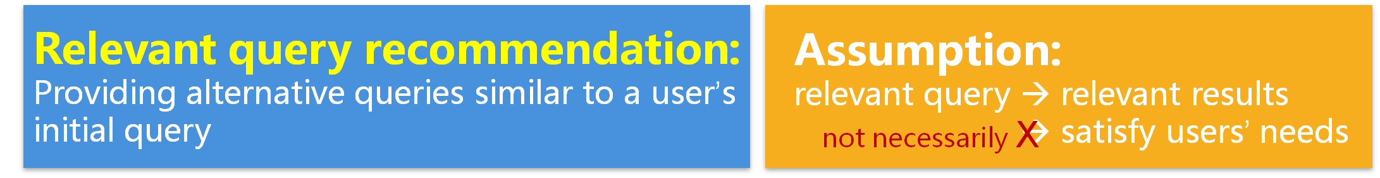
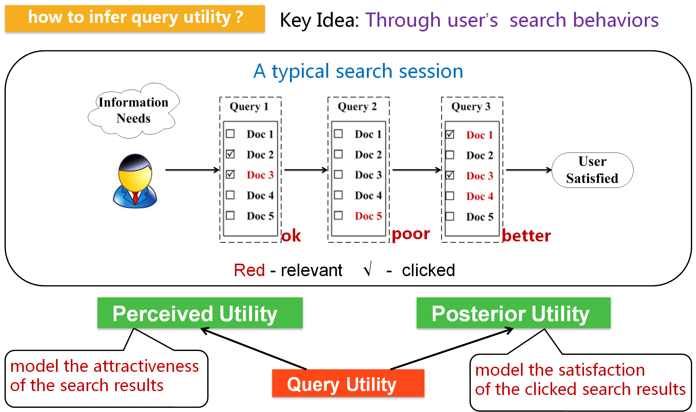
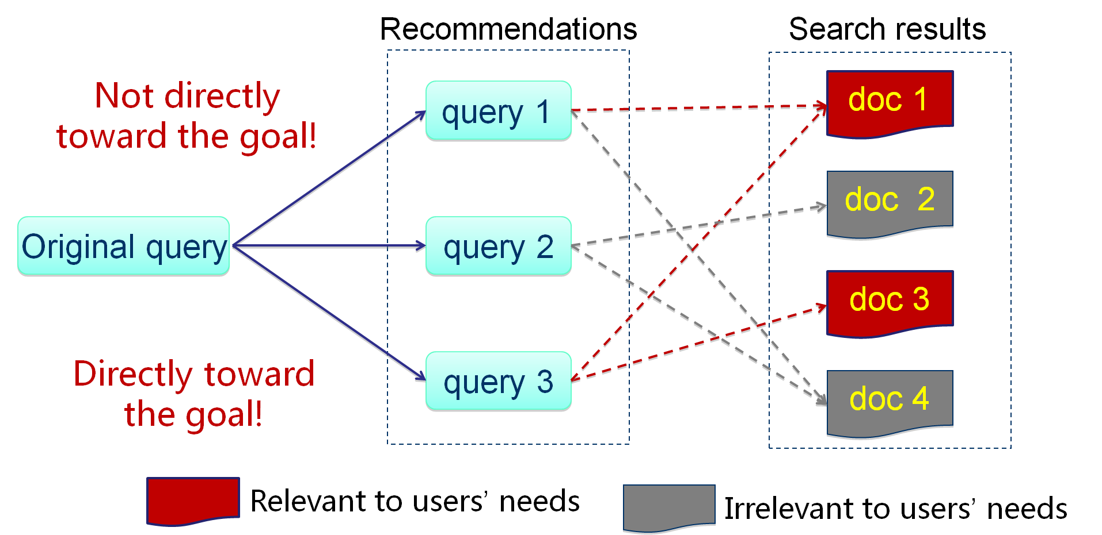
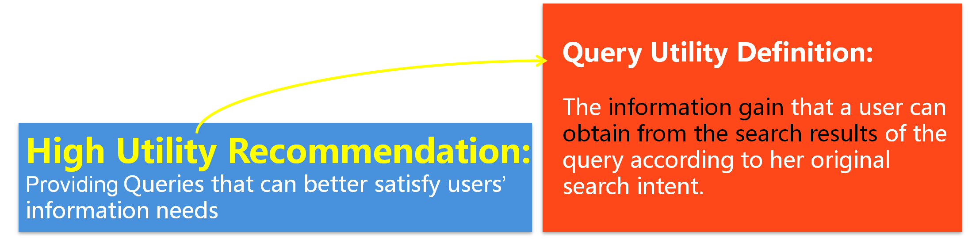
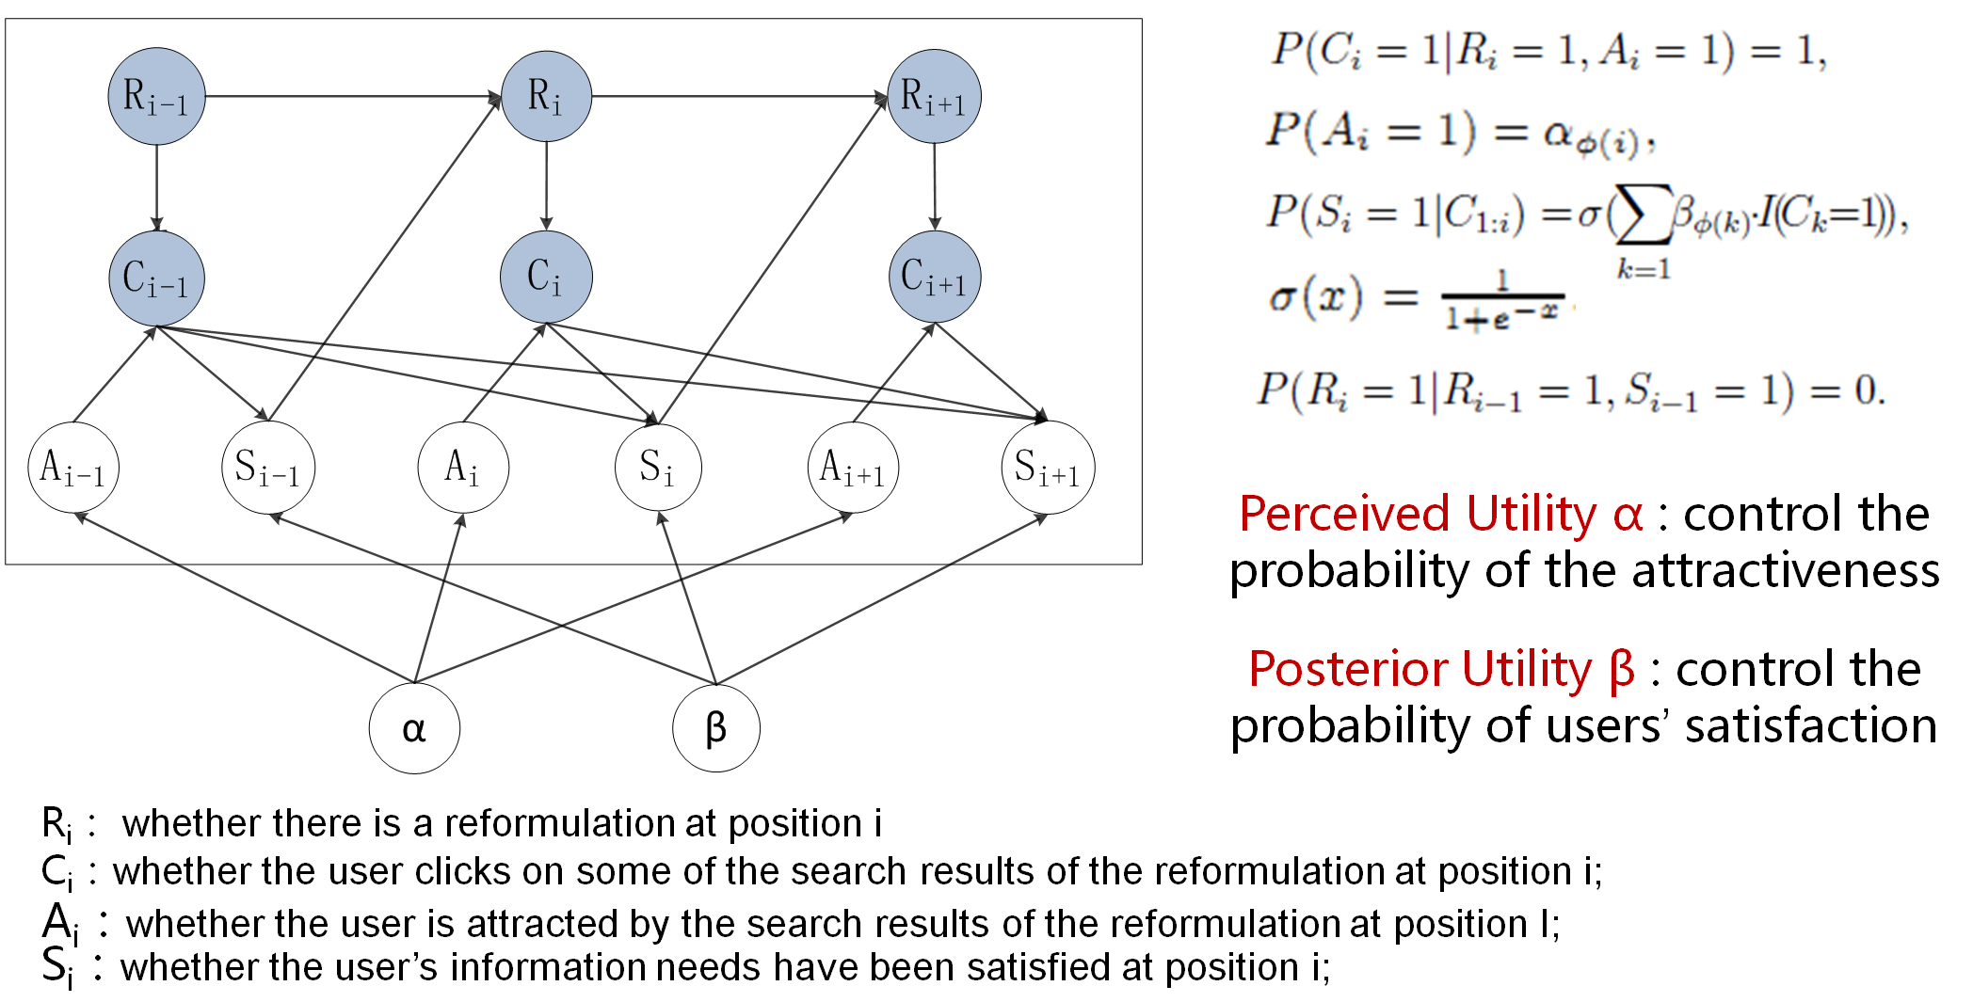
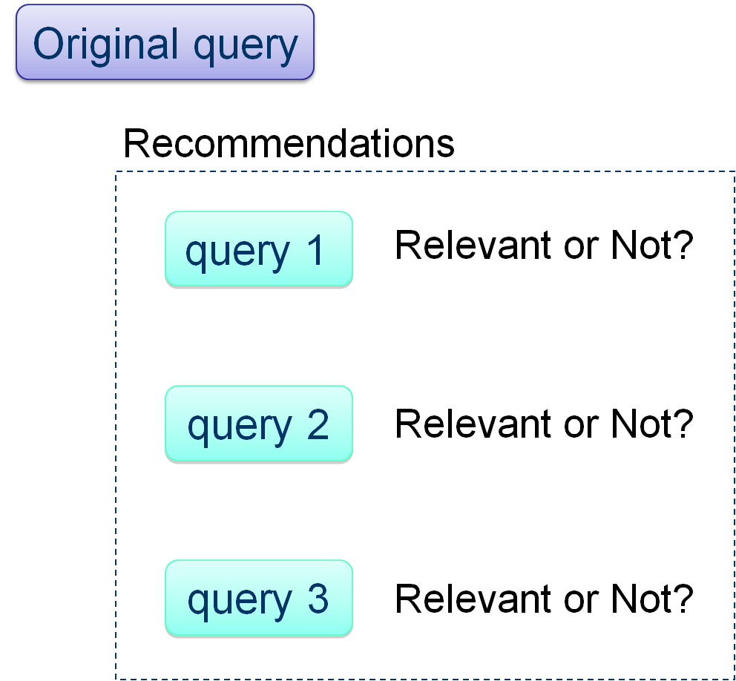
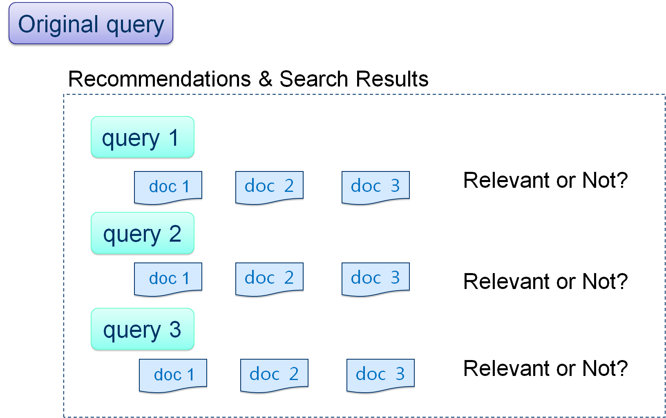
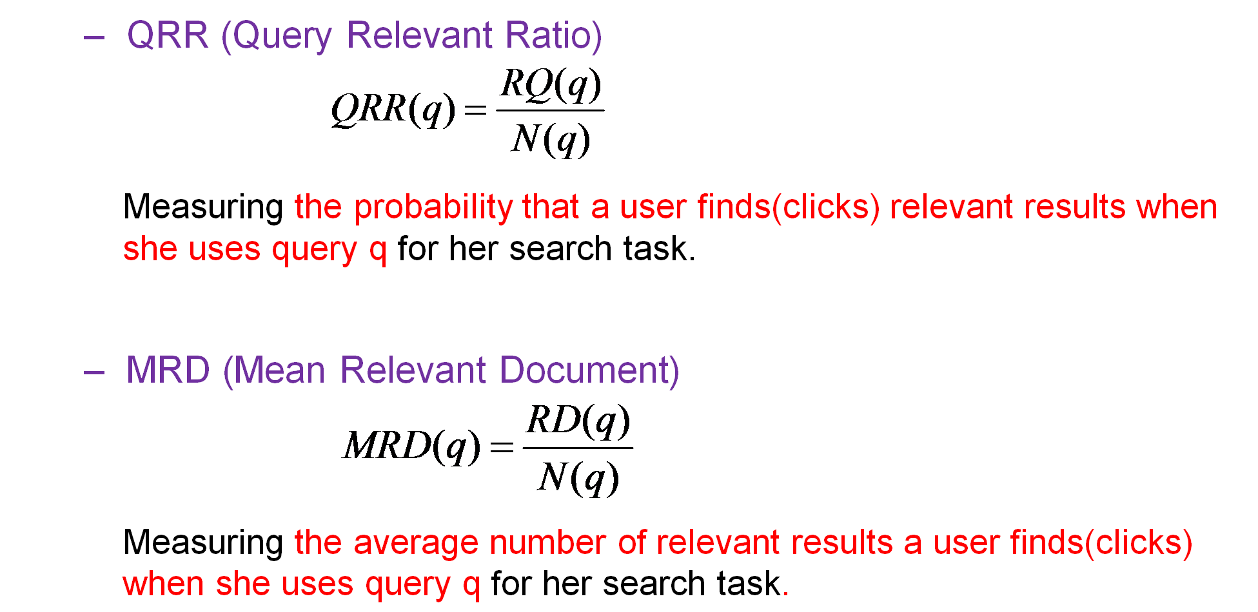

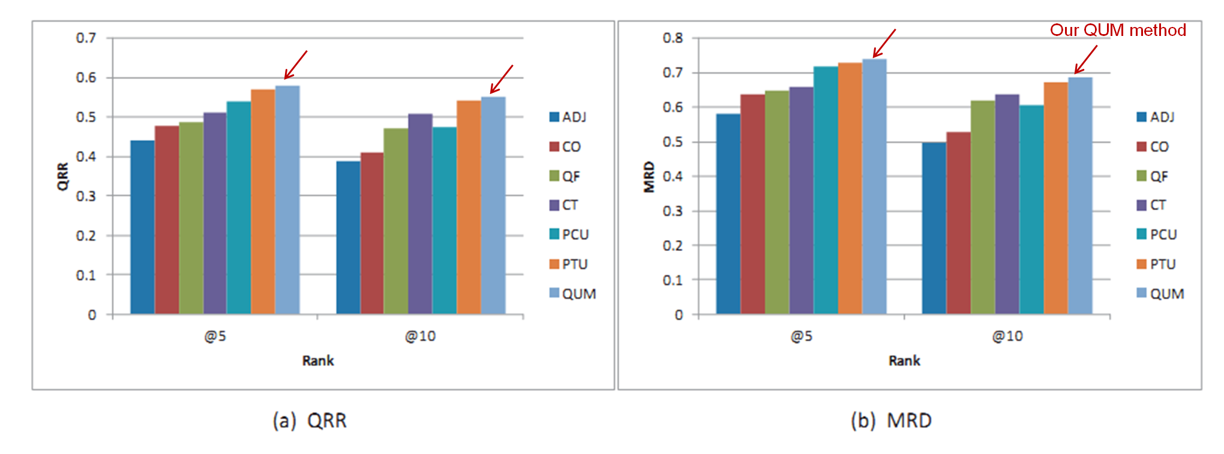
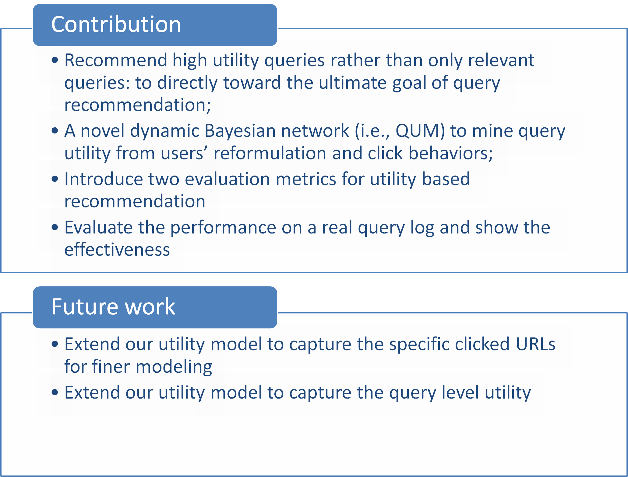
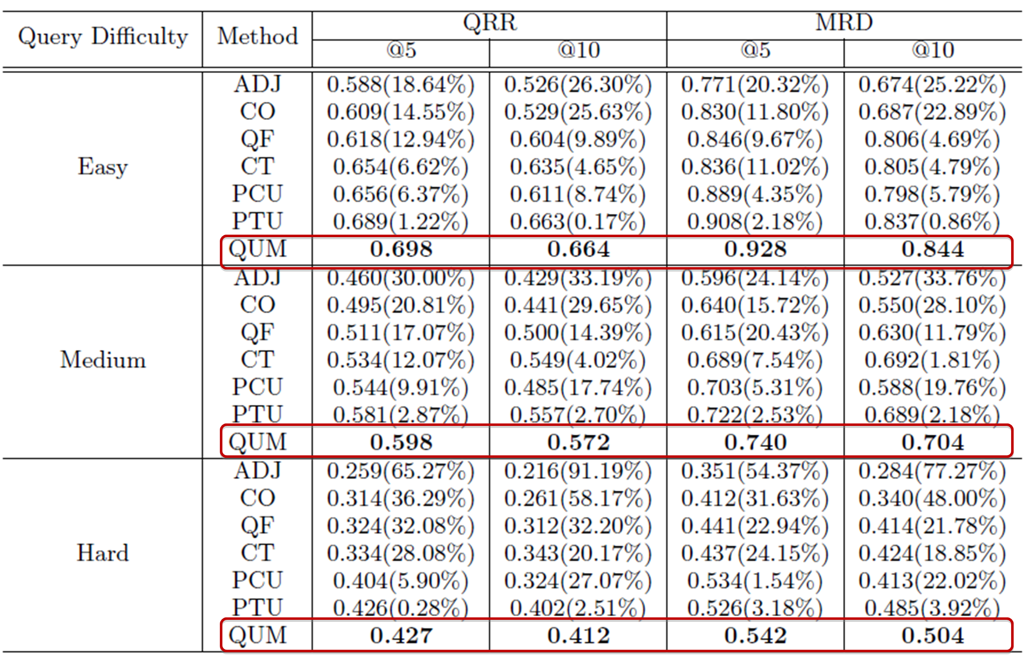

More Than Relevance: High Utility Query Recommendation By Mining Users' Search Behaviors
Xiaofei Zhu, Jiafeng Guo, Xueqi Cheng, Yanyan Lan
Institute of Computing Technology, Chinese Academy of Sciences
zhuxiaofei@software.ict.ac.cn, {guojiafeng, cxq, lanyanyan}@ict.ac.cn
1. MOTIVATION
2. KEY IDEA
3. QUERY UTILITY MODEL
4. EVALUATION METRICS
previous
our
5. EXPERIMENTAL RESULTS
6. CONCLUSIONS

