Slide 1


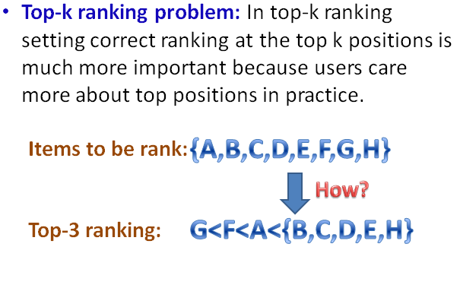
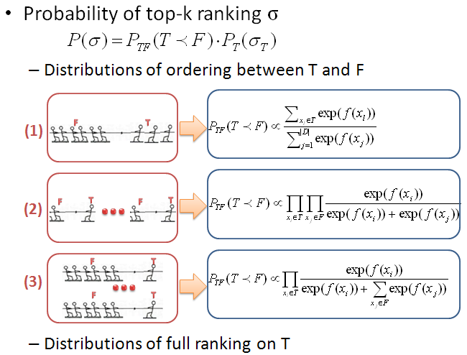
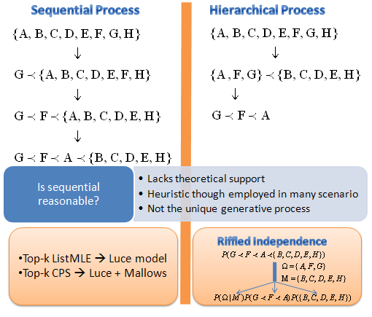
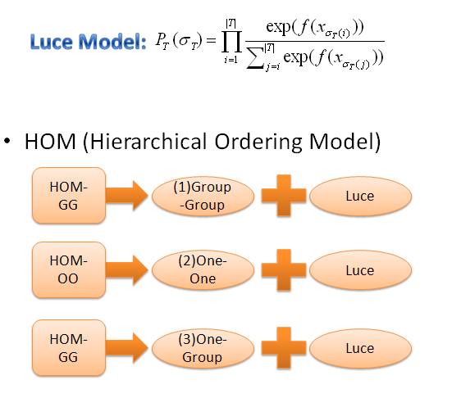
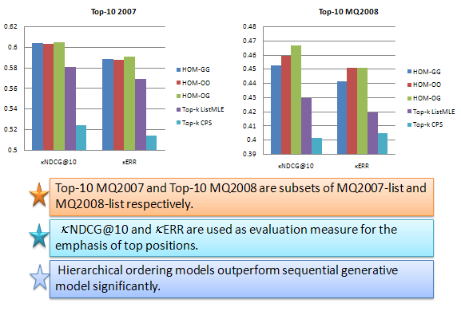
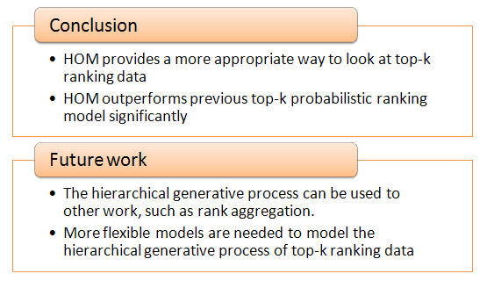
A New Probabilistic Model for
Top-k Ranking Problem
Shuzi Niu, Yanyan Lan, Jiafeng Guo, Xueqi Cheng
Institute of Computing Technology, Chinese Academy of Sciences
niushuzi@software.ict.ac.cn, {lanyanyan, guojiafeng, cxq}@ict.ac.cn
1. MOTIVATION
3. HOM (Hierarchical Ordering Model)
2. Ways to look at top-k ranking
4. EXPERIMENTAL RESULTS
5. CONCLUSIONS

