Slide 1


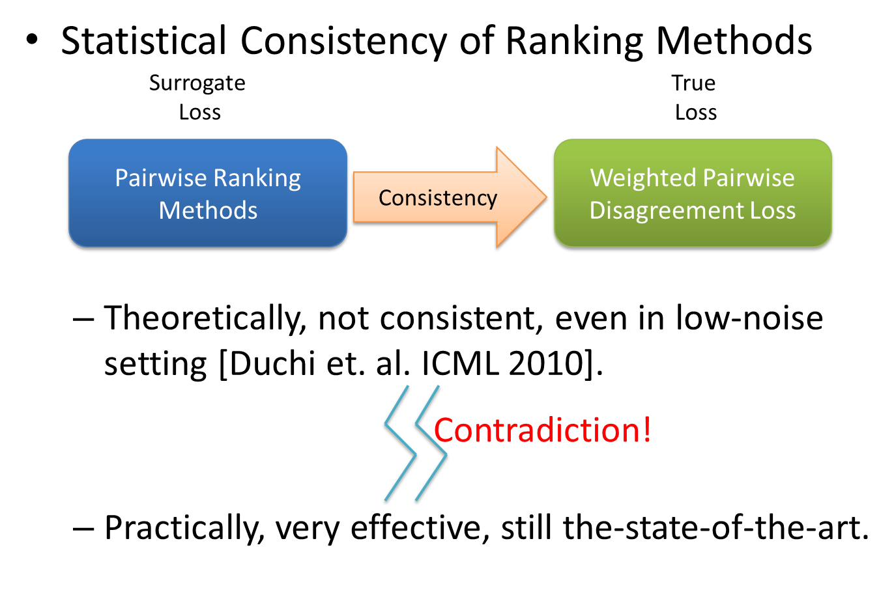
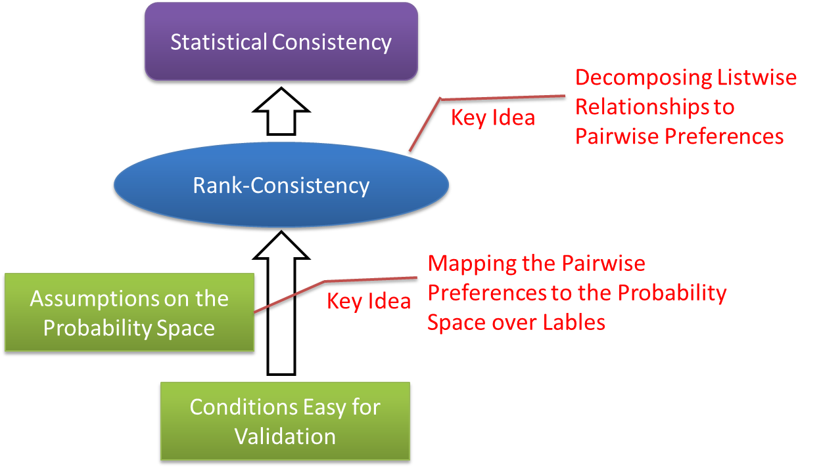
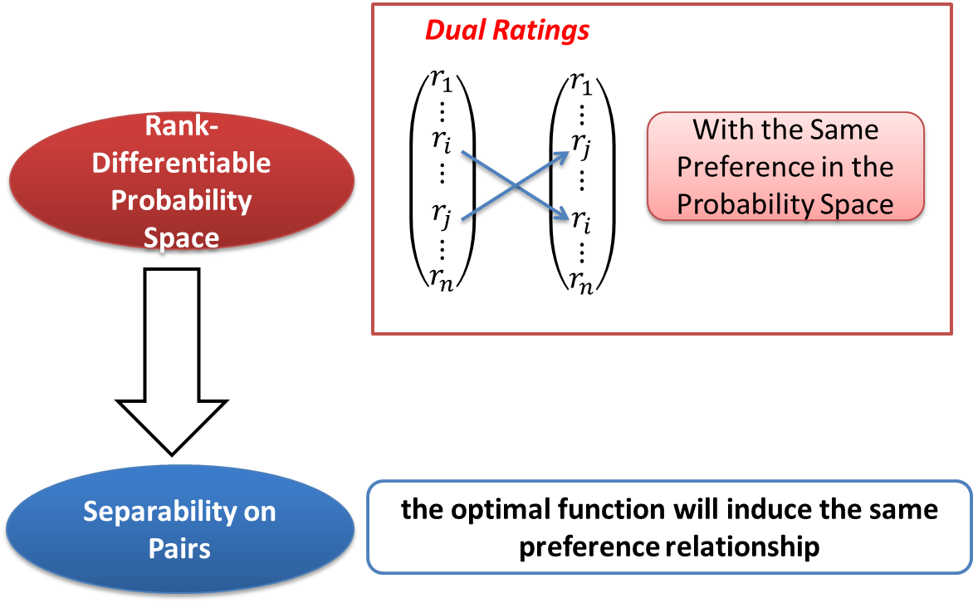
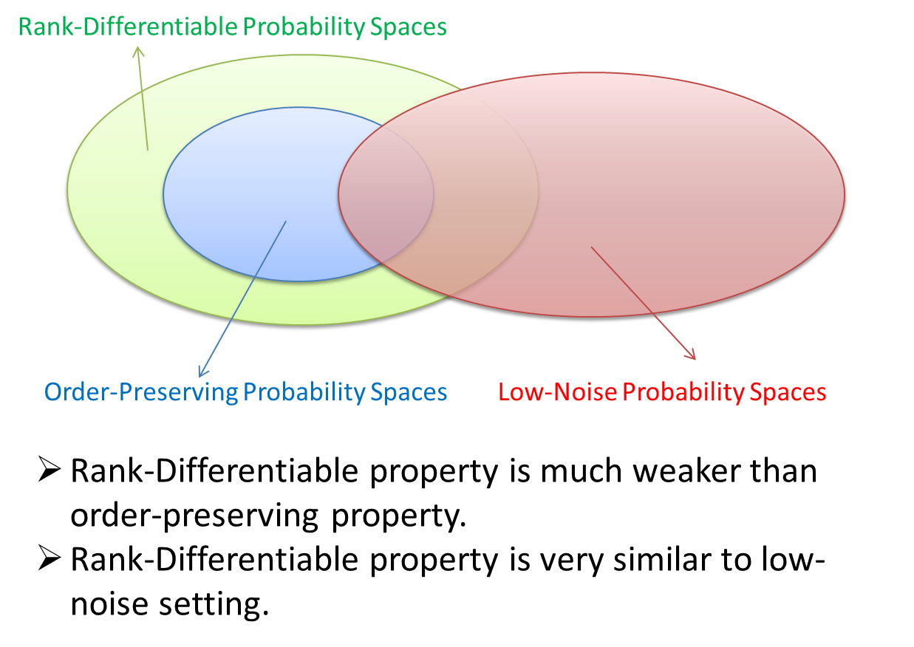
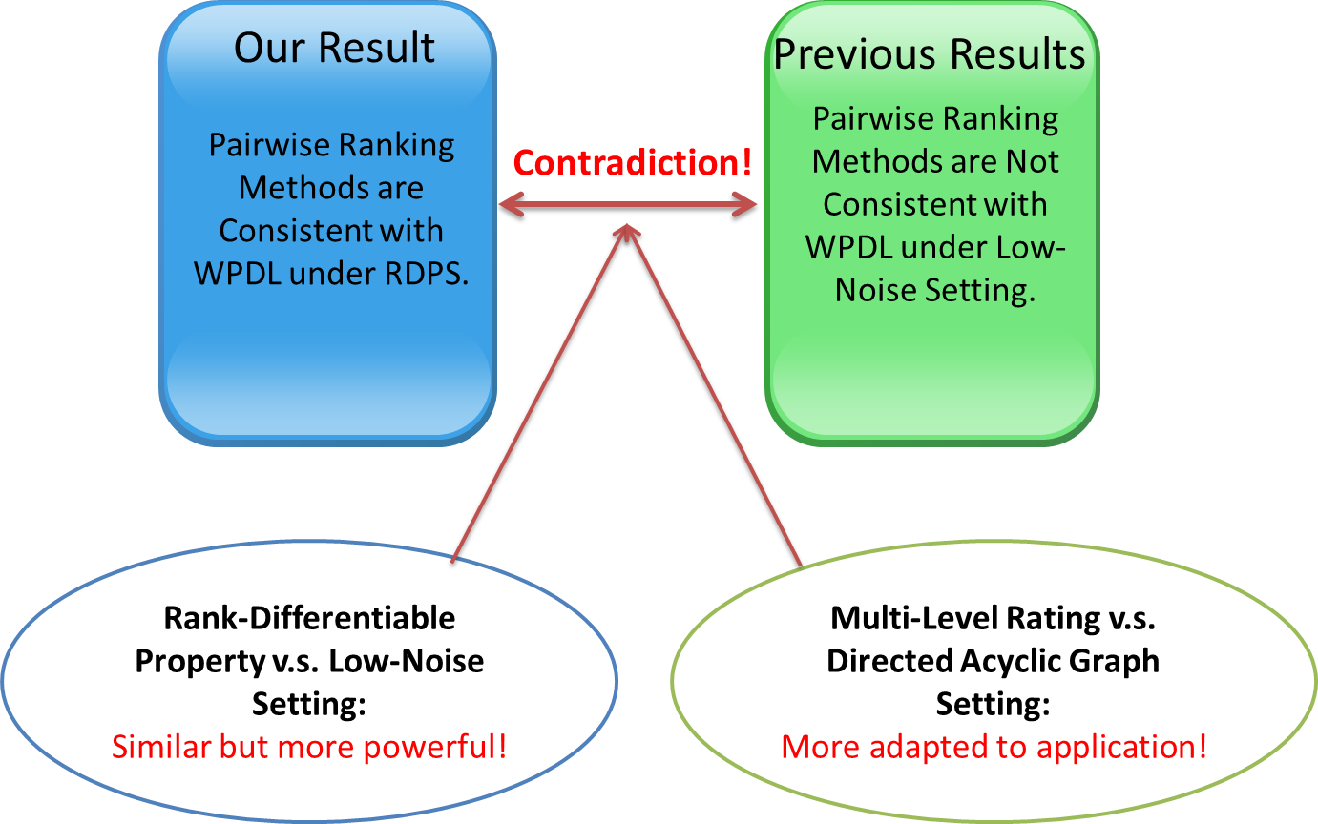
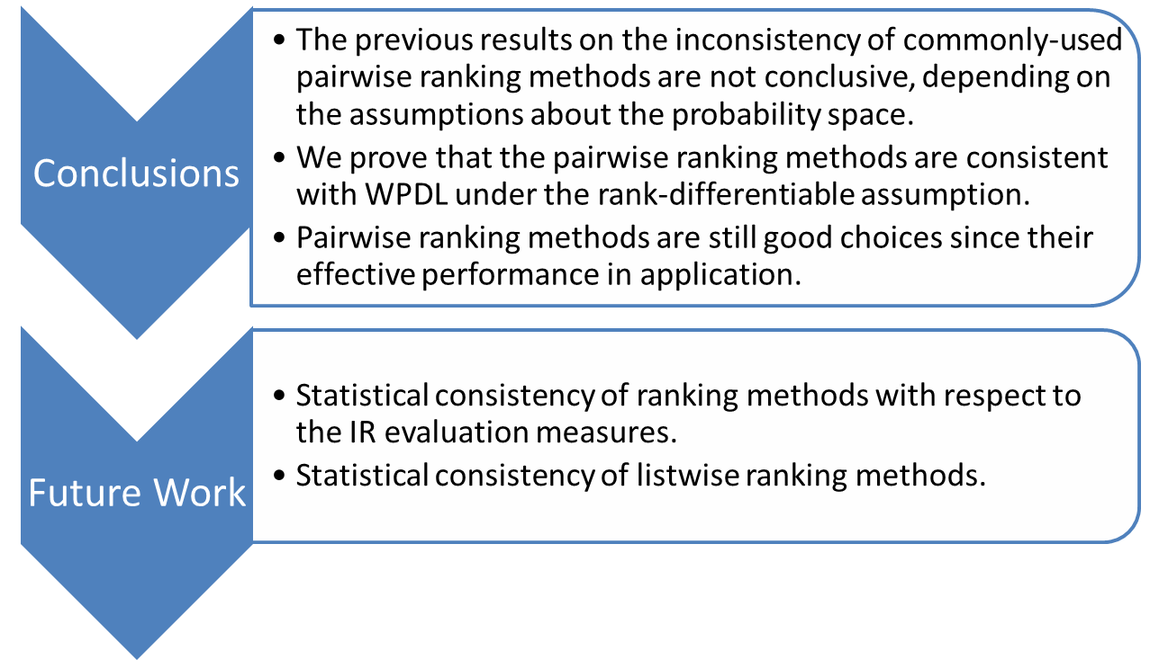
Statistical Consistency of Ranking Methods
in A Rank-Differentiable Probability Space
Yanyan Lan¹, Jiafeng Guo¹, Xueqi Cheng¹, Tie-Yan Liu²
¹Institute of Computing Technology, Chinese Academy of Sciences & ²Microsoft Research Asia
{lanyanyan, guojiafeng, cxq}@ict.ac.cn, Tie-Yan.Liu@microsoft.com
1. MOTIVATION
2. KEY IDEA
3. RANK-DIFFERENTIABLE PROBABILITY SPACE
4. RELATIONSHIPS WITH PREVIOUS WORK
5. WHY CONTRADICTION
6. CONCLUSIONS

