Slide 1
Top-K Learning to Rank: Labeling, Ranking and Evaluation
Shuzi Niu, Jiafeng Guo, Yanyan Lan, Xueqi Cheng
Institute of Computing Technology,
Chinese Academy of Sciences
Notes:
Good morning, everyone! My name is Yanyan Lan, I would like to present our work on behalf of the other coauthors, Shuzi Niu, Jiafeng Guo and Xueqi Cheng. We are all from the Institute of Computing Technology, Chinese Academy of Sciences.

Slide 2
Outlines
Motivation
Top-K Learning to Rank Framework
Top-K Labeling Strategy
FocusedRank
Top-K Evaluation
Experimental Results
Conclusions & Future Work
Notes:
This is the outline of my presentation. First, I will talk about the motivation of this work. Then I will introduce the top k learning to rank framework, including the top-k labeling strategy, the top-k ranking model named FocusedRank and the top-k evaluation. After that, I will demonstrate some experimental results and finally, I will give the conclusion and future work.

Slide 3



Motivation
One great challenge for learning to rank: it is difficult to obtain reliable training data from human assessors!
Absolute Relevance Judgment
$$x$$
$$y$$
Relevance Score
Drawbacks:
Choice of the specific of the gradations.
Increasing assessing burdens.
High level of disagreement on judgments.
Notes:
OK, Let’s talk about the motivation. In the past few years, learning to rank has been widely recognized as an important technology for information retrieval. However, when applying learning to rank to real application, one of the greatest challenge is about the training data. That is it is difficult to obtain reliable training data from human assessors! Why do we say that? Let’s have a look at the traditional labeling approach, absolute relevance judgment. Given a document x, human assessors are asked to judge the relevance score y. The labeling strategy is very straightforward. However, there are some significant drawbacks. Firstly, the specific of the gradations must be pre-defined, for example, in the popular five graded relevance judgment, o to 5 mean “bad, fair, good, excellent, perfect”, respectively. But it is not clear how these choices will affect relative performance measures. Secondly, the assessing burden increase with the complexity of the relevance gradation. Thirdly, the choice of label is not clear when there are more factors to consider, leading to high level of disagreement on judgments.

Slide 4

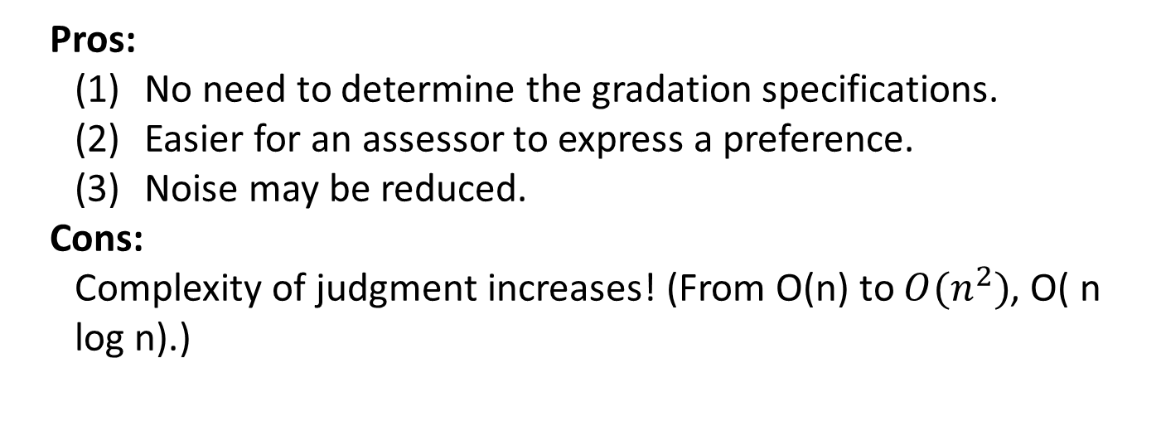


Motivation (cont’)
Pairwise Preference Judgment
$${ x}_{1}$$
$${ x}_{2}$$
$$z$$
Preference Order
Pros:
No need to determine the gradation specifications.
Easier for an assessor to express a preference.
Noise may be reduced.
Cons:
Complexity of judgment increases! (From O(n) to $O(n^{2})$, O( n log n).)
How to reduce the complexity of pairwise preference judgment?
Notes:
Recently, pairwise preference judgment has been investigated as a good alternative. Instead of assigning a relevance grade to a document, an assessor looks at two pages and judges which one is better. Compared with absolute relevance judgment, the advantages lie in that: first, there is no need to determine the gradation specifications, as it is a binary decision. Second, it is easier for an assessors to express a preference for one document over the other than to assign a pre-defined grade to each of them. Third, most state of the art learning to rank models, pairwise or listwise, are trained over preferences. Thus, by collection preferences directly, noise may be reduced. Although preference judgment likely produces more reliable training data, it is often criticized for increasing the complexity of judgment from O(n) to O(n logn). Thus, a natural problem is how to reduce the complexity of pairwise preference judgment. This is the original motivation of our paper.

Slide 5

Motivation (cont’)
Do we really need to get a total ordering for each query?
Users mainly care about the top results in real web search application!
NO!
Take more effort to figure out the top results and judge the preference orders among them.
$$\left(\begin{matrix}\begin{matrix}x_{1} \\ x_{3}\end{matrix} \\ \begin{matrix}x_{5} \\ x_{2},x_{4}\end{matrix}\end{matrix}\right)$$
Total ordering of top K results
Top-K Ground-truth
Preferences between top K
Documents and the other
N-K documents
Notes:
Do we actually need to judge so many pairs for real search systems? The answer is No. As we know, in real web search scenario, it is well accepted that users mainly care about the top results. For example, users usually just read the first one or two pages of results in Google, but ignore the latter pages. Therefore, the ordering of the top results is critical for user’s search experience. It indicate that a good labeling strategy shall take effort to figure out the top results and judge the preference orders among them, but pay less attention to the exact preference orders among the rest results. We call such ground-truth as top-k ground-truth. For example, top 3 groundtruth of five documents x1 to x5 is that, x1 is ranked first, x3 second, x5 third, and x2 and x4 are less relevant than them.

Slide 6
Motivation (cont’)
Three Tasks:
How to design an efficient pairwise preference labeling strategy to get top-k ground-truth?
How to develop more powerful ranking algorithms in the new scenario?
How to define new evaluation measures for the new scenario?
Top-K Learning to Rank
Notes:
Then how to design an efficient pairwise preference labeling strategy to get top-k ground-truth becomes the first critical task of this paper. With top-k ground-truth, the traditional ranking models and evaluation measures no longer fit this kind of data, which lead to another two tasks of this paper. This is what we call a whole top-k learning to rank framework targets.

Slide 7





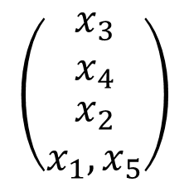








Top-k Learning to Rank：Labeling
Top-k Labeling Strategy
Pairwise preference judgment
HeapSort
Example: k=3,n=5
Step 2
O((n-k)log k)
$${ x}_{1}$$
$${ x}_{2}$$
$${ x}_{2}$$
$${ x}_{1}$$
$${ x}_{4}$$
$${ x}_{5}$$
$${ x}_{2}$$
$${ x}_{2}$$
$${ x}_{3}$$
$${ x}_{4}$$
$${ x}_{3}$$
$${ x}_{4}$$
$${ x}_{3}$$
Step 1
O(k)
$$\left(\begin{matrix}\begin{matrix}x_{3} \\ x_{4}\end{matrix} \\ \begin{matrix}x_{2} \\ x_{1},x_{5}\end{matrix}\end{matrix}\right)$$
Step 3
Top-3 Ground-truth
O(k log k)
O(n log k)
Notes:
OK, first, let’s talk about the labeling. By exploring the characteristics of the top-k ground-truth, we can see that the essence is to efficiently rank top k items from N items by using pairwise preference judgment. In the literature of algorithm design, HeapSort has been proposed to solve similar problems. Thus, it is natural to design the top-k labeling strategy on the basis of pairwise preference judgment and HeapSort. I would like to give an example to illustrate the basic idea. If you are interested in the detailed algorithm, you can find it in our paper. Let’s consider an example of getting the top 3 ground-truth from 5 items. In the first step, we select x1,x2 and x3, and build the min-heap like that, which means that x1 is less relevant than x2 or x3. In the second step, we first select x4, conduct pairwise preference judgment between x1 and x4. If x1 is less relevant that x4, then x1 is discarded and a new min-heap like this is constructed using pairwise preference judgment. After that, x5 is selected to compare with x2, if x5 is less relevant, then x5 is discarded and the min-heap remain unchanged. In the third step, pairwise preference judgments are conducted among x2, x3 and x4 and the total ordering like this is obtained. Appending x1 and x5, we get the top 3 ground-truth like this. Considering the judgment complexity, we find that the complexity of the first step is O(k), the second step is O((n-k)log k) and the third step is O(k log k). Therefore, the total judgment complexity of top-k labeling strategy is about O(n log k). Compared with QuickSort, whose complexity is O(n log n), our top-k labeling strategy significantly reduces the complexity where usually k far less than n.

Slide 8

Top-K Learning to Rank：Ranking
New characteristics of top-k ground-truth
$$\left(\begin{matrix}\begin{matrix}x_{1} \\ x_{3}\end{matrix} \\ \begin{matrix}x_{5} \\ x_{2},x_{4}\end{matrix}\end{matrix}\right)$$
Total ordering of top k items
Listiwise ranking algorithms
Preferences between top k
Items and the other
n-k items
Pairwise ranking algorithms
FocusedRank
Struct-SVM
AdaRank
ListNet
RankSVM
RankBoost
RankNet
FocusedSVM
FocusedBoost
FocusedNet
Notes:
With the top-k ground-truth, we can see that it is a mixture of the total ordering of top k items and the preferences between top k items and the other n-k items. It is natural to use listwise algorithms to model the total ordering relationship and pairwise ranking algorithms to model the preference relationship. Thus, we obtain the new ranking model for top-k ground-truth, named FocusedRank. The general formulation is like this, it is the combination of listwise and pairwise ranking algorithm. Using different listwise or pairwise ranking algorithms, we can obtain different FocusRank. For example, by combing structure SVM and RankSVM, we get FocuedSVM. Also FocusedBoost by combing AdaRank and RankBoost, and FocusedNet by combing ListNet and RankNet.

Slide 9




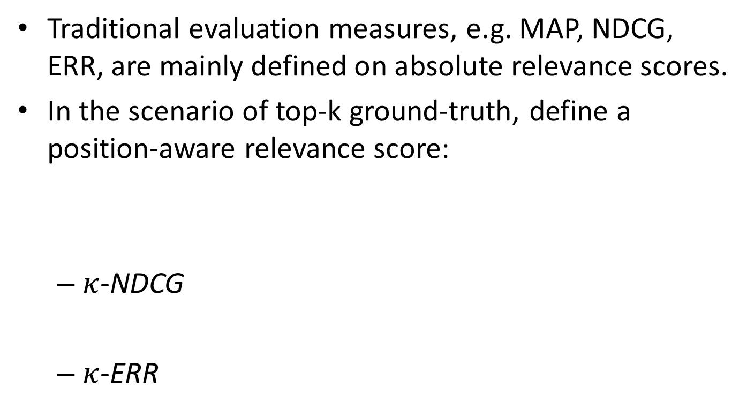
Top-K Learning to Rank: Evaluation
Traditional evaluation measures, e.g. MAP, NDCG, ERR, are mainly defined on absolute relevance scores.
In the scenario of top-k ground-truth, define a position-aware relevance score:
$κ$-NDCG
$κ$-ERR
Notes:
As to the evaluation for top-k ground-truth, we find that traditional evaluation measure can not directly apply because they are mainly defined on absolute relevance scores, while there is no absolute scores in the scenario of top-k ground-truth. In our paper, we propose to define a position-aware relevance score, which means to transform positions to scores. For example, the score y is defined like this, that is, for top k items ,their scores are from k to 1. While the scores for the rest n-k items are zero. Applying the scores to traditional NDCG and ERR, we obtain the new evaluation measures for top-k ground-truth, named \kappa NDCG and \kappa ERR.

Slide 10
Experiments
Effectiveness and efficiency of top-k labeling strategy
Data Sets: all the 50 queries from Topic Distillation task of TREC 2003, for each query, sample 50 documents.
Labeling Tools: top-10 labeling tool T1 and five-graded relevance judgment tool T2.
Assessors: Five graduate students who are familiar with web search.
Assignment: Divided into five folds Q1,…Q5, Ui judges Qi with T1 and Qi+1 with T2, for i=1,2,3,4, and U5 judges Q5 with T1 and Q1 with T2.
Notes:
Now, let’s talk about the experiments. The first experiment is to demonstrate the effectiveness and efficiency of the top-k labeling strategy. K is set to 10 in our experiments, and the baseline is the popular five graded absolute relevance judgment method. The dataset is from TREC 2003, we use all the 50 queries from Topic distillation task, and sample 50 documents for each queries. We design two labeling tools, T1 is for top 10 labeling, and T2 for five graded relevance judgment. The assessors are five graduate students who are familiar with web search. And the data are divided into five folds, and an assignment like this is adopted to avoid the possible differences between individuals.

Slide 11
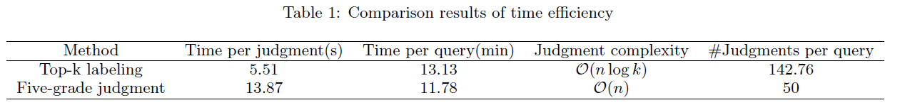
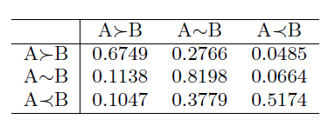
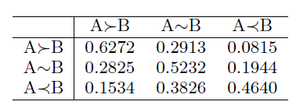
Experimental Results I
Time Efficiency
Agreement
Top 10 Labeling
5 Graded Labeling
Notes:
Two basic metrics are utilized to evaluate the labeling strategy. The first one is time efficiency, which is used to measure the cost of labeling. from the results, we can see that the average time per judgment in absolute judgments is longer than that of the preference judgments, which verifies that preference judgment is much easier than absolute judgment. Meanwhile, from the average number judgments conducted on each query, we can find that the top labeling strategy will take more judgments than the absolute judgments. Most importantly, we can see that the total judgment time spent on each query is comparable between the two methods. The results indicate that by adopting the top k labeling strategy, the complexity of pairwise preference judgment becomes similar to that of absolute judgment. Therefore, it is feasible to use top-k labeling in practice. Now let’s look at the second evaluation, agreement. Agreement is conducted between two assessors over all judgments. For example, the value in the top left corner stands for the percentage of pairs that one assessor labels A more relevance than B and the other assessor holds the same view. From the results, we can see that by adopting pairwise preference judgment, top-k labeling can largely improve the agreement among assessors over the absolute judgment. From the above two experimental results, we can conclude that the top-k labeling strategy is both efficient and effective to obtain reliable judgments from human assessors, as compared with traditional absolute judgment.

Slide 12
Experiments (cont’)
Performance of FocusedRank
Baselines:
Pairwise: RankSVM, RankBoost, RankNet,
Listwise: SVMMAP, AdaRank, ListNet,
Top-k: Top-k ListMLE
Data Sets:
MQ2007 (From LETOR): Graded MQ2007 and Top-k MQ2007
TD2003 (Previous constructed data): Graded TD2003 and Top-k TD2003
Notes:
Our second experiment is to evaluate the performance of our new ranking model, FocusedRank. Baseline algorithms includ pairwise ranking algorithms such as RankSVM, RankBoost and RankNet, listwise ranking algorithms, SVMMAP, AdaRAnk, ListNet and previous top-k ranking algorithm, Top-k ListMLE. Two datasets are used in our experiments, the first one is MQ2007 from the public datasets LETOR. Since we need both traditional graded ground-truth and top-k ground-truth for different algorithms, we use the two version of MQ2007, Graded MQ2007 and Top-k MQ2007. The second dataset is the one manually constructed in above mentioned user study experiments, we denote it as TD2003. It also includes two versions, Graded TD2003 and Top-k TD2003.

Slide 13
Experimental Results II
Top-10 MQ2007
Top-10 TD2003
κNDCG@10
κERR
Performance comparison among
FocusedRank, pairwise and listwise algorithms on Top-k datasets.
Notes:
We just show the results under NDCG@10 and ERR(or \kappa NDCG@10 and \kappa ERR for top-k ground-truth) here. The first result is about the comparison between FocusedRank and traditional pairwise and listwise algorithms. From the results, we can find that FocusedRank can significantly outperform the corresponding pairwise and listwise ranking algorithms in terms of both \kappaNDCG@10 and \kappaERR. Besides, we also observe that the best performance is always reached by our FocusedRank. The results indicate that by combing the advantages of both pairwise and listwise algorithms, FocusedRank can fully exploit the information in the top-k groundtruth and thus outperforms each single model.

Slide 14
Experimental Results II (cont’)
Graded MQ2007
Graded TD2003
NDCG@10
ERR
Performance comparison among
FocusedRank, pairwise and listwise algorithms on Graded datasets.
Notes:
From the results on the Graded data sets, MQ2007 and graded TD 2003, we can see that the overall performance of FocusedRank is comparable with traditional pairwise and listwise ranking algorithms in terms of both NDCG@10 and ERR. It shows that even though FocusedRank is proposed for top-k groundtruth, it also works quite well on traditional absolute judgment datasets under traditional IR measures. Such results reveals that, learning the ordering of the top items well is critical for the success of a learning to rank algorithm.

Slide 15
Experimental Results II (cont’)
Top-10 MQ2007
Top-10 TD2003
κNDCG@10
κERR
Performance comparison between
FocusedRank and Top-k ListMLE on Top-k datasets.
Notes:
When we compare FocusedRank with Top-k ListMLE, we can see that the performances of the two approaches are comparable. In fact, some of our FocusedRank, for example, FocusedNet, can consistently outperform Top-k ListMLE in terms of both NDCG and ERR.

Slide 16
Conclusions
Top-K Learning to Rank Framework
Top-k labeling strategy: obtain reliable relevance judgments via pairwise preference judgment. Complexity is reduced to O(n log k).
FocusedRank: capture the characteristics of the top-k ground-truth.
Top-k evaluation measures
Empirical studies show the efficiency and reliability of top-k labeling strategy, and demonstrate the effectiveness of FocusedRank.
Notes:
Now comes to the conclusion. In this paper, we propose a novel top-k learning to rank framework, including labeling, ranking and evaluation, which can be effectively adopted for real search systems. We also verify the efficiency and reliability of the proposed top-k learning strategy thorough user studies, and demonstrate the effectiveness of top-k ranking model by comparing with state-of-the-art ranking models.

Slide 17
Future Work
Further reduce the complexity of top-k labeling strategy.
Design new ranking models for top-k ranking.
Rank aggregations of top-k ground-truth.
Active learning in top-k labeling strategy.
Notes:
There are many interesting issues for further investigation under our top-k learning to rank framework. For example, how to further reduce the complexity of top-k labeling strategy, how to design new ranking models for top-k ground-truth, and the rank aggregation or active learning for top-k ground-truth. We expect the new proposed top-k learning to rank framework can help applying learning to rank technology in real search system.

Slide 18
Thanks for your Attention! Thank SIGIR 2012 for providing Shuzi Niu the student travel grants! Thank the committee for granting us the best student paper award!
lanyanyan@ict.ac.cn
Notes:
OK, that’s my presentation. Thanks for your attention!

