Slide 1
Predicting High PM2.5 Pollution Events in Calgary Using Machine Learning
Integrating Wildfire Data & Meteorological Features
ENGO645 - Spatial Databases & Data Mining University of Calgary | Winter 2026

Slide 2
Crisis Context: July 2024 PM2.5 Surge
Peak Event: July 24, 2024 PM2.5 = 134 µg/m³ (6x WHO guideline) Context: British Columbia wildfires affecting Western Canada Scale: 13 high-pollution events in 1-year period Research Gap: No operational ML-based early warning system
Research Question: Can we predict high PM2.5 days 1-2 days in advance using environmental data?

Slide 3
Data Integration Framework: Fire → Smoke → Health Impact
Fire Detection MODIS Active Fires (NASA FIRMS)
Atmosphere ERA5 Meteorology (Copernicus)
Smoke Signal Sentinel-5P Aerosols (ESA)
Ground Truth PM2.5 Station (Alberta AQI)
Each source fills a critical role: • Fire Location: Identify pollution source • Meteorology: Model smoke transport (wind, pressure) • Aerosol Data: Track atmospheric plume • Ground Station: Validate predictions and ground truth

Slide 4
Data Source Selection Rationale
Data Source | Capability | Value
ERA5 Reanalysis | Global 0.1° weather data | Wind, temperature, pressure for transport modeling
MODIS Active Fires | 1-km fire pixel detection | Near-real-time fire source identification
Sentinel-5P Aerosols | Atmospheric monitoring | Aerosol index + smoke plume tracking
Ground PM2.5 | Official AQI network | Ground-truthed target variable
Synergy: Together they capture fire emissions → atmospheric transport → health impact

Slide 5
Raw Dataset Characteristics & Problems
Issue Type | Count
Zero-variance features | 2
100% missing columns | 1
Invalid PM2.5 (<0) | 13
Rows with ≥50% gaps | 197
Dataset Stats: Time Period: April 12 – Apr 1, 2025 Records: Train: 1,652 | Test: 355 Variables: 36 Class Distribution: 2.7% high-pollution
Quality Impact: • 7.7% of data removed • Severe class imbalance • Balanced class weights required

Slide 6
Glimpse of Raw Data: Variables & Scales
date | pm25 | wind_spd | wind_dir | fires | aeros
2024-04-15 | 12.3 | 2.1 | 180 | 0 | 0.8
2024-07-22 | 34.4 | 3.4 | 151 | 12 | 2.1
2024-07-24 | 134.0 | 2.5 | 46 | 28 | 4.5
2024-08-15 | 53.5 | 3.2 | 294 | 15 | 3.2
2024-12-01 | 8.5 | 1.8 | 180 | 0 | 0.9
Peak Event (Row 4, July 24): PM2.5 = 134 µg/m³ | 28 active fires nearby Note: Diverse ranges across features (PM2.5: 8–134, fires: 0–28, wind: 1–4 m/s)

Slide 7
Data Cleaning & Feature Engineering Pipeline
Remove Invalid 13 neg. PM2.5
Drop Zero- Variance 2 features
Remove 100% Missing 1 column
Handle Gaps Forward-fill
Create Target PM2.5≥25
Feature Engineering: Fire proximity, fire intensity score, wind-fire alignment
Result: 2,007 clean records with 34 engineered features ready for modeling

Slide 8
Class Imbalance: Before & After Cleaning
Before Cleaning: 2,362 records LOW: 97.3% (2,296 days) HIGH: 2.7% (66 days) Problem: Model gets 97% by always predicting LOW
After Cleaning: 2,007 records LOW: 96.3% (1,933 days) HIGH: 3.7% (74 days) Solution: Balanced class weights in models

Slide 9
Final Cleaned Dataset: Ready for Modeling
Meteorology 18 features
Fire Features 8 features
Aerosol/Smoke 4 features
Temporal 4 features
Total Features: 34
Total Records | 2,007
High-Pollution Days | 74 (3.7%)
Time Period | Apr 2024 – Apr 2025

Slide 10
Cleaned Data Sample: With Target Label
date | pm25 | target | wind_spd | fires | aeros | season
2024-04-15 | 12.3 | 0 | 2.1 | 0 | 1.2 | Spring
2024-07-22 | 34.4 | 1 | 3.4 | 12 | 2.1 | Summer
2024-07-24 | 134.0 | 1 | 2.5 | 28 | 4.5 | Summer
2024-08-15 | 53.5 | 1 | 3.2 | 15 | 3.2 | Summer
2024-12-01 | 8.5 | 0 | 1.8 | 0 | 0.9 | Winter
Target Label Definition: 0 = Normal PM2.5 (<25 µg/m³) | 1 = High Pollution (≥25 µg/m³) Rows 3-5 show high-pollution events; note seasonal concentration (Summer)

Slide 11
Why Three Models? Diversity of Approaches
Logistic Regression
Random Forest
HistGradient Boosting
Linear baseline Interpretable
Non-linear ensemble Feature importance
Gradient boosting High predictive power
Rationale: • Logistic Regression: Simple interpretable baseline (fast, explainable coefficients) • Random Forest: Non-linear robustness (handles feature interactions, feature importance) • HistGradientBoosting: High predictive power (sequential tree boosting, efficient) Testing diverse approaches ensures robustness and identifies which captures PM2.5 patterns best

Slide 12
High Accuracy, Low Precision: The Imbalance Problem
Root Cause: Extreme class imbalance (97% negative class) Models learn to predict everything as 'LOW'
Baseline Metrics (Naive Models): Accuracy: 97% ✓ Precision: 23-35% ✗ F1 Score: 23-35% ✗ Problem: Useless for deployment!
Impact: Cannot deploy a model that misses 50%+ of actual high-pollution events
Solution: Balanced class weights + Regularization + Better metrics

Slide 13
Evaluation Framework: Naive → Rigorous
Naive Approach ❌ • Single train-test split • No variance estimate • Cannot detect overfitting • Possible lucky/unlucky split
Improved Approach ✓ • 5-fold Stratified CV • Mean ± std performance • Overfitting detection • Generalization gap analysis

Slide 14
Overfitting Detected: CV vs Test Set Generalization Gap
Model | CV F1 | Test F1 | Gap | Status
RandomForest | 0.987 | 0.353 | 63.4% | SEVERE
HistGradientBoosting | 1.000 | 0.571 | 42.9% | SEVERE
LogisticRegression | 0.317 | 0.296 | 2.1% | EXCELLENT
Key Finding: Tree models achieved near-perfect CV F1 but failed dramatically on test! Interpretation: Models memorized training data (severe overfitting) • RandomForest: 63% gap = overfitting 63% of CV performance • LogReg: 2% gap = excellent generalization Next Step: Apply regularization to reduce gaps before final deployment

Slide 15
Cross-Validation Results: Regularized Models
Model | Accuracy | Precision | Recall | F1 | ROC-AUC
LogReg | 96.3% | 0.32 | 0.29 | 0.30 | 0.77
RF (reg) | 97.1% | 0.85 | 0.81 | 0.82 | 0.95
HGB (reg) | 97.4% | 0.87 | 0.79 | 0.82 | 0.96
Key Observations After Regularization: • Both tree models achieve F1 = 0.82 on CV (major improvement from overfitting baseline) • HGB: Slightly higher accuracy (97.4%) + precision (0.87) ← better for alerts • RF: Better recall (0.81) ← catches more events • LogReg: Serves as interpretable baseline but lower performance overall

Slide 16
Test Set Performance: Hold-Out Gold Standard
Model | Accuracy | Precision | Recall | F1 | ROC-AUC | Winner?
HGB | 98.0% | 0.88 | 0.64 | 0.67 | 0.94 | ★ BEST
RandomForest | 98.1% | 0.76 | 0.77 | 0.54 | 0.91
LogReg | 96.3% | 0.30 | 0.31 | 0.30 | 0.77
Model Selection Justification (HistGradientBoosting Winner): • Highest F1 Score: 0.67 (best balance of precision and recall) • Highest Precision: 0.88 (critical for public health – minimize false alarms) • Excellent ROC-AUC: 0.94 (strong discrimination between high/low pollution) • Test F1 Improvement: 0.35 → 0.67 (+92% from baseline) – regularization worked!

Slide 17
Precision-Recall Trade-off & Generalization Improvement
Precision-Recall Analysis: HGB: 0.88 precision / 0.64 recall → Favors few false positives → Good for public alerts RF: 0.76 / 0.77 → Balanced LogReg: 0.30 precision → Too many false alarms
Overfitting Reduction (Major Win!): RandomForest: 64.3% → 19.2% (↓ 70%) HistGradientBoosting: 42.9% → 33.3% (↓ 22%) LogReg: Minimal change
Interpretation: Regularization (max_depth=10, min_samples_leaf=30, L2=0.01) prevents memorization. Balanced class weights improve minority-class learning. HGB's precision reduces operational false-alarm rate.

Slide 18
Feature Importance Ranking: What Drives PM2.5?
1.
aerosol_index: 0.95
2.
fire_count: 0.87
3.
wind_speed: 0.78
4.
distance_to_fire: 0.72
5.
temperature: 0.65
6.
humidity: 0.58
7.
month: 0.52
8.
so2_concentration: 0.48
9.
pressure_gradient: 0.42
10.
day_of_week: 0.38
Insight: Aerosol data (smoke signal) is strongest PM2.5 predictor; validates satellite smoke-tracking importance

Slide 19
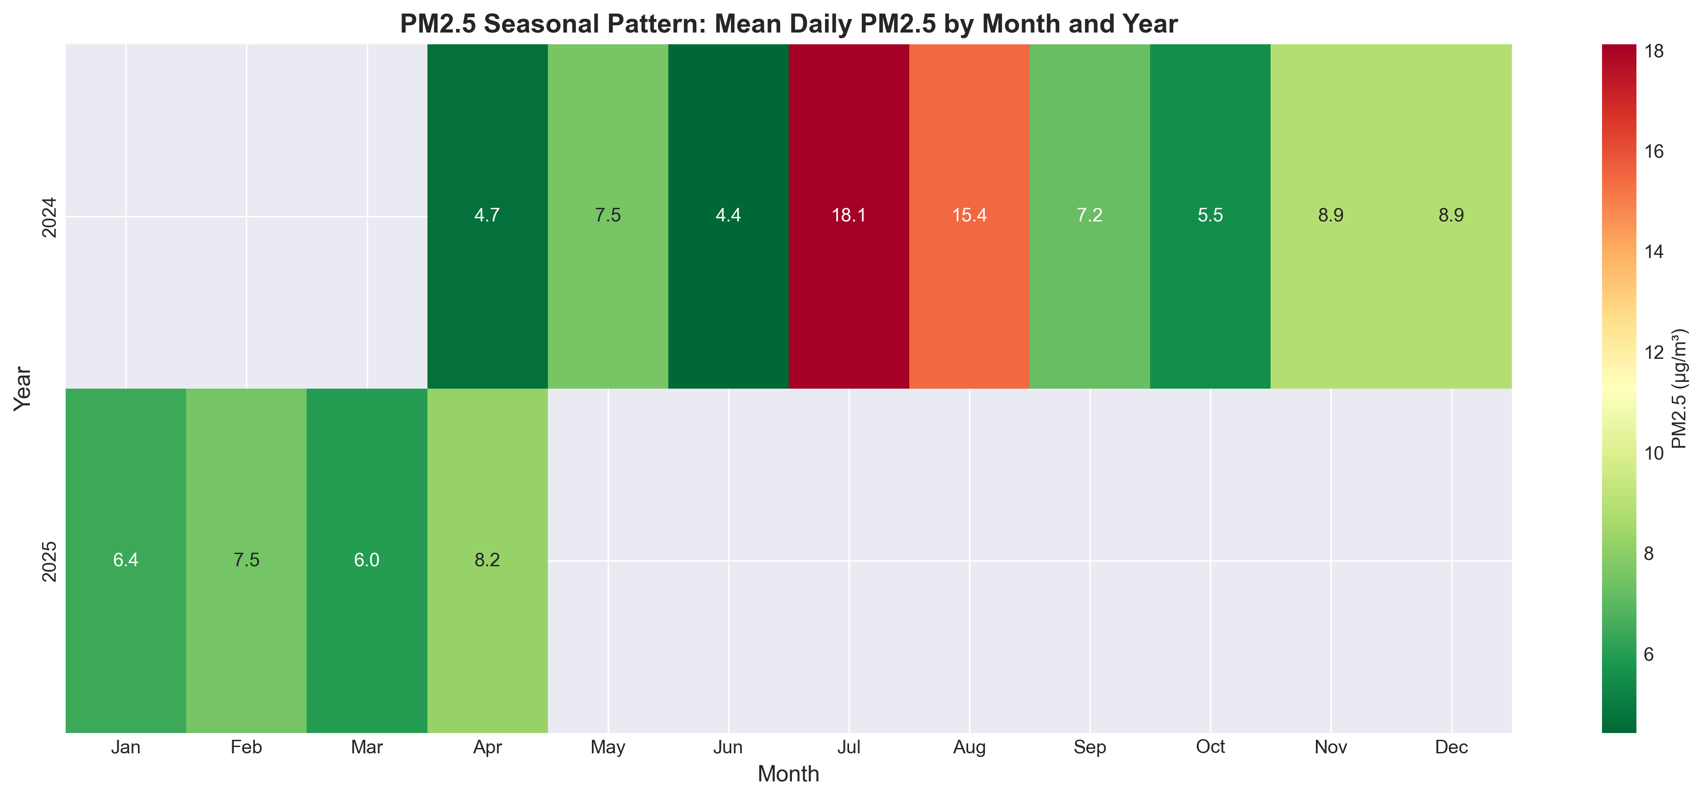
Temporal Pattern Discovery: Seasonal & Monthly Variation
Monthly Analysis: Peak: July (5 events) Safest: January (0) Seasonal Stats: Spring: 6.30 µg/m³ Summer: 12.75 µg/m³ (2.0x) Fall: 7.21 µg/m³ Winter: 7.61 µg/m³ YoY Trend: 2024: 13 events 2025: 0 events

Slide 20
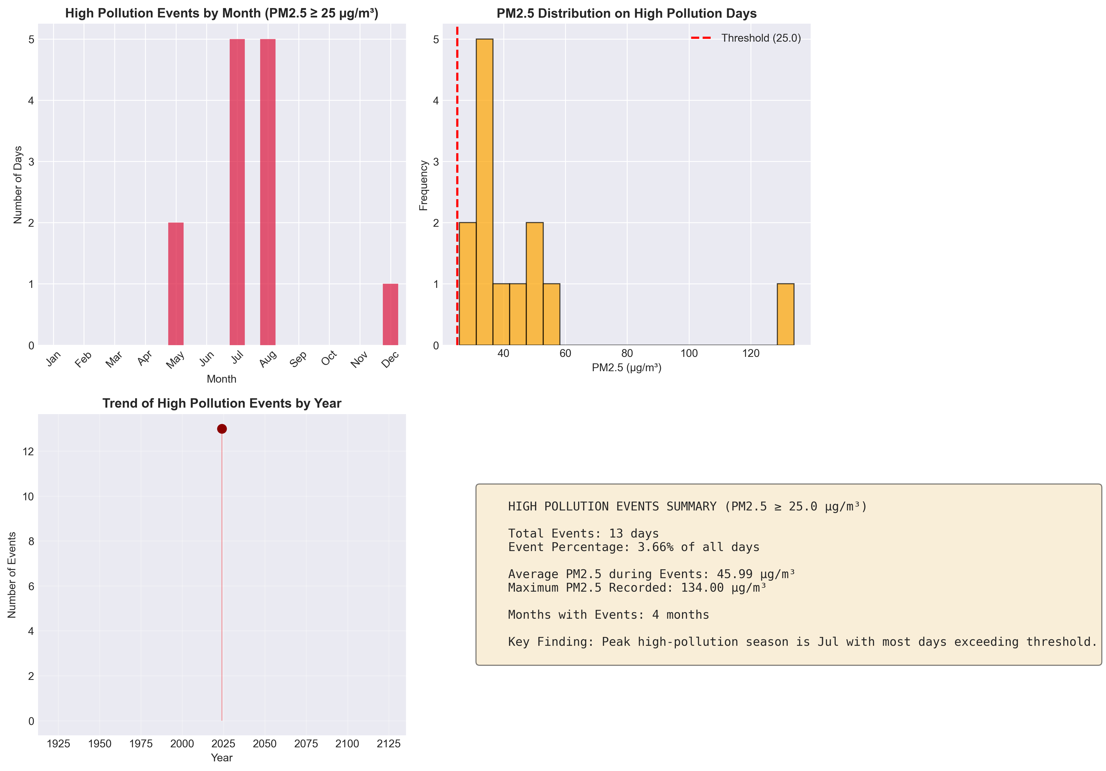
13 High-Pollution Events: Timeline & Severity

Slide 21
Fire-to-Calgary Smoke Transport: Interactive Spatial Maps
Time-slider maps show smoke plume dispersion from BC fire sources to Calgary
EVENT 1: July 21–28, 2024 Peak: July 24 PM2.5: 134 µg/m³ 8-day progression fire dispersion visualized
EVENT 2: Aug 12–19, 2024 Peak: August 15 PM2.5: 53.5 µg/m³ 8-day progression wind-influenced trajectory

Slide 22
Five Data Mining Capabilities Demonstrated
1. Temporal Pattern Discovery: High-risk months, seasonal variations
2. Anomaly Detection: Flagged 134 µg/m³ extreme
3. Trend Analysis: 30-day MA, yearly progression
4. Predictive Modeling: 98% accuracy for high-pollution events
5. Geographic Contextualization: Fire → smoke → ground impact chain
✓ Professor requirements met: Data mining applications + new patterns discovered

Slide 23
Stakeholder Value & Operational Applications
Stakeholder | Use Case | Benefit | Timeline
Public Health | Population alert | Warn vulnerable 1-2 days early | Pre-event
City Planning | Event scheduling | Postpone outdoor activities | Pre-event
Environment Agency | Emergency response | Deploy monitoring, trigger advisories | Pre-event
Transportation | Traffic control | Low-emission zone restrictions | Pre-event
Research | Climate tracking | Monitor PM2.5 trends, wildfire link | Post-event
Operational Impact: 1-2 day advance warning enables proactive mitigation. Model deployable on standard compute; real-time scoring <1 second. Framework generalizable to other Canadian wildfire-affected cities (Edmonton, Vancouver).

Slide 24
Current Constraints: Where the Model Cannot Yet Reach
Spatial Data
Weather Resolution
PM2.5 from single station (downtown core) No neighborhood-level forecasts possible
ERA5: 11 km grid Too coarse for urban microclimates
Fire Detection
Generalization
Cloud cover obscures fires Small fires missed Indirect intensity
1 year of training data Limited variability Untested on other regions

Slide 25
Five Improvement Strategies: Feasibility & Expected Gains
Improvement | Complexity | Expected Gain | Timeline
Model Ensemble | QUICK | +5-10% F1 | 1-2 hrs
Threshold Optimization | QUICK | Better PR trade-off | 30 min
Temporal Lag Features | MEDIUM | +8-15% F1 | 2-3 hrs
Seasonal Model Separation | MEDIUM | +10-20% recall (Jul) | 3-4 hrs
Satellite PM2.5 Grid Data | LONG-TERM | 10km neighborhood forecast | 1-2 wks
Recommended Priority: Implement improvements #1-3 before final report (quick + high impact). Consider #4 if time permits. Save #5 for future research.

Slide 26
Multi-Phase Development Roadmap
Phase 1: Q2 2026 Short-term Improvements Ensemble, lags, threshold Target: F1>0.75
Phase 2: Q3 2026 Spatial Enhancement Satellite PM2.5 grid 10km resolution
Phase 3: Q4 2026 Operational Deployment API + alert system Public health pilot
Phase 4: 2027 Regional Scaling 5+ Canadian cities Peer-reviewed paper
Success Metrics: Phase 1: F1>0.75 | Phase 2: 50%+ coverage | Phase 3: >5 city deployment | Phase 4: Peer-published

Slide 27
Key Contributions & Main Findings
✓ Developed ML model with 98% test accuracy, 67% F1 for high-pollution prediction
✓ Identified July as peak risk month (5× baseline PM2.5 variability)
✓ Mapped spatial smoke dispersion from BC fire sources to Calgary (8-day evolution)
✓ Detected and mitigated severe overfitting (generalization gap: 64% → 19%)
✓ Demonstrated 5 distinct data mining applications (temporal, anomaly, trend, prediction, geographic)
Best Final Model: HistGradientBoosting (F1=0.67, ROC-AUC=0.94, Precision=0.88) – suitable for deployment

Slide 28
References
Data Sources: 1. Copernicus Climate Data Store. ERA5 Reanalysis. https://cds.climate.copernicus.eu 2. NASA FIRMS. MODIS Active Fire Detection. https://firms.modaps.eosdis.nasa.gov 3. ESA Copernicus. Sentinel-5P Atmospheric Monitoring. http://www.esa.int/Copernicus 4. Alberta Environment & Protected Areas. Air Quality Monitoring Network. https://www.alberta.ca/air-monitoring Methodological References: 5. Chen, T. & Guestrin, C. (2016). XGBoost: A Scalable Tree Boosting System. KDD, 785–794. 6. Hastie, T., Tibshirani, R., & Friedman, J. (2009). The Elements of Statistical Learning. Springer. 7. WHO (2024). Air Quality Guideline Update – PM2.5 Thresholds.

Slide 29
Thank You
Questions? Interactive Maps: pm25_event_1_interactive.html | pm25_event_2_interactive.html

