Slide 1

Predicting High PM2.5
Pollution Events in Calgary
Using Machine Learning
Integrating Wildfire Data & Meteorological Features
ENGO645 - Spatial Databases & Data Mining
University of Calgary | Winter 2026
Presenter: Jiageng Mi
Shima Moradi Mousavi

Slide 2
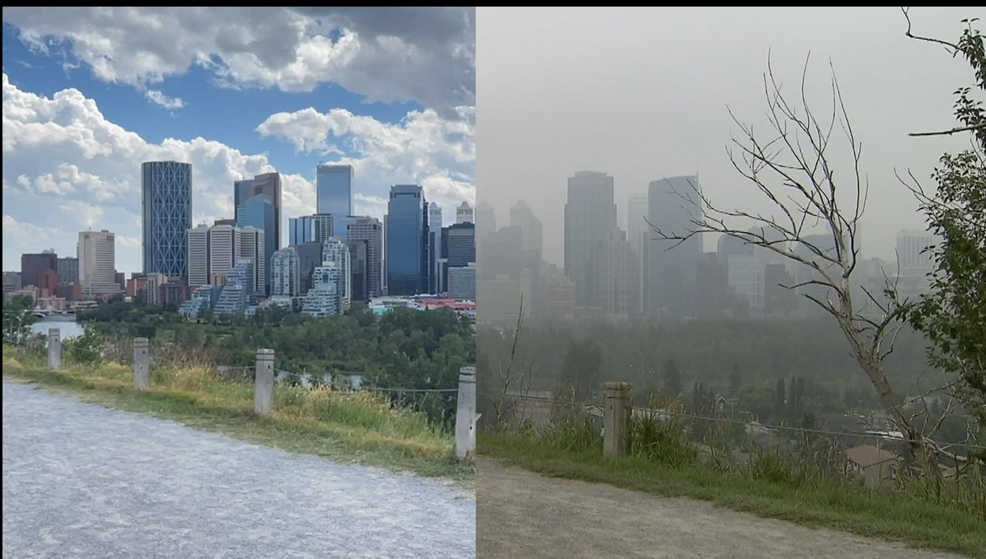



Why Does This Matter?
Peak Event
July 24, 2024 — BC wildfires smoke
134
Scale
13 high-pollution events in 1 year
Research Gap
PM2.5 µg/m³ peak
No operational ML-based early warning
6× WHO guideline
Question is: Can we predict high PM2.5 days 1-2 days in advance using environmental data?
July 24, 2024 — BC wildfires smoke

Slide 3




Data Integration Framework: Fire → Smoke → Health Impact
Fire Detection
▶
Atmosphere Transport
▶
Feature Integration
▶
Ground Truth
MODIS Active Fires
(NASA FIRMS)
ERA5 Reanalysis + Environment Canada Hourly Weather
Daily Integrated Fire-Weather Features
PM2.5 Station
(Alberta AQI)
Fire Location: Identify fire location and intensity
Meteorology: Model smoke transport conditions
Integrated Features: Combine fire and weather signals
Ground Station: Validate predictions and define target
They connect fire emissions, atmospheric transport, and health impacts.

Slide 4
Data Source Selection Rationale
Data Source | Time Range | Size | Capability | Value
ERA5 Reanalysis | 2018/1/1-2025/12/31 | 70128*8 | Reanalysis-based regional meteorology (wind, temperature, pressure) | Drive smoke transport and dispersion features
VIIRS Active Fires | 2018/4/1-2025/12/31 | 3691161*15 | 1-km fire pixel detection | Near-real-time fire source identification
Weather station hourly | 2018/1/1-2025/12/31 | 7012831 | Local near-surface meteorological monitoring | Provide hourly weather covariates (wind, RH, temperature, precipitation, visibility) for daily feature engineering
Ground PM2.5 | 2016/3/10-2026/3/17 | 3062*10 | Official AQI network | Ground-truthed target variable
They connect fire emissions, atmospheric transport, and health impacts.
Raw Data Sample
date | pm25 | wind_spd | fires | aerosol
2024-04-15 | 12.3 | 2.1 | 0 | 0.8
2024-07-24 | 134.0 | 2.5 | 28 | 4.5

Slide 5
Raw Dataset Characteristics & Quality Issues
Dataset Overview
Identified Issues from the original one
Issue Type | Count
Zero-variance features | 2
100% missing columns | 1
Invalid PM2.5 (<0) | 13
Rows with ≥50% gaps | 197
Time Period
April 2018 – April 2024
Model Ready
2,361 records → 2,007 records
Train / Test
1,652 / 355 records
Variables
36
Class Distribution
2.7% high-pollution
We removed 7.7% of the data due to missing values, invalid PM2.5 entries, and low-quality rows, while also addressing severe class imbalance with balanced class weights.

Slide 6
Data Cleaning & Feature Engineering Pipeline
Remove Invalid
13 neg. PM2.5
Drop Zero-
Variance (2)
Remove 100%
Missing (1)
Handle Gaps
Forward-fill
Create Target
PM2.5≥25
▶
▶
▶
▶
After cleaning and feature engineering, we retained 2,007 records, built 34 predictors, and identified 74 high-pollution days, with a 3.7% event rate.
2,007
34
74
3.7%
Clean Records
Engineered Features
High-Pollution Days
Event Rate

Slide 7
Class Imbalance: Before & After Cleaning
Before Cleaning
After Cleaning
2,362 records
2,007 records | Balanced class weights applied
The model achieved 97% accuracy by mostly predicting the LOW class.
We therefore used balanced class weights to address the class imbalance.

Slide 8

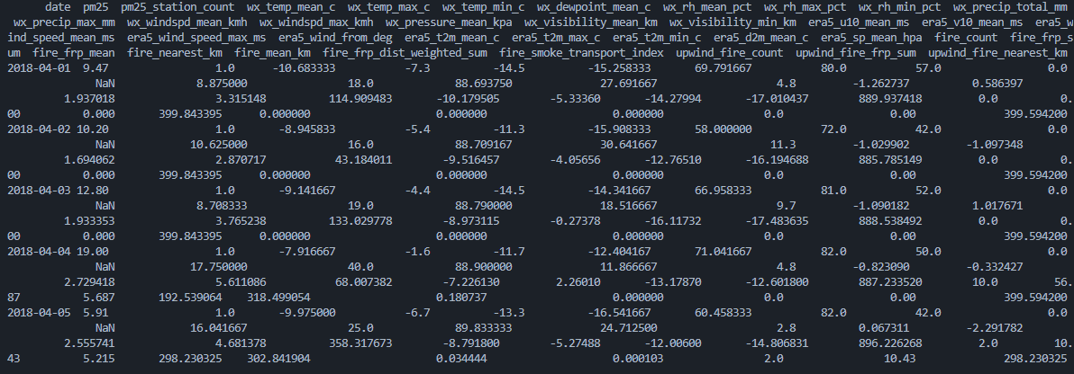
Final Cleaned Dataset: Ready for Modeling
Meteorology
Fire Features
Aerosol/Smoke
Temporal
18 features
8 features
4 features
4 features
Total Features: 34
Total Records | 2,007
High-Pollution Days | 74 (3.7%)
Time Period | 2018/4-2025/4

Slide 9


Model Selection: Three Diverse Approaches
Logistic
Regression
Random
Forest
HistGradient
Boosting
Linear baseline
Non-linear ensemble
Gradient boosting
Interpretable coefficients
Feature importance
High predictive power
Fast & explainable
Handles interactions
Sequential tree boosting
Testing diverse approaches ensures robustness and identifies which captures PM2.5 patterns best

Slide 10
Overfitting Detected: CV vs Test Generalization Gap
Model | CV F1 | Test F1 | Gap | Status
RandomForest | 0.987 | 0.353 | 63.4% | SEVERE
HistGradientBoosting | 1.000 | 0.571 | 42.9% | SEVERE
LogisticRegression | 0.317 | 0.296 | 2.1% | EXCELLENT
Key Finding
Tree models achieved near-perfect CV F1 but failed on test set.
Solution: Apply regularization to reduce overfitting gaps

Slide 11
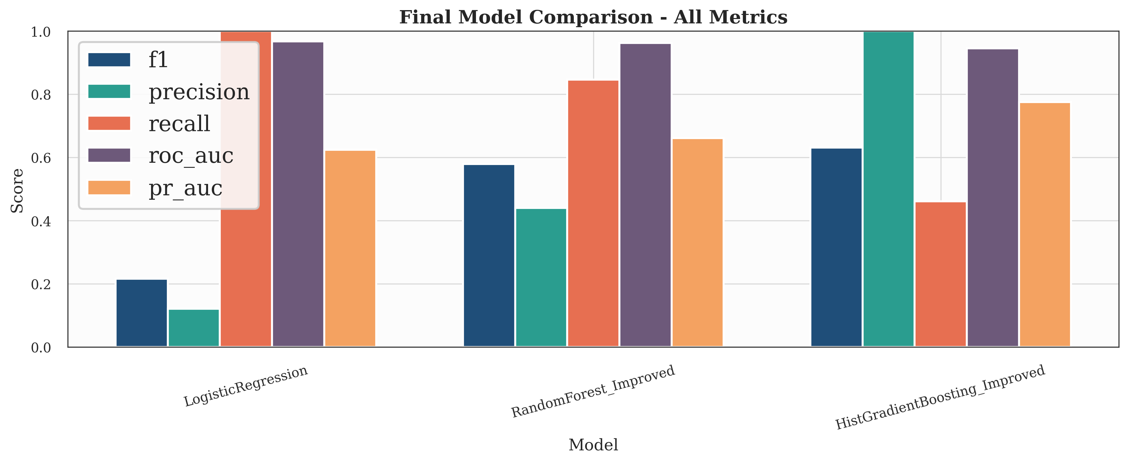
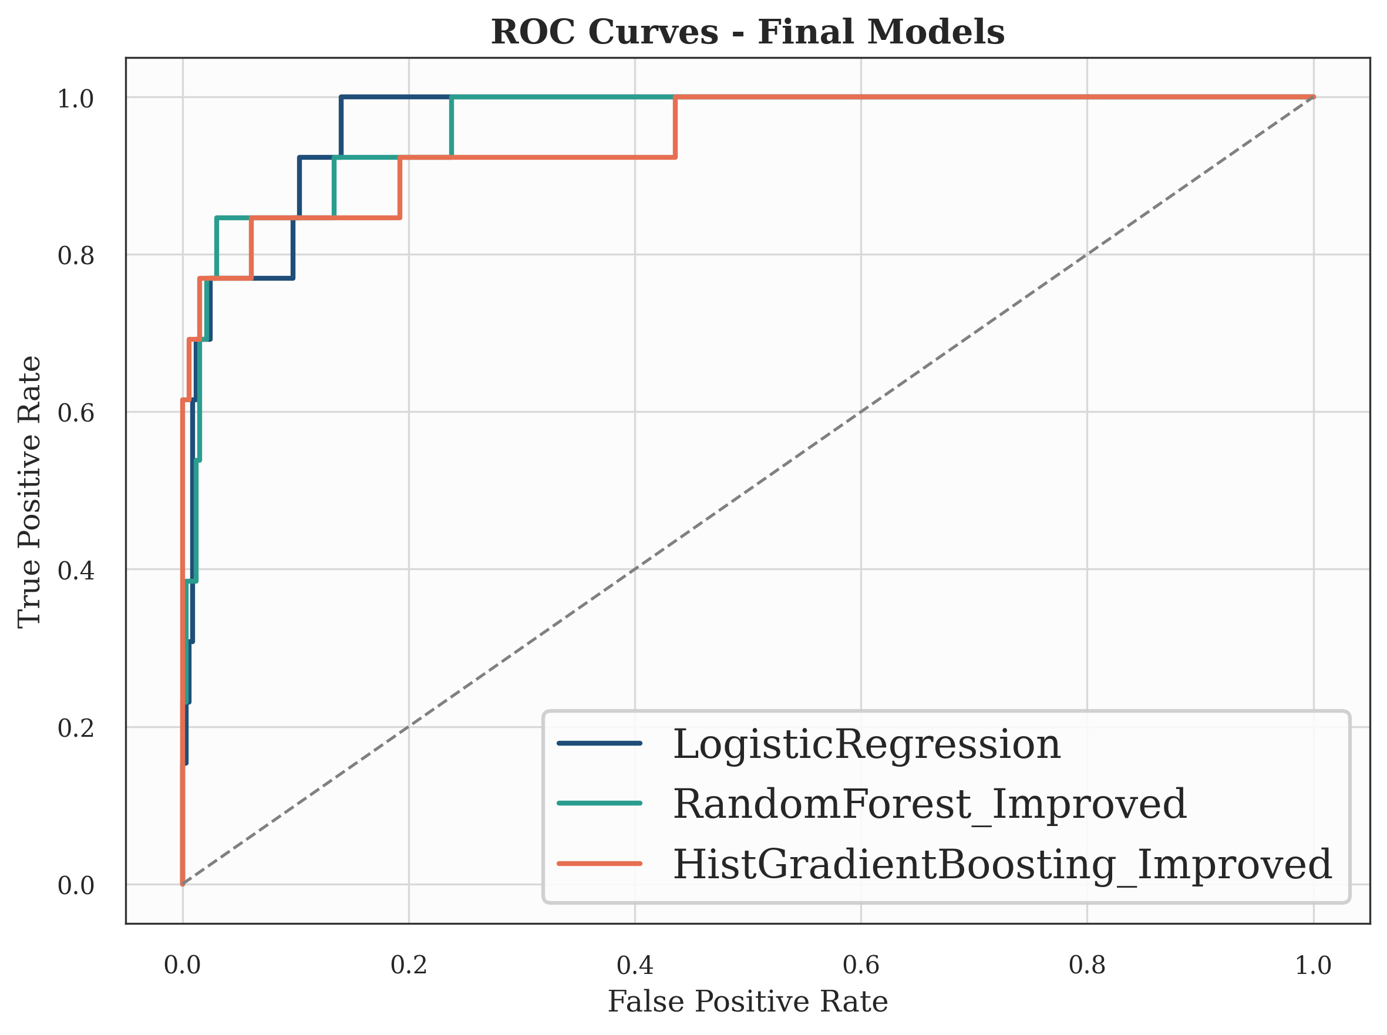
Model Selection: HGB Chosen by Best Test F1 and Precision
Model | Accuracy | Precision | Recall | F1 | ROC-AUC
HGB | 98.0% | 0.88 | 0.64 | 0.67 | 0.94 | ★ BEST
RandomForest | 98.1% | 0.76 | 0.77 | 0.54 | 0.91 | Best Recall
LogReg | 96.3% | 0.30 | 0.31 | 0.30 | 0.77 | Baseline

Slide 12




Test Set Performance: Hold-Out Gold Standard
Model | Accuracy | Precision | Recall | F1 | ROC-AUC
HGB | 98.0% | 0.88 | 0.64 | 0.67 | 0.94 | ★ BEST
RandomForest | 98.1% | 0.76 | 0.77 | 0.54 | 0.91
LogReg | 96.3% | 0.30 | 0.31 | 0.30 | 0.77
HistGradientBoosting: Best Model Selection
Highest F1: 0.67 (best balance of precision and recall)
Highest Precision: 0.88 (minimize false alarms for public health)
ROC-AUC: 0.94 (strong discrimination high/low pollution)
Test F1 Improvement: 0.35 → 0.67 (+92% from baseline)

Slide 13
Precision-Recall Trade-off & Generalization Improvement
Precision-Recall Analysis
Overfitting Reduction
HGB
0.88 / 0.64 — Few false positives
RF
0.76 / 0.77 — Balanced trade-off
LogReg
0.30 / 0.31 — Too many false alarms
Regularization (max_depth=10, min_samples_leaf=30, L2=0.01) prevents memorization. HGB’s precision reduces false-alarm rate.

Slide 14
Feature Importance Ranking: What Drives PM2.5?
Key Insight
Aerosol index (smoke signal) is the strongest PM2.5 predictor, validating the importance of satellite-based smoke tracking.
Fire count and wind speed are the 2nd and 3rd most important features, confirming the fire → transport → impact chain.

Slide 15
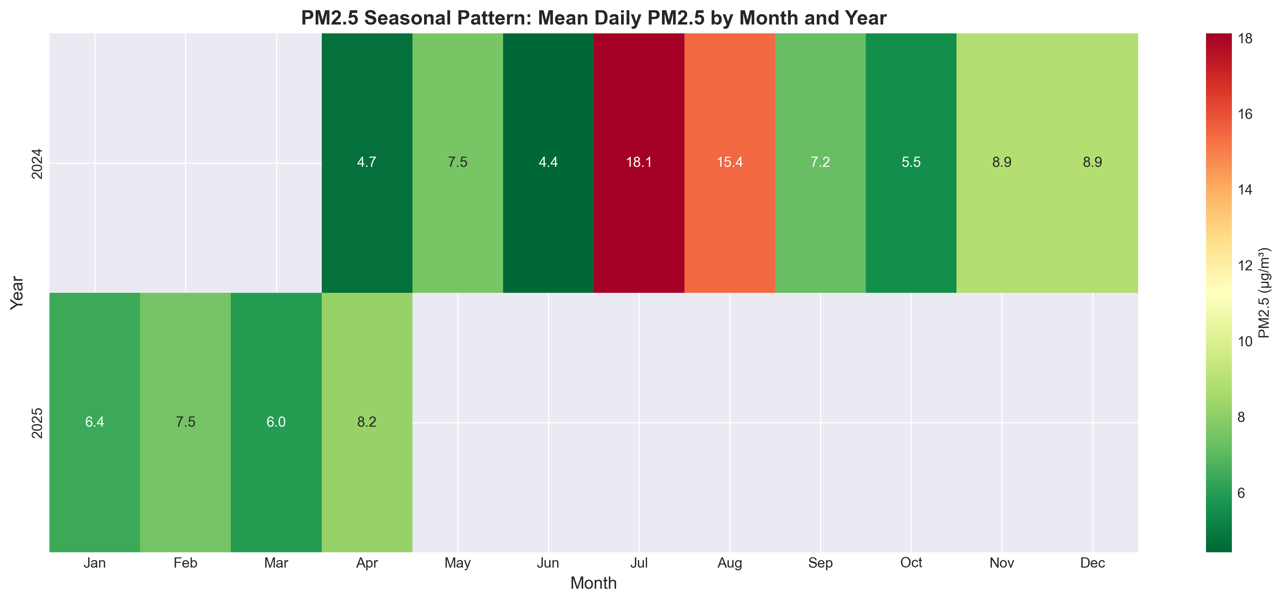
Temporal Pattern Discovery: Seasonal & Monthly Variation
Peak Month
July (5 events)
Safest
January (0)
Spring
6.30 µg/m³
Summer
12.75 µg/m³ (2.0×)
Fall
7.21 µg/m³
Winter
7.61 µg/m³
2024
13 events
2025
0 events

Slide 16
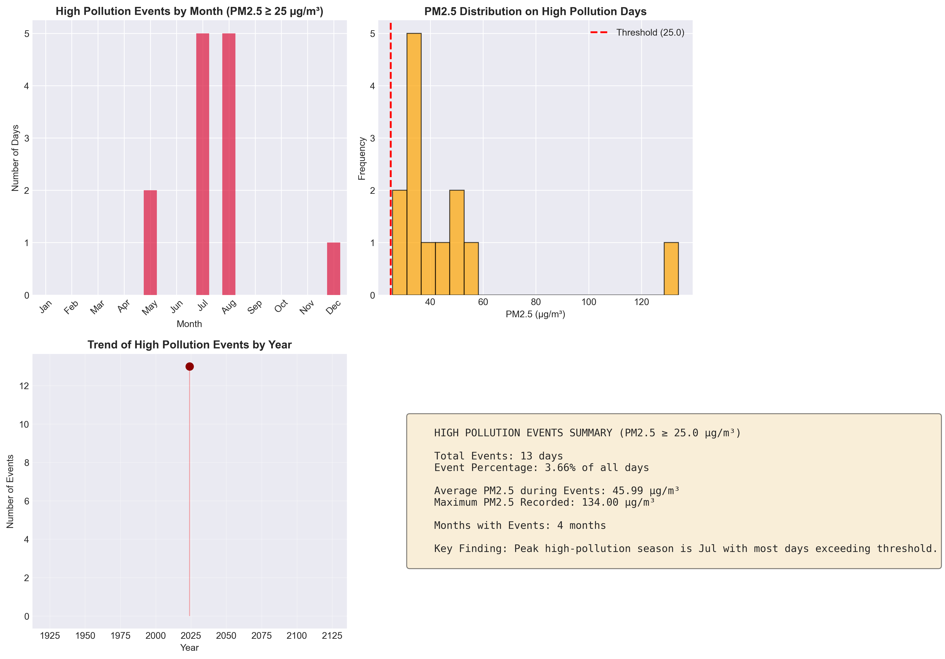
13 High-Pollution Events: Timeline & Severity

Slide 17
Fire-to-Calgary Smoke Transport: Spatial Analysis
Time-slider maps show smoke plume dispersion from BC fire sources to Calgary
EVENT 1
EVENT 2
July 21–28, 2024
Aug 12–19, 2024
Peak: July 24
Peak: August 15
PM2.5: 134 µg/m³
PM2.5: 53.5 µg/m³
8-day fire dispersion
Wind-influenced trajectory

Slide 18





What We Learned & How It Applies
What We Learned
How to Apply It
Temporal Patterns
July is the peak risk month;
summer PM2.5 is 2× baseline
Public Health
1-2 day advance warning for
vulnerable populations
Anomaly Detection
Identified 134 µg/m³ extreme;
13 high-pollution events in 1 year
City Planning
Schedule outdoor events
around predicted pollution
Trend Analysis
30-day moving average reveals
seasonal pollution cycles
Emergency Response
Trigger air quality advisories
and deploy monitoring
Predictive Modeling
98% accuracy, F1=0.67 with
HistGradientBoosting
Transportation
Activate low-emission zone
restrictions pre-event
Spatial Context
BC fire → smoke transport →
Calgary ground-level PM2.5
Research & Scaling
Generalizable framework for
Edmonton, Vancouver, etc.

Slide 19


Current Constraints: Where the Model Cannot Yet Reach
Spatial Data
Weather Resolution
PM2.5 from single station (downtown core)
No neighborhood-level forecasts possible
ERA5: 11 km grid
Too coarse for urban microclimates
Fire Detection
Generalization
Cloud cover obscures fires
Small fires missed, indirect intensity
6 year of training data
Limited variability, untested on other regions

Slide 20
Future Improvements & Submission Priority
5 Quick Improvement Ideas
Before Final Report
Model Ensemble
(10 days left)
1
+5-10% F1
QUICK
Combine 3 models: voting/weighted avg
1-2 hrs
✅ Do These
2
Threshold Optimization
Better precision
Model Ensemble (quick + high impact)
QUICK
Adjust probability cutoff via PR curve
30 min
Threshold Optimization (for deployment)
Temporal Lag Features (+15% F1)
3
Temporal Lag Features
+8-15% F1
MEDIUM
⏳ Try If Time Allows
Add pm25_lag1, lag3, rolling_mean
2-3 hrs
Seasonal Model Separation
(good idea but moderate work)
4
Seasonal Model Split
+10-20% recall
MEDIUM
Separate models: Summer vs Other
3-4 hrs
📅 Save for Next Project
5
Satellite PM2.5 Grid
Transformative
Higher-resolution PM2.5 data
(1-2 weeks, long-term payoff)
LONG
MERRA-2/GEOS-CF → 10km coverage
1-2 wks

Slide 21


Key Contributions & Main Findings
ML model with 98% test accuracy, 67% F1 for high-pollution prediction
July identified as peak risk month (5× baseline PM2.5 variability)
Mapped spatial smoke dispersion from BC fires to Calgary (8-day evolution)
Detected and mitigated severe overfitting (gap: 64% → 19%)
Demonstrated 5 distinct data mining applications
Best Final Model: HistGradientBoosting (F1=0.67, ROC-AUC=0.94, Precision=0.88) — suitable for deployment

Slide 22
References
Data Sources
1. Copernicus Climate Data Store. ERA5 Reanalysis. https://cds.climate.copernicus.eu
2. NASA FIRMS. MODIS Active Fire Detection. https://firms.modaps.eosdis.nasa.gov
3. ESA Copernicus. Sentinel-5P Atmospheric Monitoring. http://www.esa.int/Copernicus
4. Alberta Environment & Protected Areas. Air Quality Monitoring. https://www.alberta.ca/air-monitoring
Methodological References
5. Chen, T. & Guestrin, C. (2016). XGBoost: A Scalable Tree Boosting System. KDD, 785–794.
6. Hastie, T., Tibshirani, R., & Friedman, J. (2009). The Elements of Statistical Learning. Springer.
7. WHO (2024). Air Quality Guideline Update – PM2.5 Thresholds.

Slide 23
Thank You
Questions?
Interactive Maps: pm25_event_1_interactive.html | pm25_event_2_interactive.html

