Slide 1
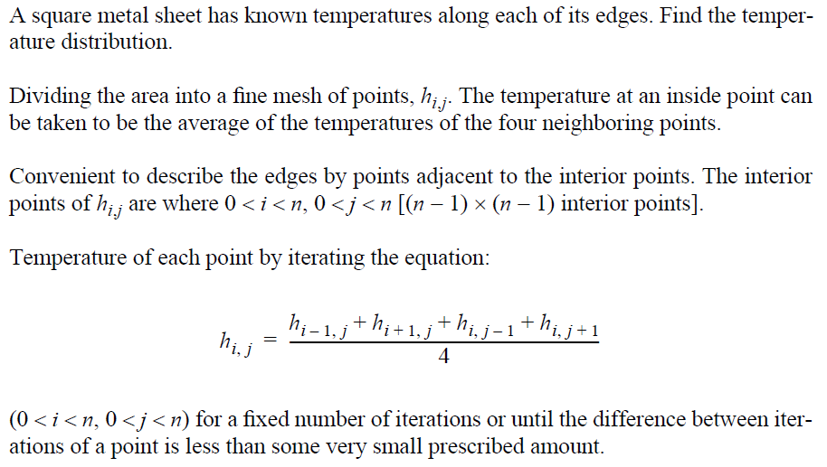
Heat Distribution (1)

Slide 2
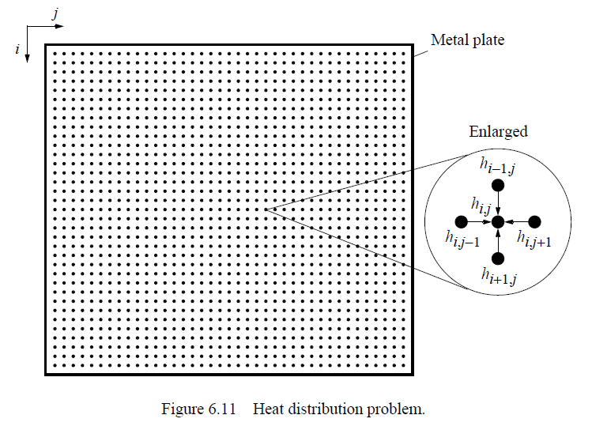
Heat Distribution (2)

Slide 3
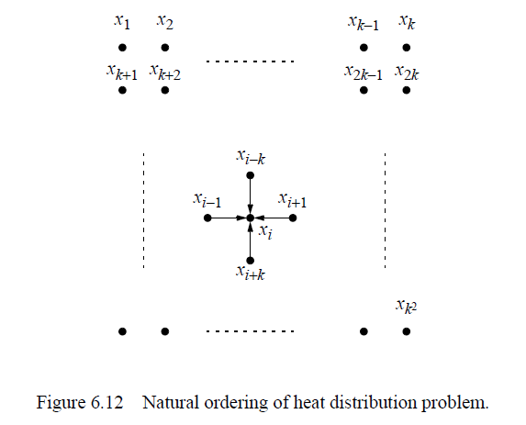
Heat Distribution (3)

Slide 4
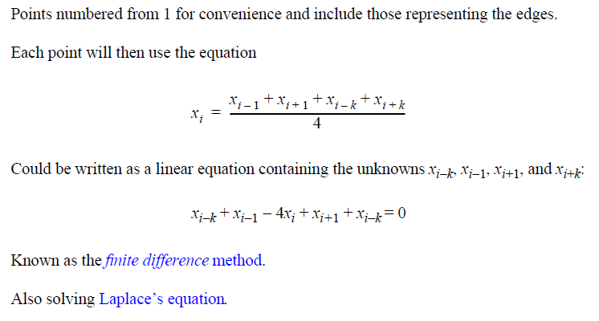
Heat Distribution (4)

Slide 5
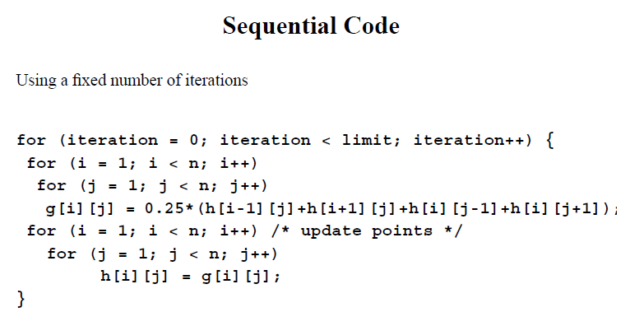
Heat Distribution (5)

Slide 6
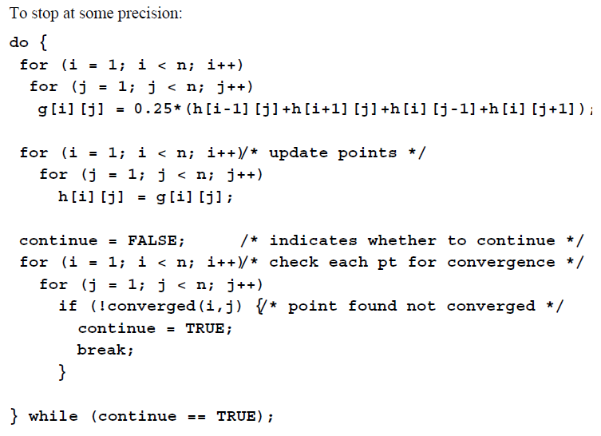
Heat Distribution (6)

