Slide 1
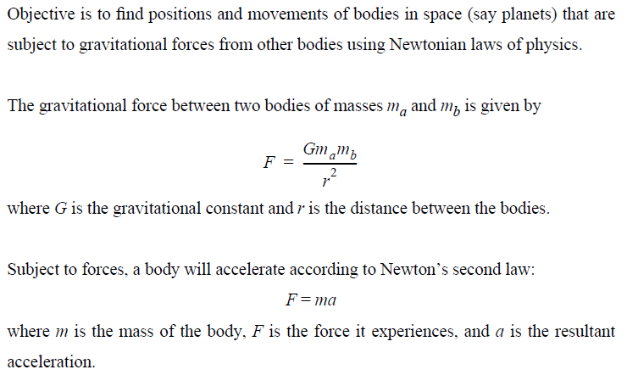
N-Body Simulation (1)

Slide 2
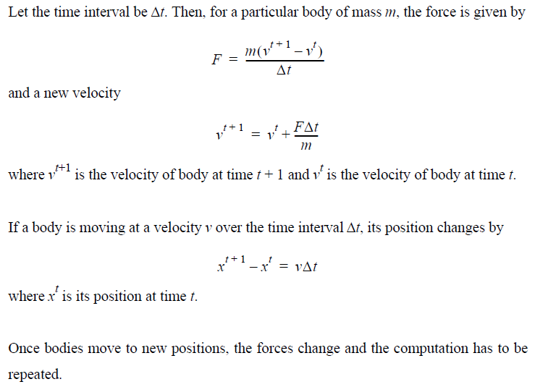
N-Body Simulation (2)

Slide 3
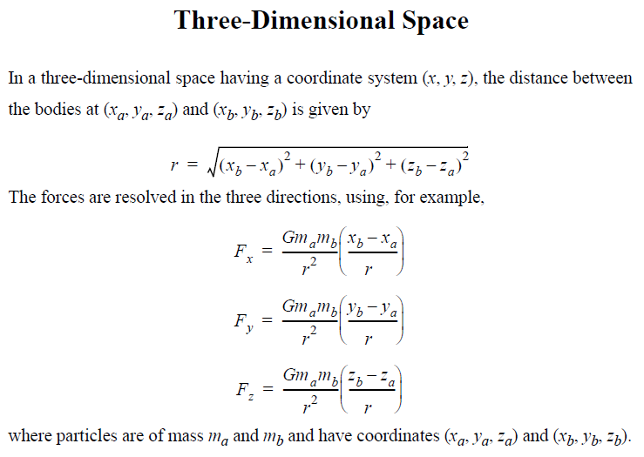
N-Body Simulation (3)

Slide 4
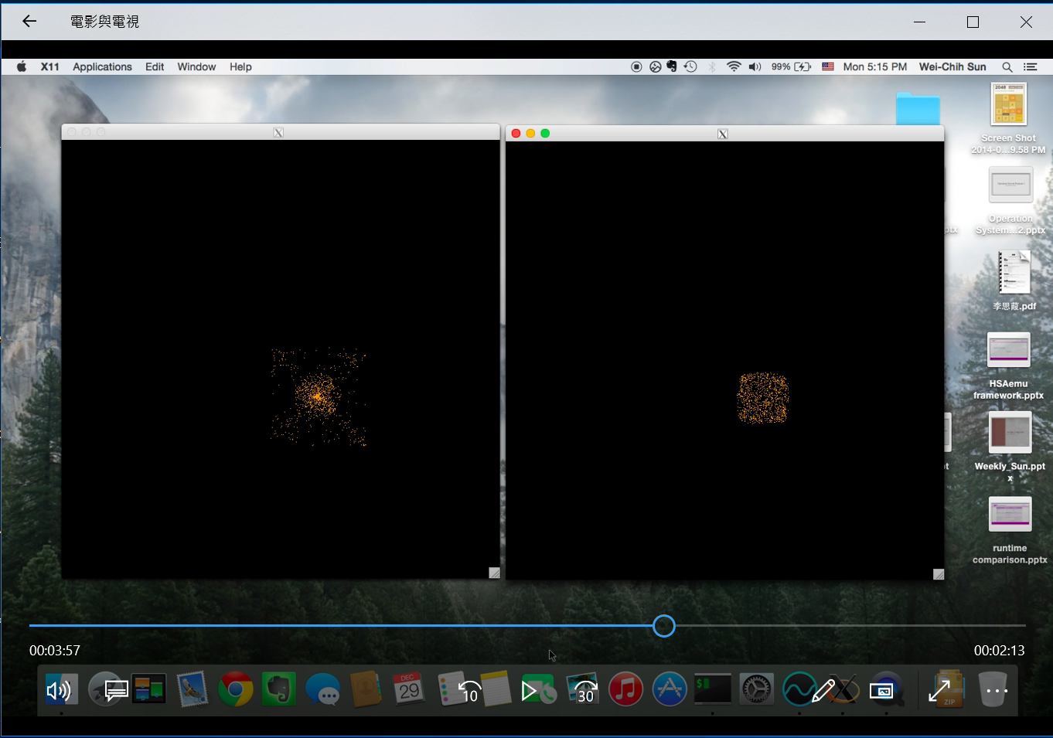
N-Body Simulation (4)

