Slide 1


GroupName
Jiahao Zhang | Kexin Tian | Haochen Shi | Dongfei Fan | Shuhao Hu
https://dev.d1mqoecap8suz3.amplifyapp.com
SENG3011 Deliverable 3

Slide 2
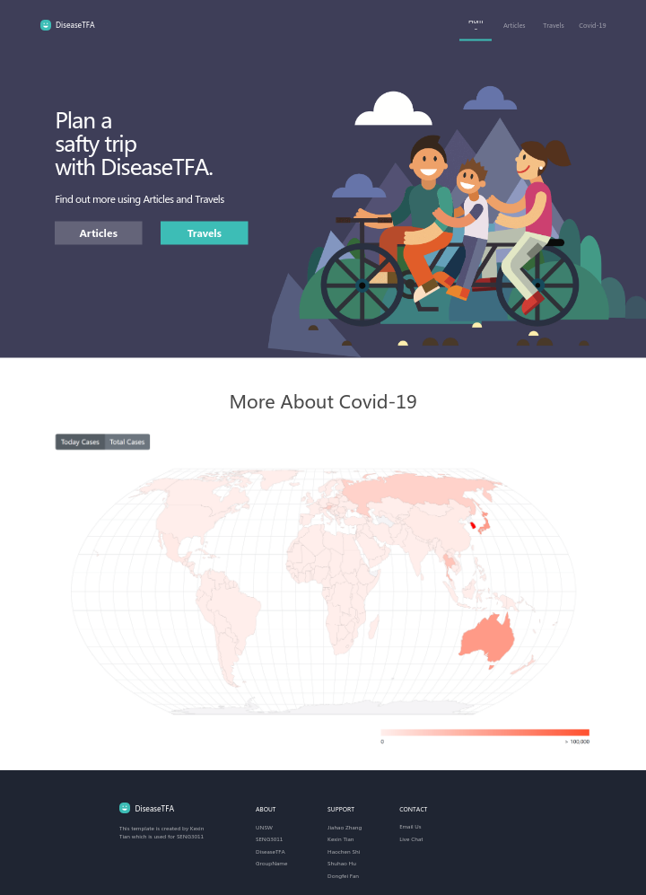
diseaseTFA
TFA is short for Travel, Fun and Adventures
Lower case disease is a symbol of travel situation under disease
Conclusion: Travel with Fun and Adventures under disease circumstance
Business Value
Health: A comprehensive website containing both travel planner and disease searching
Culture: Introduce local history and culture by searching locations
Education: Learn about disease and live with nature
Economy: For countries, boost local consumption For diseaseTFA, improve users’ retention and referral

Slide 3
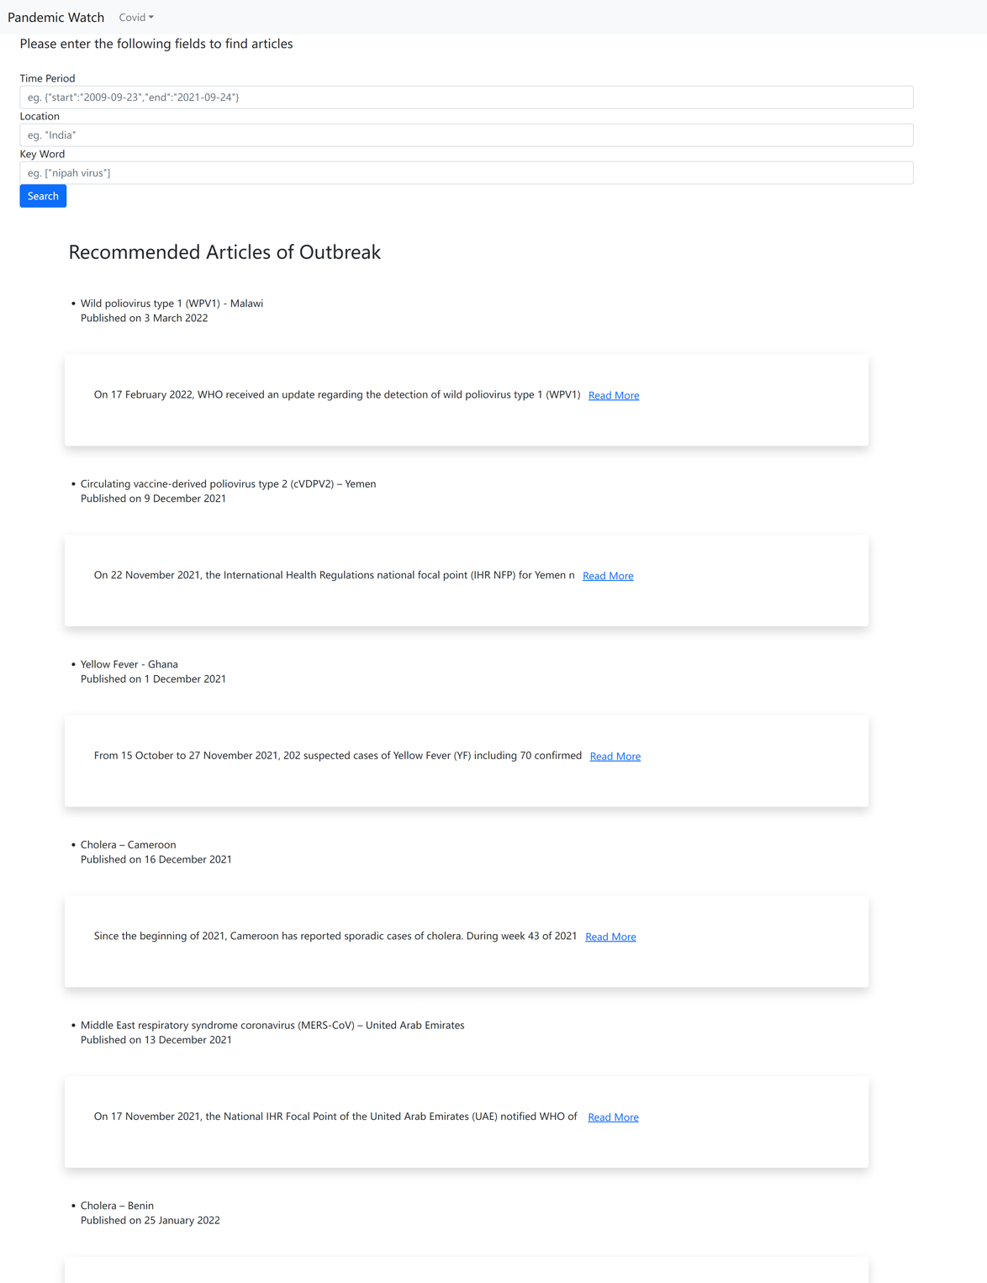
Implementation
Completed the prototype drawing in stages
The page is running successfully
Page structure and layout are being processed
Prototype is done using xiaopiu
As a user,
I want to know the states of Covid-19 about a country,
so that I can decide my trip based on the safety level of a county.
Disease articles are functionally successfully shown using API
As a user,
I want to know the states of disease about a location now or in the past,
so that I can travel more safely.

Slide 4
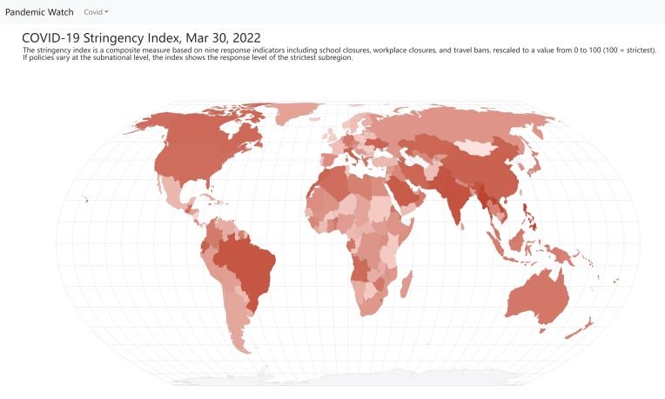
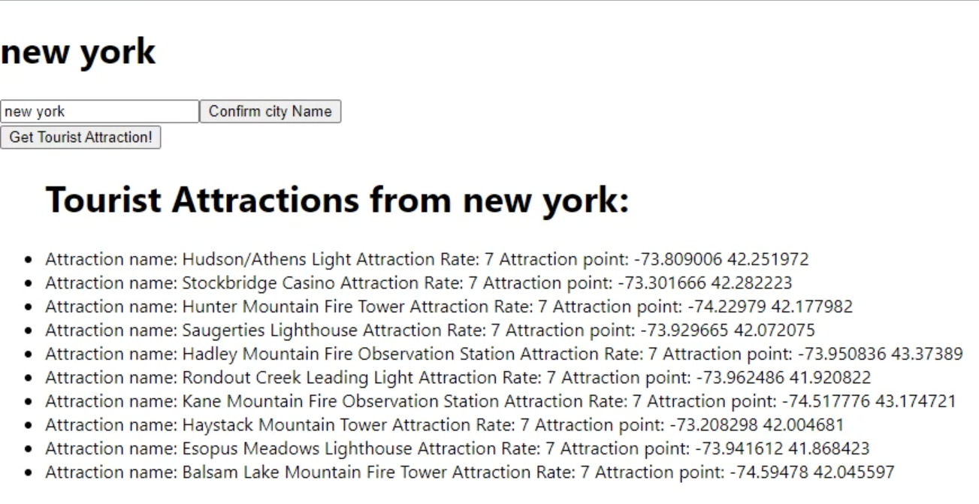
Global COVID-19 statistic showing on global map
As a user I want to know the government response level of a country,
so that I can plan a trip safely by knowing a country’s safety level and my potential quarantine time
Successfully returned the tourist attractions using API
As a user I want to know what places is attracted to me in a city,
so that I can decided where to go once I travel to a city

Slide 5
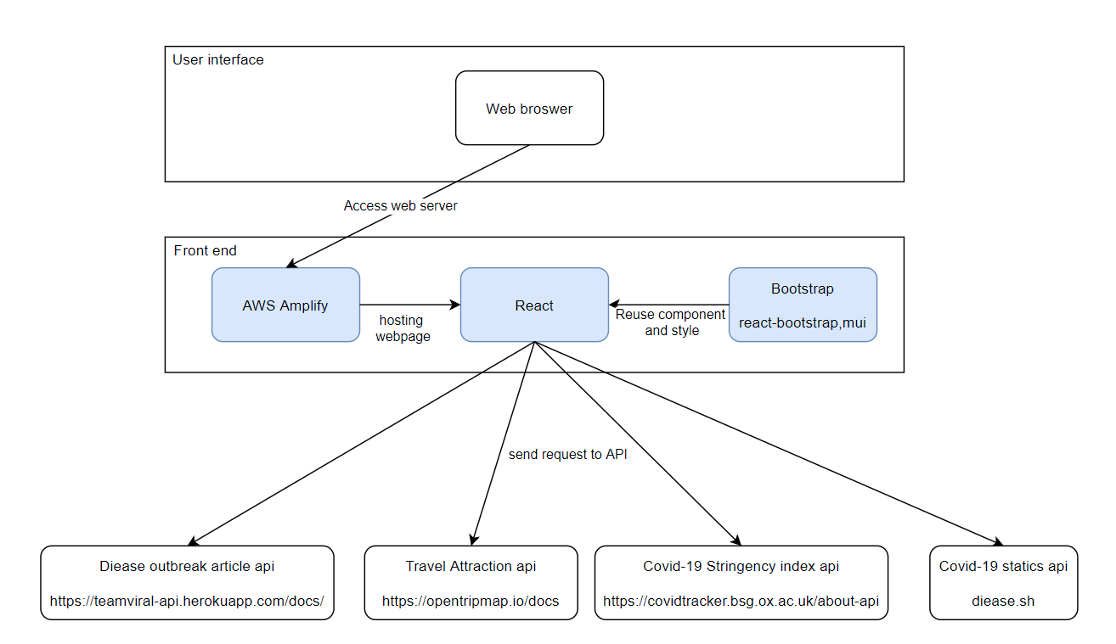
Technical Point of View

