Slide 1
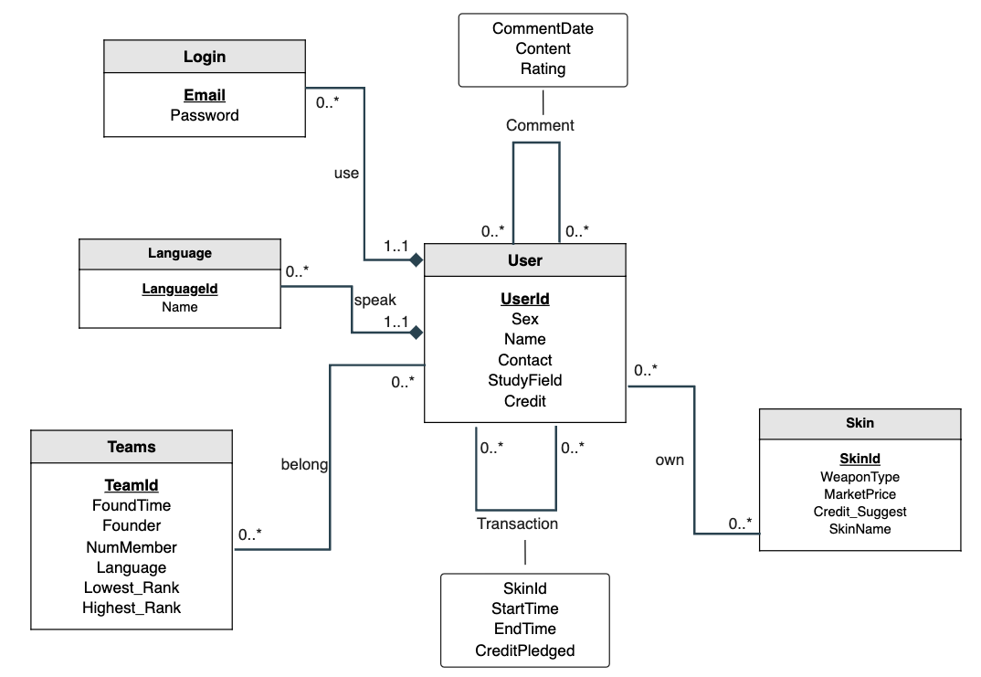


LendStatus
BorrowerId
StartDate
Credit
Due
Description and Assumeptions:
A user represents a person.
A user could use multiple emails to log in.
A team contains information to benefit joiners to fit their needs.
A skin has its weapon type and its market price and its name.
A user could speak multiple languages.
A user could have one comment on another user until it update it.
A user could only have one rent transaction with another until it ends.
However, you are able to have transactions with others if you really want to rent multiple skins.
A user could join multiple teams, a team has multiple users.
A user could have multiple skins.
Relational Schema:
User(UserId:INT[PK], Sex:VARCHAR(10), Name:VARCHAR(10), Contact:VARCHAR(30), StudyField:VARCHAR(10), Credit:INT)
Login(Email:VARCHAR(30)[PK], Password:VARCHAR(30), UserId:INT[FK to User.UserId])
Teams(TeamId:INT[PK], FoundTime:Date, Founder:INT[FK to User.UserId], NumMenber:INT, Language: VARCHAR(30)[FK to Language.Name], Lowest_Rank:INT, Highest_Rank:INT)
Skin(SkinId[PK], WeaponType:VARCHAR(30), MarketPrice:Decimal, Credit_Suggest:INT, SkinName:VARCHAR(30))
Transaction(Lender:INT[PK][FK to User.UserId], Borrower:INT[PK][FK to User.UserId], SkinId:INT[FK to Skin.SkinId], StartTime:Date, EndTime:Date, CreditPledged:INT)
Comment(From:INT[PK][FK to User.UserId], To:INT[PK][FK to User.UserId], CommentDate:Date, Content:VARCHAR(100), Rating:INT)
Own(UserId:INT[PK] ][FK to User.UserId], SkinId:INT[PK] ][FK to Skin.SkinId)
Belong(UserId:INT[PK] ][FK to User.UserId], TeamId:INT[PK] ][FK to Skin.SkinId)

