Slide 1
Faster and Smaller Inverted Indices with Treaps
Jiahao LU
Zhihao LI

Slide 2
Idées Basiques
Indexe inversé
Ranked or boolean
Both when stored on disk and in main memory, reducing the size of the inverted index representation is crucial.
docID & weight (tf*idf)
Algo de l’union et de l’intersection
Term-at-a-time (TAAT) and Document-at-a-time (DAAT)
Main difficulty for compression: Encoding of one value makes other values hard to be compressed

Slide 3
Solution: Treap data structure
Treap:= binary tree where nodes has key & priority.
left sub key <root key < right sub key
parent priority > children priority

Slide 4
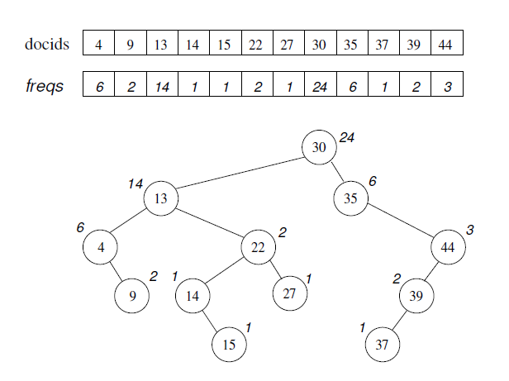
Inverted index representation
Treap:= binary tree where nodes has key & priority.
left sub key <root key < right sub key
parent priority > children priority
For each posting list of term
Keys: docID
Priorities: tf or term impact or other term weights

Slide 5
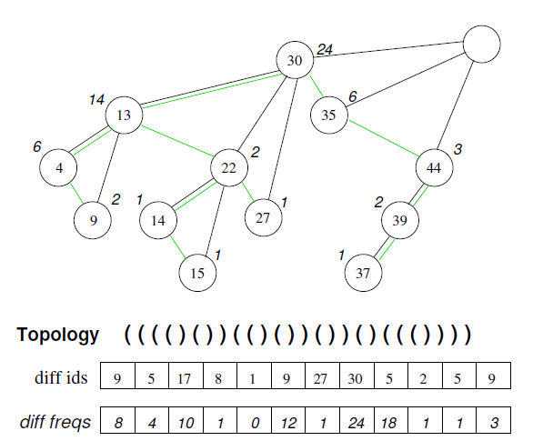

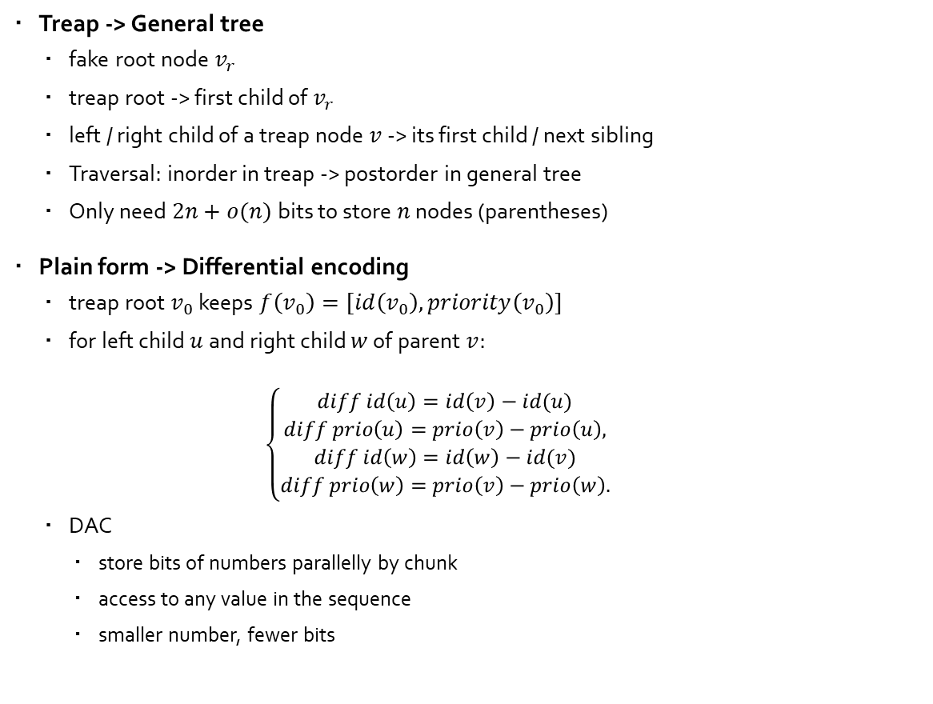
Compression of treap
Treap -> General tree
fake root node $v_{r}$
treap root -> first child of $v_{r}$
left / right child of a treap node $v$ -> its first child / next sibling
Traversal: inorder in treap -> postorder in general tree
Only need $2n+o(n)$ bits to store $n$ nodes (parentheses)
Plain form -> Differential encoding
treap root $v_{0}$ keeps $f\left(v_{0}\right)=[id\left(v_{0}\right), priority\left(v_{0}\right)]$
for left child $u$and right child $w$ of parent $v$:
$$\left\{\begin{aligned}diff id\left(u\right)=id\left(v\right)−id(u) \\ diff prio\left(u\right)=prio\left(v\right)−prio\left(u\right), \\ diff id\left(w\right)=id\left(w\right)−id(v) \\ diff prio\left(w\right)=prio\left(v\right)−prio\left(w\right).\end{aligned}\right.$$
DAC
store bits of numbers parallelly by chunk
access to any value in the sequence
smaller number, fewer bits
$$v_{r}$$

Slide 6
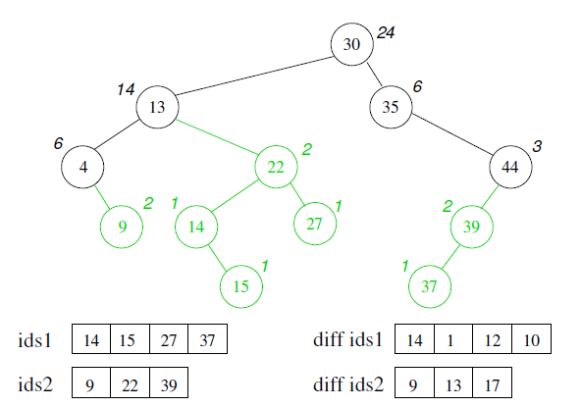


compression of treap
Advantages
All nodes with a priority below the threshold $f_{0}$ can be discarded
Many short posting lists -> more efficient with two DAC sequences
Many terms unnecessary to be stored because they never occurs more than $f_{0}$ times
$$f_{0}=2$$

Slide 7

query processing
General procedure
query $Q={\left\{t_{i}\right\}}_{0<i≤q}$, collection of terms $t$
DAAT for top-k documents from $\left\{∪,∩\right\}$
for $q$ posting lists, $score\left(Q, d\right)=\sum_{t}{ω(t,d)}=\sum_{t}{tf_{t,f}}∙idf_{t}$
results $\left(key, priority\right)$ inserted into k-element limited min-priority queue

Slide 8
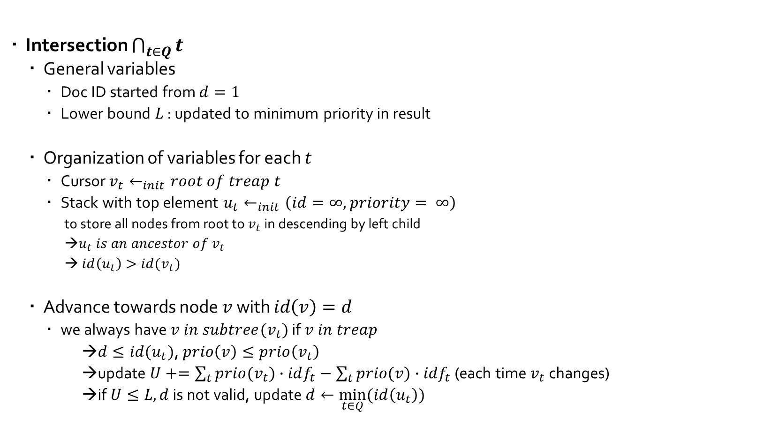
query processing
Intersection $\bigcap_{t∈Q}{t}$
General variables
Doc ID started from $d=1$
Lower bound $L$ : updated to minimum priority in result
Organization of variables for each $t$
Cursor $v_{t}←_{init}root of treap t$
Stack with top element $u_{t}←_{init}\left(id=∞, priority= ∞\right)$
to store all nodes from root to $v_{t}$ in descending by left child
→$u_{t} is an ancestor of v_{t}$
→ $id\left(u_{t}\right)>id(v_{t})$
Advance towards node $v$ with $id\left(v\right)=d$
we always have $v in subtree(v_{t})$ if $v in treap$
→$d≤id(u_{t})$, $prio\left(v\right)≤prio\left(v_{t}\right)$
→update $U+=\sum_{t}{prio(v_{t})}∙idf_{t}−\sum_{t}{prio(v)}∙idf_{t}$ (each time $v_{t}$ changes)
→if $U≤L, d$ is not valid, update $d←\min_{t∈Q}{(id\left(u_{t}\right))}$

Slide 9
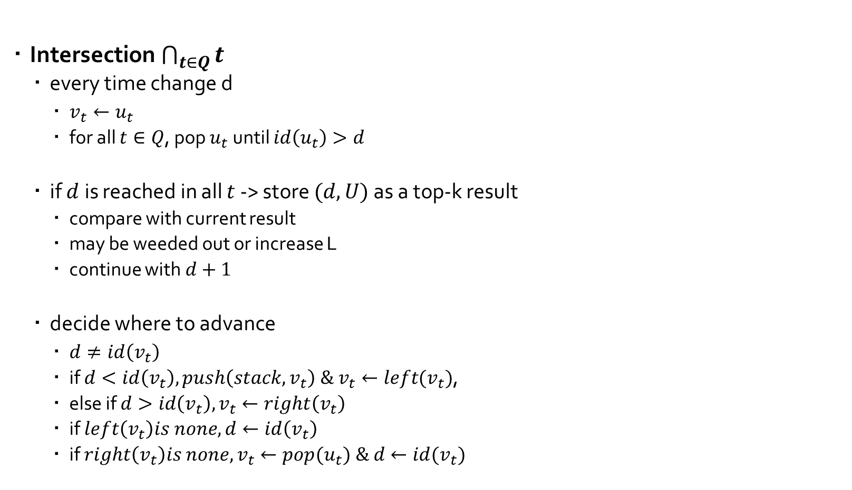
query processing
Intersection $\bigcap_{t∈Q}{t}$
every time change d
$v_{t}←u_{t}$
for all $t∈Q$, pop $u_{t}$ until $id\left(u_{t}\right)>d$
if $d$ is reached in all $t$ -> store $(d,U)$ as a top-k result
compare with current result
may be weeded out or increase L
continue with $d+1$
decide where to advance
$d≠id\left(v_{t}\right)$
if $d<id\left(v_{t}\right), push\left(stack, v_{t}\right) \& v_{t}←left(v_{t})$,
else if $d>id\left(v_{t}\right), v_{t}←right\left(v_{t}\right)$
if $left\left(v_{t}\right)is none, d←id\left(v_{t}\right)$
if $right\left(v_{t}\right)is none, v_{t}←{pop(u}_{t}) \& d←id(v_{t})$

Slide 10
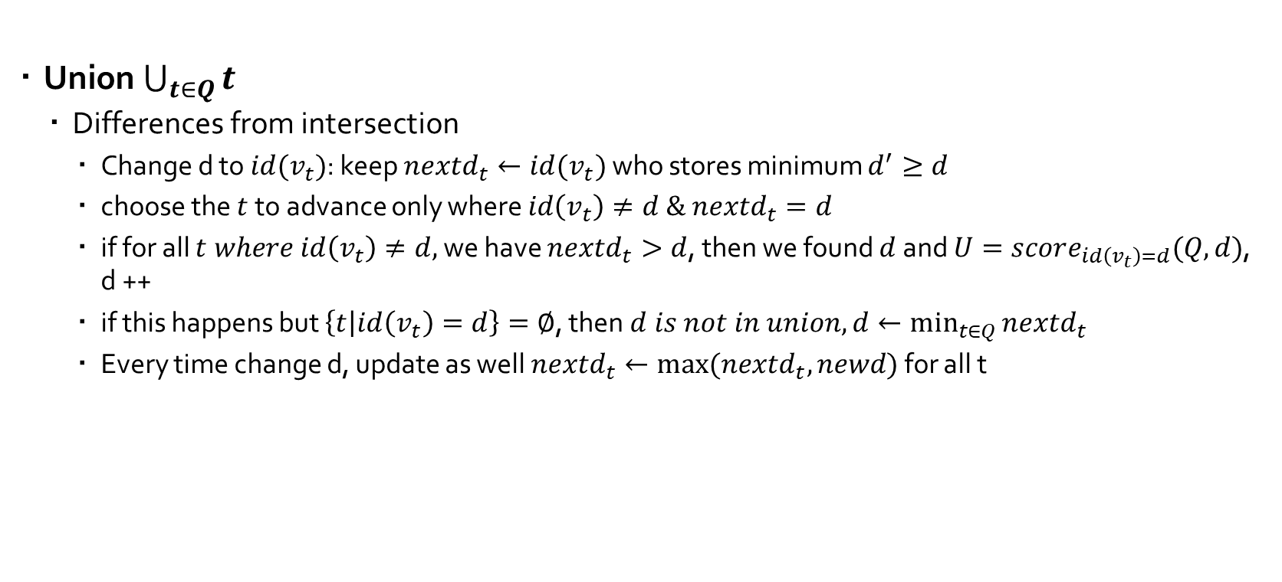
query processing
Union $\bigcup_{t∈Q}{t}$
Differences from intersection
Change d to $id(v_{t})$: keep $nextd_{t}←id(v_{t})$ who stores minimum $d^{′}≥d$
choose the $t$ to advance only where $id\left(v_{t}\right)≠d \& nextd_{t}=d$
if for all $t where id\left(v_{t}\right)≠d,$ we have $nextd_{t}>d$, then we found $d$ and $U=score_{id\left(v_{t}\right)=d}(Q, d)$, d ++
if this happens but $\left\{t | id\left(v_{t}\right)=d\right\}=∅$, then $d is not in union, d←\min_{t∈Q}{nextd_{t}}$
Every time change d, update as well $nextd_{t}←max⁡(nextd_{t}, newd)$ for all t

Slide 11
Implementation
On
https://github.com/JiahaoLU/ProjetFRIWeb.git

