Slide 1


Internal internship presentation
Soutenance – 05/07/2021
Maxime Georges
Misbehavior detection in CPM messages in a V2X network
Intership realised from march to july 2021
Internship tutors : Ines Ben Jemaa / Francesca Bassi

Slide 2


Presentation overview
Internship context
F2MD integration from Veins To Artery
Adding CPM features to F2MD
Overall features
Attacks
Checks
Results
Conclusion
Notes:
Ne pas parler de veins ni artery, juste des outils

Slide 3

Presentation overview
Internship context
F2MD integration from Veins To Artery
Adding CPM features to F2MD
Overall features
Attacks
Checks
Results
Conclusion

Slide 4
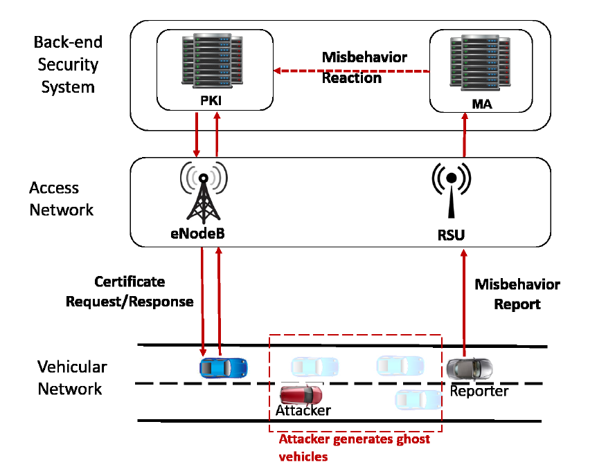
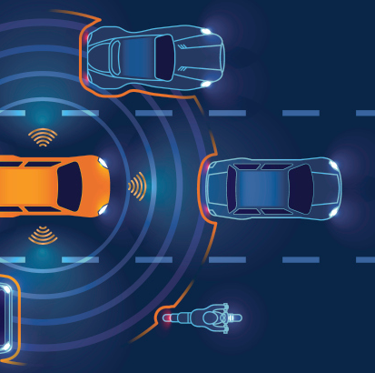
SCA project
2017 - 2020
TAM project
2021 - 2024
Internship context
F2MD Framework
Framework based on veins and omnet++, that implements:
A set of V2X attacks on CAM
Several CAM MbD algorithms
Visualize detections in real time
Generates dataset and reports sent to a Misbehavior Authority
My internship
Add CPM features to the F2MD framework, including:
A new set of attacks based on CPM
Several CPM MbD checks

Slide 5
Presentation overview
Internship context
F2MD integration from Veins To Artery
Adding CPM features to F2MD
Overall features
Attacks
Checks
Results
Conclusion

Slide 6
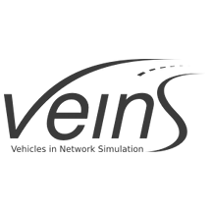
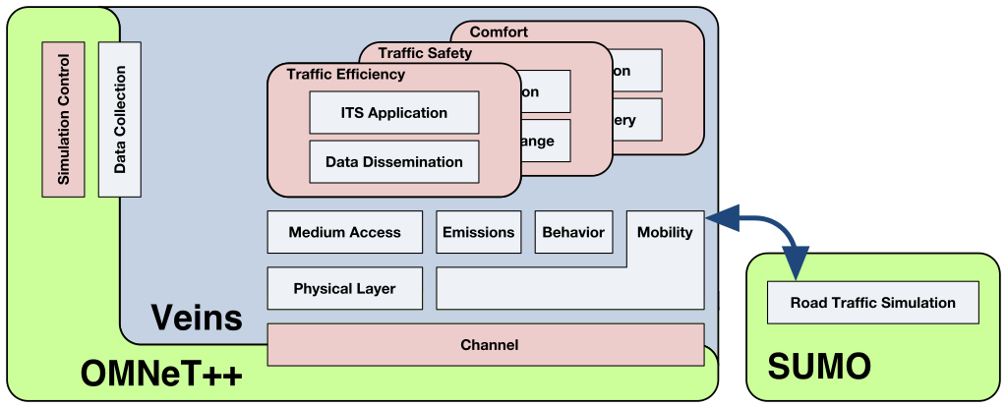

F2MD: from veins to Artery Limits of Veins
F2MD was built as an application module of Veins. Compared to other framework, Veins has several drawbacks:
Poor modularity: adding a new application module, of modify mobility services requires to modify backend code of veins
No sensors/perception module implemented. CPM implementation should be created from scratch
Do not take official regulation into account
F2MD
Application layer
Data & report generation
Veins (car2x.org)

Slide 7
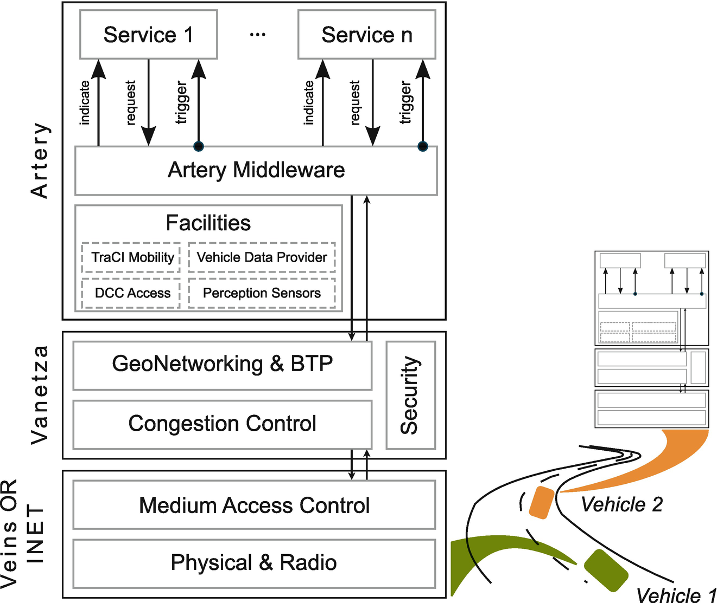

F2MD: from veins to Artery Advantages of Artery
Using Artery instead of veins offers several advantages:
Modularity of services, for each vehicles. Several services, including CAM, CPM and DEN are already implemented
Facilities already implemented offers useful functionalities, such as sensors
Artery was at first an extension of veins, so F2MD can easily be adapted for Artery
Artery V2X Simulation Framework (v2x-research.eu)

Slide 8
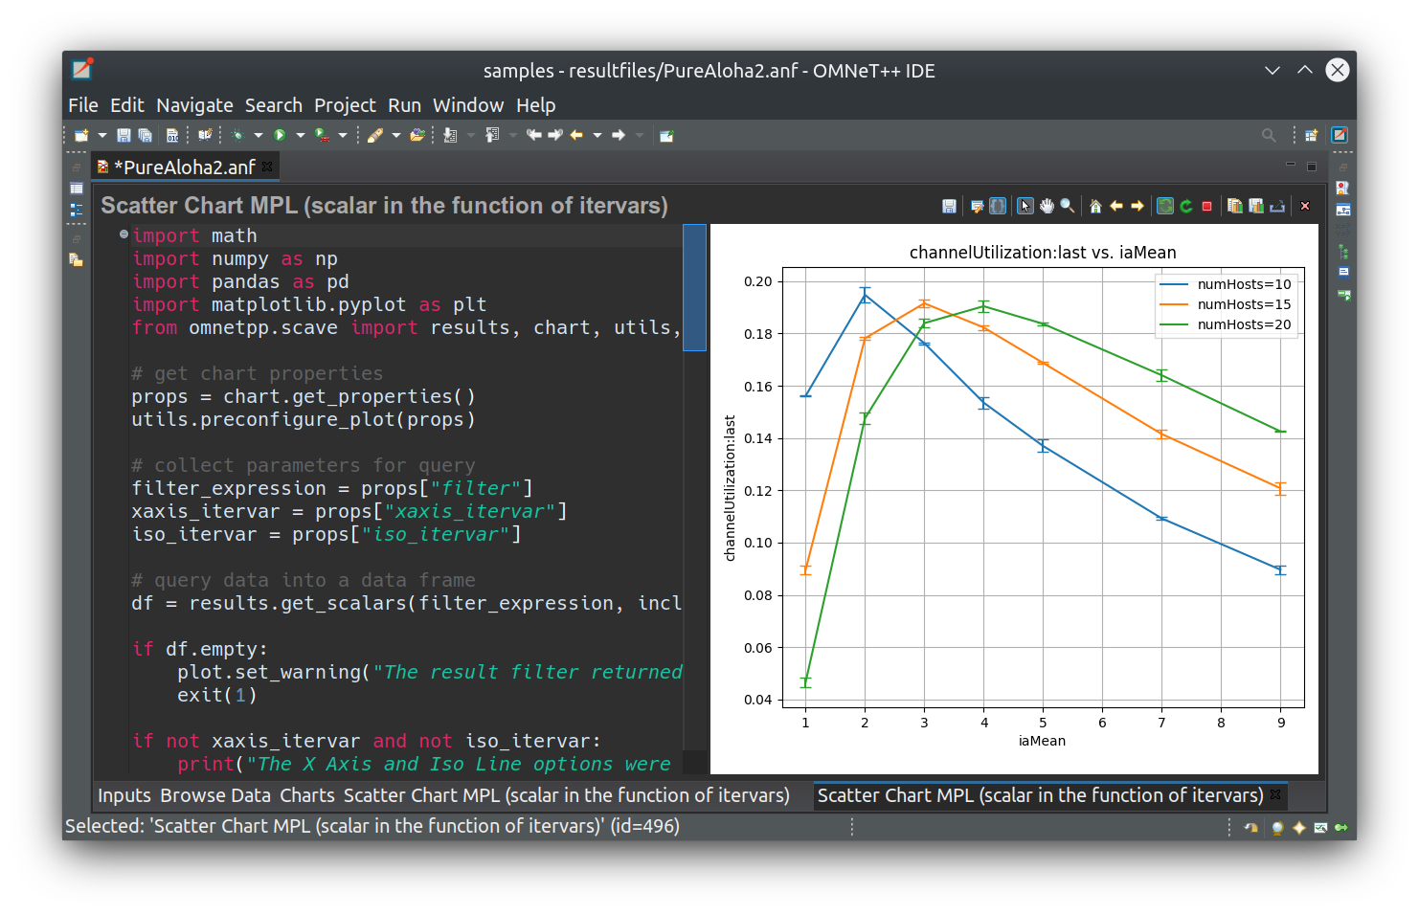


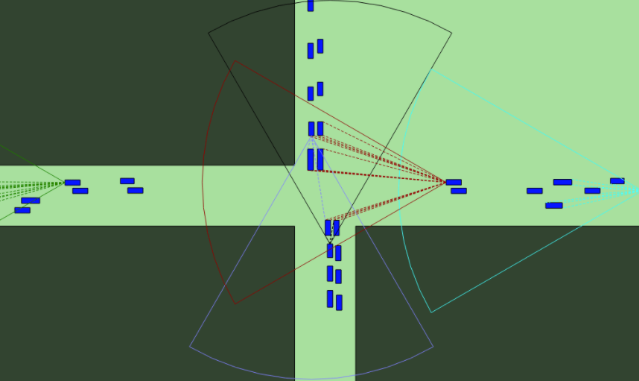
F2MD: from veins to Artery Local Environment Model
locEnvMod
Each vehicles owns a local environment model, which is defined by :
An area, restricted by the type and the number of sensors located on the vehicle
All the vehicles that are located in this area are considered as “perceived” and thus are added in this environment model
Makes the CPM implementation easy

Slide 9
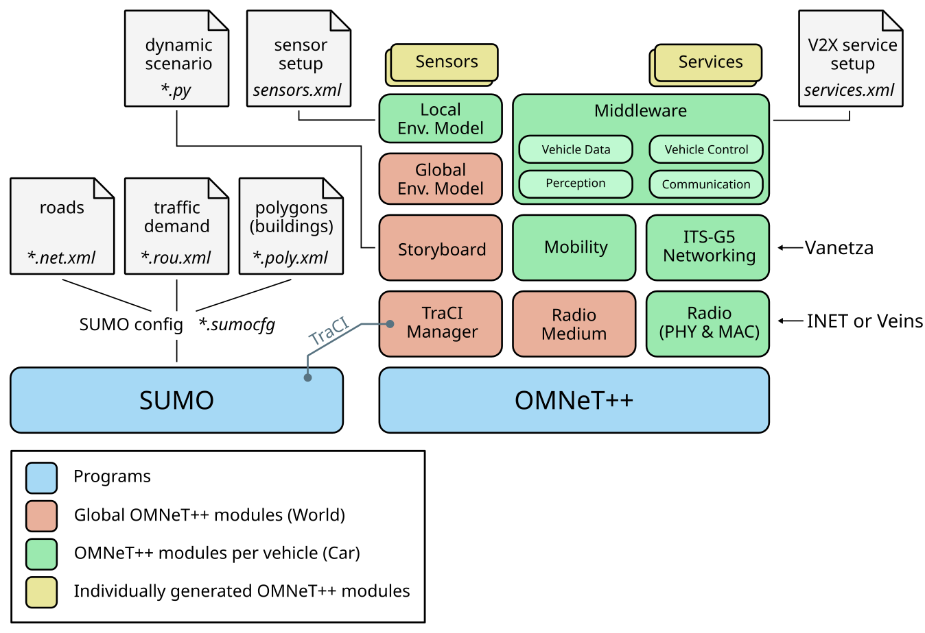


F2MD: from veins to Artery Modularity of Artery
Sensors description
Let you assign different sensors to each vehicle of the simulation individually
F2MD
Service description
Let you assign different services to each vehicle of the simulation individually
ASN regulation files
ASN regulation files
Describes the fields and the rules related to each types of V2X messages (CAM, CPM and DEN)

Slide 10
Main problems encountered
While porting F2MD to Artery
F2MD
F2MD Files
M
I
D
D
L
E
W
A
R
E
Facilities and others Artery back end code
Veins coords
Veins spatial system: heading and positions are differents
Artery coords
Artery spatial system: heading and positions are differents
F2MD Veins App
Layer
Veins format
Artery format
Veins & INET layers
Vanetza networking layers
INET packet type
INET mac address and BSM fields
Vanetza packet type
Vanetza BSM fields

Slide 11
Main problems encountered
While porting F2MD to Artery
F2MD
getAttributes from facilities
(position, speed…)
F2MD Facility
M
I
D
D
L
E
W
A
R
E
Facilities and others Artery back end code
Artery coordinates
Artery coords
Artery spatial system: heading and positions are differents
Artery coordinates
Artery spatial system
F2MD Service
F2MD Files
conversion
Veins coords
Veins spatial system: heading and positions are differents
Vanetza networking layers
Veins spatial system
Sends or reveices a new message
Vanetza packet type
Declaration of a new BSM type
Veins coord

Slide 12
Presentation overview
Internship context
F2MD integration from Veins To Artery
Adding CPM features to F2MD
Overall features
Attacks
Checks
Results
Conclusion

Slide 13
Overal Architecture
Middleware
Triggers the sending of a CPM periodically
Indicates the reception of a new CPM
CPM Service
CAM Service
Service that allows vehicle to send (trigger) and receive (indicate) CPMs.
Service that allows vehicle to send (trigger) and receive (indicate) CAMs.

Slide 14
Overall Architecture
Middleware
Triggers the sending of a CPM periodically
Indicates the reception of a new CPM
CPM Service
CAM Service
CPM F2MD Processing
CAM F2MD Processing
Service that allows vehicle to send (trigger) and receive (indicate) CPMs.
Service that allows vehicle to send (trigger) and receive (indicate) CAMs.
F2MD framework. Implements, among other features:
CPM attacks
CPM checks
F2MD framework. Implements, among other features:
CAM attacks & checks
Pseudonyms
Report generation
CPM Parameters
CAM Parameters
Stores CPM related F2MD parameters
Stores CAM related F2MD parameters

Slide 15

Implemented attacks
CPM Data
18 Implemented attacks, based on :
Header
Sender ID
CPM ID
Management & vehicle data container
senderType
Ego GPS position
Ego speed
Ego heading
Perceived object container
For each perceived object:
Object ID
Time of Measurement
Distance Value & Conf.
Speed Value & Conf.
Yaw angle value & Conf.
Random Distance
Distance Offset
Ghost Object
Change the distance randomly
Adds an offset to the perceived distance
Adds a fake object to the list of percvd. objects
Random Speed
Speed Offset
Drop Object
Change the speed randomly
Adds an offset to the perceived speed
Remove a perceived object
Constant Offset
Drop all Objects
Remove all the perceived objects
Adds an offset to all the perceived object attributes
Naïve attacks
Discrete attacks
Malicious attacks

Slide 16


Misbehaviour detection
Plausibility tests
Distance Plausibility
Distance < MaxRadarRange
Radar range
Speed Plausibility
Speed < MaxPlausibleSpeed
$$S>S_{max}$$
$$S_{max}$$

Slide 17
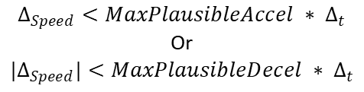




Misbehaviour detection
Consistancy tests
Distance Consistancy
$$Dist_{t−1}$$
$| Dist_{t} −Dist_{t−1} |<MaxSpeed ∗2 ∗ Δ_{t}$
$$Dist_{t}$$
Speed Consistancy
$$Δ_{Speed}<MaxPlausibleAccel ∗ Δ_{t}$$
Or
$|Δ_{Speed}|<MaxPlausibleDecel ∗ Δ_{t}$
$${Speed}_{t−1}$$
$${Speed}_{t}$$

Slide 18







Misbehaviour detection
Predictive tests
Distance Prediction
Let’s define :
$$RelSpeed_{t}=\left|Speed_{t}−EgoSpeed_{t}\right|$$
$$RelSpeed=moy\left(RelSpeed_{t} , RelSpeed_{t−1}\right)$$
$∆_{dist} =RelSpeed∗ Δ_{t}±DistConfidence$
$${Speed}_{t−1}$$
$${Speed}_{t}$$
$$Ego{Speed}_{t−1}$$
$${EgoSpeed}_{t}$$
$$Dist_{t−1}$$
$$Dist_{t}$$

Slide 19
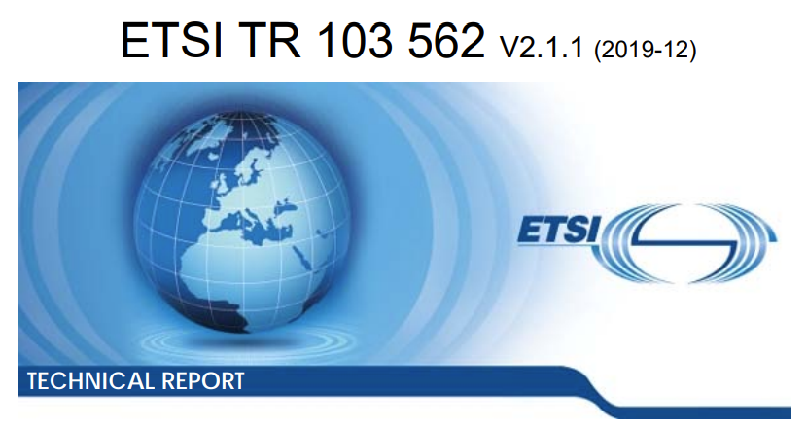
Main problems encountered
While creating CPM features
Measurements units
Positions, speeds and heading – among other CPM-fields – must be declared in the correct units (centimetres, degrees…). If not, the CPM is not sent.
Pseudonym redundancy
Cpm is already implemented in Vanetza/Artery, following the ETSI regulation
Thus, each cpm sent must fulfil all the requirements defined in this regulation
senderID can only take a value between 0 and 255. In huge scenarios, this can cause several vehicles to have the same ID. Worse, we currently use the two last digits of the artery ID of each vehicles which sometimes cause ID repetitions even with a 10 vehicles scenario
Tests and logging must be adapted
Debbugging or logging values cannot be sent through the CPM, as it is not defined in the regulation

Slide 20
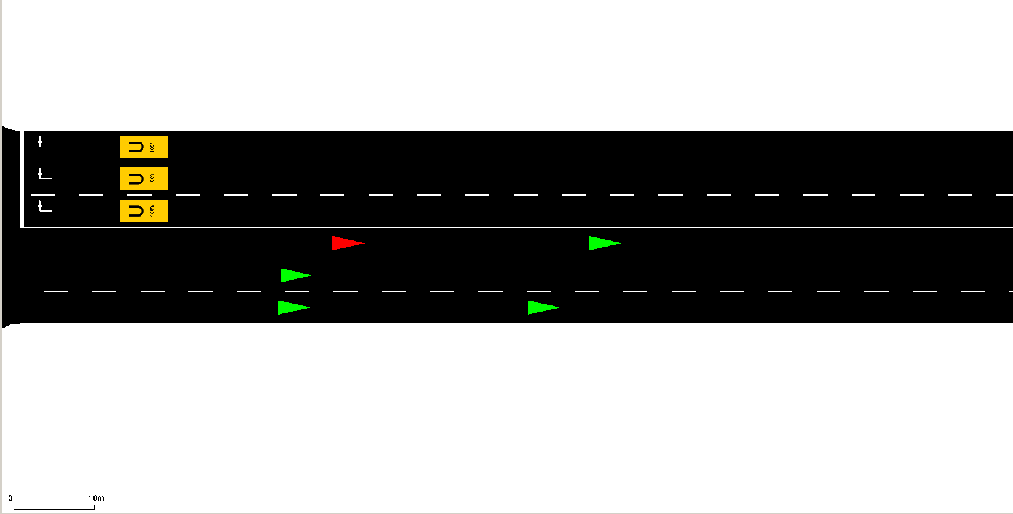
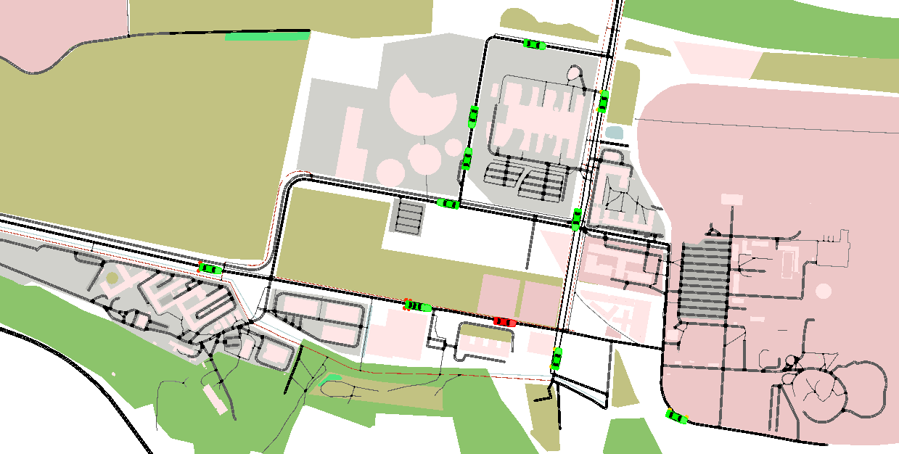
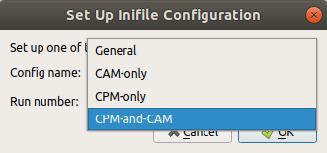

Scenarios
Highway test Scenario
IRTS complex Scenario
Highway
IRTS
Simple highway scenario useful for testing
Unlimited amount of cars and scenario time
2 ways highway ( vehicle can cross each others
Vehicles can overpass if their speed is different
Vehicles are the same during all the simulation
Complex scenario with a city-like environment
Unlimited amount of cars and scenario time
Multiple intersections and buildings
Vehicles can exit and enter the map at any time
User can choose between CAM, CPM, and both

Slide 21
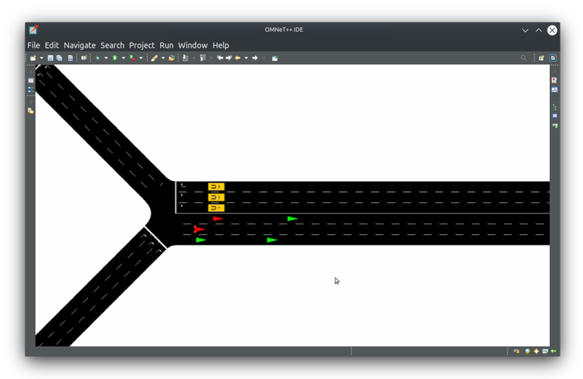
Examples
Example 1
Scenario Highway
5 vehicles
2 attackers
Penetration rate 100%
Attack: Offset Random
Result: all attackers are detected with basic tests

Slide 22
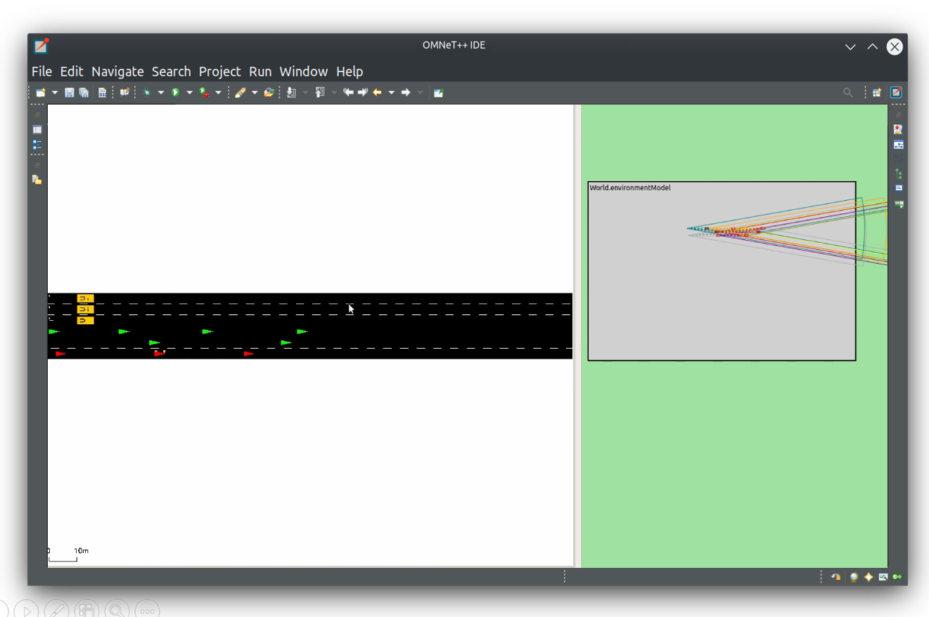
Examples
Example 2
Scenario Highway
15 vehicles
4 attackers
Penetration rate 100%
Attack: Offset Random
Result: all attackers are detected with basic tests, apart from one that does not perceive any objects

Slide 23
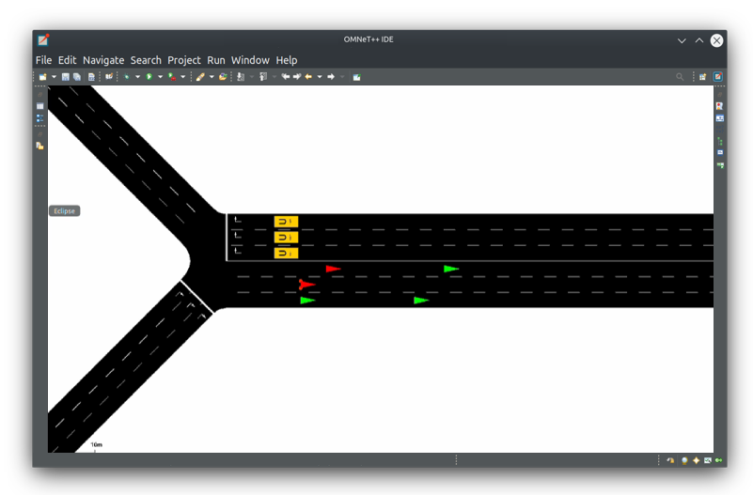
Examples
Example 3
Scenario Highway
5 vehicles
2 attackers
Penetration rate 100%
Attack: Ghost Objects
Result: Basic tests does not allow to detect such attacks. One attackers is detected because of redundant pseudonym

Slide 24

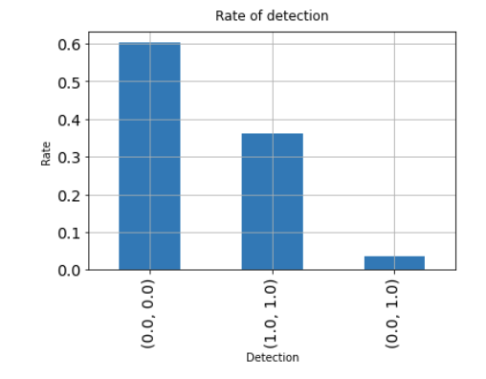
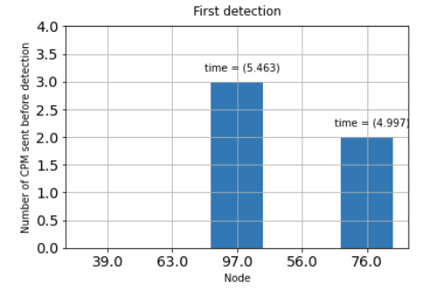
Results
Offset attack / 5 vehicles
Random Sped
40% of attackers ( id {97; 76} ) – 100% penetration rate
Random distance offset
30 seconds – 1 CPM / second
Change the speed randomly
True Negative
True positive
False Negative

Slide 25
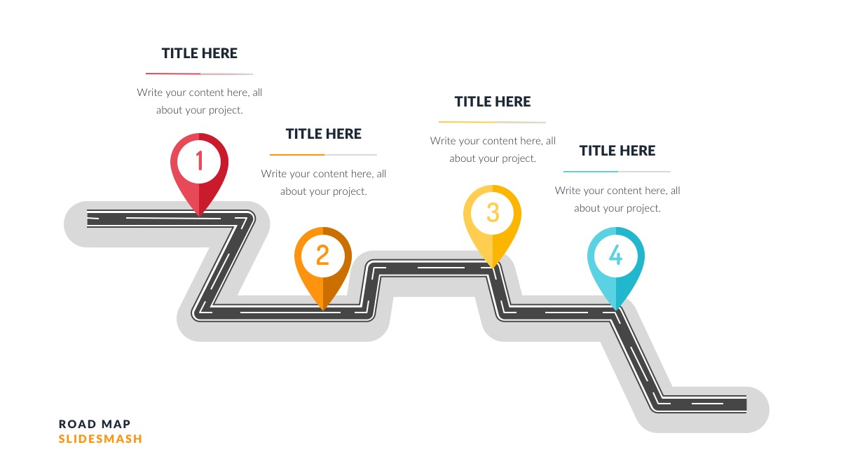
Next steps
End of the internship
Start of the thesis
Solve minor problems
Pseudonyms redundancy, tests fail or innacurate
Add all missing features to CPM F2MD
Write a documentation
Test the complete Framework in various complex scenarios
There is still a lack of features in CPM facility compared to CAM
So that this code can be used and modified with ease
The framework must be robust and efficient on highly complex scenarios, such as IRTS

Slide 26
Presentation overview
Internship context
F2MD port from Veins To Artery
Adding CPM features to F2MD
Overall features
Attacks
Checks
Results
Conclusion

Slide 27

Thank you for listening
Please feel free to ask questions

