Slide 1

Body Fat Percentage Prediction with Body Circumference Measurements
Group1: Jiahuan He, Xinyun Chen, Haiyi Chen

Slide 2

Introduction
Body fat percentage is an important health measure that reflects obesity, and associated with serious medical diseases, such as cancer, heart disease, and diabetes.
Underwater weighing is one of the accurate methods to measure body fat percentage. Siri’s equation (1956):
Body fat percentage = 495/D - 450
D = Body Density (g/cm^3),
assuming that density of lean body tissue = 1.10 gm/cm^3
and density of fat tissue = 0.90 gm/cm^3.

Slide 3
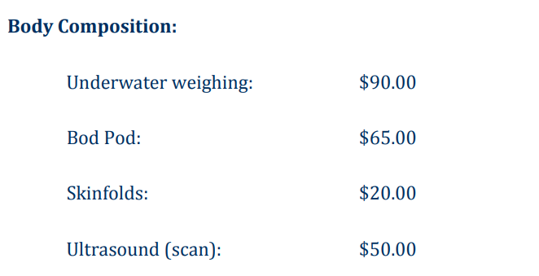
Introduction
Underwater weighing method is very accurate to measure the body fat percentage, but is EXPENSIVE!

Slide 4
Aim
Build a linear model to predict the body fat percentage with age, weight, height and body circumference measurements such as neck circumference, abdomen circumference.
If this is feasible, we can have a cheap and convenient way of measuring body fat percentage.
You only need a measuring tape!

Slide 5
Data
Dataset provided by Dr. A. Garth Fisher (personal communication, October 5, 1994) contains data of 252 males with the following variables:
Density determined from underwater weighing
Percent body fat from Siri's (1956) equation
Age (years)
Weight (lbs)
Height (inches)
Neck circumference (cm)
Chest circumference (cm)
Abdomen 2 circumference (cm)
Hip circumference (cm)
Thigh circumference (cm)
Knee circumference (cm)
Ankle circumference (cm)
Biceps (extended) circumference (cm)
Forearm circumference (cm)
Wrist circumference (cm)

Slide 6
Analysis Plan
Descriptive data analysis (missing values, data that do not make sense, look at association patterns between response and predictors)
Specify maximum model (all main effects plus interactions if any).
Diagnostics: eigen-analysis to find collinearity and remove covariates with collinearity, and assumption diagnostics to see if transformations are needed.
Model selection: backward selection with alpha=0.15.

Slide 7
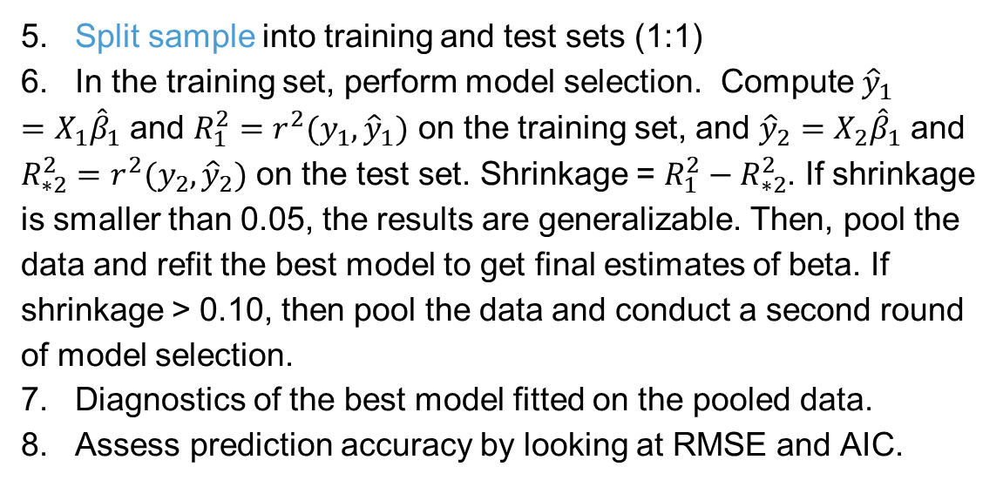
Analysis Plan
5. Split sample into training and test sets (1:1)
6. In the training set, perform model selection. Compute ${\hat{y}}_{1}=X_{1}{\hat{β}}_{1}$ and $R_{1}^{2}=r^{2}(y_{1},{\hat{y}}_{1})$ on the training set, and ${\hat{y}}_{2}=X_{2}{\hat{β}}_{1}$ and $R_{∗2}^{2}=r^{2}(y_{2},{\hat{y}}_{2})$ on the test set. Shrinkage = $R_{1}^{2}−R_{∗2}^{2}$. If shrinkage is smaller than 0.05, the results are generalizable. Then, pool the data and refit the best model to get final estimates of beta. If shrinkage > 0.10, then pool the data and conduct a second round of model selection.
7. Diagnostics of the best model fitted on the pooled data.
8. Assess prediction accuracy by looking at RMSE and AIC.

Slide 8
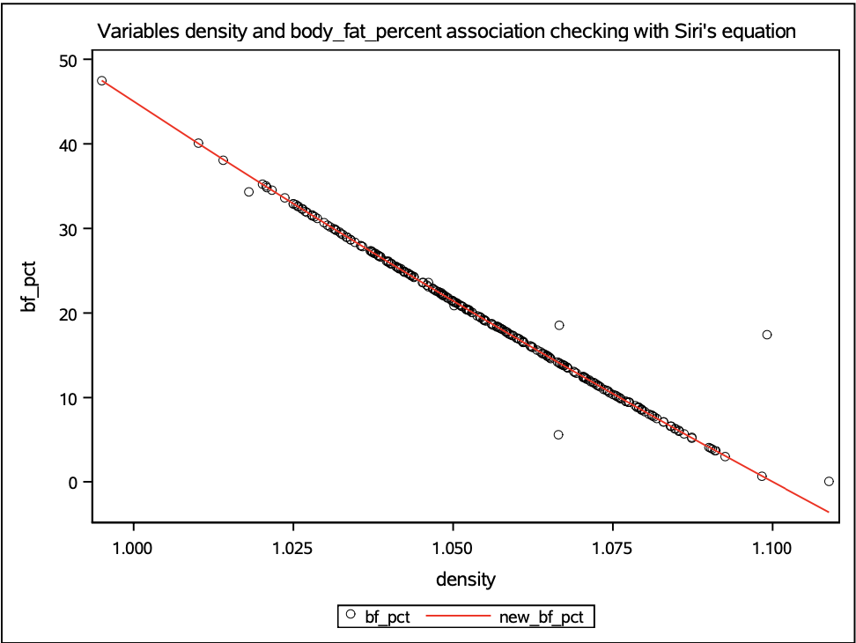
EDA
First Step: Missing data checking
No missing value found
Second Step: Siri’s equation relationship checking
In density vs body_fat_percent scatter plot matrix, the relationship between them does not follow Siri’s equation relationship
Recalculation performed and updated dataset with the new variable

Slide 9
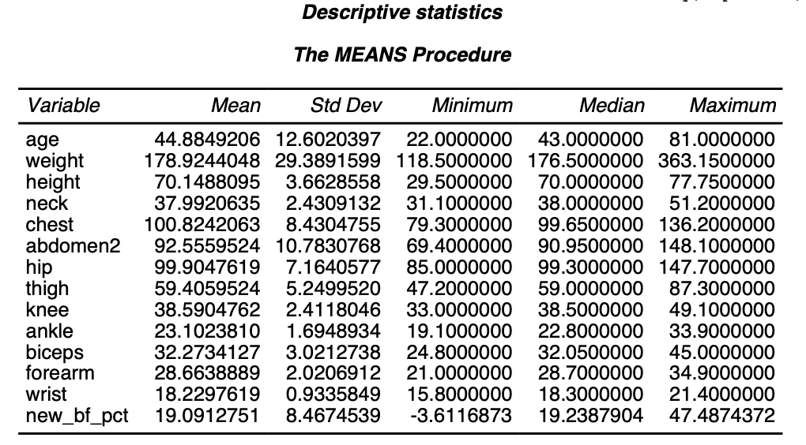
EDA cont’d
Third Step: Descriptive statistics summarizing
Displaying each variable’s mean, standard deviation, minimum, median, and maximum

Slide 10
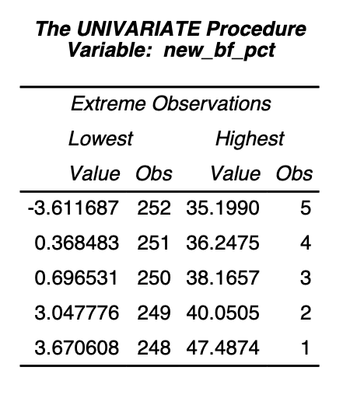
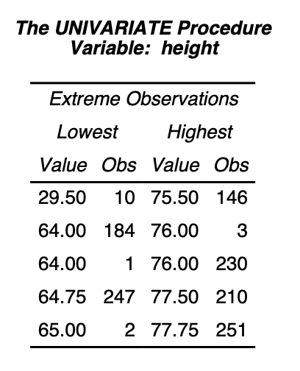
EDA cont’d
Fourth Step: Extreme values finding
Listing five largest and five smallest values for each variable
From the result we found some abnormal values need to be removed
Abnormal values: body_fat_percent<3% and height observation with 29.5 inches

Slide 11
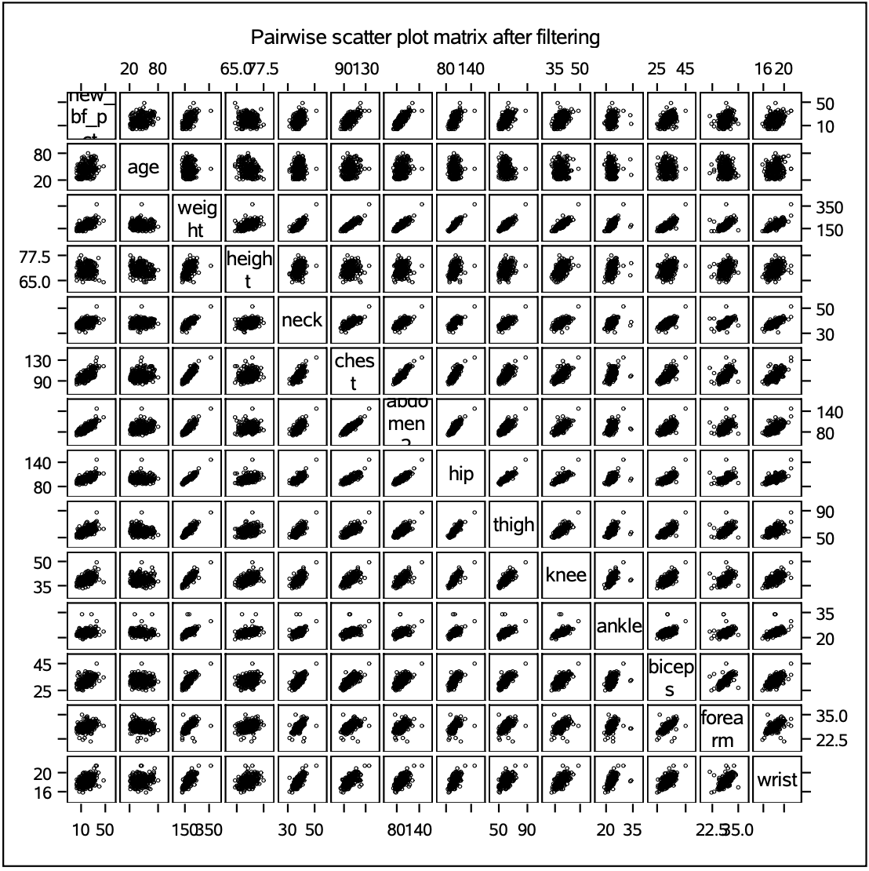
EDA cont’d
Fifth Step: Pairwise scatter plot matrix after filtering performing

Slide 12
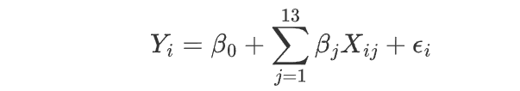
Maximum model
Include all the main effect terms of the 13 covariates.
There is no scientific opinion that we need to include an interaction term for 2 specific predictors. And the sample size is not large enough to estimate a model with all interaction terms.

Slide 13
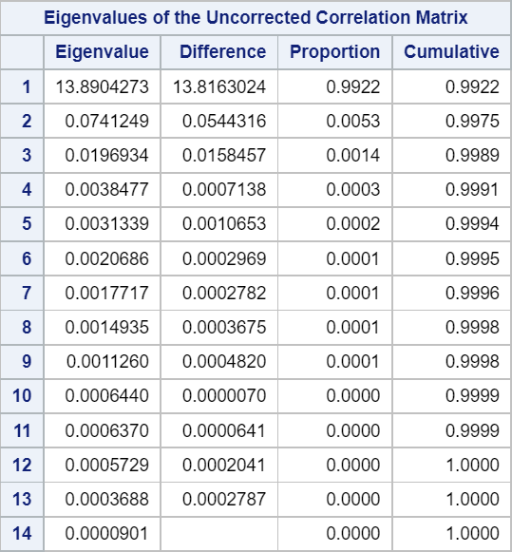
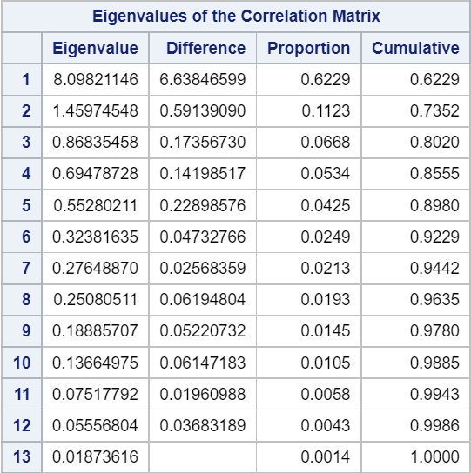
Computation Diagnostics
Scaled SSCP
Condition number=392.67
Correlation matrix
Condition number=20.79

Slide 14
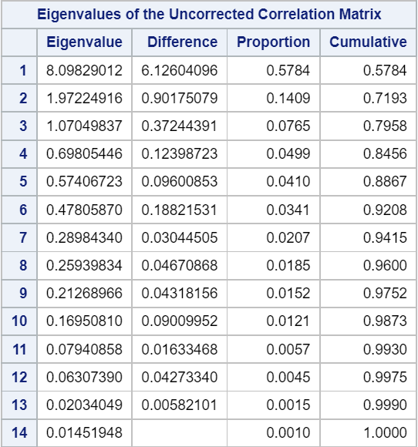
Computation Diagnostics - Cont’d
Centralize all predictors except age.
Scaled SSCP
Condition number=23.62

Slide 15
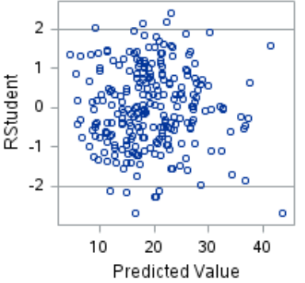
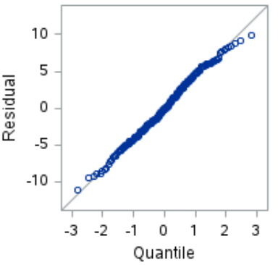
Assumption Diagnostics

Slide 16
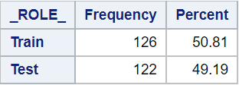
Split Sample
Training set: used for model selection. In the full model p=14. n=126 > 5p=70
Testing set: used to analyze the reliability of the selected model.

Slide 17
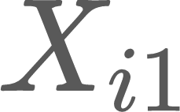
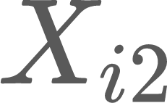
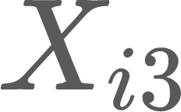
Selected Model
is the variable of centralized weight
is the variable of centralized abdomen 2 circumference
is the variable of centralized ankle circumference
is the variable of centralized wrist circumference

Slide 18
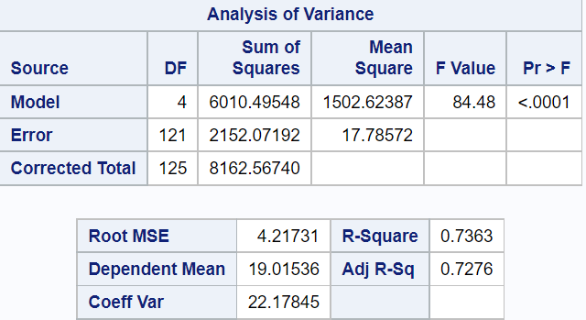
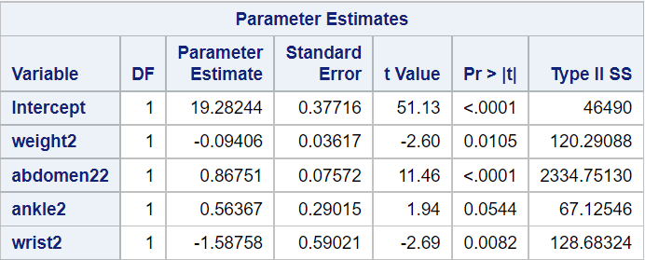
Selected Model

Slide 19
Reliability assessment
On the training set, R-square is 0.7363
On the testing set, R-square is 0.6991
The shrinkage is 0.7363-0.6991=0.0372<0.05
The reliability of the selected model is good.

Slide 20
Accuracy Assessment
An equation by the Naval Health Research Center (NHRC)[1]:
% body fat = 86.010 x log10 (abdomen - neck) - 70.041 x log10 (height) + 36.76
 | RMSE | AIC
Our Model | 4.71 | 382.77
The NHRC Equation | 5.09 | 399.92
[1] Shaheen A, Javed N, Azam F, Liaquat A, Khan M, Alam SM, Mumtaz S. Comparison of Bioelectrical Impedance and Navy Seal Formula to Measure Body Composition in Medical Students. Cureus. 2019 May 22;11(5):e4723. doi: 10.7759/cureus.4723. PMID: 31355083; PMCID: PMC6650177.

Slide 21

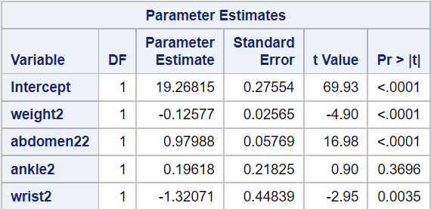
Fit Model on the Pooled Data

Slide 22
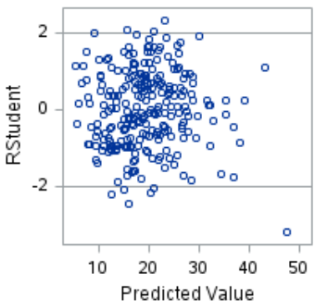
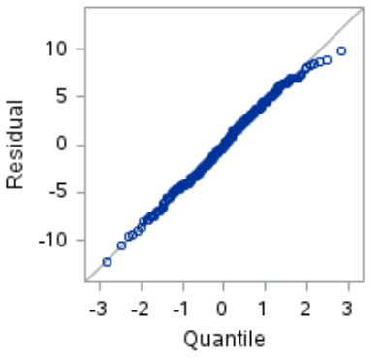

Slide 23
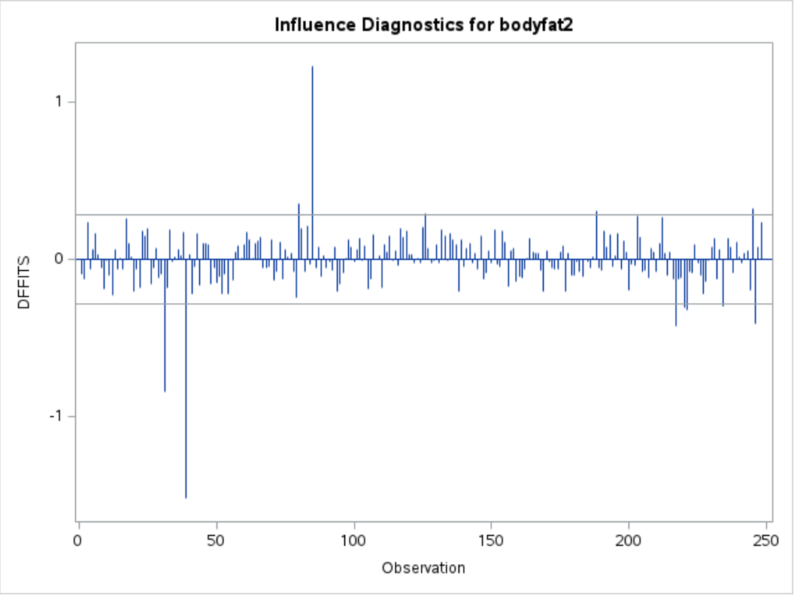
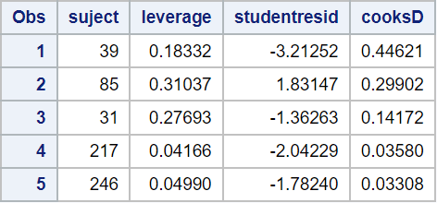
Influential Diagnostics

Slide 24
Conclusion
We find a linear model using weight, abdomen, ankle and wrist circumference to predict body fat percentage in men:
% body fat = 19.27 -0.13 x weight* + 0.98 x abdomen* + 0.20 x ankle* - 1.32 x wrist*
weight* = weight - 179.28 (lbs),
abdomen* = abdomen circumference - 92.67 (cm),
ankle* = ankle circumference - 23.12 (cm),
wrist* = wrist circumference -18.25 (cm).
The model we find has good reliability based on split-sample analysis and good accuracy when compared to a reference model.

Slide 25
Discussion
One disadvantage of using body circumference measurements is that the parts of the body measured need to be accurate. Also, difference in body shape and fat distribution may lead to inaccuracy in prediction.
We compared our best model fitted in the training set with the reference model based on their prediction accuracy in the test set, and showed that our model has smaller RMSE and AIC. However, it is possible that our test set is more similar to the training set than the data set used to fit the reference model.
The dataset we use only contain males. The body fat percentage estimating equations for females can be established in a similar way using data of females.

Slide 26

Thank You!

