Slide 1
Musicbox recommendation system
ds501
Jiahui tao

Slide 2
Agenda
Data Loading
Data Cleaning
Data Exploration
Model Evaluation
Benchmarks
ALS Explicit Model
ALS Implicit Model

Slide 3
Data Loading & cleaning
Data Loading
Load original data into Spark (Databricks) and compile into 2 dataframes: play and download
Extract date from the file name and create a new column as “date”
Data Cleaning
Trim each column to remove extra space
Cast “play_time”, “song_length” to int
Cast “date” to date
Remove rows where “uid” or “play_time” is null
Remove rows where “song_name” and “singer” are in one column (data was not separated properly)
Process “uid”: substring from misformatted uid’s; define a function to trim the special characters from substring; cast “uid” to int
Play
uid
device
song_id
song_type
song_name
singer
play_time
song_length
paid_flag
date
Download
uid
device
song_id
song_name
singer
paid_flag
date

Slide 4
Data cleaning
There is a serious issue of “song_id”:
play has 1,679,872 song_id’s, 1,760,049 song_name's and 2,255,855 song_name&singer
32,754 song_id’s have more than 1 song_name (1.95% of total unique sid’s) with 67,150,874 rows (40.9% of all rows)
265,937 song_name&singer with >1 song_id, which is 11.8% of total song_name&singer
I decided to create a new sid for each unique song_name&singer.
select song_name, and singer from play and download
remove rows where song_name or singer is null or “”
identify a song by song_name and singer, and input with new sid
save the song_name, singer, sid as “sid.parquet” for future reference
2,309,630 sid’s
play_sid: 162,451,873
down_sid: 6,592,790

Slide 5
Data cleaning
The “song_length” for each song is not consistent.
Use the most frequent song_length as the song_length for each sid
Songs with only song_length =0 are removed
2,146,170 songs remains
%sql
select sid, song_length
from (
select sid, song_length,
rank() over (partition by sid order by count(*) desc) as rank
from play_sid
where song_length>0
group by sid, song_length
)r
where r.rank=1
order by sid

Slide 6
data exploration
identify outliers and robots
there are 54 days in records
99% users have records of 1843 or less, which is 34 songs a day
99.5% users have records of 2489 or less, which is 46 songs a day
99.9% users have records of 4678 or less, which is 87 songs a day
IQR=139-8=131 139+131*1.5=335.5
I decided to remove uid’s with 2489 or more records (seen as robots)
after removing the robots
play_filtered: 112,836,361 rows; 797,170 users; 1,913,909 songs
down_filtered: 4,920,514 rows; 214,947 users; 535,303 songs

Slide 7
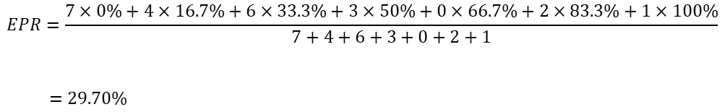
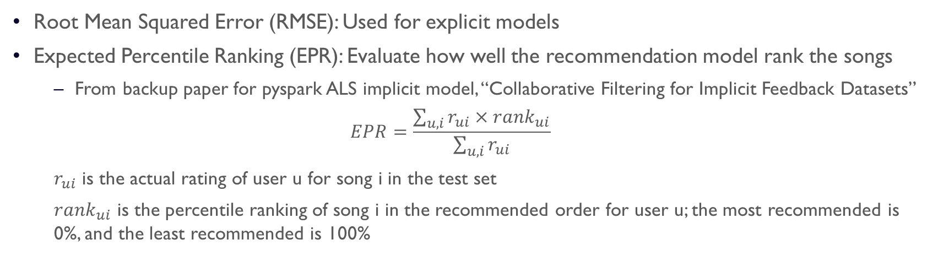
model evaluation
Root Mean Squared Error (RMSE): Used for explicit models
Expected Percentile Ranking (EPR): Evaluate how well the recommendation model rank the songs
From backup paper for pyspark ALS implicit model, “Collaborative Filtering for Implicit Feedback Datasets”
$$EPR=\frac{\sum_{u,i}{r_{ui}×{rank}_{ui}}}{\sum_{u,i}{r_{ui}}}$$
$r_{ui}$ is the actual rating of user u for song i in the test set
${rank}_{ui}$ is the percentile ranking of song i in the recommended order for user u; the most recommended is 0%, and the least recommended is 100%
uid | sid | rating | prediction | rank
5000 | 1046 | 7 | 0.98 | 0%
5000 | 3022 | 4 | 0.86 | 16.7%
5000 | 4056 | 6 | 0.77 | 33.3%
5000 | 3200 | 3 | 0.68 | 50%
5000 | 4433 | 0 | 0.55 | 66.7%
5000 | 1002 | 2 | 0.43 | 83.3%
5000 | 5097 | 1 | 0.20 | 100%
$$EPR=\frac{7×0\%+4×16.7\%+6×33.3\%+3×50\%+0×66.7\%+2×83.3\%+1×100\%}{7+4+6+3+0+2+1}$$
$=29.70\%$

Slide 8

benchmarks
Popularity-based Model
Order songs by the number of users listened (popularity)
Recommend to all users the same list of songs
A robust model
Best EPR possible
Assume all the songs recommended by the model is ordered as they actually listened (from most frequent to least frequent)
uid | sid | rating | prediction | rank
5000 | 1046 | 7 | 0.98 | 0%
5000 | 3022 | 4 | 0.86 | 16.7%
5000 | 4056 | 6 | 0.77 | 33.3%
5000 | 3200 | 3 | 0.68 | 50%
5000 | 4433 | 0 | 0.55 | 66.7%
5000 | 1002 | 2 | 0.43 | 83.3%
5000 | 5097 | 1 | 0.20 | 100%
uid | sid | rating | rank
5000 | 1046 | 7 | 0%
5000 | 3022 | 4 | 33.3%
5000 | 4056 | 6 | 16.7%
5000 | 3200 | 3 | 50%
5000 | 4433 | 0 | 100%
5000 | 1002 | 2 | 66.7%
5000 | 5097 | 1 | 83.3%
$$EPR=26.09\%$$

Slide 9
explicit model
Data Processing:
Use all data available
If play_time/song_length >= threshold, count as 1
compared threshold = 60% and 80%; decided to use 80%
Scoring: bin the play count to 4 levels
0-dislike count=0-1 0-50%
1-listened count=2-3 50%-90%
2-like count=4-6 90%-97.5%
3-very like count>6 97.5%-100%
Download: score +1, but capped by 3
Randomly split all data by 8:2 to train and test

Slide 10
explicit model - Tuning
from pyspark.ml.recommendation import ALS
Parameters
maxIter: the maximum number of iterations to run.
rank: the number of latent factors in the model.
regParam: the regularization parameter in ALS.
nonnegative: whether or not to use nonnegative constraints for least squares.
implicitPrefs: whether to use the explicit feedback ALS variant or one adapted for implicit feedback data.
coldStartStrategy: set to 'drop' to ensure we don't get NaN evaluation metrics
Benchmarks: Popularity Model EPR: 43.51% Best EPR: 7.07%
maxIter | rank | regParam | nonnegative | implicitPrefs | coldStartStrategy | RMSE | EPR
7 | 50 | 0.08 | False | False | drop | 0.6535 | 34.39%

Slide 11
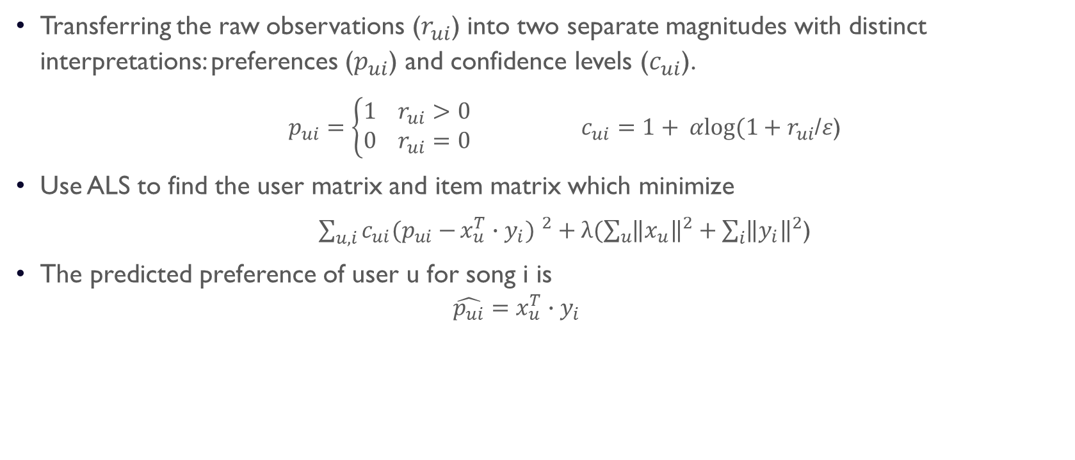
implicit model
Transferring the raw observations ($r_{ui}$) into two separate magnitudes with distinct interpretations: preferences ($p_{ui}$) and confidence levels ($c_{ui}$).
$p_{ui}=\left\{\begin{aligned}1{ r}_{ui}>0 \\ 0{ r}_{ui}=0\end{aligned}\right. c_{ui}=1+ αlog⁡(1+r_{ui}$/$ε$)
Use ALS to find the user matrix and item matrix which minimize
${\sum_{u,i}{c_{ui}(p_{ui}−}x_{u}^{T}∙y_{i}) }^{2}+λ(\sum_{u}{{\left\|x_{u}\right\|}^{2}}+\sum_{i}{{\left\|y_{i}\right\|}^{2}}$)
The predicted preference of user u for song i is
$${\hat{p_{ui}}=x}_{u}^{T}∙y_{i}$$

Slide 12
implicit model
I. week 13-17 as training data, week 18 as testing data
Benchmarks: Popularity Model EPR: 45.99% Best EPR: 13.55%
II. Use all data available, random split by 80%:20%
Benchmarks: Popularity Model EPR: 43.32% Best EPR: 12.92%
maxIter | rank | regParam | alpha | nonnegative | implicitPrefs | coldStartStrategy | EPR
7 | 50 | 0.1 | 100 | False | True | drop | 43.59%
maxIter | rank | regParam | alpha | nonnegative | implicitPrefs | coldStartStrategy | EPR
7 | 50 | 0.1 | 100 | False | True | drop | 33.04%

Slide 13
Thank you !

