Slide 1
Multivariate Curve Resolution-Alternating Least Squares (MCR-ALS)
Chen Xu
2018.4.9

Slide 2

Principle
Multivariate Curve Resolution methods are focused on extracting relevant information of the pure components in a mixture system through a bilinear model decomposition of the experimental data matrix D into the product of matrices C and S^{T} that contain pure profiles of components linked to the row mode (usually concentrations or peak profiles) and the column mode (usually spectra), respectively.
where E is the matrix of residuals not explained by the resolved components.

Slide 3

Principle
Multiset analysis can be done by MCR-ALS when applied simultaneously to several data sets organized in a single structure. Thus, the Eq allows the simultaneous MCR-ALS analysis of multiple independent experiments run under different experimental conditions by the same instrumental technique.
This data arrangement gives rise to a column-wise augmented matrix.
The ALS optimization is based on the application of constraints during the resolution. Both natural constraints (non-negativity, unimodality, closure…) and more advanced constraints such as multilinear, kinetic or correlation constraints can be chosen.

Slide 4
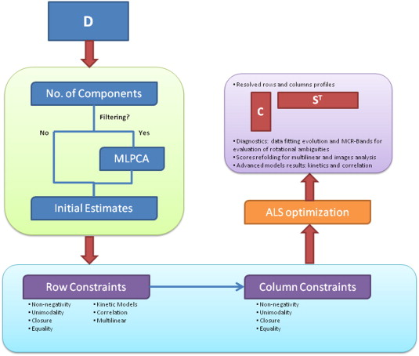
Flowchart of MCR-ALS

Slide 5
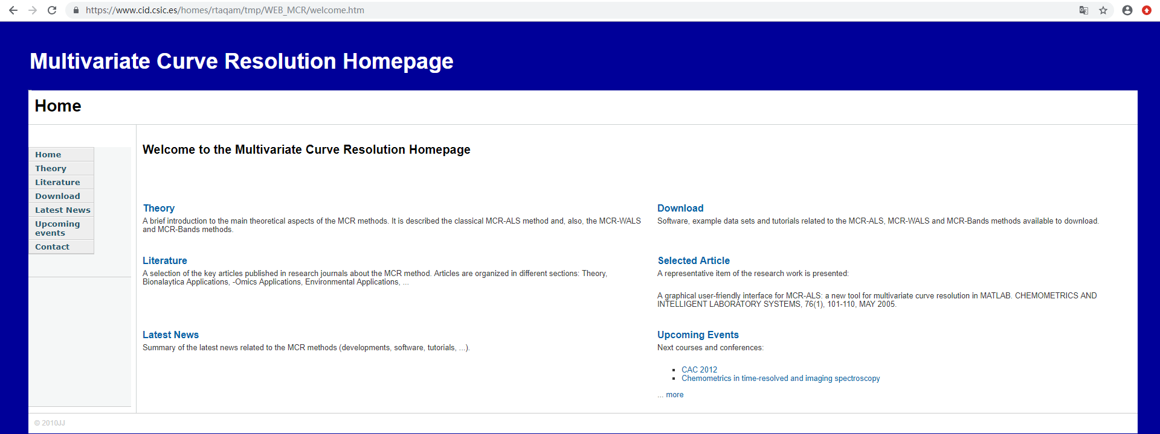
Software download
URL: https://www.cid.csic.es/homes/rtaqam/tmp/WEB_MCR/welcome.htm

Slide 6
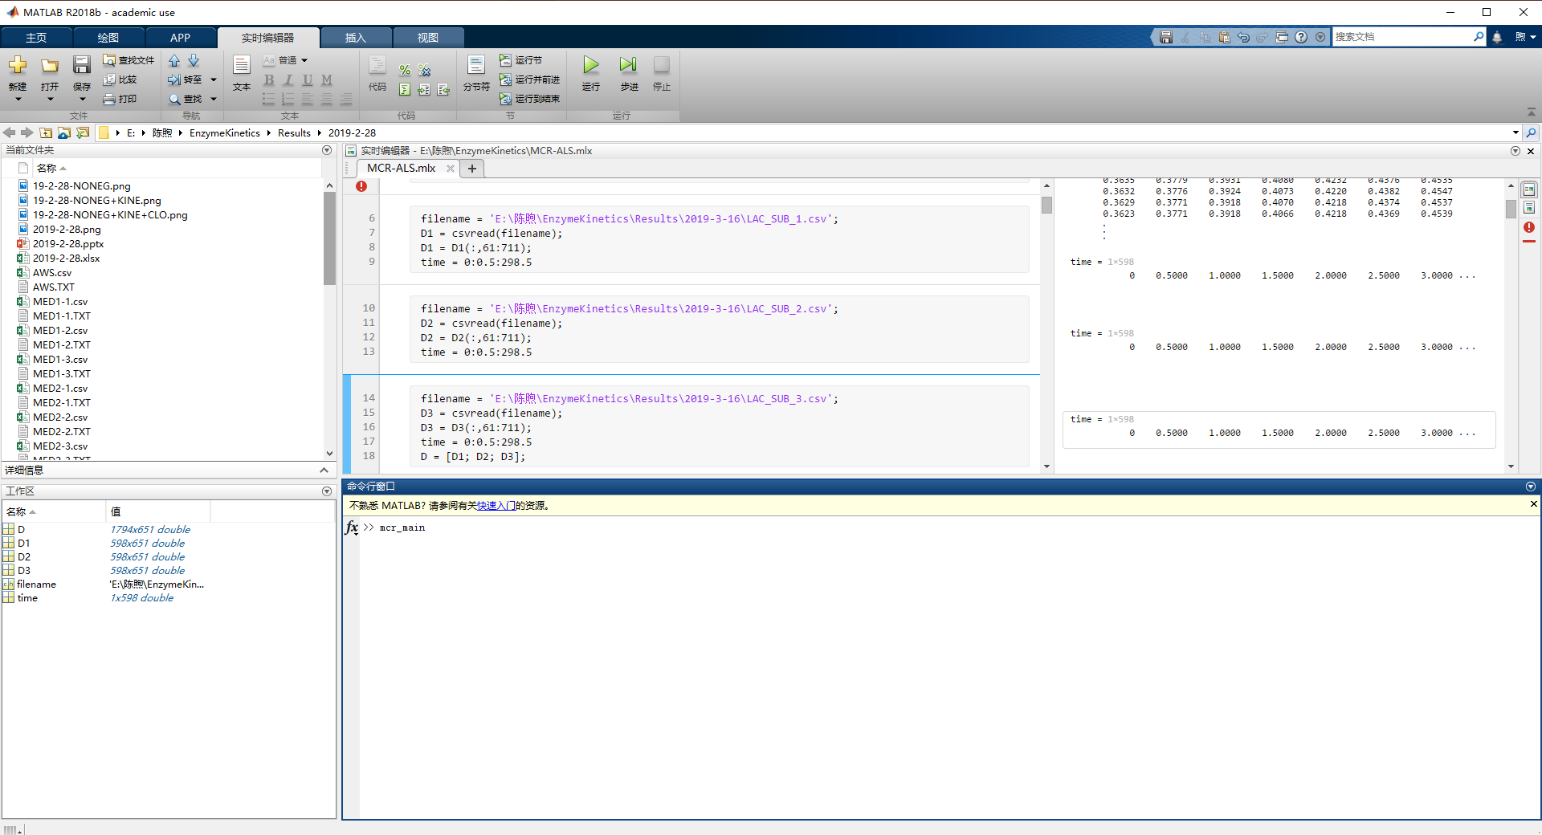
Input

Slide 7
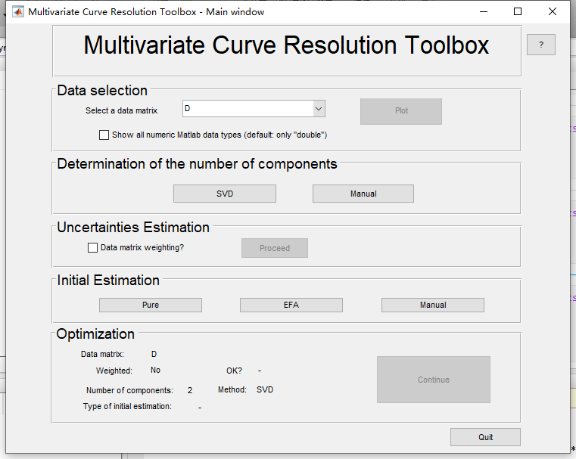
MCR-main window

Slide 8
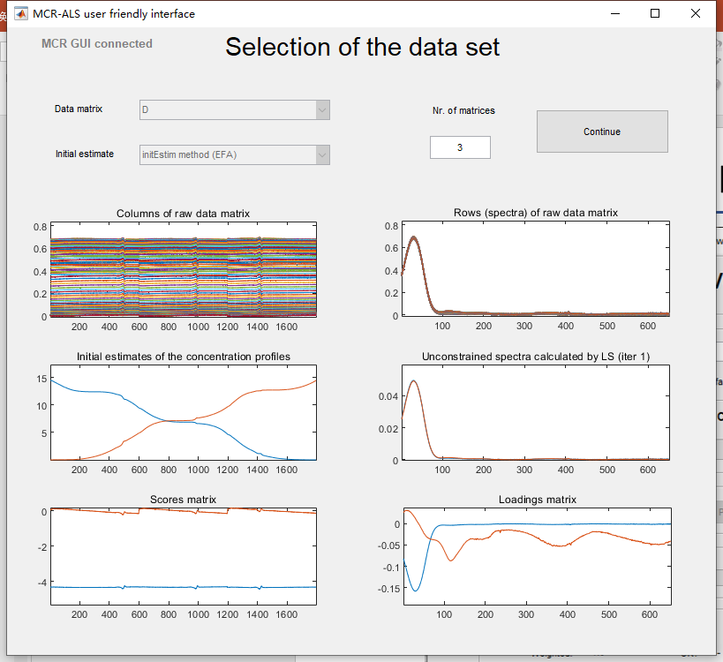

Slide 9
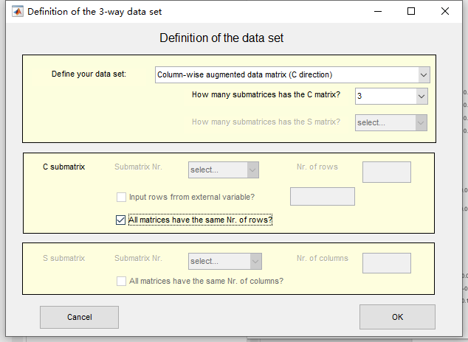

Slide 10
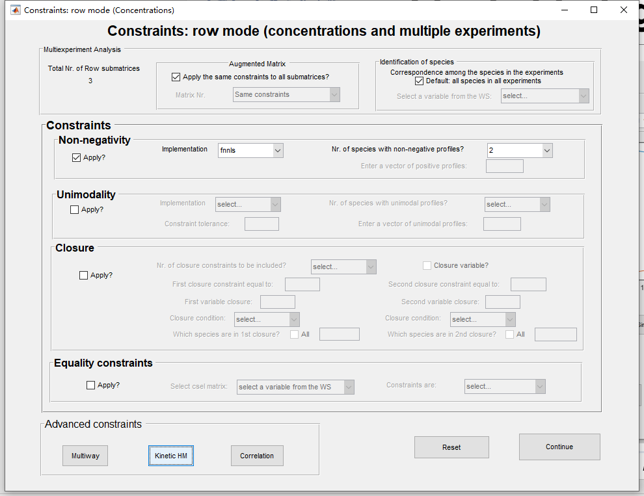

Slide 11
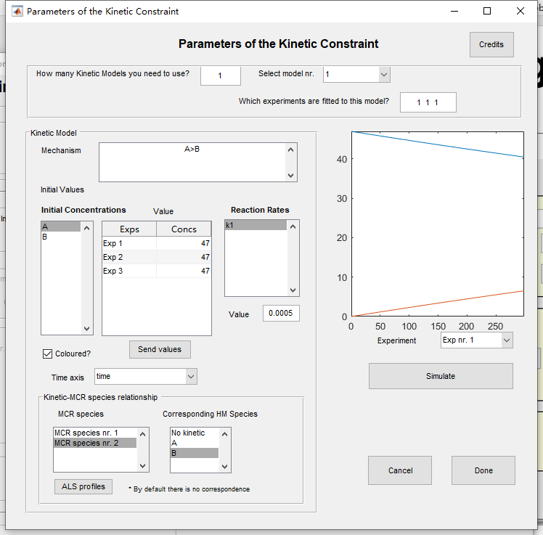

Slide 12
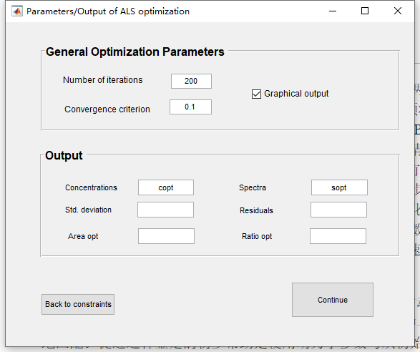

Slide 13
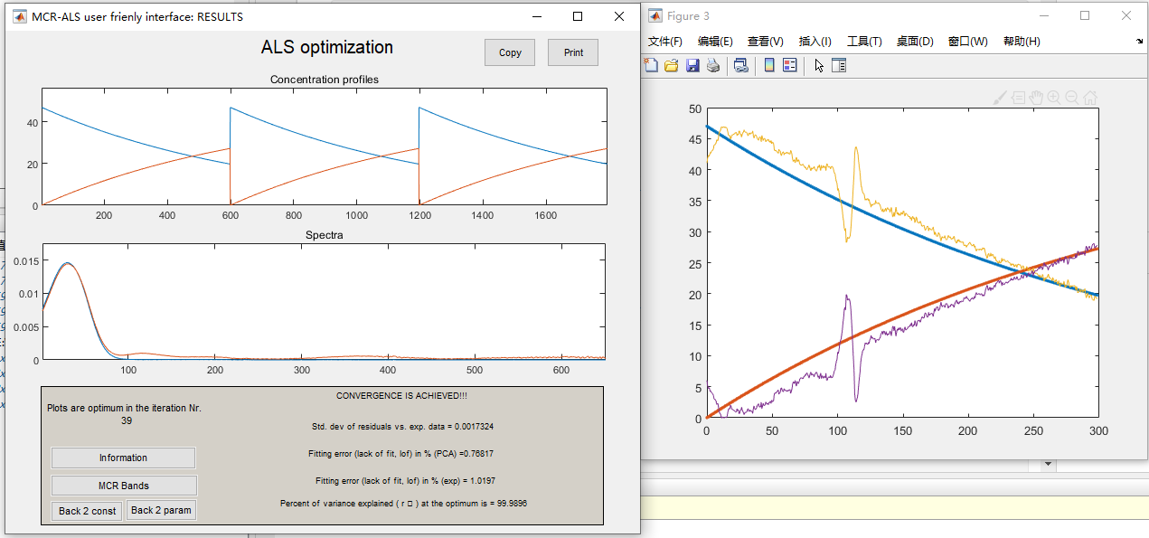

Slide 14
Thank you!

