Slide 1
SEMI-SUPERVISED CLASSIFICATION WITH GRAPH CONVOLUTIONAL NETWORKS
Contribution:
a localized first-order approximation of spectral graph convolutions

Slide 2
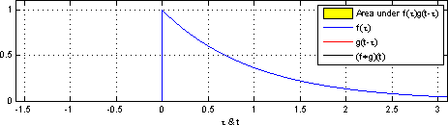

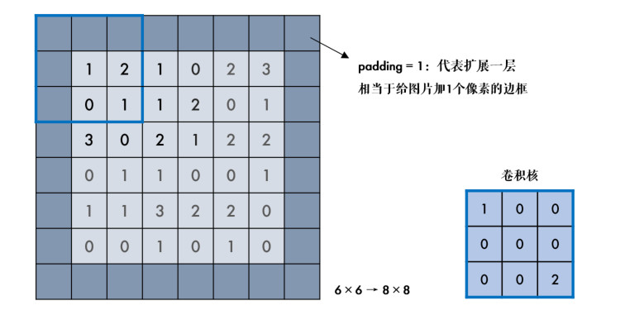
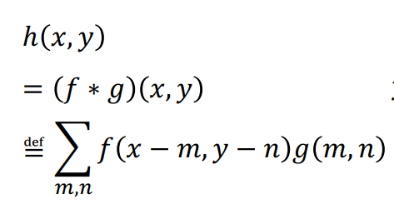
Introduction
Convolution is a mathematical operation on two functions, 𝒇 and 𝒈, to produce a third function 𝒉

Slide 3
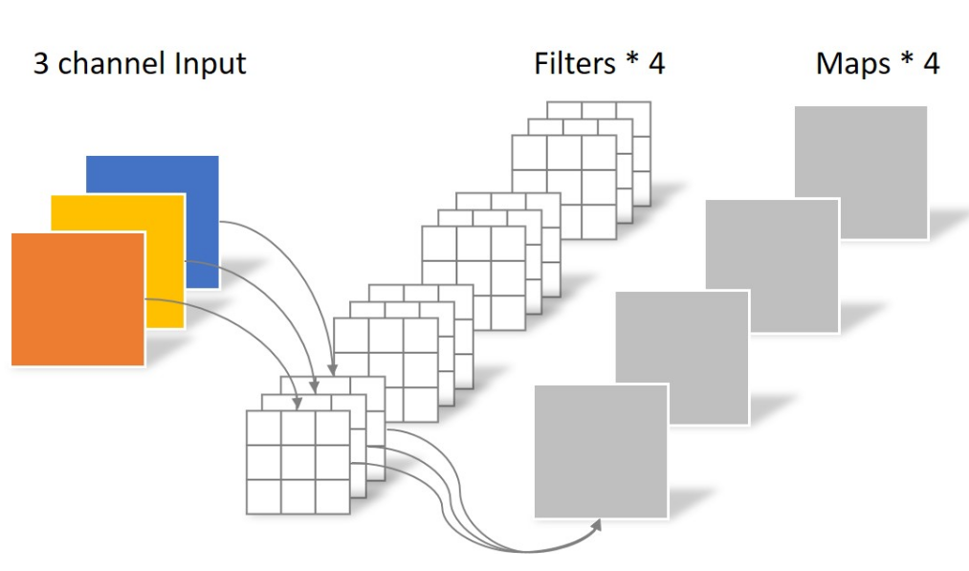
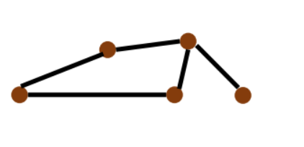
Introduction
In multiple channels case: In graph convolution case:

Slide 4
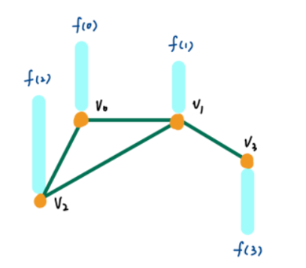

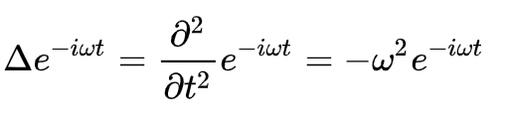




Introduction
is Fourier base
is Laplace operator
is characteristic function
is laplace matrix

Slide 5

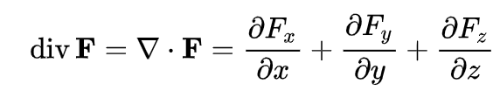
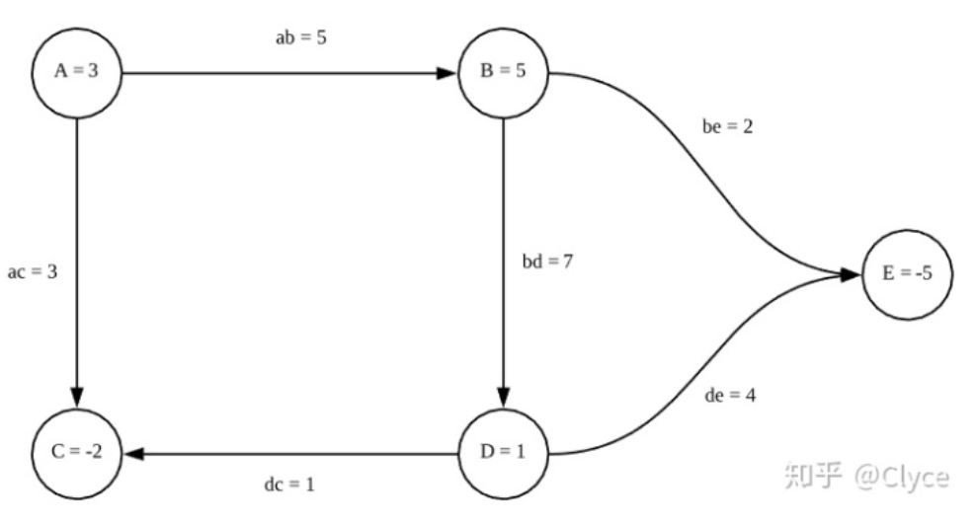

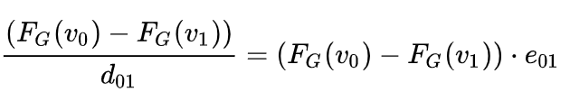
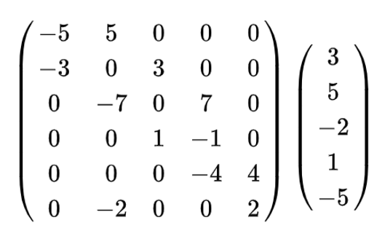
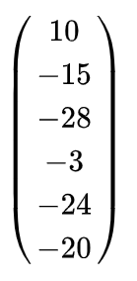

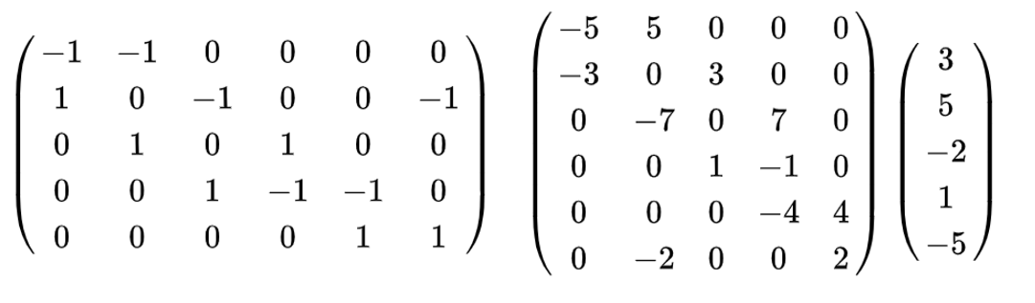
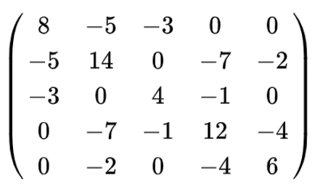
Why Laplace matrix could be write as
=
=
=

Slide 6
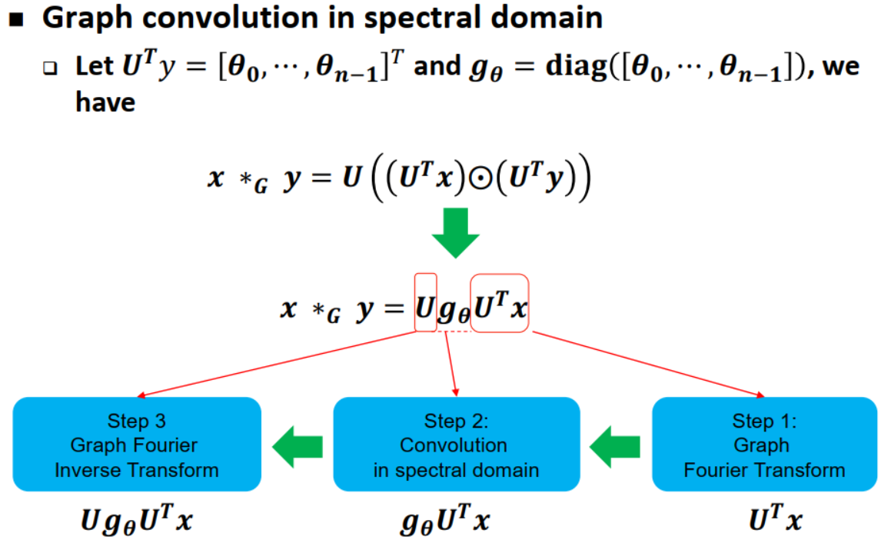
Introduction

Slide 7
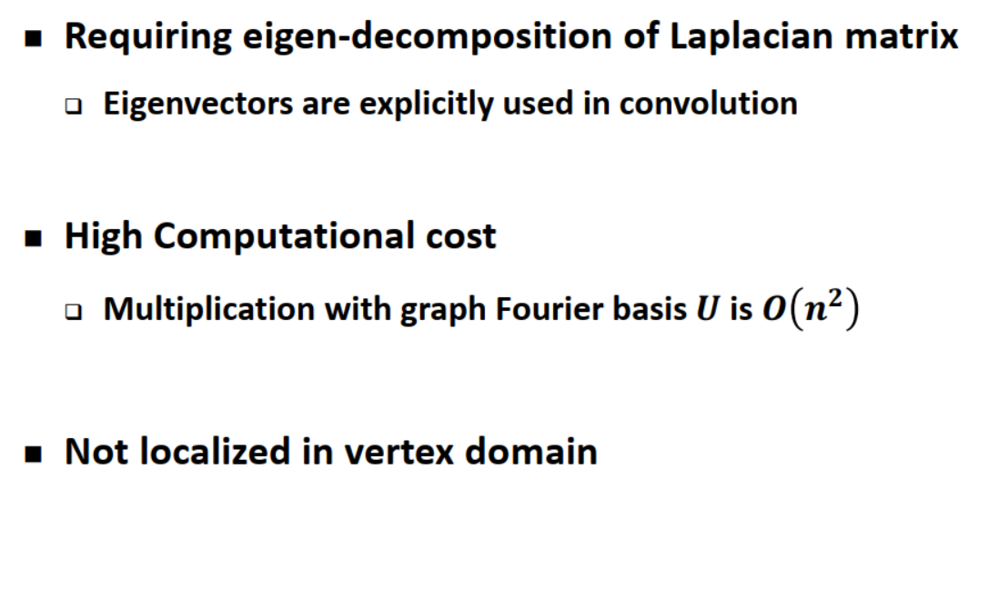
Shortcomings of Spectral graph CNN

Slide 8
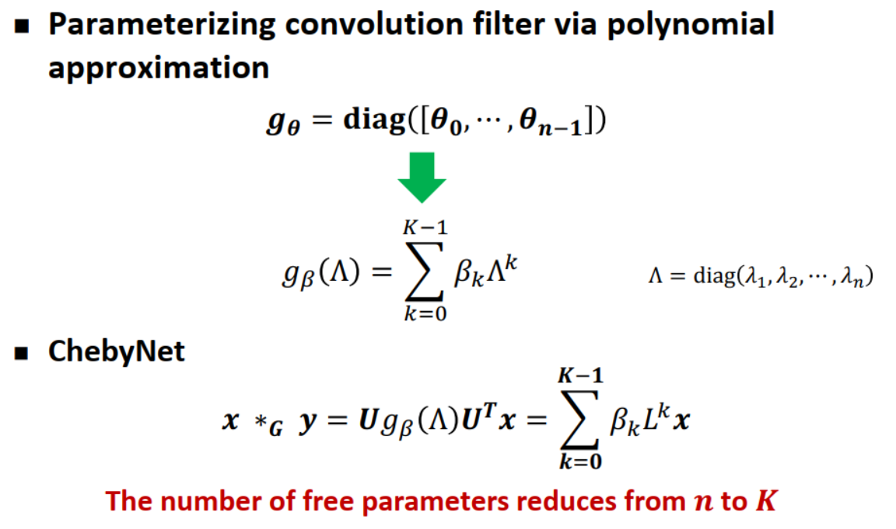
ChebyNeT

Slide 9
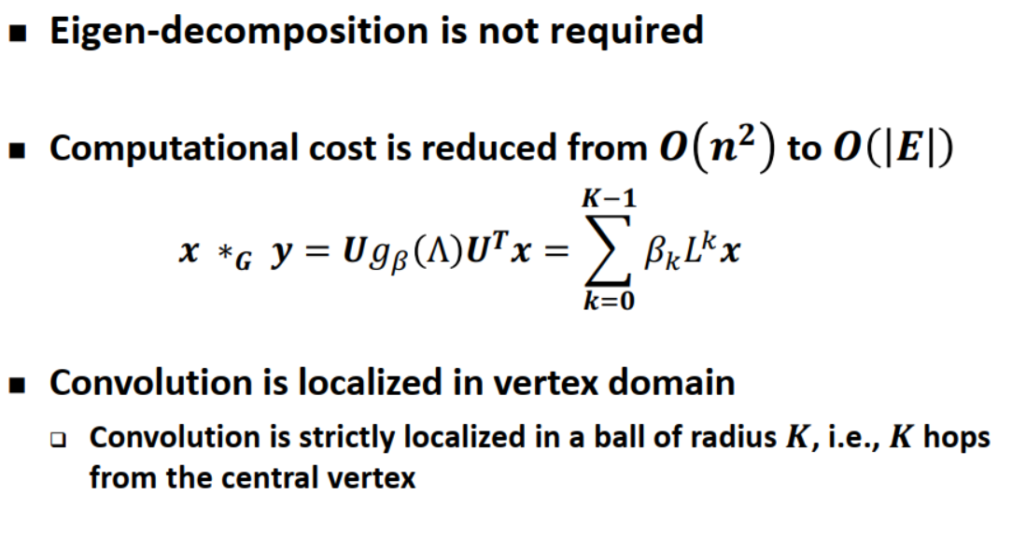
ChebyNeT

Slide 10

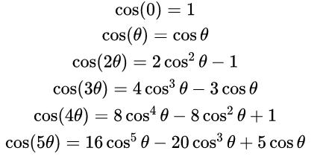






Chebshev polynomia
have n solutions

Slide 11
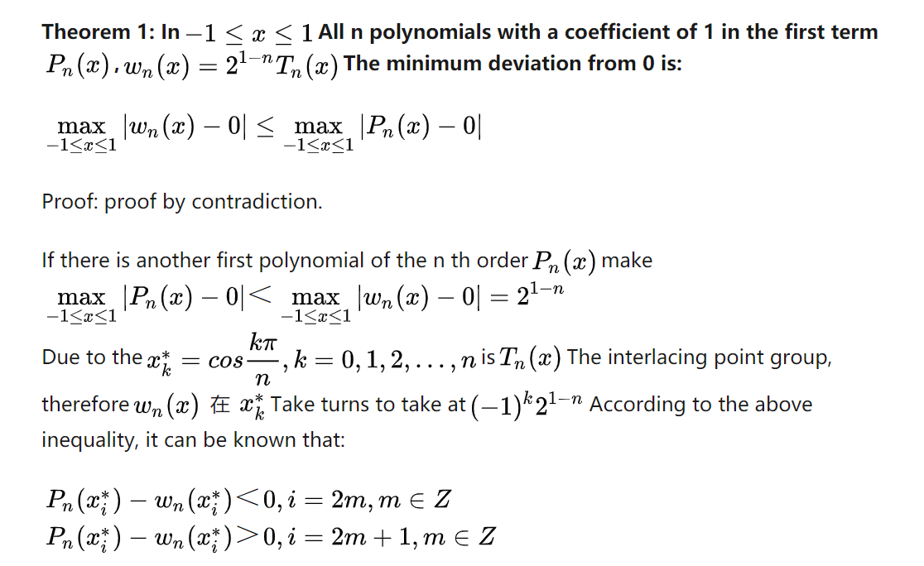
Chebshev polynomia

Slide 12
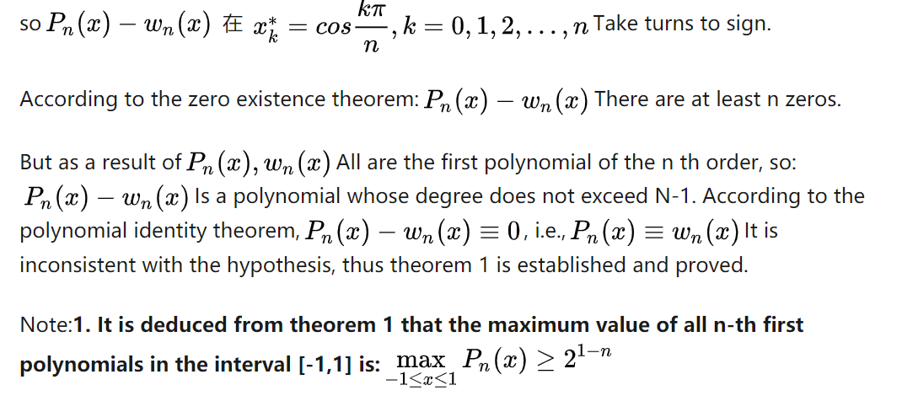
Chebshev polynomia

Slide 13
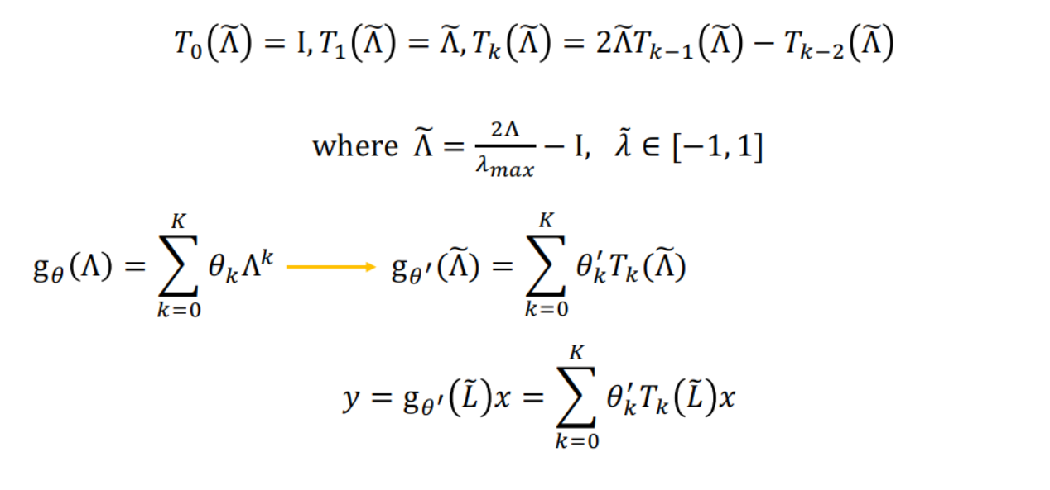
ChebyNeT

Slide 14
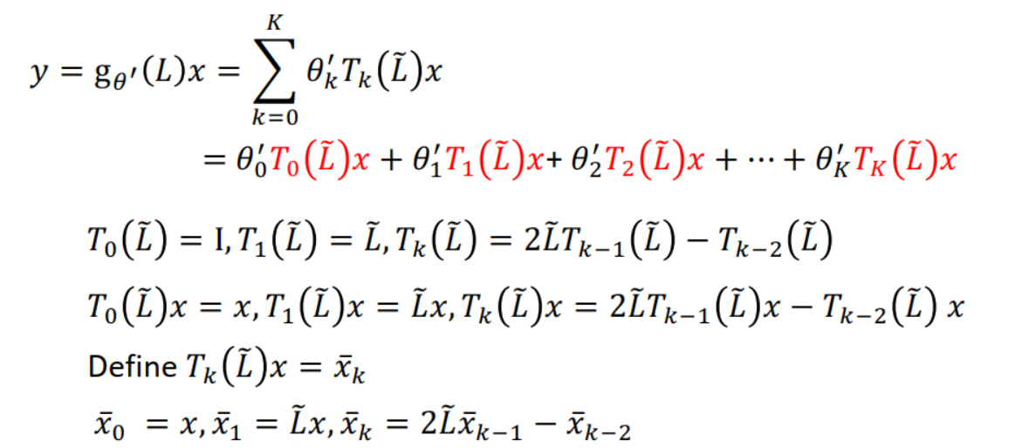
ChebyNeT

Slide 15
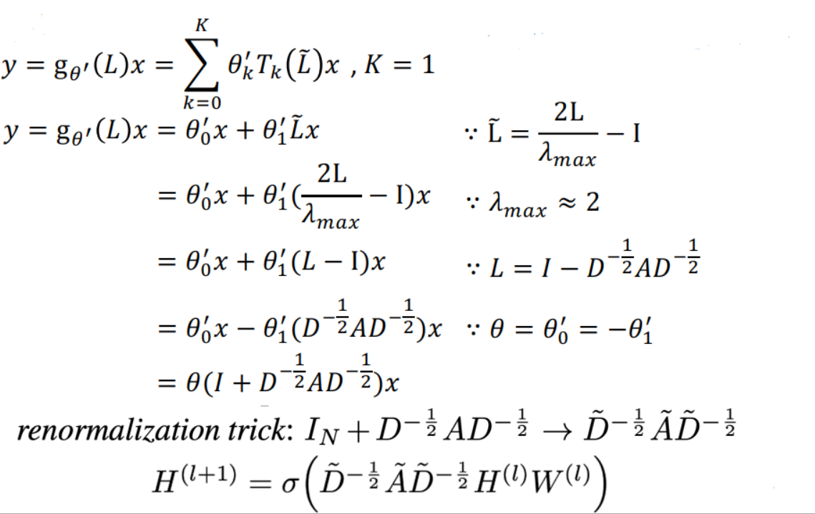
GCN

Slide 16

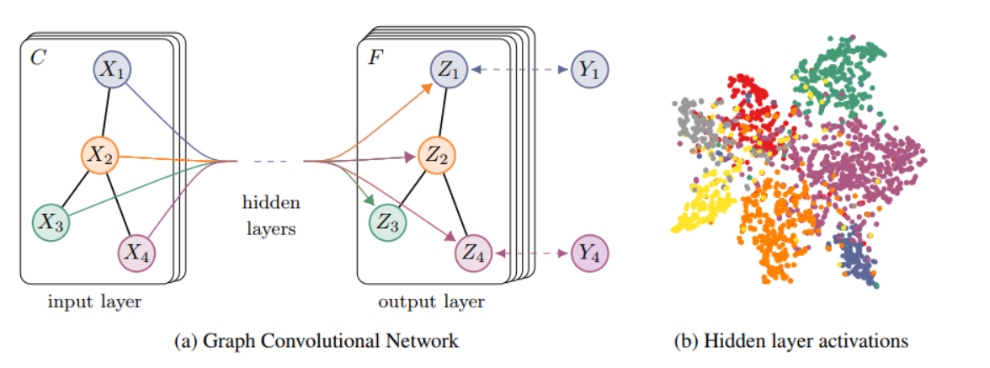
EXAMPLE
By t-SNE
a two-layer GCN trained on the Cora dataset using 5% of labels

Slide 17
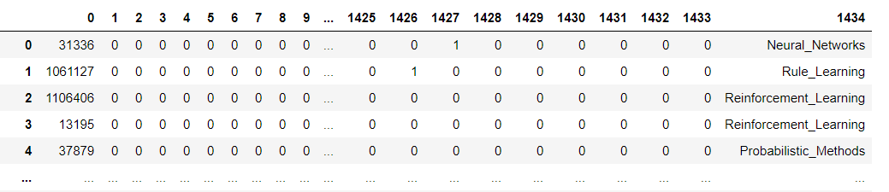

Cora dataset
2708 articles
Each article is divided into 7 categories.1) base case 2) Genetic algorithm;3) Neural network;4) Probability method;5)
Intensive learning;6) Learning rules;7) theory
1433 word vectors, each dimension represents one word, 1 represents have, 0 represents nothing.

Slide 18
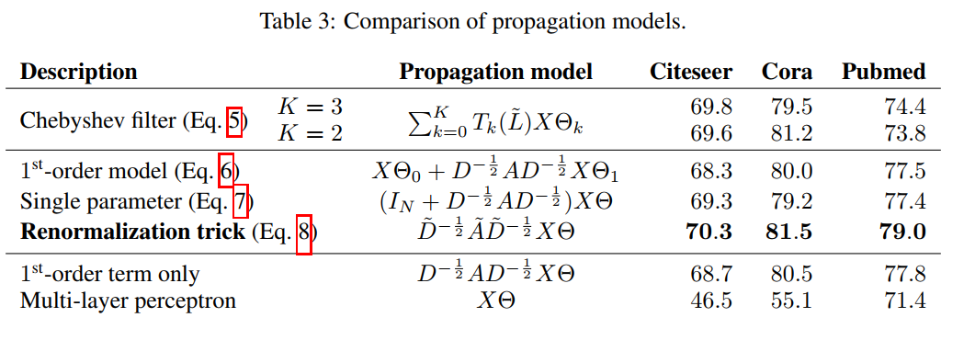
EVALUATION OF PROPAGATION MODEL

