Slide 1
On Link Prediction in Knowledge Bases: Max-K Criterion and Prediction Protocols
Jiajie Mei^{1*}, Richong Zhang¹, Yongyi Mao², Ting Deng¹
¹Beihang University, ²University of Ottawa
*jiajie.mei@buaa.edu.cn

Slide 2


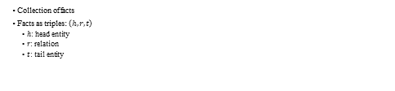
Knowledge Base (KB)
Collection of facts
Facts as triples: $\left(h,r,t\right)$
$h$: head entity
$r$: relation
$t$: tail entity
isCapitalOf

Slide 3
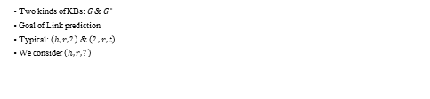
Link Prediction
Two kinds of KBs: $G$ & $G^{∗}$
Goal of Link prediction
Typical: $\left(h,r,?\right)$ & $\left(?,r,t\right)$
We consider $\left(h,r,?\right)$
isCapitalOf
?

Slide 4


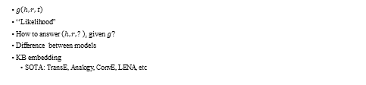
Score Function
score
$g\left(h,r,t\right)$
“Likelihood”
How to answer $\left(h,r,?\right)$, given $g$?
Difference between models
KB embedding
SOTA: TransE, Analogy, ConvE, LENA, etc
10.0
isCapitalOf
1.0
0.1

Slide 5

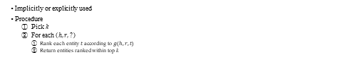
Top-k Criterion
score
Implicitly or explicitly used
Procedure
Pick k
For each $\left(h,r,?\right)$
Rank each entity $t$ according to $g\left(h,r,t\right)$
Return entities ranked within top k
10.0
1.0
0.1

Slide 6
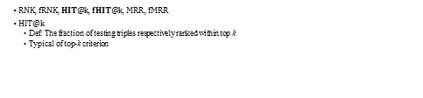
Top-k Metrics
$RNK$, $fRNK$, $HIT@k$, $fHIT@k$, $MRR$, $fMRR$
$HIT@k$
Def: The fraction of testing triples respectively ranked within top k
Typical of top-k criterion

Slide 7
Limitations of the Top-k Criterion
Consider k is 3

Slide 8
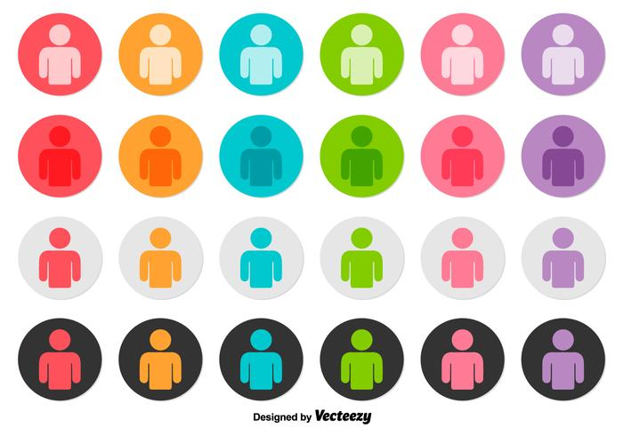
Limitations of the Top-k Criterion
Case 1: (Beijing, isCapitalOf, ?)
Case 2: (Beijing, isBirthplaceOf, ?)

Slide 9
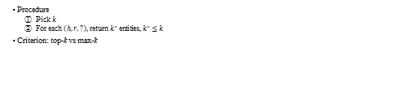
Max-k Criterion
Procedure
Pick $k$
For each $\left(h,r,?\right)$, return $k^{∗}$ entities, $k^{∗}≤k$
Criterion: top-k vs max-k

Slide 10
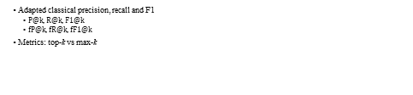
Max-k Metrics
Adapted classical precision, recall and F1
$P@k$, $R@k$, $F1@k$
$fP@k$, $fR@k$, $fF1@k$
Metrics: top-k vs max-k

Slide 11

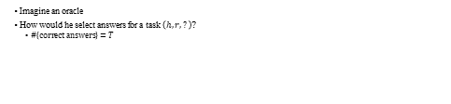
Justification of Max-k
Imagine an oracle
How would he select answers for a task $\left(h,r,?\right)$?
$\#\left\{correct answers\right\}=T$

Slide 12


Justification of Max-k
Top-k
If $T≤k$, return $T$ correct and $k−T$ wrong answers
If $T>k$, return $k$ correct answers
Max-k
If $T≤k$, return $T$ answers
If $T>k$, return $k$ correct answers

Slide 13


Justification of Max-k
Top-k
$P@k=\min\left\{\frac{T}{k},1\right\}$
$R@k=\min\left\{\frac{k}{T},1\right\}$
$F1@k=\min\left\{\frac{2k}{k+T},\frac{2T}{k+T}\right\}$
Max-k
$P@k=1$
$R@k=\min\left\{\frac{k}{T},1\right\}$
$F1@k=\min\left\{\frac{2k}{k+T},1\right\}$

Slide 14
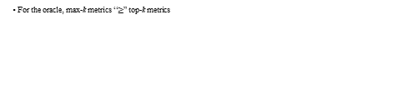
Justification of Max-k
For the oracle, max-k metrics “$≥$” top-k metrics

Slide 15
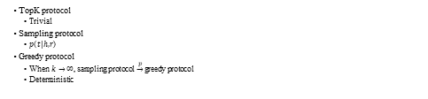
Prediction Protocols
TopK protocol
Trivial
Sampling protocol
$p\left(t|h,r\right)$
Greedy protocol
When $k→∞$, sampling protocol $\underset{→}{p}$ greedy protocol
Deterministic

Slide 16
Experiments
Models: TransE, ComplEx, Analogy, ProjE
Datasets: FB15K, WN18, FB15K-237, WN18RR

Slide 17
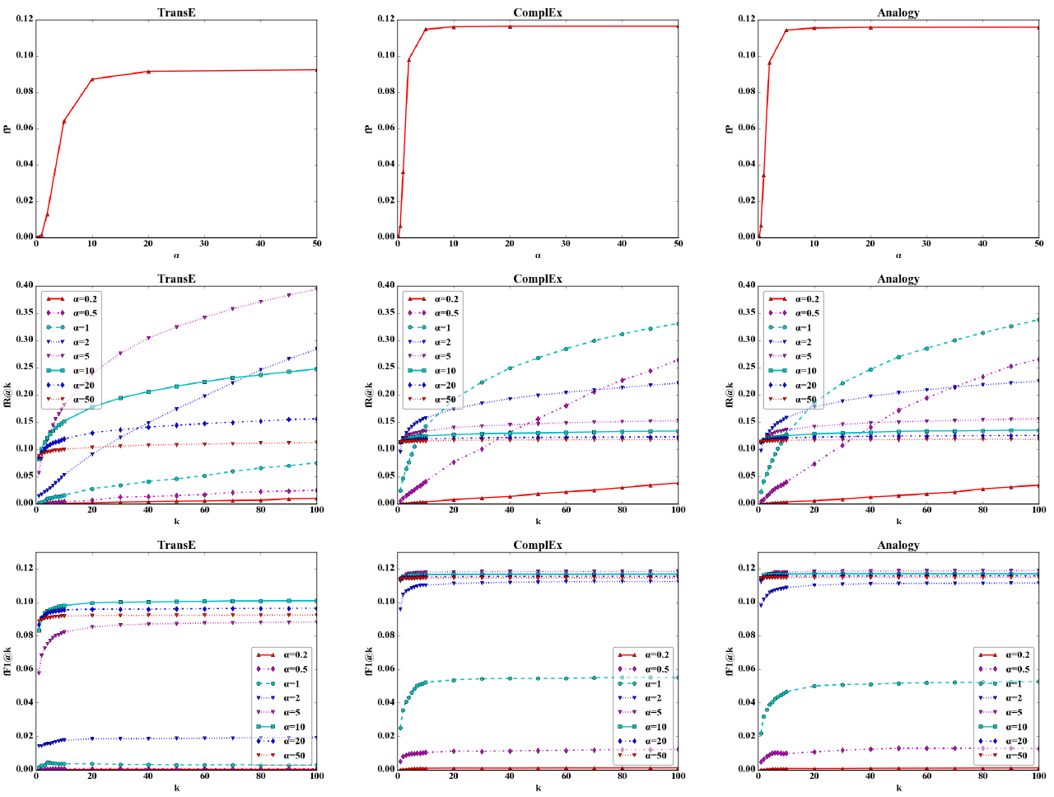
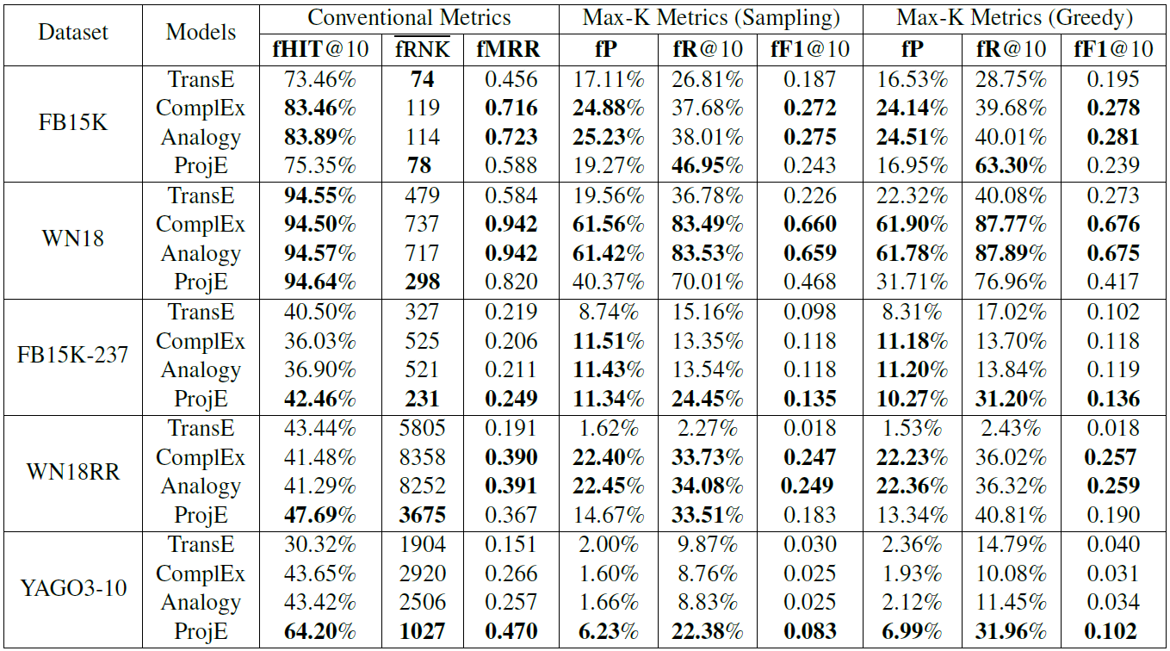
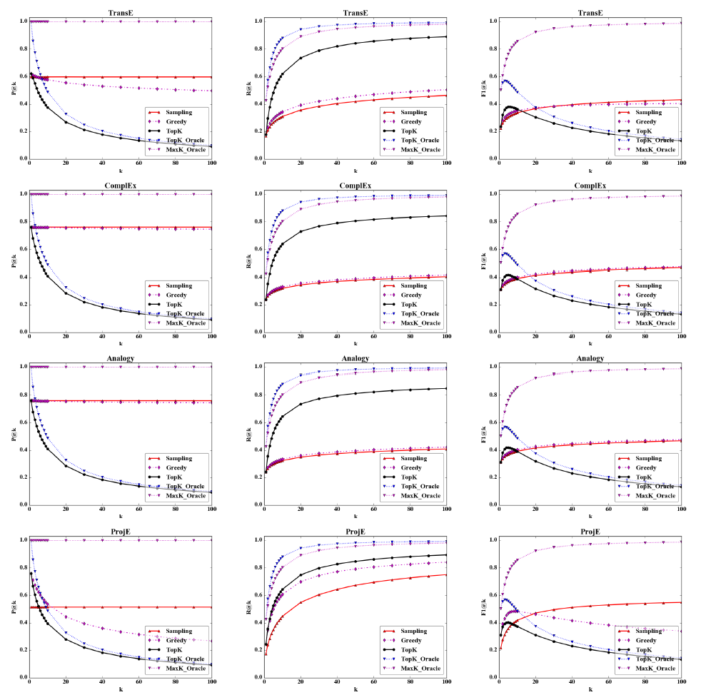
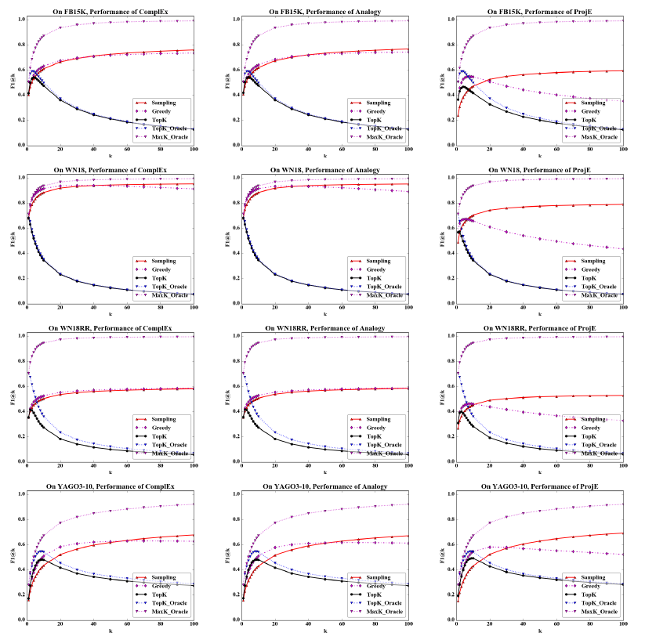
Results

Slide 18
Conclusion
We present the max-k criterion to replace top-k
Two protocols with strong theoretical justifications are proposed for max-k
Max-k is shown to be advantageous
Can we design models specially for max-k?

