Slide 1
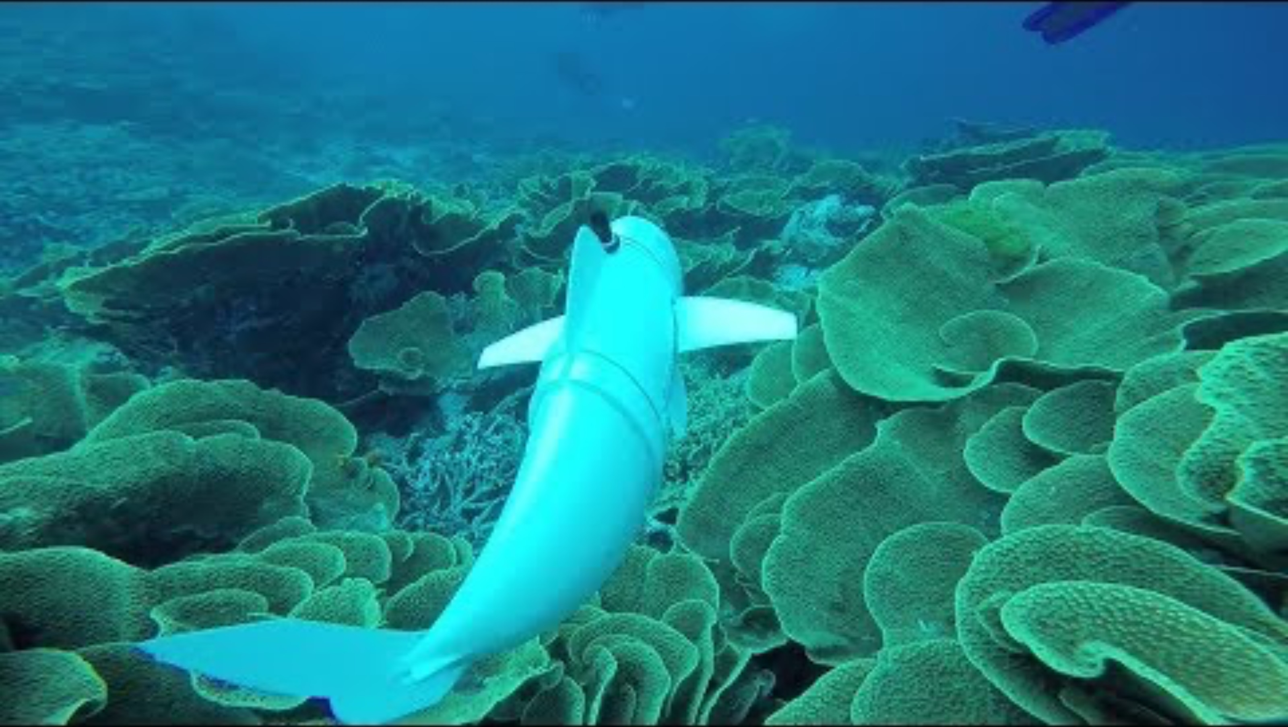
Soft Robotic Fish:
Bending & Propulsion via Flexible Beam Model
Problem & Motivation
  Underwater exploration requires a soft robots that are capable of agile swimming maneuvers.
  Soft robotic fish are safer and quieter compared to rigid propellers.
MAE-263F Mechanics of Flexible Structures & Soft Robots
Jiajin Cui
Notes:
Slide 1 script (~60 sec):
We propose a soft robotic fin modeled as a flexible beam to study how stiffness and actuation shape bending and propulsive performance. Soft propulsion is attractive because it is quieter and safer than rigid propellers. Prior soft fish and foil studies show that fin stiffness and the motion program critically affect thrust and efficiency, and efficient cruising often lies near Strouhal numbers around 0.2 to 0.4. We will build on these findings with a simplified beam model to obtain clear, design-relevant maps from stiffness and actuation to performance.

Slide 2
Prior Works and Future Approach
Katzschmann et al. (2018)
  developed the SoFi soft robotic fish, showing compliant propulsion in real field tests.
  Fluid-structure simulation, computational fluid dynamics
Esposito et al. (2012) and Lauder et al. (2012).
  foils, finding that fin stiffness and motion programs strongly affect thrust and lift
  Prescribed motion, 2-way fluid structure interaction using Navier-Stokes solvers
Zhong et al. (2021)
  demonstrated that tunable stiffness improves swimming speed and efficiency
  Non-linear FEA involving electro active polymers
Approach
Fish -> an Euler-Bernoulli beam
Actuation -> distributed loads or base oscillation
System -> Implicit Time Integration
Key parameters: frequency, amplitude, stiffness, and viscosity
Anticipated Contribution
fast simulation and parametric studies of stiffness, frequency, and amplitude, without requiring full CFD coupling.
computationally efficient abstraction to understand key trends in fin bending and propulsive performance.

