Slide 1
Soft Robotic Fish:
Bending via Flexible Beam Model
Previous Studies
FEM-based soft robots (Katzschmann et al.)
stiffness–thrust relationships (Esposito et al.)
tunable stiffness (Zhong et al.)
hydrodynamics platforms (Lauder)
Strouhal number theory (Eloy)
MAE-263F Mechanics of Flexible Structures & Soft Robots
Jiajin Cui
Problem
  Previous soft robotic fish simulations usually requires complex computation such as computational fluid dynamics, and finite element analysis.
Motivation
  Using Euler-Bernoulli to model the fish as a spring-node network with a time-varying curvature to simulate the movement of a bionic fish
Notes:
Slide 1 script (~60 sec):
We propose a soft robotic fin modeled as a flexible beam to study how stiffness and actuation shape bending and propulsive performance. Soft propulsion is attractive because it is quieter and safer than rigid propellers. Prior soft fish and foil studies show that fin stiffness and the motion program critically affect thrust and efficiency, and efficient cruising often lies near Strouhal numbers around 0.2 to 0.4. We will build on these findings with a simplified beam model to obtain clear, design-relevant maps from stiffness and actuation to performance.

Slide 2

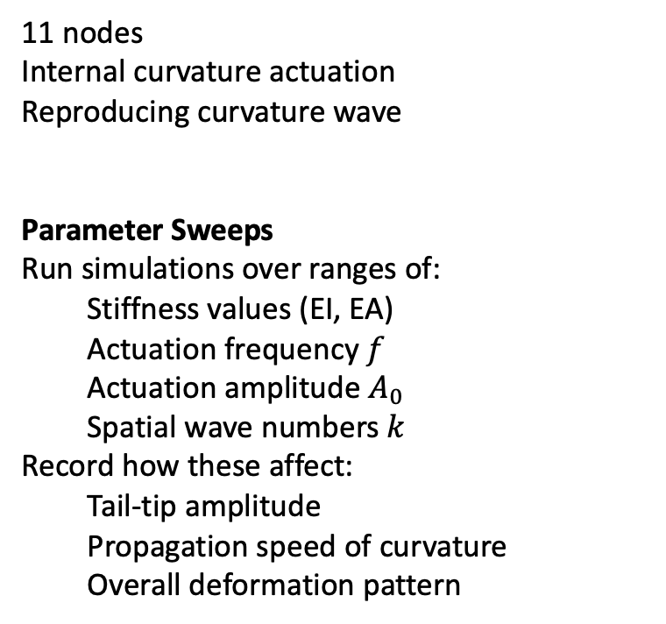
The scope
11 nodes
Internal curvature actuation
Reproducing curvature wave
Parameter Sweeps
Run simulations over ranges of:
  Stiffness values (EI, EA)
  Actuation frequency $f$
  Actuation amplitude $A_{0}$
  Spatial wave numbers $k$
Record how these affect:
  Tail-tip amplitude
  Propagation speed of curvature
  Overall deformation pattern

Slide 3
Default Parameters
Default Stiffness EI = 7.854e-04 N·m²
Default frequency = 0.5 Hz
Default Amplitude = 1.5 m⁻¹
Default wave number = 10.0 rad/m

Slide 4
Geometry
Rod Length L = 0.1m
11 nodes

Slide 5
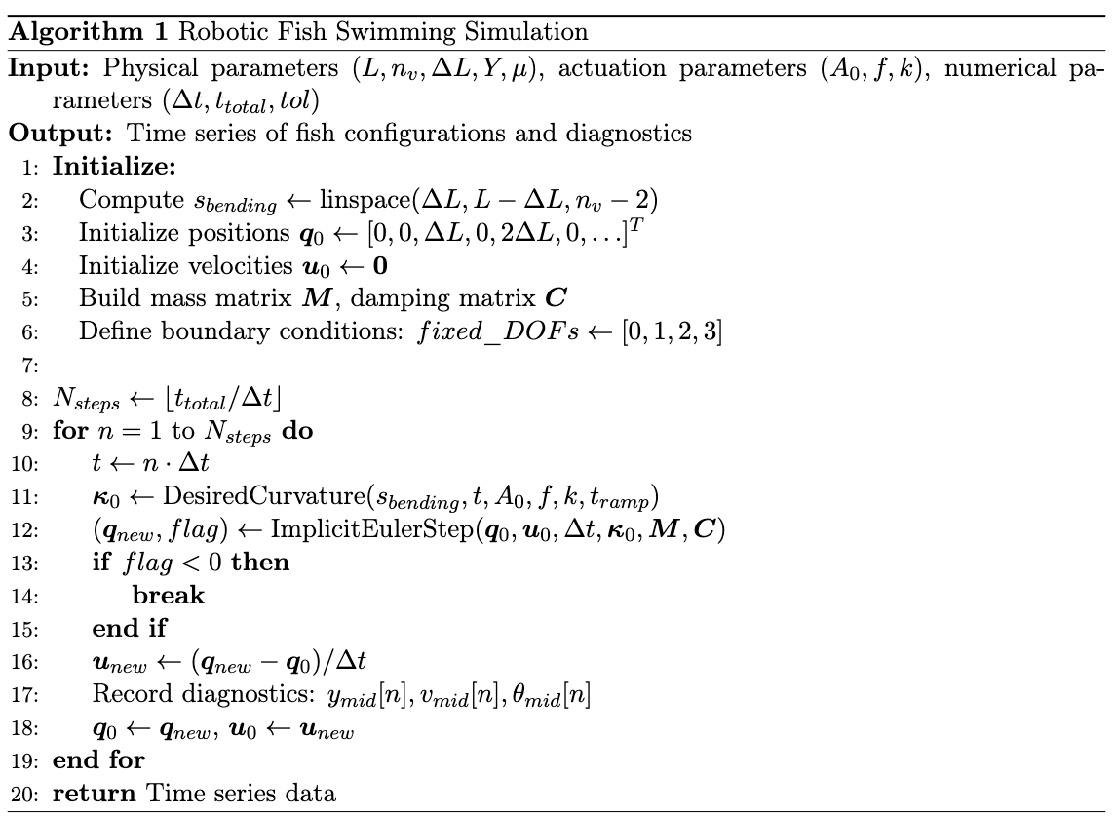
Code

Slide 6
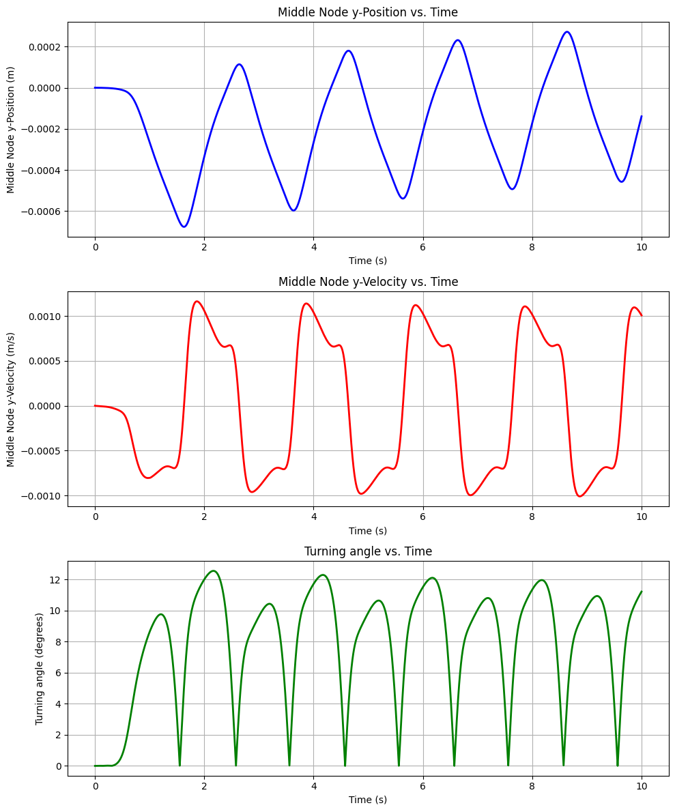
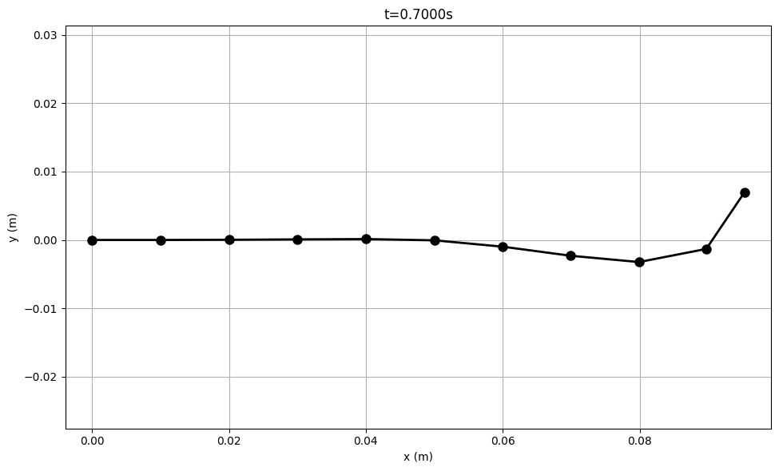
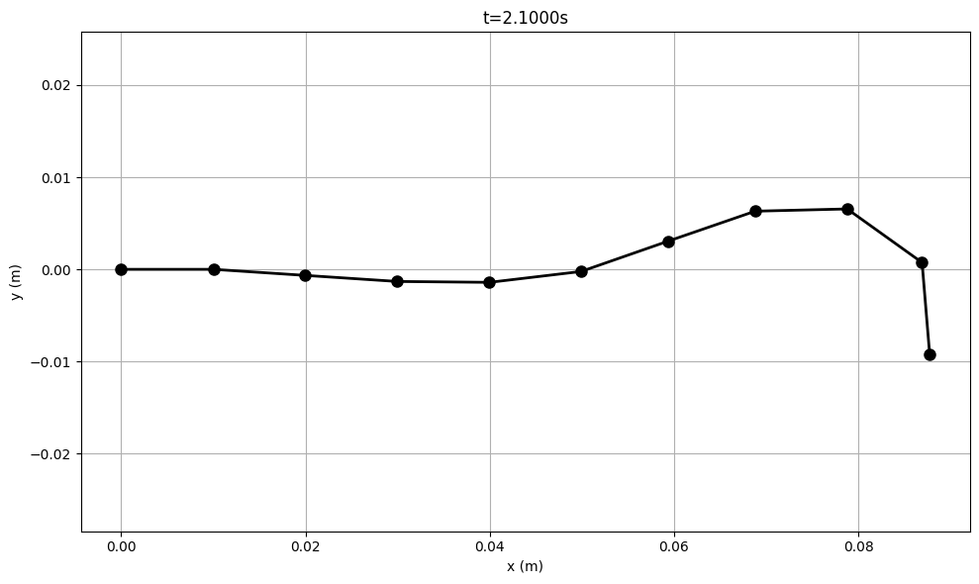
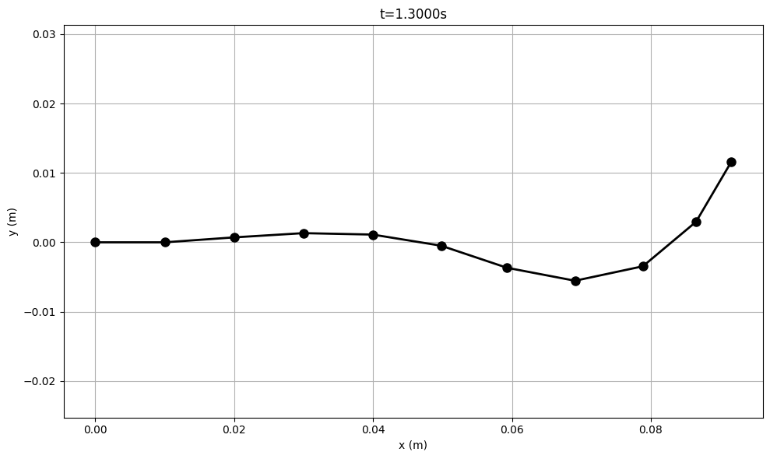
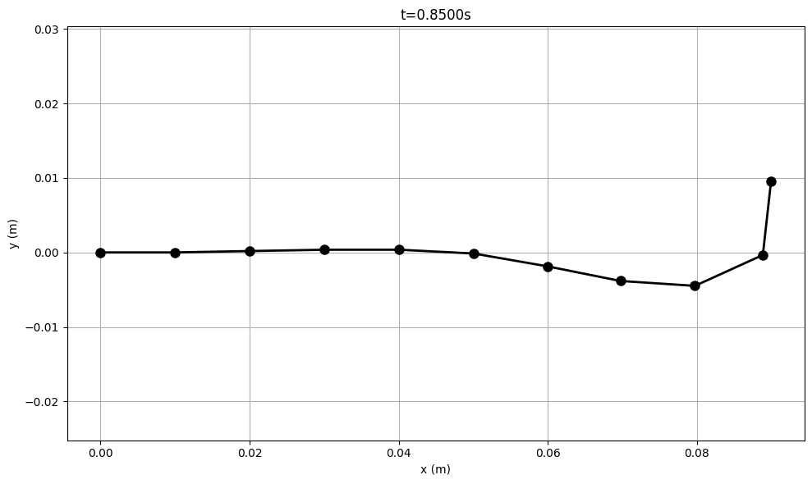
The motion of a single simulation

Slide 7
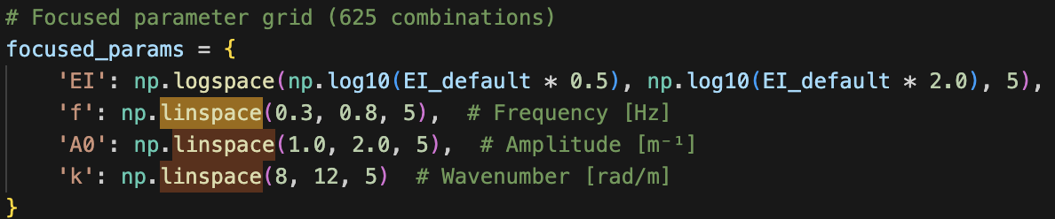
Parameter Sweep

Slide 8
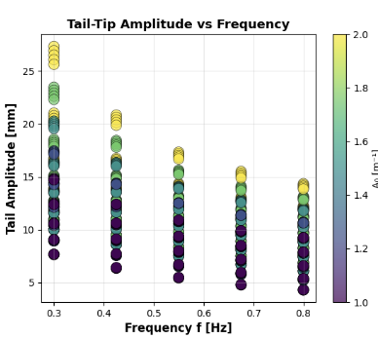
Findings
Tail amplitude decreases slightly as frequency increases (0.3→0.8 Hz). At low frequencies (~0.3 Hz), the largest oscillations (~27 mm) takes place

Slide 9
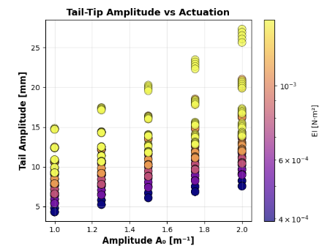
Findings
Strong linear relationship - higher curvature actuation (A₀) directly produces larger tail oscillations.

Slide 10
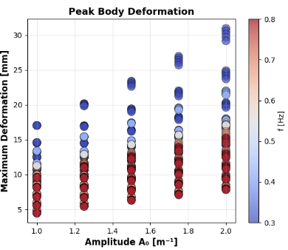
Findings
Higher actuation amplitude (A₀) produces larger peak deformations, as expected.

Slide 11
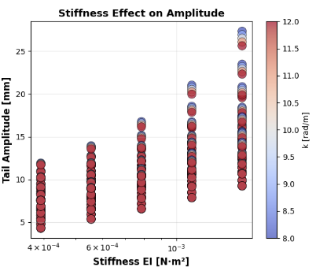
Findings
Higher Young’s Modulus slightly increases tail amplitude. the curvature wave produces more rigid-body-like motion, leading to larger tail displacement

Slide 12
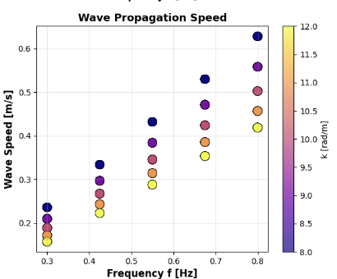
Findings
higher frequencies produce faster wave speeds (v = f × wavelength) smaller k (yellow) gives longer wavelengths and thus higher speeds at the same frequency.

Slide 13
Reference
Eloy, C. (2012). Optimal Strouhal number for swimming animals. Journal of Theoretical Biology, 324, 41–49.
Esposito, C. J., Tangorra, J. L., Flammang, B. E., & Lauder, G. V. (2012). A robotic fish caudal fin: Effects of stiffness and kinematics on locomotor performance. Journal of Experimental Biology.
Katzschmann, R. K., DelPreto, J., MacCurdy, R., & Rus, D. (2018). Exploration of underwater life with an acoustically controlled soft robotic fish. Science Robotics, 3(16), eaar3449.
Lauder, G. V., Madden, P. G., Mittal, R., Jones, E. A., & Baker, T. V. (2012). Fish-inspired robotics: Multi-phase hydrodynamics. Integrative and Comparative Biology, 52(6), 891–896.
Zhong, J., Wang, T., Li, G., & Zhu, J. (2021). Tunable stiffness swimming robots. Science Robotics, 6(54), eabd2971.

