Slide 1
Soft Robotic Fish:
Bending via Flexible Beam Model
Previous Studies
FEM-based soft robots (Katzschmann et al.)
stiffness–thrust relationships (Esposito et al.)
tunable stiffness (Zhong et al.)
hydrodynamics platforms (Lauder)
Strouhal number theory (Eloy)
MAE-263F Mechanics of Flexible Structures & Soft Robots
Jiajin Cui
Problem
  Previous soft robotic fish simulations usually requires complex computation such as computational fluid dynamics, and finite element analysis.
Motivation
  Using Euler-Bernoulli to model the fish as a spring-node network with a time-varying curvature to simulate the movement of a bionic fish
Notes:
Slide 1 script (~60 sec):
We propose a soft robotic fin modeled as a flexible beam to study how stiffness and actuation shape bending and propulsive performance. Soft propulsion is attractive because it is quieter and safer than rigid propellers. Prior soft fish and foil studies show that fin stiffness and the motion program critically affect thrust and efficiency, and efficient cruising often lies near Strouhal numbers around 0.2 to 0.4. We will build on these findings with a simplified beam model to obtain clear, design-relevant maps from stiffness and actuation to performance.

Slide 2
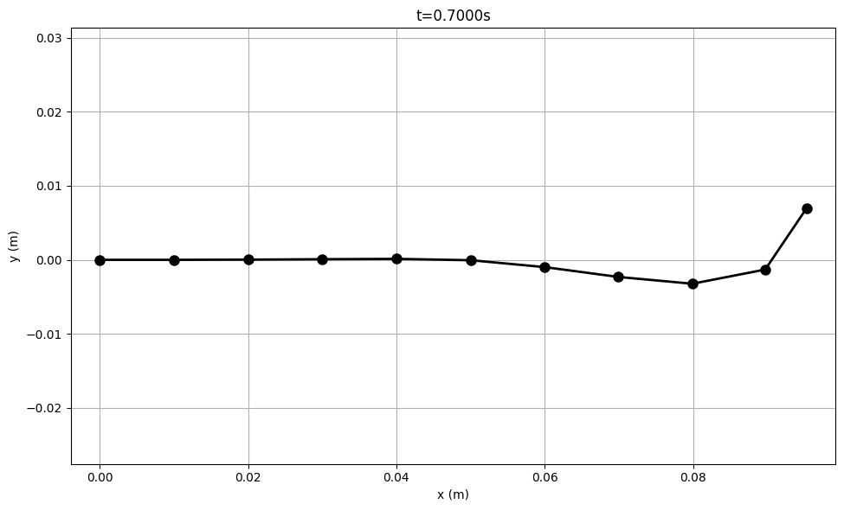
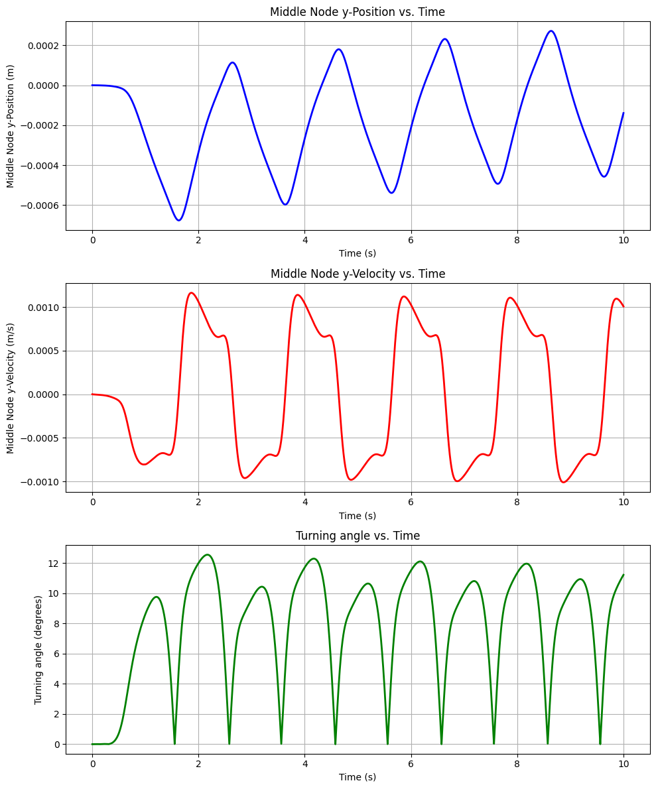
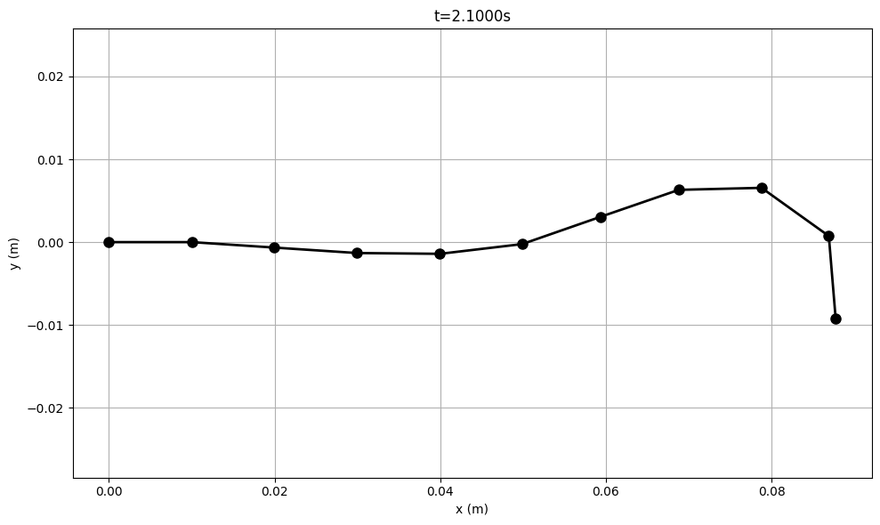
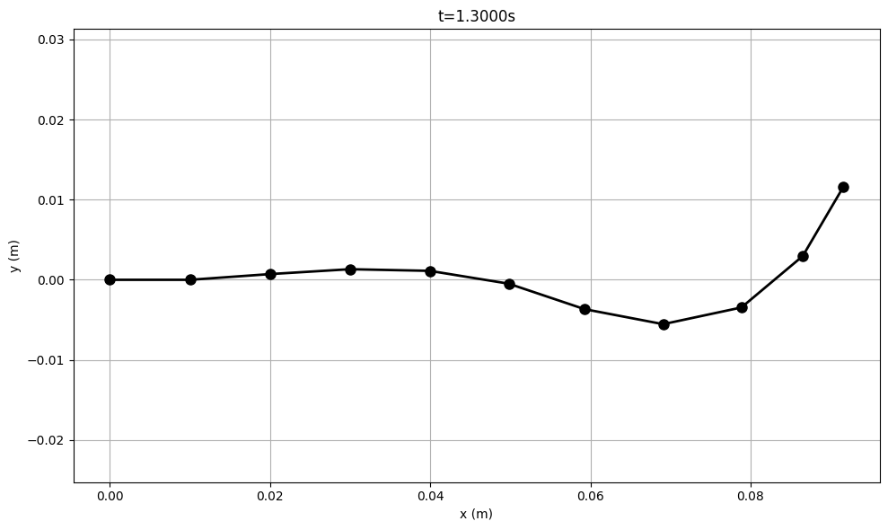
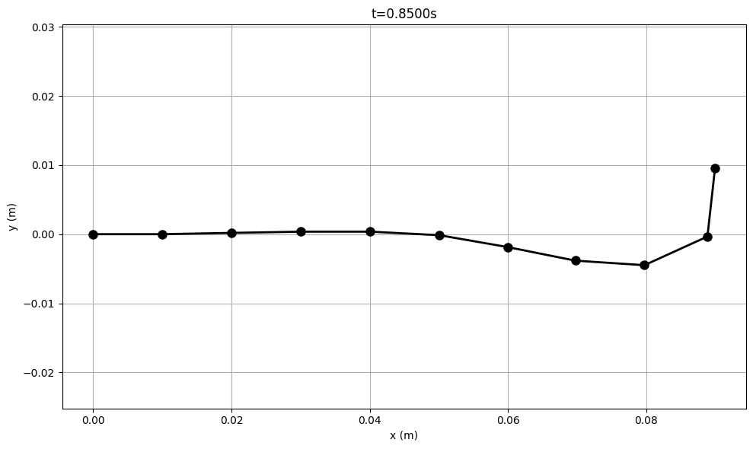

11 nodes
Internal curvature actuation
Reproducing curvature wave
Parameter Sweeps
Run simulations over ranges of:
  Stiffness values (EI, EA)
  Actuation frequency $f$
  Actuation amplitude $A_{0}$
  Spatial wave numbers $k$
Record how these affect:
  Tail-tip amplitude
  Propagation speed of curvature
  Overall deformation pattern

Slide 3
Reference
Eloy, C. (2012). Optimal Strouhal number for swimming animals. Journal of Theoretical Biology, 324, 41–49.
Esposito, C. J., Tangorra, J. L., Flammang, B. E., & Lauder, G. V. (2012). A robotic fish caudal fin: Effects of stiffness and kinematics on locomotor performance. Journal of Experimental Biology.
Katzschmann, R. K., DelPreto, J., MacCurdy, R., & Rus, D. (2018). Exploration of underwater life with an acoustically controlled soft robotic fish. Science Robotics, 3(16), eaar3449.
Lauder, G. V., Madden, P. G., Mittal, R., Jones, E. A., & Baker, T. V. (2012). Fish-inspired robotics: Multi-phase hydrodynamics. Integrative and Comparative Biology, 52(6), 891–896.
Zhong, J., Wang, T., Li, G., & Zhu, J. (2021). Tunable stiffness swimming robots. Science Robotics, 6(54), eabd2971.

