Slide 1

Alexa
Skill construction from VoiceFlow

Slide 2
Escape Room
You are in a room. You can turn left and right. There is a door in one direction. In another you will find a key that you can pick up to use on the door, otherwise the door cannot be opened. The door cannot be opened without a key.
Learned: default function block
https://creator.voiceflow.com/demo/4250513938

Slide 3
Delivery Order Dialog Platform
You have three choices and 3 sizes. (e.g. Margarita, Calzone and Vegetarian / large, medium and small). In the end, the order should be confirmed by the user so that a binding order could be made. Please ask for the name and use a personal address.
Learned: capture user intention(intent block)
https://creator.voiceflow.com/demo/4369041048018535

Slide 4
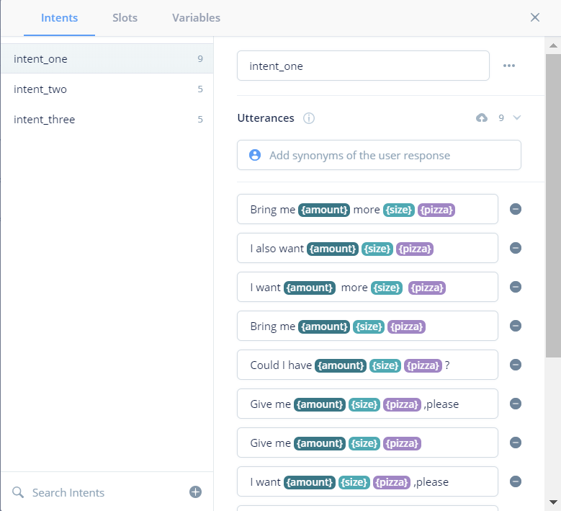
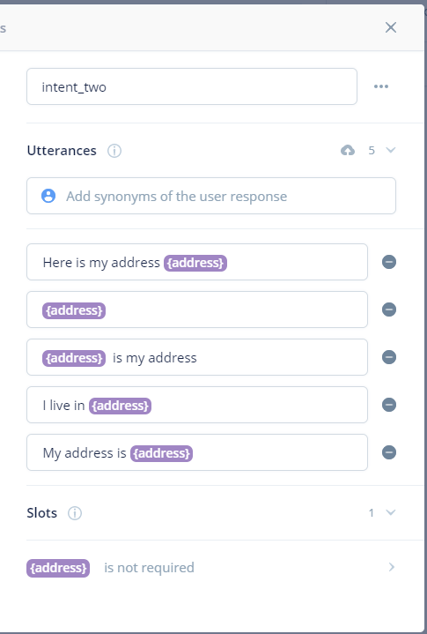
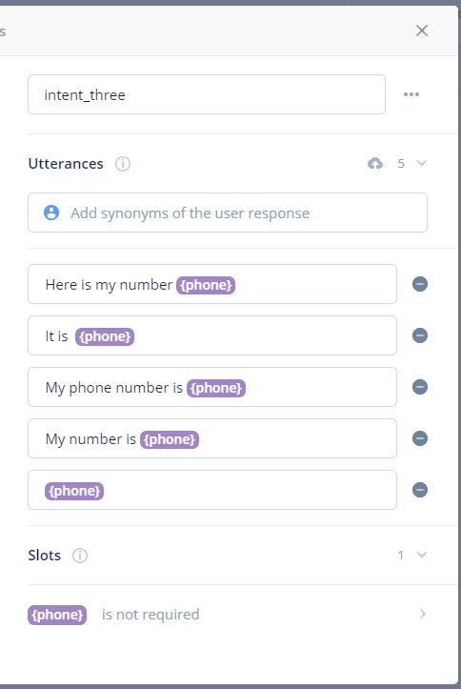

Slide 5
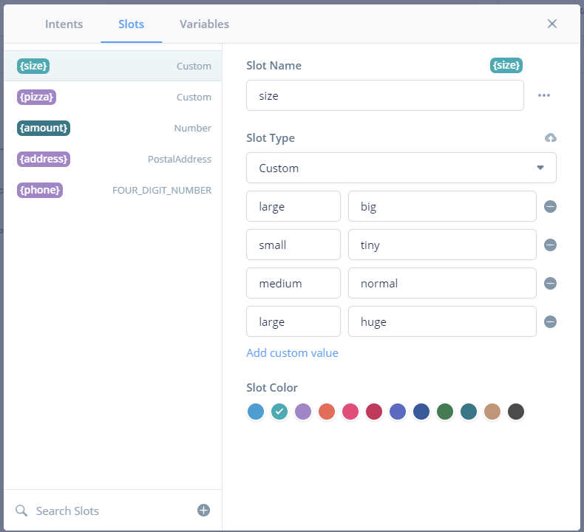

Slide 6
Game: Still Standing(test)
If you can answer 5 questions from our questions base correctly, you will get our jackpot! Just for reminding, questions will become harder one by one.
Learned: Javascript & external tool Google Sheets(code block,google sheet block)
Query question from sheet randomly
https://creator.voiceflow.com/demo/4623901992700819

Slide 7
More skill construction details are in my own VoiceFlow account project management.
Suggested tutorial:
https://www.youtube.com/watch?v=S6SGb-WW3Ys https://www.youtube.com/watch?v=kt7wr2j_uuA https://www.youtube.com/watch?v=RMiFeJMun8s
Might differ from version of VoiceFlow

