Slide 1
A
B
//
C

Slide 2
A
B
//
C

Slide 4
A
B

Slide 5
A
B
C
D

Slide 6
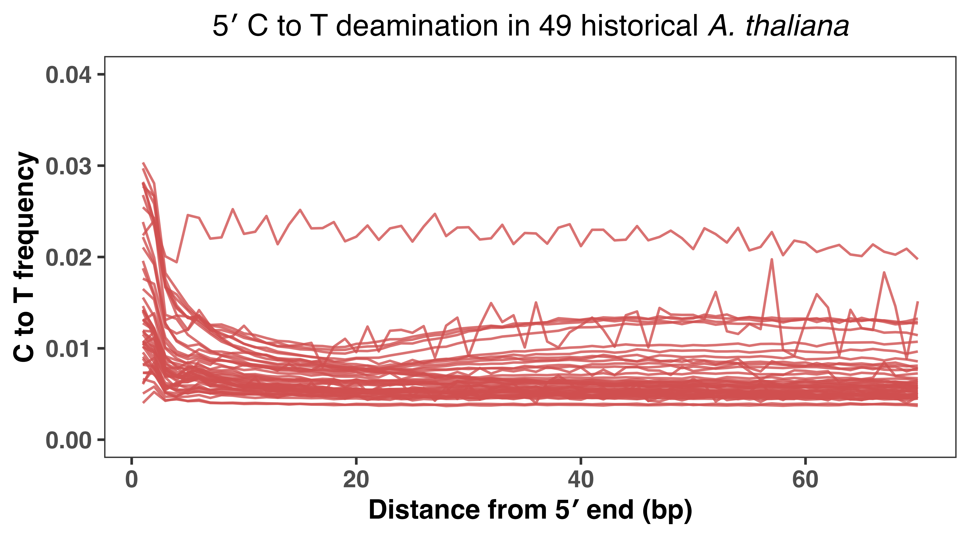
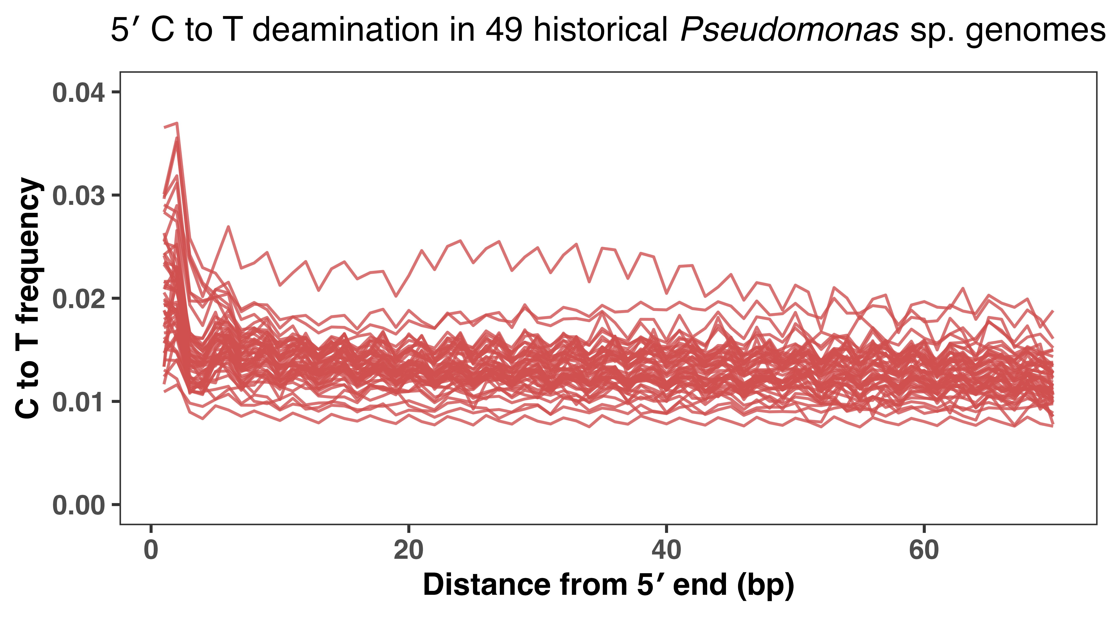
A
B
C
D
E

Slide 7
A
B

Slide 8
With modern 1350 not resampled

Slide 9
A
B
//
C

