Slide 1
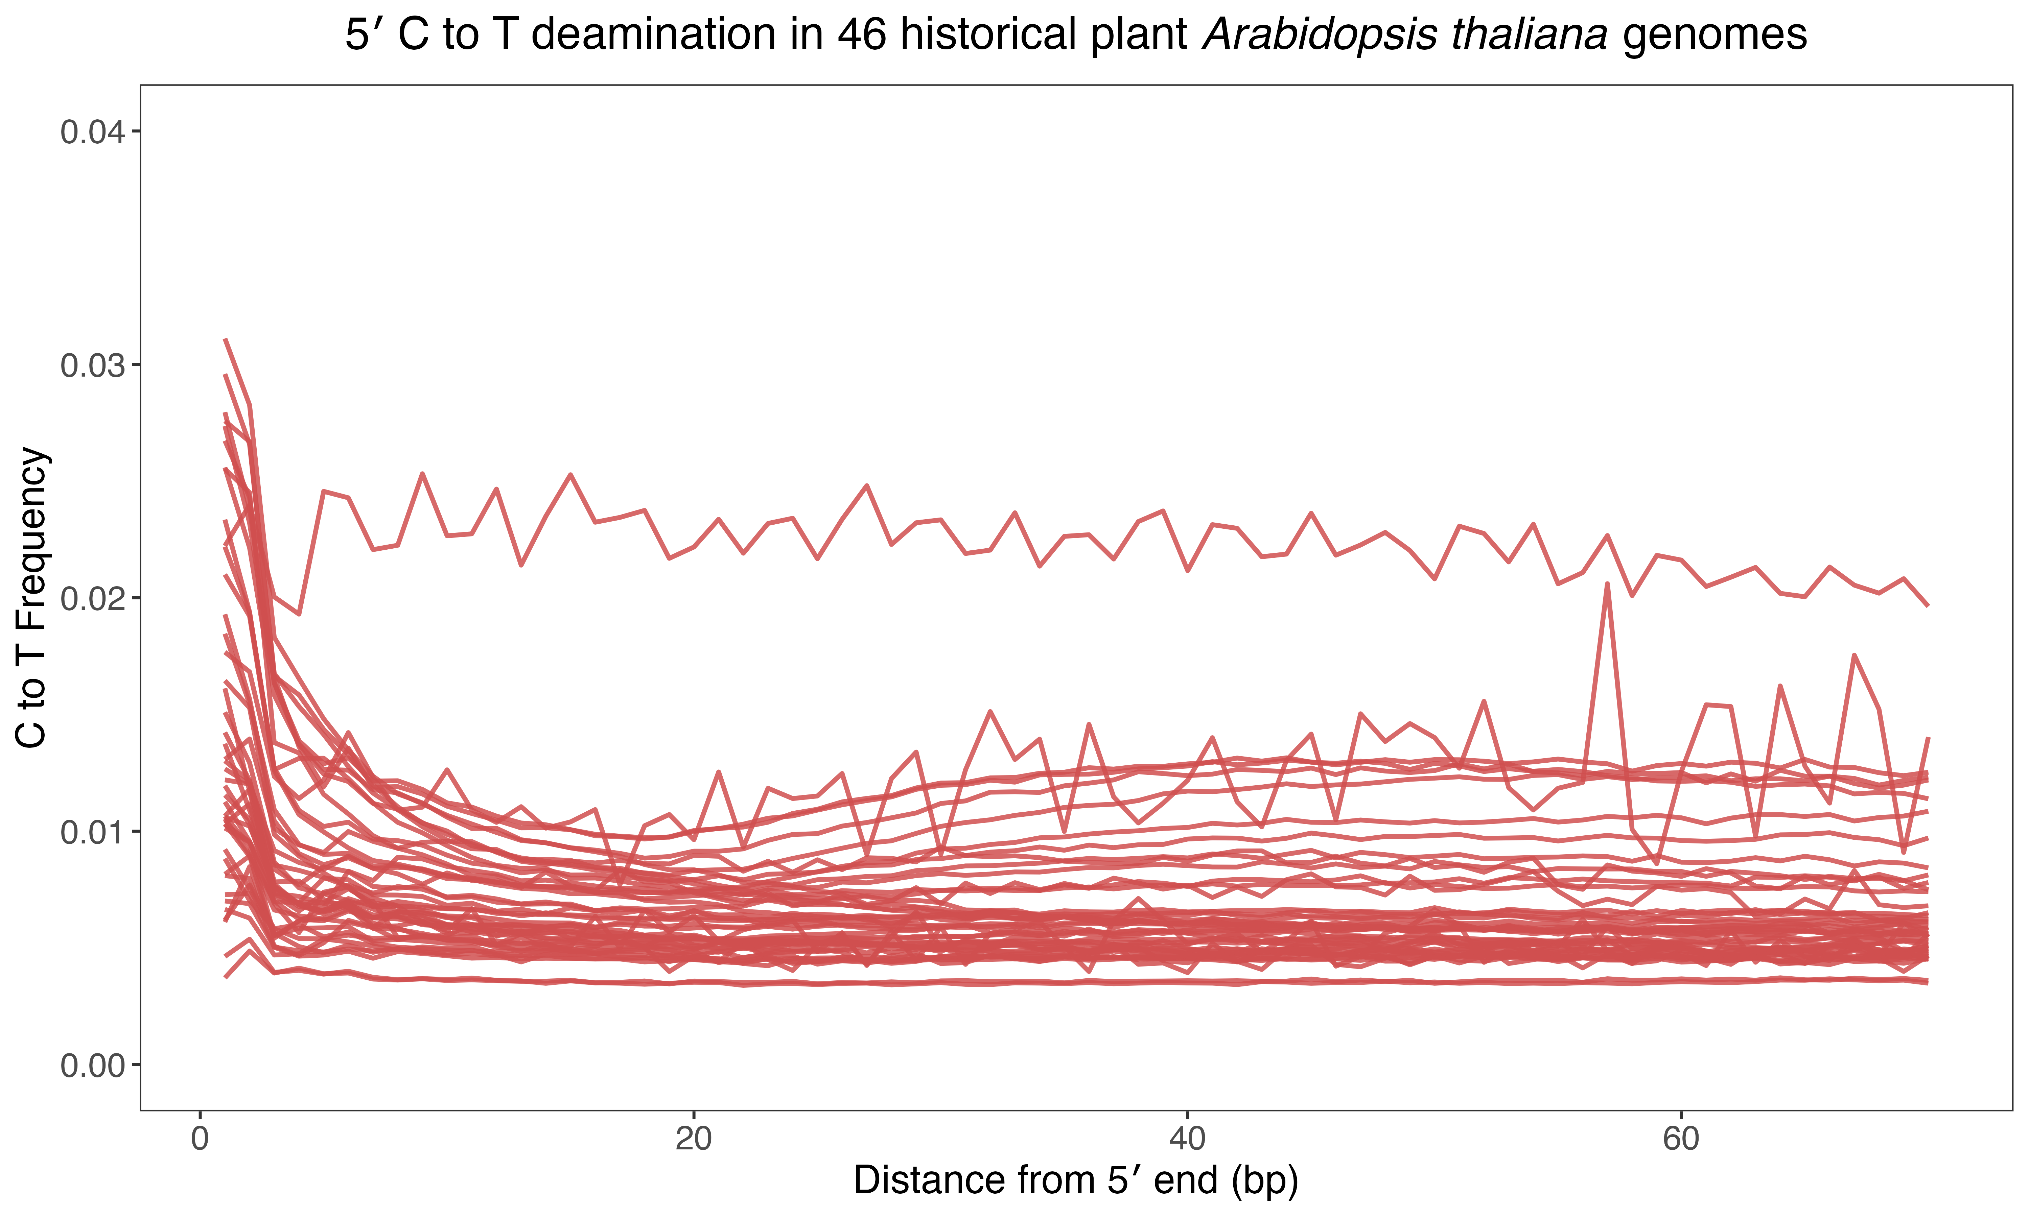
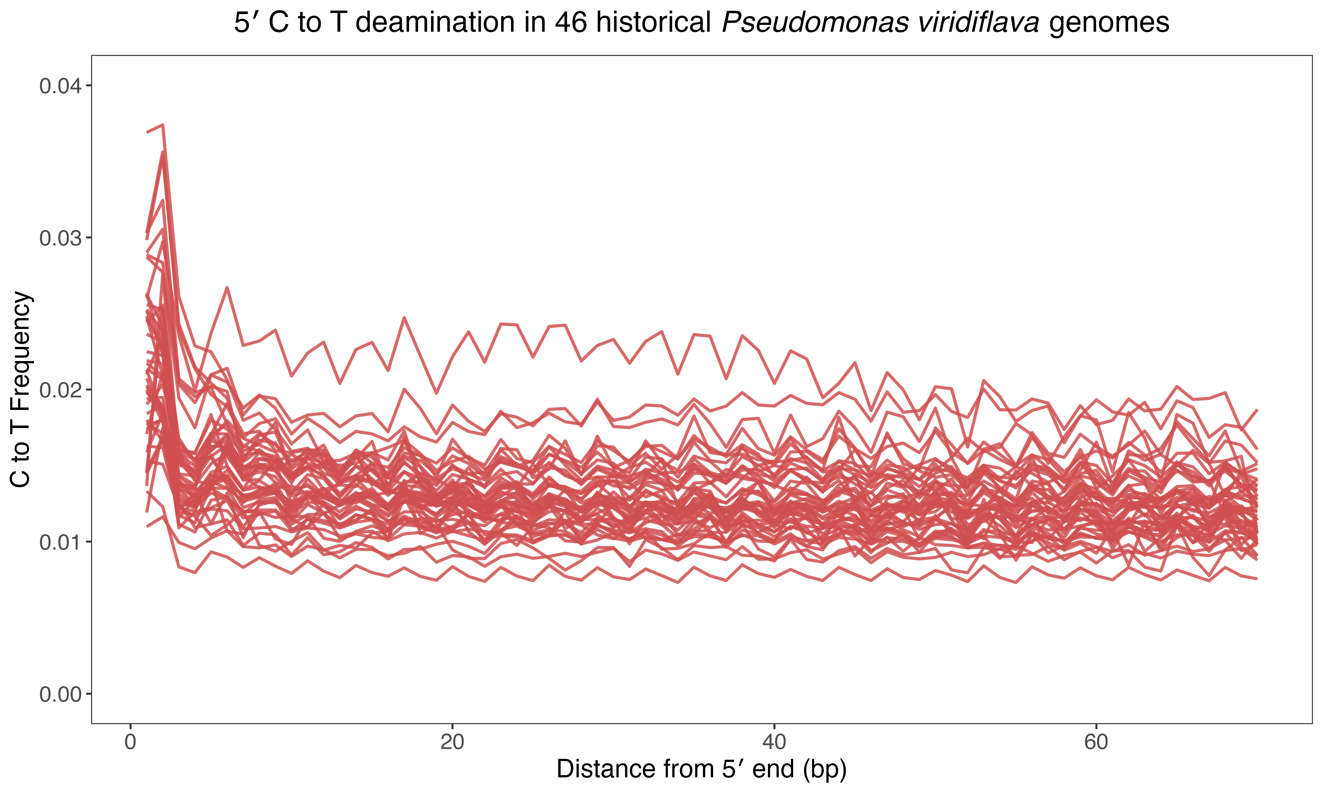
A
B
C
D
E

Slide 2
A
B
Modern
Historical

Slide 3
A
B
C

Slide 4
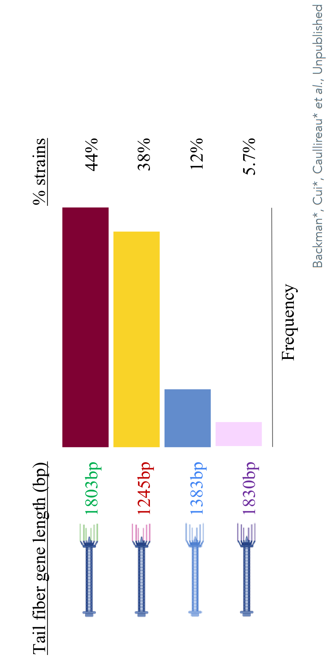
A
B
C
D
D

Slide 5
A
B
C
D

Slide 7
A
B
C
D

