Slide 1
﻿整数线性规划题目讲解

Slide 2
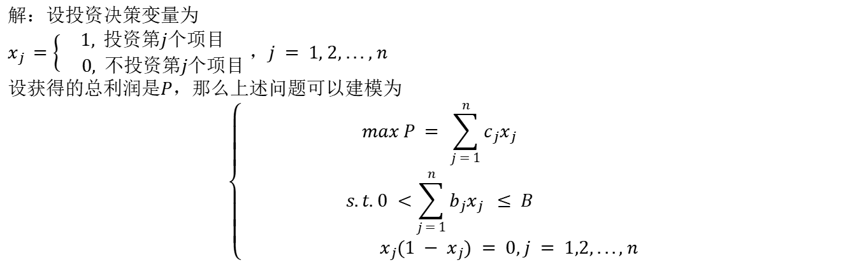
Problems 6
Problem: The total amount of funds that a department can use for investment in the next five years is B
million. There are n(n > 3) projects that can be invested. Assuming that each project can be
invested at most once,The investment fund required for the j − th project is bj million, and the
profit obtained is cj million. Ask how to choose an investment project to maximize the total
profit?
解：设投资决策变量为
$x_{j }=\left\{\begin{aligned}1, &投资第j个项目 \\ 0, &不投资第j个项目\end{aligned}\right.$ ，$j = 1, 2, ... , n$
设获得的总利润是$P$，那么上述问题可以建模为
$$\left\{\begin{aligned}max P = \sum_{j = 1}^{n}{c_{j}x_{j}} \\ s.t. 0 <\sum_{j = 1}^{n}{b_{j}x_{j}} ≤ B \\ { x}_{j}(1 − x_{j}) = 0, j = 1,2, ..., n\end{aligned}\right.$$

Slide 3
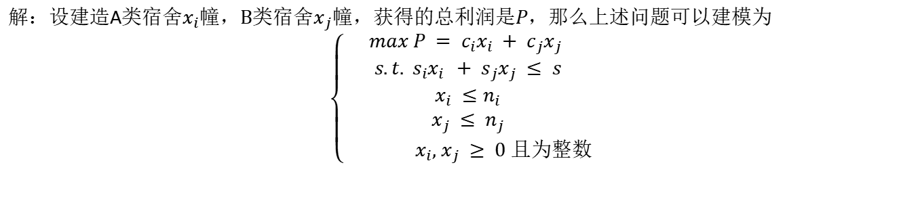
Problems 7
Problem: A construction company has contracted to build two types of dormitories. Each dormitory of
type A covers an area of si, and each dormitory of type B covers an area of sj . The company
has purchased a building land of s. According to the plan, the number of Type A dormitories
shall not exceed ni, and the number of Type B dormitories shall not exceed nj . One dormitory
of type A can earn ci, and one dormitory of type B can earn cj . How many type A and B
dormitories should the company build?
解：设建造A类宿舍$x_{i}$幢，B类宿舍$x_{j}$幢，获得的总利润是$P$，那么上述问题可以建模为
$$\left\{\begin{aligned}max P = c_{i}x_{i} + c_{j}x_{j} \\ s.t. s_{i}x_{i } + s_{j}x_{j} ≤ s \\ x_{i} ≤n_{i} \\ x_{j} ≤ n_{j} \\ { x}_{i}, x_{j} ≥ 0 且为整数\end{aligned}\right.$$

Slide 4
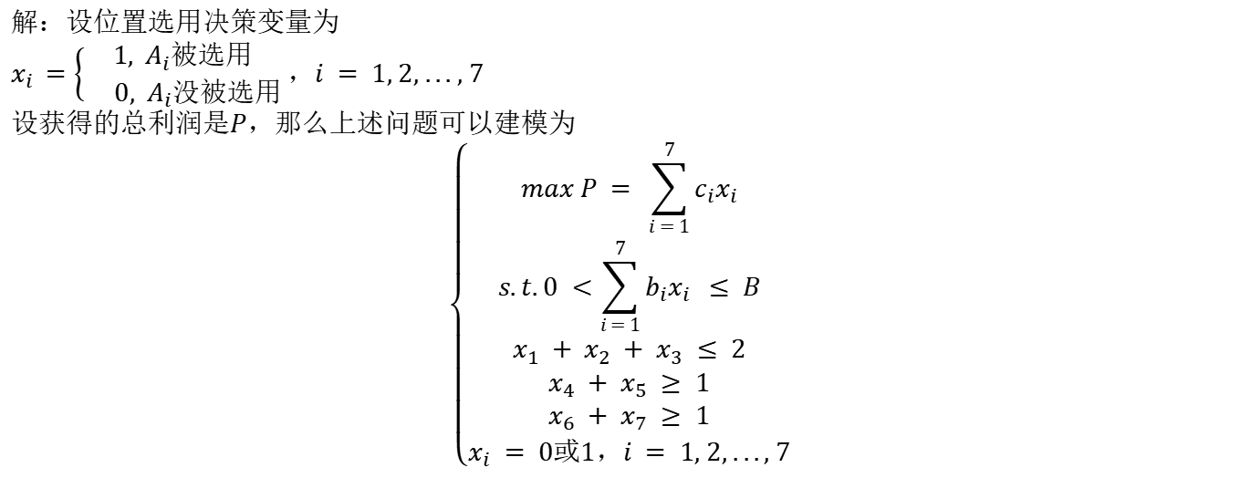
Problems 8
Problem: A company plans to establish a sales department in the east, west and south districts of the city. Seven locations Ai(i = 1, 2, ..., 7) are proposed. It is stipulated that in the east area, at most two of the three positions from A1, A2, A3 should be selected; In the west area, at least one of the two positions from A4, A5 should be selected; In the south area,at least one of the two positions from A6, A7 should be selected. If the location Ai is selected, the equipment investment is estimated to be bi yuan, and the annual profit is estimated to be ci yuan, but the total investment cannot exceed B yuan. Which positions should be selected to maximize the annual profit?
解：设位置选用决策变量为
$x_{i }=\left\{\begin{aligned}1, &A_{i}被选用 \\ 0, A_{i}没被选用\end{aligned}\right.$ ，$i = 1, 2, ... , 7$
设获得的总利润是$P$，那么上述问题可以建模为
$$\left\{\begin{aligned}max P = \sum_{i = 1}^{7}{c_{i}x_{i}} \\ s.t. 0 <\sum_{i = 1}^{7}{b_{i}x_{i}} ≤ B \\ x_{1} + x_{2} + x_{3} ≤ 2 \\ x_{4} + x_{5} ≥ 1 \\ x_{6} + x_{7} ≥ 1 \\ x_{i} = 0或1，i = 1, 2, ..., 7\end{aligned}\right.$$

Slide 5
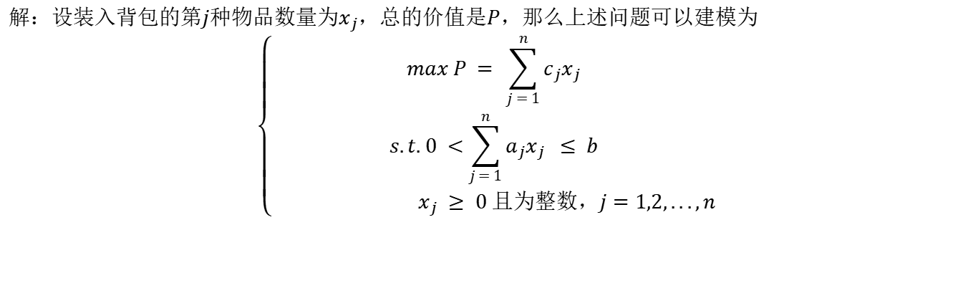
Problems 9
Problem: A hiker needs to bring a backpack. The total weight of the backpack is limited to b kg. Now
there are n kinds of items to choose from.The j − th item is known to weigh aj kg each and the
use value is cj , how should the traveler choose these items to maximize the total value?
解：设装入背包的第$j$种物品数量为$x_{j}$，总的价值是$P$，那么上述问题可以建模为
$$\left\{\begin{aligned}max P = \sum_{j = 1}^{n}{c_{j}x_{j}} \\ s.t. 0 <\sum_{j = 1}^{n}{a_{j}x_{j}} ≤ b \\ { x}_{j} ≥ 0 且为整数，j=1,2,...,n\end{aligned}\right.$$

Slide 6

Problems 10
Problem: There are n people assigned to do n jobs. It is stipulated that each person can only do one job, and
each job can only be done by one person. It is known that the efficiency of the i − th person to
do the j − th work is cij . How should we allocate to maximize overall efficiency?
解：设决策变量为
$x_{ij }=\left\{\begin{aligned}1, &分配第i个人去做第j个工作 \\ 0, &其他\end{aligned}\right.$ ，$i, j = 1, 2, ... , n$
设总效率是$P$，那么上述问题可以建模为
$$\left\{\begin{aligned}max P = \sum_{i = 1}^{n}{\sum_{j = 1}^{n}{c_{ij}x_{ij}}} \\ s.t. \sum_{j = 1}^{n}{x_{ij}} = 1, i = 1,2,...,n \\ \sum_{i = 1}^{n}{x_{ij} = 1, j = 1,2,...,n} \\ x_{ij} = 0或1\end{aligned}\right.$$

