Slide 1

Lab Slides
Turing Adder
郭泓锐 实验课助教 guohongrui17@mails.ucas.ac.cn
CS101

Slide 2
Outline
Week 1: Lab highlights, design Q&A
  Submit the 1st version design
Week 2: Team discussion, peer review
  Submit the 2nd version design
Week 3: Team presentation to the class
  Submit project report

Slide 3
First week

Slide 4
Team Formation
Form 8 teams, each consisting of 5 or 6 students and a team leader who serves the team.
课间自由组队，助教老师可做微调

Slide 5
Week1 Outline
Introduction of Turing Machine
Experiment Platform
Two Examples
Questions

Slide 6
Objective
Design three Turing machines to perform, respectively
  unary addition
  4-bit binary addition
  arbitrary-bit binary addition

Slide 7
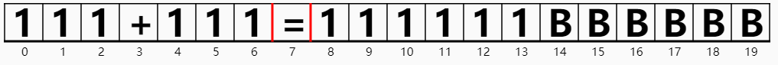
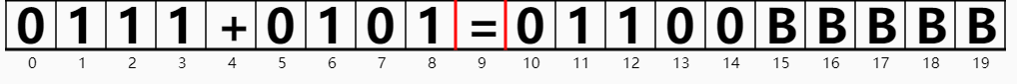
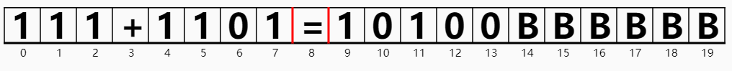
Objective
Design three Turing machines to perform, respectively
  unary addition
  4-bit binary addition
  arbitrary-bit binary addition
Unary addition
4-bit binary addition
Arbitrary-bit binary addition

Slide 8
Turing machine
In addition to the state-transition diagram stored in the Finite State Controller, there is an infinite tape in a Turing machine
Tape

Slide 9
Turing machine
In addition to the state-transition diagram stored in the Finite State Controller, there is an infinite tape in a Turing machine
Read-
Write
Head
Tape

Slide 10
Turing machine
In addition to the state-transition diagram stored in the Finite State Controller, there is an infinite tape in a Turing machine
Read-
Write
Head
State Transition Diagram
Tape

Slide 11
Turing machine
In addition to the state-transition diagram stored in the Finite State Controller, there is an infinite tape in a Turing machine
Read-
Write
Head
State Transition Diagram
State-Transition Table
Current State | Symbol Read | Symbol to Write | Head Move | Next State
q₀ | 0 | B | → | q₀
q₀ | 1 | B | → | q₀
q₀ | @ | B | → | q₁ (Halt)
Tape

Slide 12
Turing machine
In addition to the state-transition diagram stored in the Finite State Controller, there is an infinite tape in a Turing machine
Cleanup: Replace every symbol by a blank (B)
  The input data string is initially placed in the tape between two blanks
Read-
Write
Head
State Transition Diagram
State-Transition Table
Current State | Symbol Read | Symbol to Write | Head Move | Next State
q₀ | 0 | B | → | q₀
q₀ | 1 | B | → | q₀
q₀ | @ | B | → | q₁ (Halt)
Tape

Slide 13
Definition of Turing Machine
A Turing machine is a 7-tuple M={Q, Σ, Γ, δ, q₀, q_{Accept}, q_{Reject} }.
Q is a finite, non-empty set of states.
Σ is a finite, non-empty set of input symbols.
Γ is a finite, non-empty set of tape symbols. There is a special character B∈Γ for the blank symbol. We require B∉Σ and Σ⊂Γ.
δ:(Q-{q_{Accept}, q_{Reject} })×Γ → Q×Γ×{→,←} is the transition function.
q₀∈Q is the initial state.
q_{Accept}∈Q is the accept state.
q_{Reject}∈Q is the reject state.

Slide 14
Simple Example
Goal：Judge parity of the number “1” in a “01” string
State Set Q = {q₀, q₁, q_{accept}, q_{reject}}
Input Symbols Set: Σ = {0, 1}
Tape Symbols Set: Γ = {0, 1, B}
Transition function: δ (next slide)
Initial state: q₀
Accept state: q_{accept}
  Representing the number of “1” is even
Reject state: q_{reject}
  Representing the number of “1” is odd

Slide 15
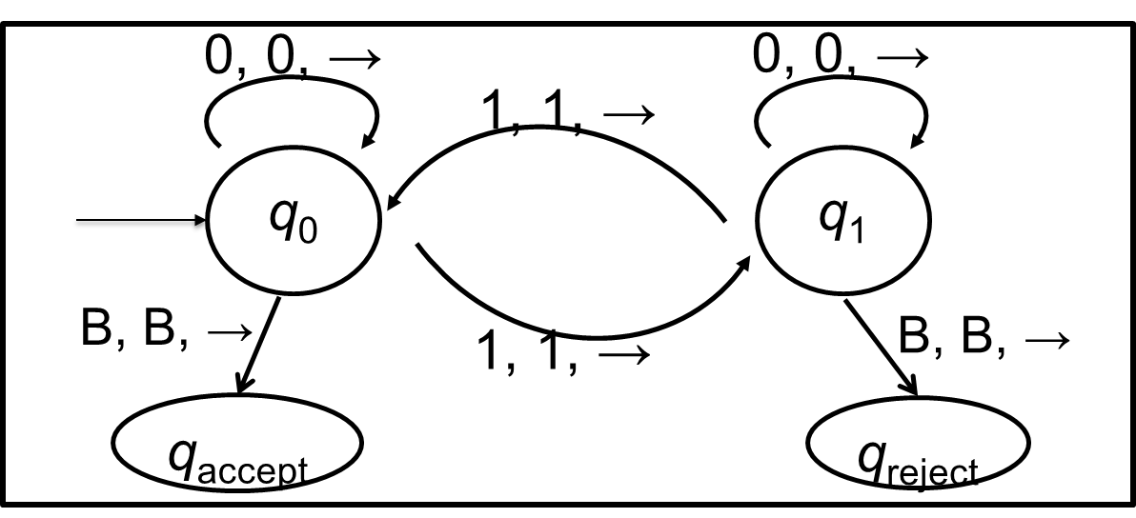
Simple Example -- Transition Function

Slide 16
Simple Example -- Transition Function
Current State | Symbol Read | Symbol to Write | Head Move | Next State
q₀ | 0 | 0 | → | q₀
q₀ | 1 | 1 | → | q₁
q₀ | B | B | → | q_{accept}
q₁ | 0 | 0 | → | q₁
q₁ | 1 | 1 | → | q₀
q₁ | B | B | → | q_{reject}

Slide 17
Simple Example -- Transition Function
更进一步，如果要在纸带上写上 “Even” 和 “Odd” ，怎么办？
Current State | Symbol Read | Symbol to Write | Head Move | Next State
q₀ | 0 | 0 | → | q₀
q₀ | 1 | 1 | → | q₁
q₀ | B | B | → | q_{accept}
q₁ | 0 | 0 | → | q₁
q₁ | 1 | 1 | → | q₀
q₁ | B | B | → | q_{reject}

Slide 18
Week1 Outline
Introduction of Turing Machine
Experiment Platform
Two Examples
Questions

Slide 19
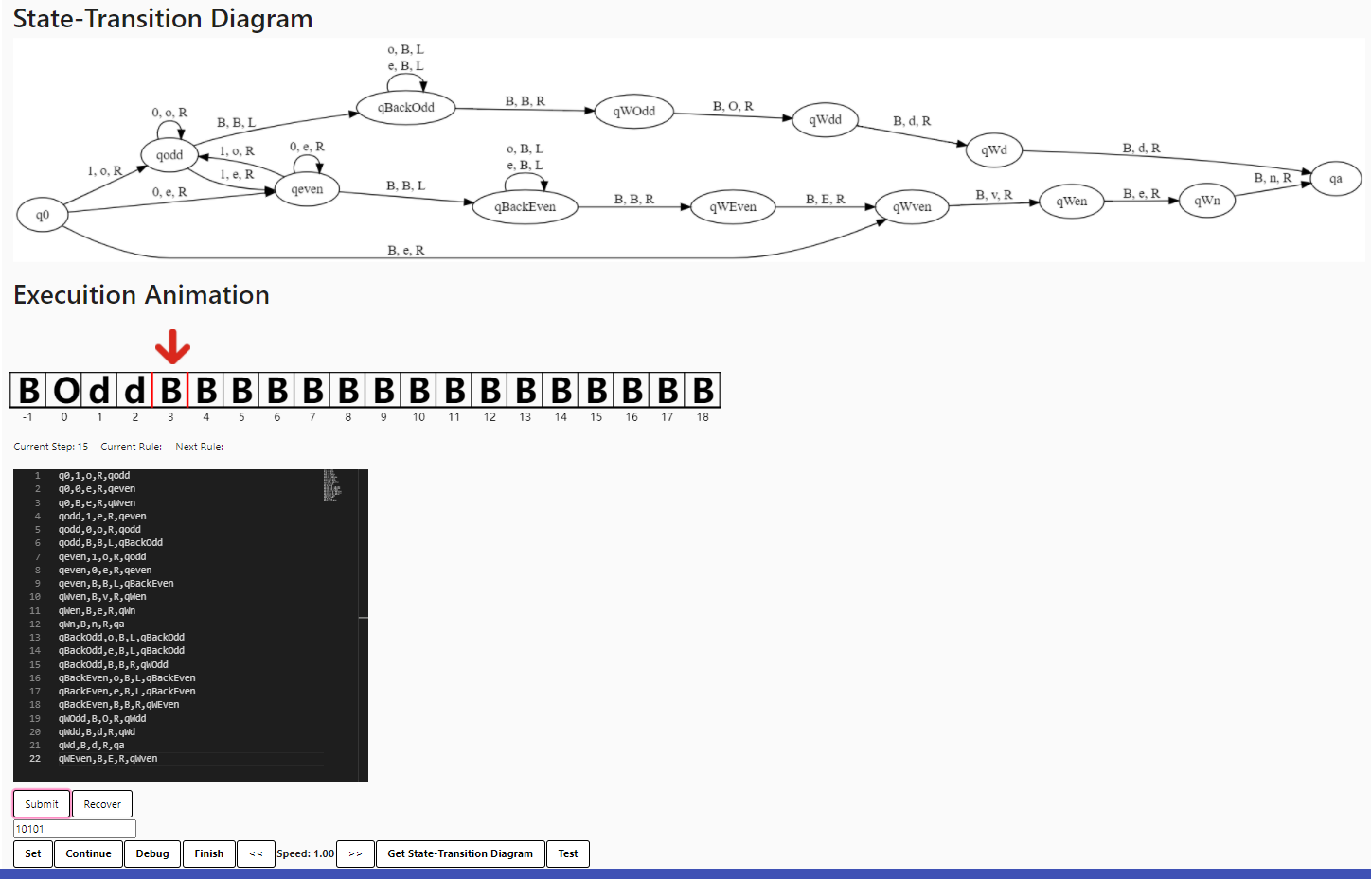
Experiment Platform

Slide 20
Experiment Platform -- Overview
Property
  The input is put on the tape, and other square are letter B
  Infinite for both side of tape
  Header is initially on the far-left side of the input string
Buttons
  “Set”: Initialize Turing machine, including import rules and tape data initialization
  “Pause”/“Continue”: Pause or continue execution
  “Debug”: Invalid when in continue state, otherwise execute one step
  “Finish”: Skip animation and display the result of the Turing machine
  “<< ” : Slow down the execution
  “>> ”: Speed up the execution
  “Get State Transition Diagram”: As the name suggests
  “Test”: See if you can pass a test point
Note
  If the simulation exceeds 10,000 steps on a certain input, we believe that the Turing machine will not terminate on this input and throw a “no terminate” error.

Slide 21
Experiment Platform -- How to Use
Only state-transition table is needed to submit
  Multiple lines
  Each line only include one state-transition rule, in the form of:
  State, Symbol Read, Symbol to Write, Head Move, Next State
  Note
    State / Next State: a string. Specify q0 as the initial state and qa as the stop state.
    Symbol Read: a visible ASCII character, represent the letter that head read.
    Symbol to Write: a visible ASCII character, represent the letter that head write.
    Head Move: One of {L, R}, where L means the head moves one space to the left, R means the head moves one space to the right.
    Case sensitive.

Slide 22
How to Use （2）
Automatic generate 6-tuples
  State Set: Q is generated according to the state transition table, including all the states that have appeared in the "state"/"next state" column of the state transition table.
  Tape Symbols Set: Γ is specified as all the visible ASCII codes.
  Input Symbol Set: Σ is a subset Γ\{B}
  State Transition Function: δ (last slide)
  Initial State: q0
  Stop State: qa
Example
  q0, B, B, R, q1
  q1, B, 1, L, qa
Notes:
解释一下为什么不是七元组，因为实验的问题的答案体现在纸带上，只需要一个停机状态（把接受和拒绝状态合并为停机状态了）

Slide 23
Week1 Outline
Introduction of Turing Machine
Experiment Platform
Two Examples
Questions

Slide 24
Two Examples
Turing machine of parity recognition
  Judge parity of the number of “1” in a “01” string
  If the number of “1” is even, then write “Even” on the tape
  If the number of “1” is odd, then write “Odd” on the tape
Turing machine of palindrome recognition
  Judge whether a “01” string is palindrome or not
  If yes, then write “Y” on the tape
  Otherwise, write “N”

Slide 25
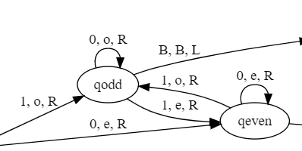
Parity Recognition -- Key Idea
Key Idea
  qodd: the number of “1” in the string ever read is odd
  qeven: the number of “1” in the string ever read is even
  Read “1”: qodd →qeven, qeven → qodd
  Read “0”: qodd →qodd, qeven → qeven
From “Simple example”

Slide 26
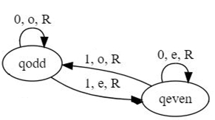
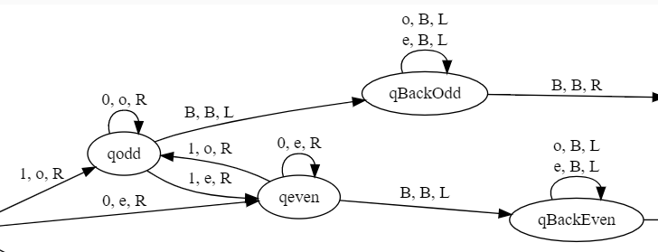
Parity Recognition -- Key Principle
Key Principle:
  Loop
    Use four rule to handle infinite input
    NOT infinite rule
      qodd1→ qeven1, qeven2→qodd3, …
  Able to Move Back
    Read the tape Many Times

Slide 27
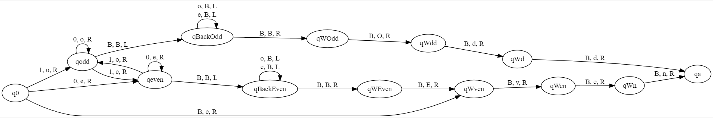
Parity Recognition -- state-transition diagram/table
q0,1,o,R,qodd | qWven,B,v,R,qWen | qWOdd,B,O,R,qWdd
q0,0,e,R,qeven | qWen,B,e,R,qWn | qWdd,B,d,R,qWd
q0,B,e,R,qWven | qWn,B,n,R,qa | qWd,B,d,R,qa
qodd,1,e,R,qeven | qBackOdd,o,B,L,qBackOdd | qWEven,B,E,R,qWven
qodd,0,o,R,qodd | qBackOdd,e,B,L,qBackOdd
qodd,B,B,L,qBackOdd | qBackOdd,B,B,R,qWOdd
qeven,1,o,R,qodd | qBackEven,o,B,L,qBackEven
qeven,0,e,R,qeven | qBackEven,e,B,L,qBackEven
qeven,B,B,L,qBackEven | qBackEven,B,B,R,qWEven

Slide 28
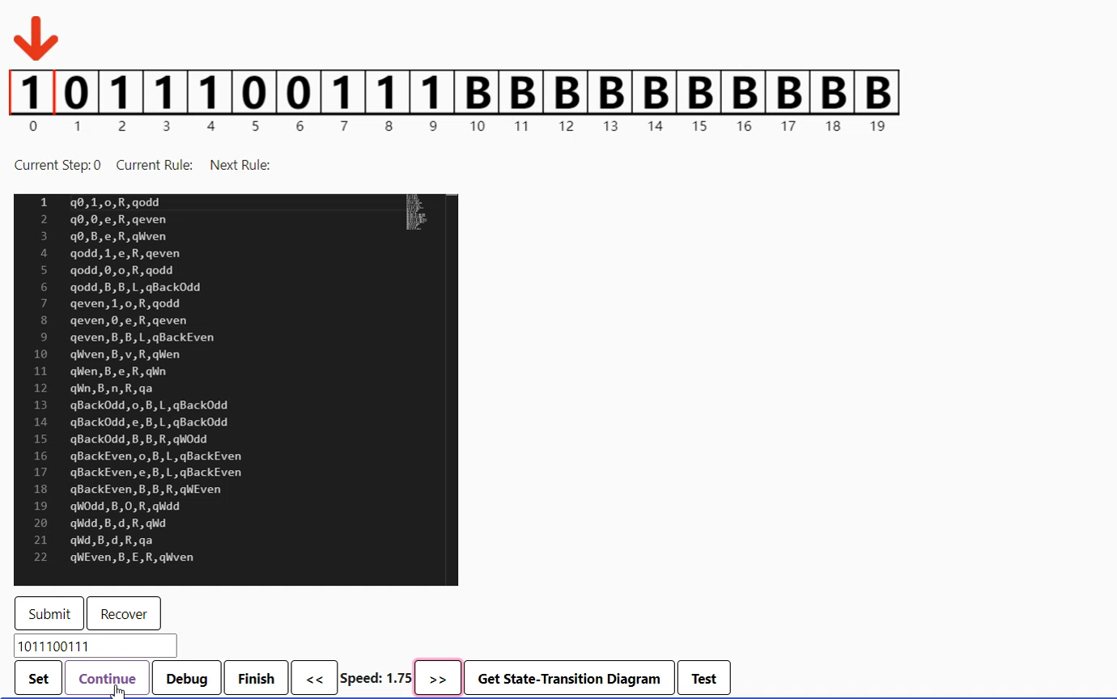
Parity Recognition -- Execution Animation

Slide 29
Two Examples
Turing machine of parity recognition
  Judge parity of the number of “0” in a “01” string
  If the number of “0” is even, then write “Even” on the tape
  If the number of “0” is odd, then write “Odd” on the tape
Turing machine of palindrome recognition
  Judge whether a “01” string is palindrome or not
  If yes, then write “Y” on the tape
  Otherwise, write “N” on the tape
Notes:
英[ˈpælɪndrəʊm]

Slide 30
Palindrome Recognition -- Key Idea
Key Idea
  qSeen0: Found 0 on the far-left of the remaining string
  qSeen1: Found 1 on the far-left of the remaining string
  qWant0: Move right to seek “0” on the far-right of the remaining string
  qWant1: Move right to seek “1” on the far-right of the remaining string
  qBack: found the wanted letter on the far-right of the remaining string

Slide 31
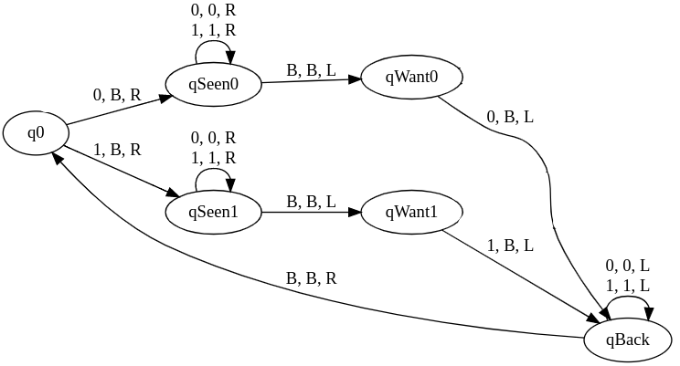
Palindrome Recognition -- Key Idea
有限的规则处理无限的输入

Slide 32
Palindrome Recognition -- Key Principle
Key Principle
  Loop
    Use finite rule to handle infinite input
  Move back and Mark
    The tape can be read infinite times
    Write letters to the tape, and assign some meaning
  Implicit conditional judgements
    Use current state and symbol read as a unique condition
      Result of condition holds:
        write a symbol and change to the next state

Slide 33
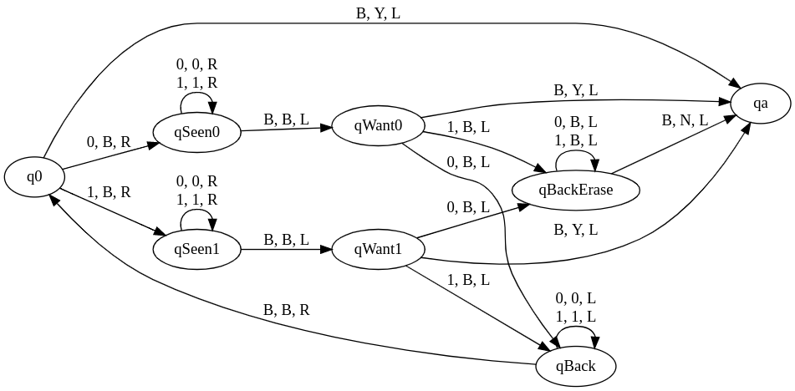
Palindrome Recognition -- State-Transition Diagram
Loop

Slide 34
Palindrome Recognition -- State-Transition Diagram
Mark
Mark
Mark
Loop

Slide 35
Palindrome Recognition -- State-Transition Diagram
Mark
Move Back
Move Back
Mark
Mark
Move Back
Loop

Slide 36
Palindrome Recognition State-Transition Table
q0,0,B,R,qSeen0 | qWant0,0,B,L,qBack | qBackErase,0,B,L,qBackErase
q0,1,B,R,qSeen1 | qWant0,1,B,L,qBackErase | qBackErase,1,B,L,qBackErase
q0,B,Y,L,qa | qWant0,B,Y,L,qa | qBackErase,B,N,L,qa
qSeen0,0,0,R,qSeen0 | qWant1,0,B,L,qBackErase
qSeen0,1,1,R,qSeen0 | qWant1,1,B,L,qBack
qSeen0,B,B,L,qWant0 | qWant1,B,Y,L,qa
qSeen1,0,0,R,qSeen1 | qBack,0,0,L,qBack
qSeen1,1,1,R,qSeen1 | qBack,1,1,L,qBack
qSeen1,B,B,L,qWant1 | qBack,B,B,R,q0

Slide 37
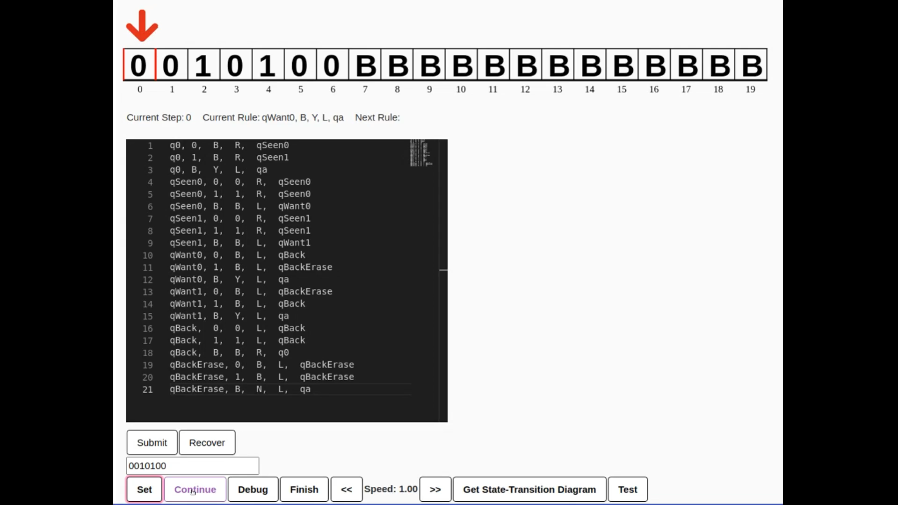
Palindrome Recognition -- Execution Animation

Slide 38
Week1 Outline
Introduction of Turing Machine
Experiment Platform
Two Examples
Questions

Slide 39
This project includes three questions
Q1: Unary addition of two unary numbers
Q2: Binary addition of two 4-bit numbers
Q3: Binary addition of two arbitrary numbers

Slide 40
Examples of Unary and Binary Addition
Unary Addition
  11 + 11 = ?
  111 + 1111 = ?
Binary Addition
  1010 + 1 = ?
  111 + 1111 = ?

Slide 41
Examples of Unary and Binary Addition
Unary Addition
  11 + 11 = ? 1111
  111 + 1111 = ? 1111111
Binary Addition
  1010 + 1 = ? 1011
  111 + 1111 = ? 10110

Slide 42
Question 1
Design a Turing machine that can perform arbitrary bit unary addition
Format requirement:
  Input: (some 1)+(some 1)=
  Output on tape: …###(some 1)B###...
    The input “some 1” represents the unary number to be added, which may be zero ones; the output “some 1” on the tape when the machine stops represents the results; “#” is any letter in Γ.
    The starting position of result should be one square to the right of the original position of ‘=’ in the input, and end with ‘B’.
  Samples：
    Input: 11+1=
    Output on tape: …11+1=111B…
    Input: 11+1=
    Output on tape: … FBc01111BcWW…
      Note: the position of blue letter 1 in output is same as the position of letter = in input

Slide 43
Question 2
Design a Turing machine that can perform binary addition of 4-bit numbers
Format requirement:
  Input: (4-bit 0 or 1)+(4-bit 0 or 1)=
  Output on tape: ...###(5-bit 0 or 1)B###...
    The input “4-bit 0 or 1” represents the binary number to be added; the “5-bit 0 or 1” on the tape when the machine stops represents the results (pay attention to the leading 0 when the result ≤ 4 bits); “#” is any letter in Γ.
    The starting position of result should be one square to the right of the original position of ‘=’ in the input, and end with ‘B’.
  Samples:
    Input: 1101+0011=
    Output on tape: …1101+0011=10000B…
    Input: 0001+0011=
    Output on tape: …001101101000100B000…
      Note: the position of blue letter 0 in output is same as the position of letter = in input

Slide 44
Question 3
Design a Turing machine that can perform arbitrary bit binary addition
Format requirement:
  Input: (some 0 or 1)+(some 0 or 1)=
  Output on tape: …###(some 0 or 1)B###...
    The input “some 0 or 1" must not contain leading 0s; the length of each operand is greater than or equal to 1. The “some 0 or 1” on the tape when the machine stops represents the results; “#” is any letter in Γ.
    The result should not contain leading 0s. The starting position of result should be one square to the right of the original position of ‘=’ in the input, and end with ‘B’.
  Samples:
    Input: 11+1001=
    Output on tape: …11+1001=1100B…
    Input: 11+1001=
    Output on tape: …wRQTqLaA1100BssR…
      Note: the position of letter A in output is same as the position of letter = in input

Slide 45
Grading Policy
Submission of Questions (50%)
  50% for the unary adder
  20% for the 4-bit binary adder
  30% for the arbitrary-bit binary adder
  Score = Max{ first submission*1, second submission*0.95 }
Team Presentation (20%)
Project Report (30%)
Notes:
若干测试点，随机挑，6分钟演讲。2分钟补充。2分提问

Slide 46
关键时间节点
4月21日12:00前 提交第一版图灵机代码
  会给反馈，包括未通过测试点
4月28日12:00前 提交第二版图灵机代码
  会给反馈，包括未通过测试点
暂定5月5日12:00前 提交报告和演讲幻灯片

