Slide 1
The prognostic Discovery for type 2 diabetes and its Heterogeneity
Jialin Huang
Fatima Jafri
Saifur Rahman Khan

Slide 2
Type 2 Diabetes
Type 2 diabetes (T2D), a complex metabolic disease that develops primarily in midlife, is caused partly by impaired insulin secretion from pancreatic beta cells and insulin action.
Approximately 400 million people suffer from T2D worldwide. It is the major cause of heart attack, kidney failure,and blindness. Notably, there is no cure. As such, early detection of T2D is helpful for adopting proper preventive therapy and lifestyle modification-related interventions.

Slide 3
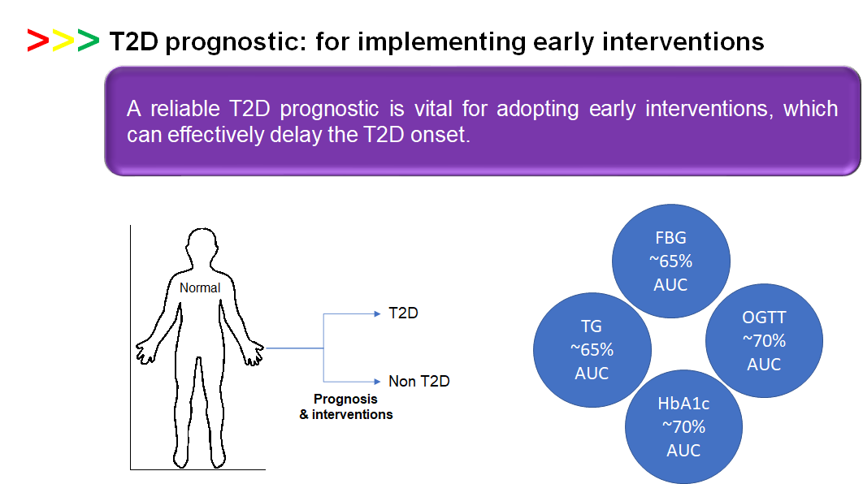

Slide 4
Classification
To discover a better prognostic to predict future T2D onset from a blood sample of non-diabetes participants.

Slide 5
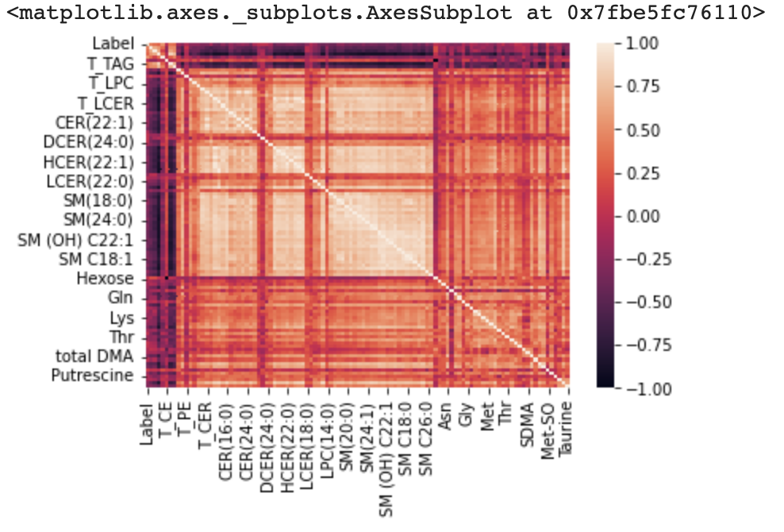
Step-1: Selecting top 10 variables for applying machine learning algorithms
A) Filtering features with at least 0.2 correlation coefficient with class classification (i.e., label).

Slide 6
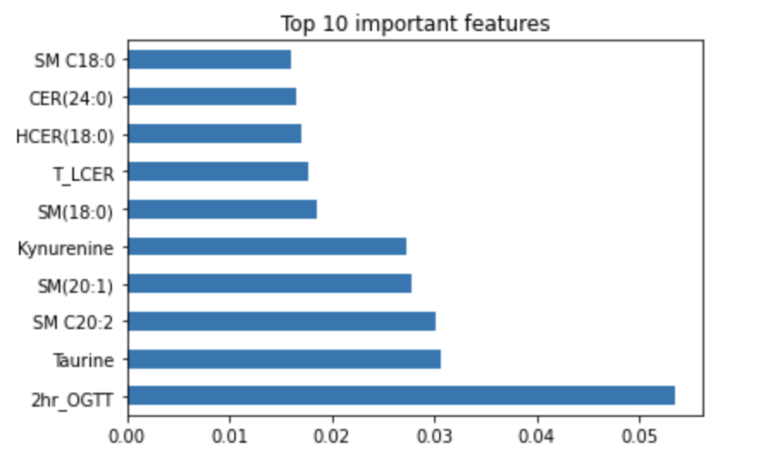
B) Applying random forest to identify top 10 variables.

Slide 7
Step-2: Explore different classification algorithms (i.e., supervised machine learning) to find the best predictors/prognostics.
Explored machine learning models:
Random Forest - 79.5% Accuracy
SVM, Oversampling and Combination Sampling
Stepwise Multiple Logistic Regression
Deep Neural Network

Slide 8
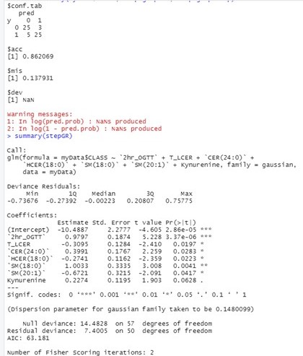
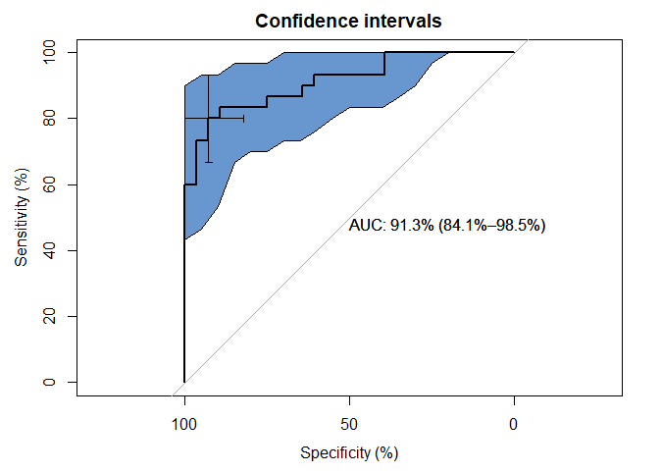
The Best Model: Stepwise Multiple Logistic Regression
86.2% Accuracy
Confidence Interval

Slide 9
Disease Heterogeneity
‘One-model-fits-all’ strategy is mostly unsuccessful in the case of T2D treatment and prognosis - may be due to disease heterogeneity

Slide 10
Clustering variables: (major identifiers for T2D)
2hr_OGTT
HOMA-IR
FPG
Explored methods:
Hierarchical cluster
K-means cluster
Notes:
We selected OGTT, HOMA-IR, and FPG for clustering variables since these three variables represent the insulin secretion and its functions (major identifiers for T2D).

Slide 11
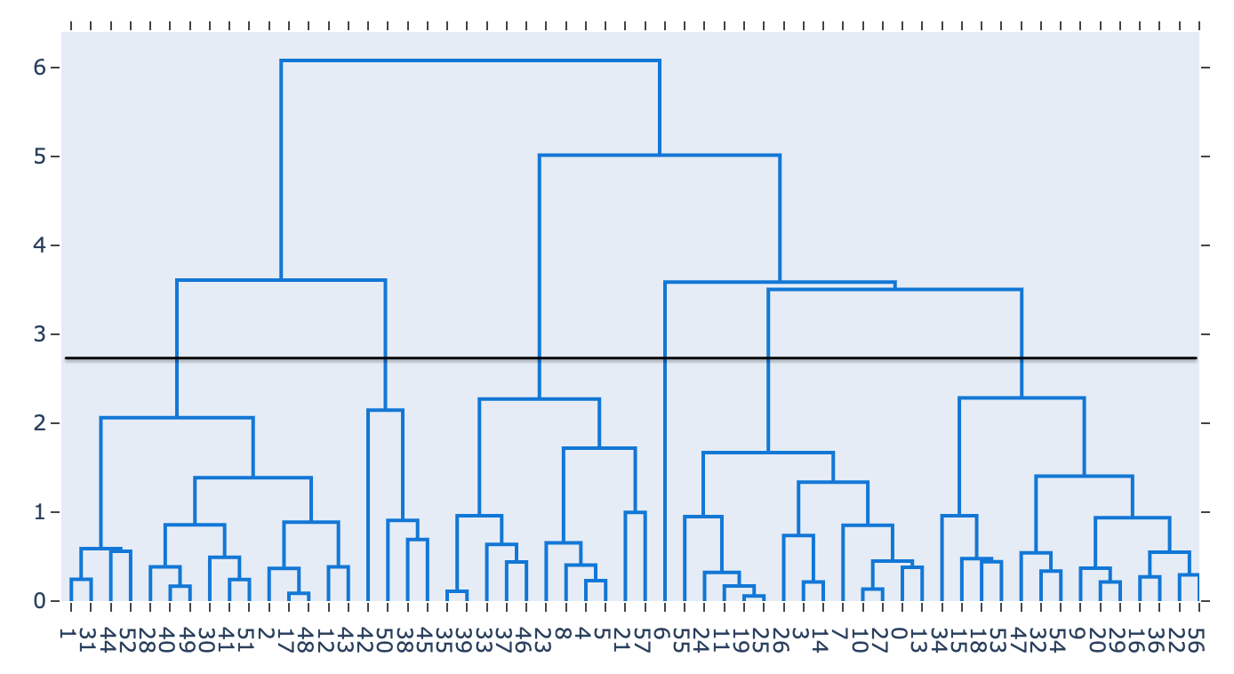
Hierarchical Clustering: The number of cluster is random, and high - complex scenario which is not adaptable in clinical setting.

Slide 12
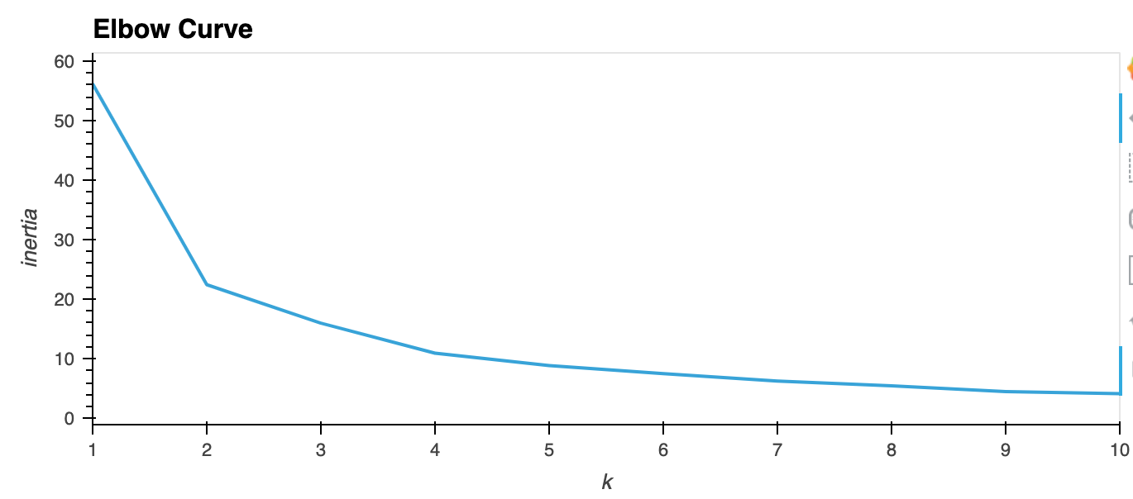
K-Means Clustering: Identified 4 clusters in this study population.

Slide 13
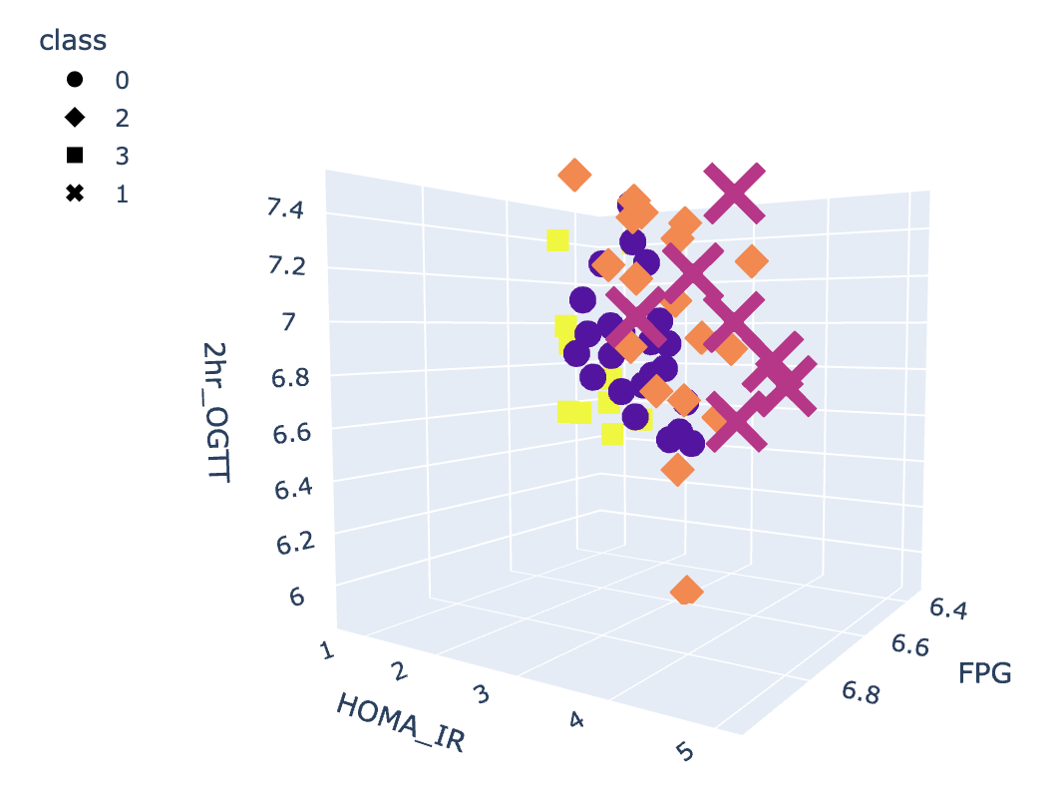
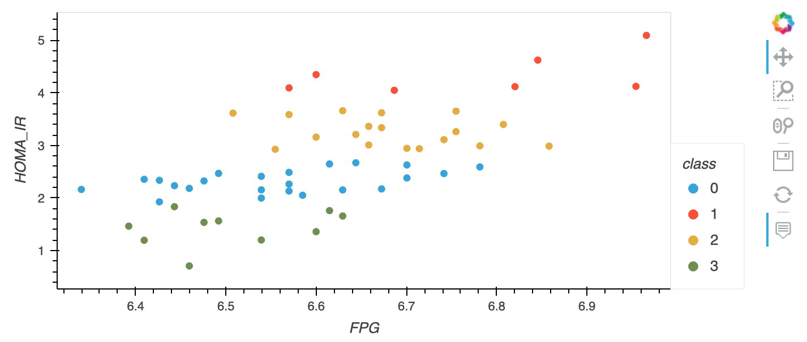
K-Means Clustering scatter plot

Slide 14
Conclusion: We have identified a 7-analyte prognostic with 86% accuracy and ROC-AUC 91% using the stepwise multiple logistic regression. This prognostic has a better accuracy and ROC-AUC (i.e., probabilistic accuracy) than currently available prognostics.
T2D treatments and prognostics fail frequently due to disease heterogeneity. Here, we discovered T2D disease heterogeneity using clustering analyses.
Limitation: The population size is very small.

