Slide 1
Automatic Translation and Cleaning of Chinese Comics to English
Jia-luen Yang
1002055480

Slide 2
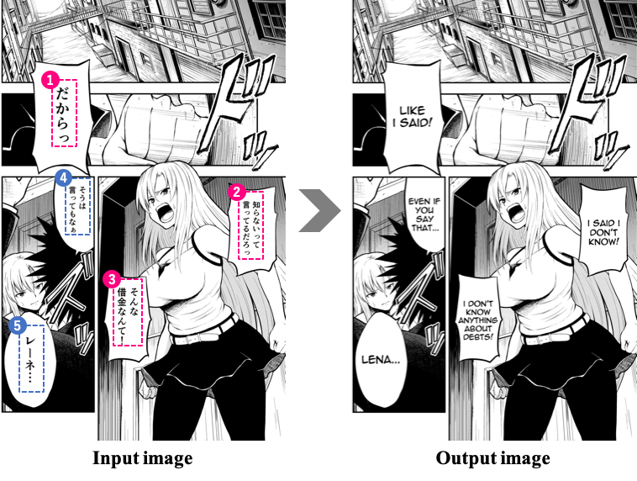
Goal

Slide 3
Steps
OCR text detection
Combining separate lines of texts into sentences
Chinese to English translation
Background cleaning
Typesetting English texts using previously calculated bounding boxes
Output image files

