Slide 1
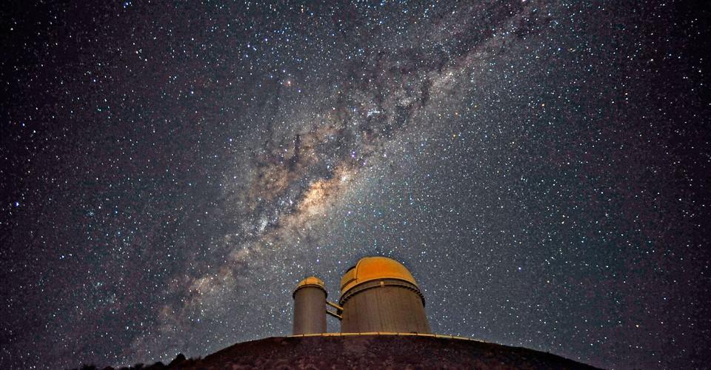
What causes steller levitation?
Department of Physics and Astronomy
Jialun Liu
Supervisor: Dr. Ralph Schönrich
The Milky Way above a space observatory in Chile (ESO / S. BRUNIER)

Slide 2
Background

Slide 3
Structure of Milky Way
z
x
y
Bar
Thick disc
Disc
Thin disc
Halo

Slide 4
Importance
Thick disc
Origin of the universe
Thin disc
Evolutionary history of the Milky Way

Slide 5
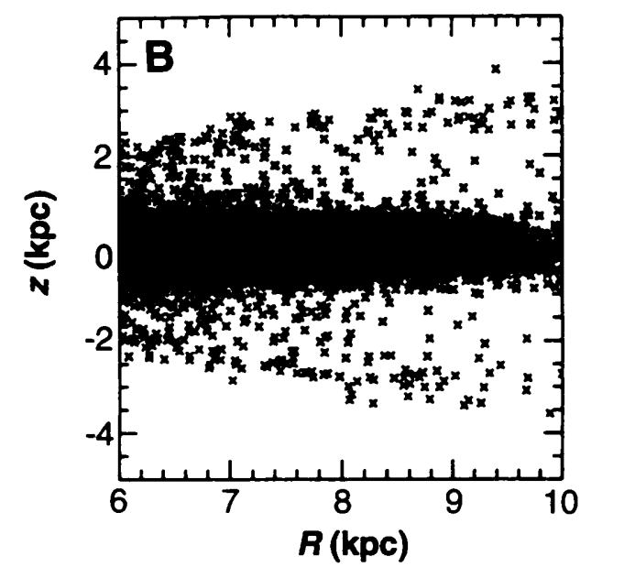
Levitation
Thick disc
Thin disc
Sridhar and Touma (1996)
Notes:
Define levitation

Slide 6
Aim & Objective

Slide 7
What?
Cause
MOR
Levitation
Suppression

Slide 8
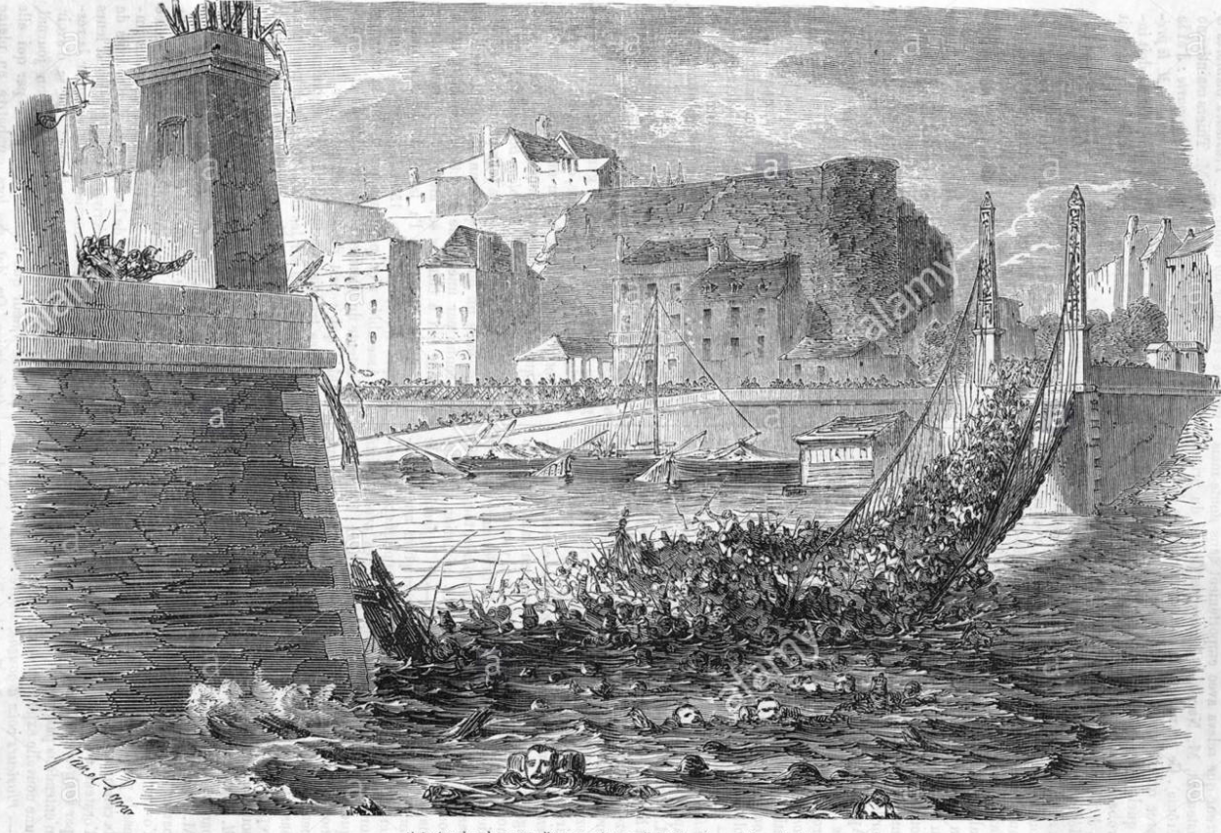
Resonance
Mean-motion resonance
(MOR)
fR : fz = l : n

Slide 9
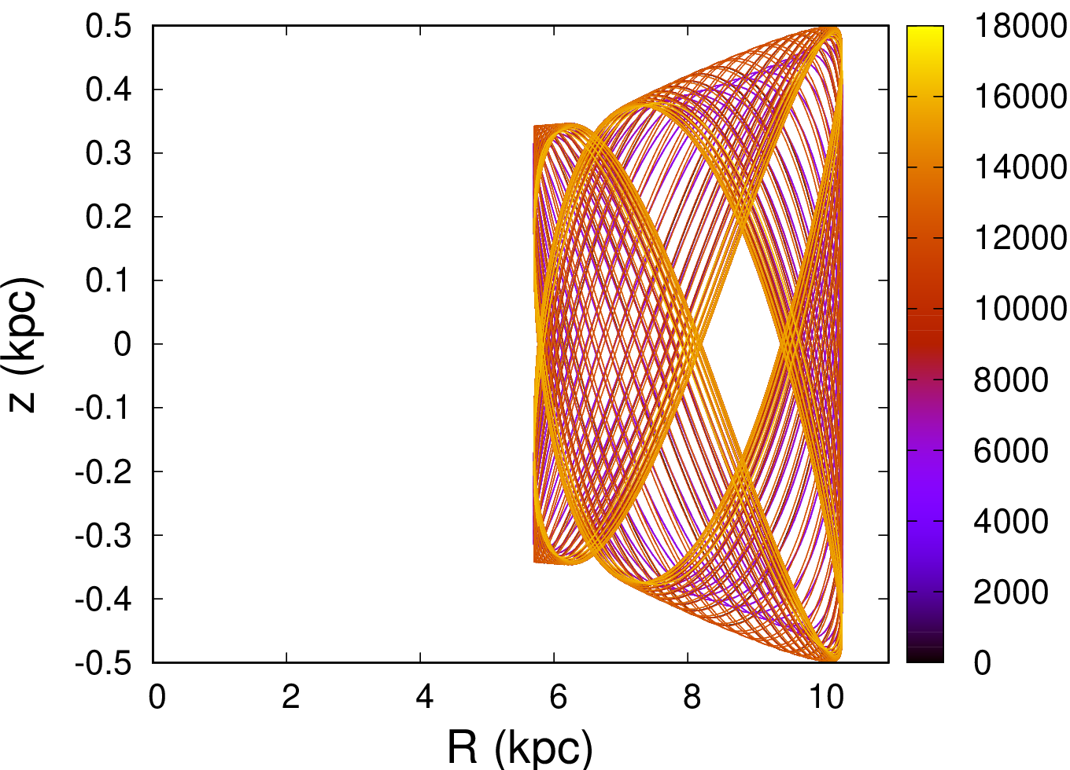
Resonant stellar orbit
How to identify the MOR?
age (Gyr)

Slide 10
What?
Fourier analysis
Cause
MOR
Levitation
Suppression

Slide 11
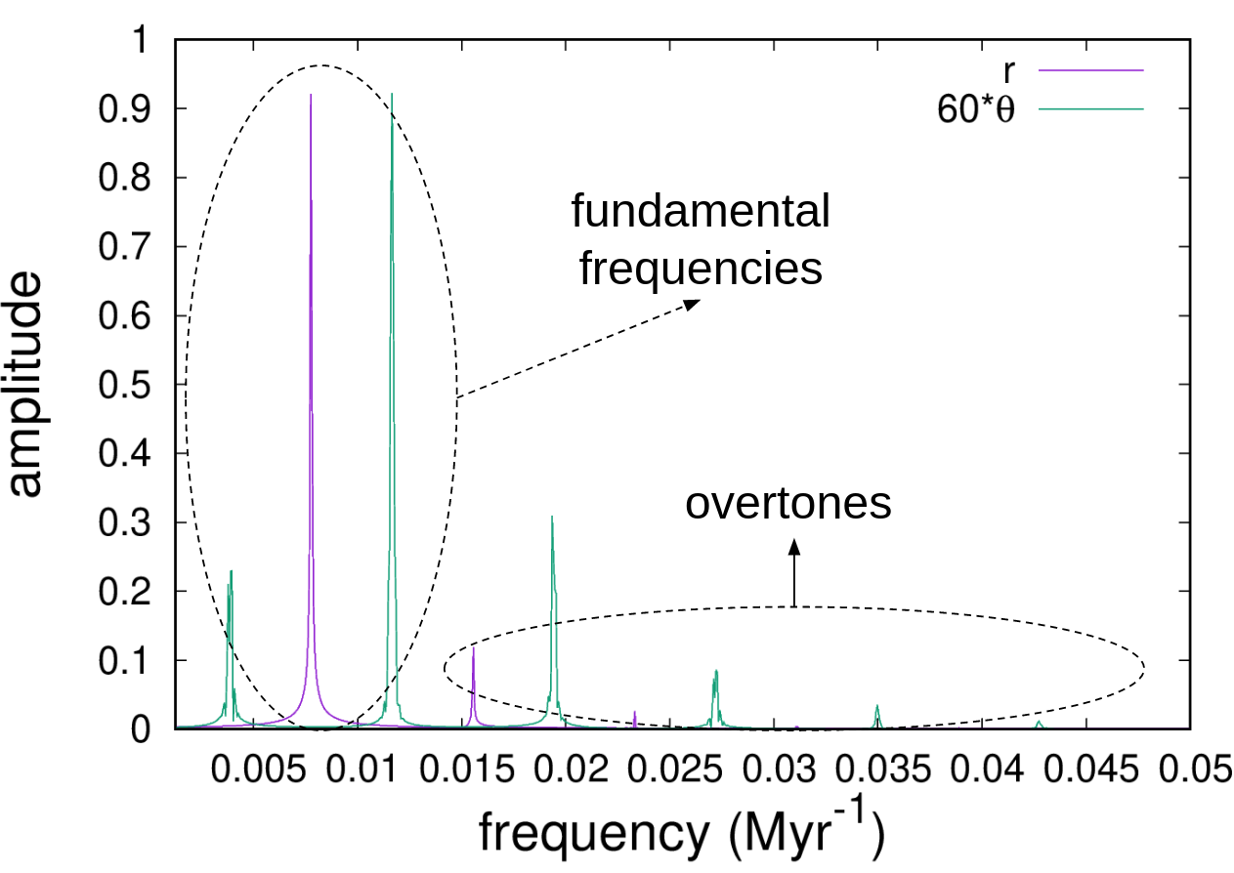
Fourier analysis

Slide 12
2 : 3 MOR
age (Gyr)

Slide 13
What?
Fourier analysis
Cause
MOR
Action
Growing potentials
Levitation
Suppression

Slide 14
Radial action
J_{R}
Vertical action
J_{z}
Azimuthal action
J_{φ} = L_{z}
Actions

Slide 15
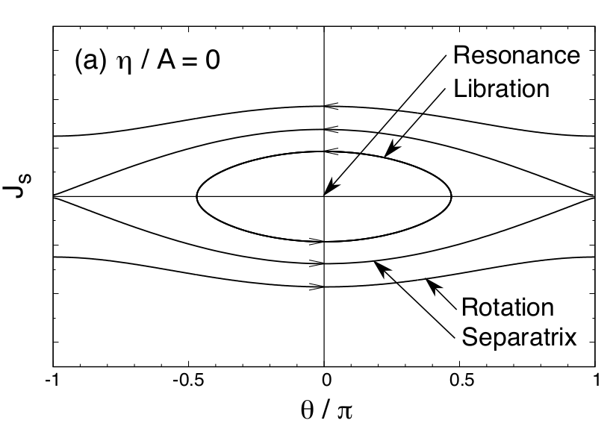
Actions
Non-resonant
resonant
Chiba et al. (2019)

Slide 16
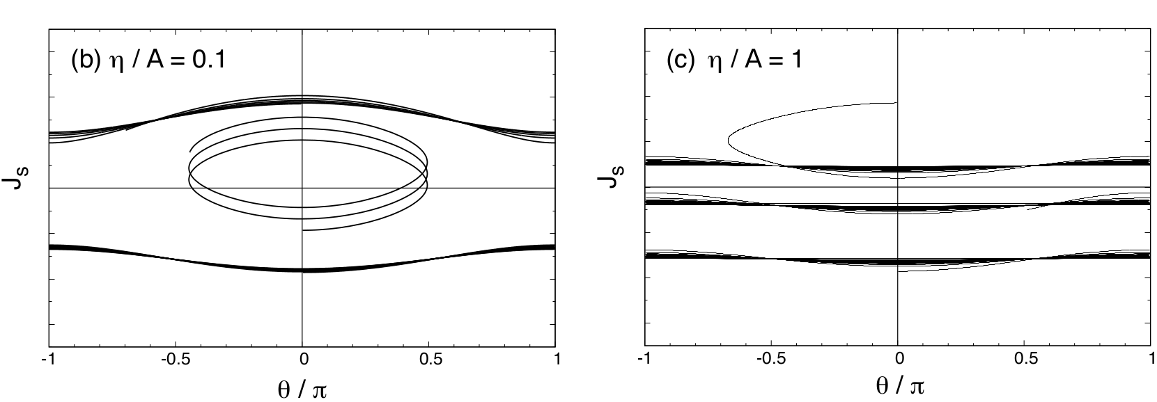
Growing potentials
(a) slow growth
(b) fast growth
Resonant dragging
Chiba et al. (2019)

Slide 17

Trapped orbits
Resonance

Slide 18
What?
Fourier analysis
Cause
MOR
Action
Growing potentials
Where?
Epicycle frequency
Levitation
Suppression

Slide 19
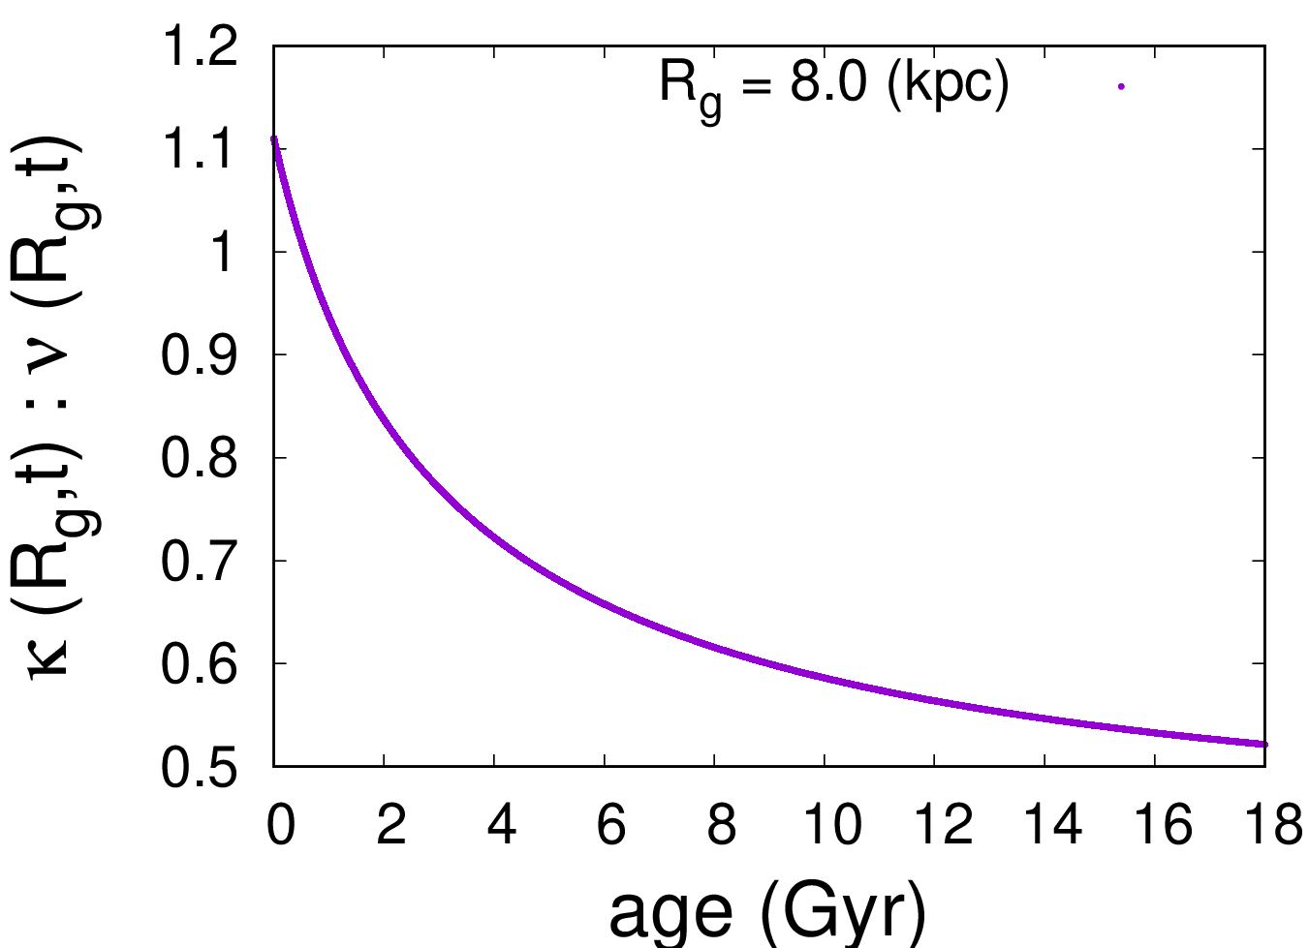
Epicycle frequency
MOR
age (Gyr)

Slide 20
Simple harmonic oscillator
U (z)
z
0

Slide 21
Results
z
Bar
x
y
MOR
MOR
Disc
Halo

Slide 22
What?
Fourier analysis
Cause
MOR
Action
Growing potentials
Where?
Epicycle frequency
Levitation
Fast growth
Suppression

Slide 23
Trapped orbits
MOR

Slide 24
What?
Fourier analysis
Cause
MOR
Action
Growing potentials
Where?
Epicycle frequency
Levitation
Fast growth
Suppression
Missed MOR

Slide 25
Epicycle frequency
MOR
age (Gyr)

Slide 26
Formation of the thick disc
Levitation
Suppress
Works

Slide 27
What?
Fourier analysis
Result:
MOR rise
J_{R} to J_{z}
Cause
MOR
Action
Growing potentials
Epicycle frequency
Where?
Levitation
How further above?
Only
J_{R} to J_{z}?
GMC
Fast growth
Suppression
Missed MOR

Slide 28
Q & A

Slide 29
Formation of the thick disc
Merger events
Levitation
Radial migration
...

Slide 30
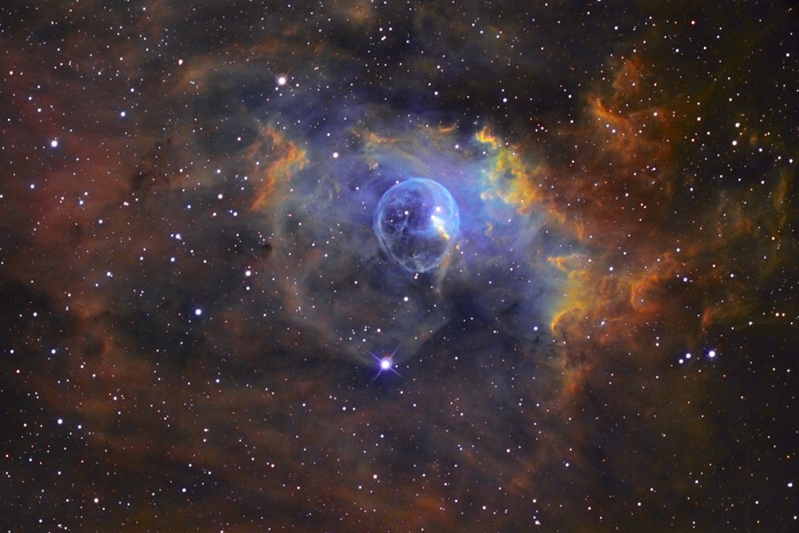
Giant molecular clouds (GMC)

Slide 31
Giant molecular clouds (GMC)
Thick disc
Thin disc

Slide 32
Experiment
No.
The occurrence of the 1:1 MOR
Liouville theorem Overdensity

Slide 33
A more realistic model

Slide 34
Epicycle frequency
Epicycle
Star
y
Star
x
z
κ: radial epicycle frequency
ν: vertical epicycle frequency
Galaxy centre
Notes:
This is a perfect circular orbit. If we perturb this orbit with an epicycle from the Star, it will turn into a nearly circular orbit like the stellar orbits in the disc. Therefore epicycle frequencies are measures of how much a stellar orbit deviates from the frequency of a circular orbit in the radial and vertical directions respectively.

Slide 35
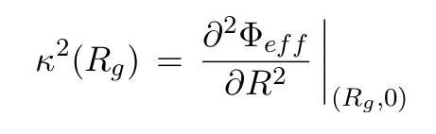
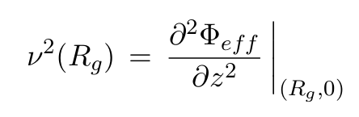
Epicycle frequency
κ: Radial
ν: Vertical

Slide 36
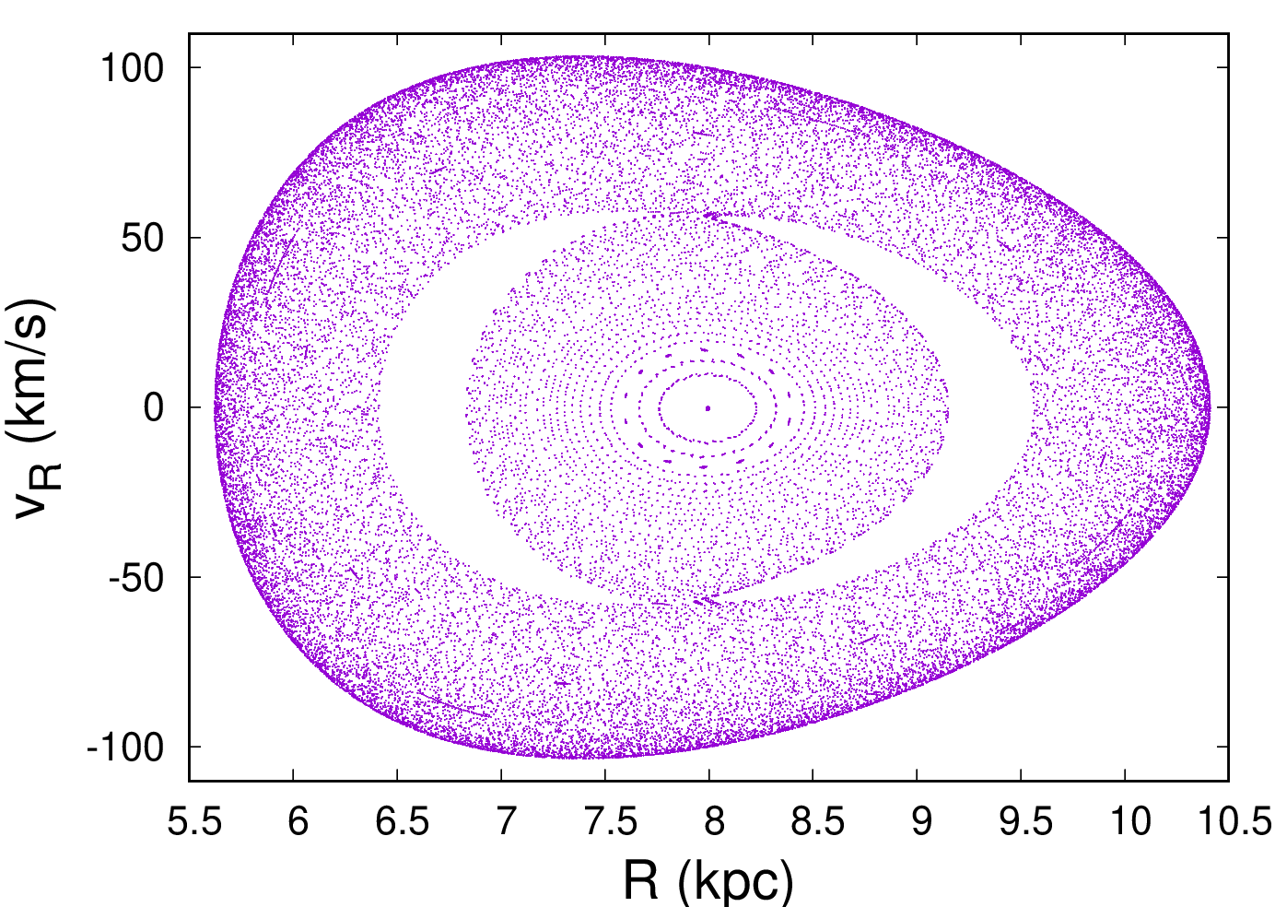
Surface of sections

